Slide 1
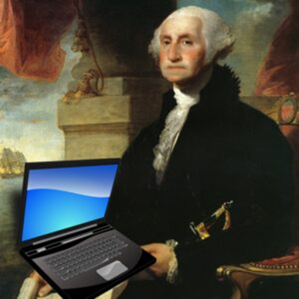
Social Media Issues:
What if the Founding Fathers had Facebook?
Cara Leahy White
Taylor, Olson, Adkins, Sralla & Elam L.L.P.
TMHRA Civil Service and Labor Relations Workshop
January 30, 2025

Slide 2
Social Media
Popular Platforms
Forms of electronic communications through which users create online communities to share information, ideas, personal messages, and other content. Merriam-Webster.com.
Notes:
Some of us are more familiar with the concept of social media than others, so I think a good place to start is a basic definition.
Merriam-Webster defines “social media” as -- forms of electronic communications through which users create online communities to share information, ideas, personal messages, and other content. Well-known examples include, Facebook, Twitter, Linked-In, YouTube, and Instagram. (Short explanation of how facebook, twitter, and instagram work.)
These applications, or websites, or platforms – in different ways – offer a space where users can write and post information, messages, locations, thoughts, pictures, videos, and links to articles or other internet sites. Most of these platforms allow users to comment below another user’s posting which creates an interactive space where conversation and sharing and engaging with one another can occur.

Slide 3
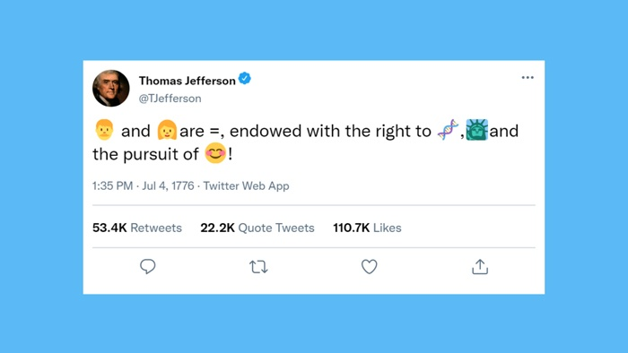
Social Media
Pros and Cons
Gene Policinski - Freedom Forum
Notes:
“All people are created equal and endowed with the right to life, liberty, and the pursuit of happiness!”
The public has grown in many ways to expect cities to have some kind of social media presence in order to disseminate information and allow a forum for comment. And it makes sense to use the latest technology to help keep the public informed. However, there are many issues to consider when city employee sand officials maintain and use individual social media pages and when the city itself maintains a social media account.

Slide 4
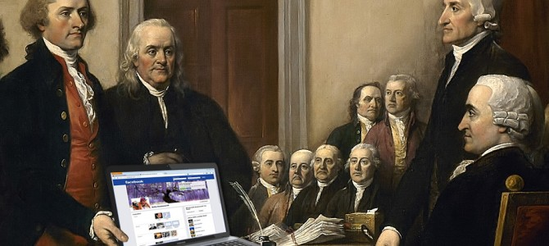
Social Media
Presentation Overview
Personal Social Media Accounts
Employee Discipline
City Accounts and Devices
www.thefederalist.com
Notes:
There are many issues that could be discussed under the umbrella of Social Media Issues. These are three key areas that are likely the most relevant and useful to you in your role in Human Resources.

Slide 5
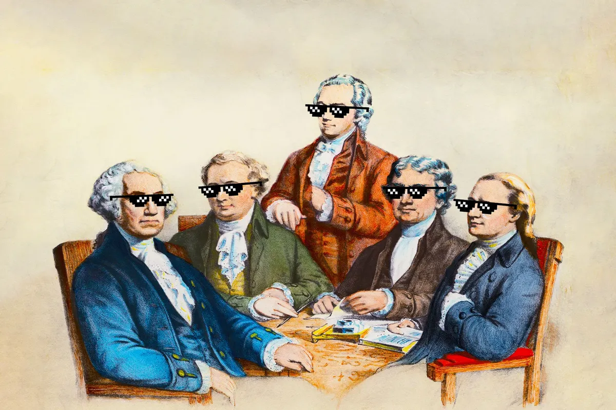
Social Media
Some Legal Issues Covered:
First Amendment
Illegal Discrimination
Open Government Laws
(Photo illustration by Salon/Getty Images)
Notes:
Within those three key areas, I’ll be discussing the legal issues that may arise in an employment context - most commonly concerning the first amendment and illegal discrimination; but I’ll also briefly mention how your legal analysis is different for evaluating social media under Texas’ open government laws.

Slide 6
Personal
Social Media Accounts
George Washington
July 4, 1776
@GWash== ==
General of the Continental Army.
Posts made while fighting for liberty. Please excuse any typos.
I got 99 problems but a king ain’t one
Notes:
We’ll begin by looking at the topic of personal social media accounts of public employees or officials - these may even pre-date their election or city employment. Some of the questions that come up are: (1) Can city employees and officials have their own personal social media accounts? (2) If someone is employed by the city, can they post about work? (3) Can they engage with people on city-related topics and delete comments or block users if they don’t like their opinions? These are the things we’ll look a little more closely at in this section.

Slide 7
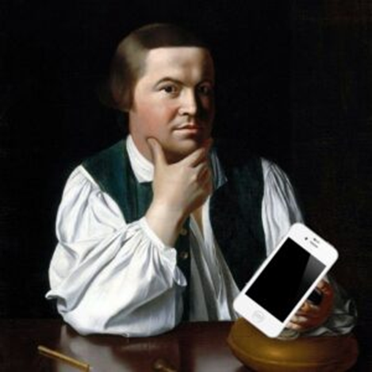
Personal Social Media Accounts
Do city employees/officials have…
First Amendment right to free speech? Yes.
Right to use social media accounts? Yes.
Right to appear to be speaking on behalf of the city? No.
Notes:
We know city employees/officials don’t check their first amendment rights at the door when they begin city employment or are elected to public office. Therefore, city employees/officials have the right to use social media to express themselves and to communicate with the public and their constituents. However, for government employees/officials, posts to personal social media accounts could be seen as representative of the views of the city. So, why does it matter? How does the characterization of the account as purely personal or as an official governmental account change how the employee or official can use the account?

Slide 8
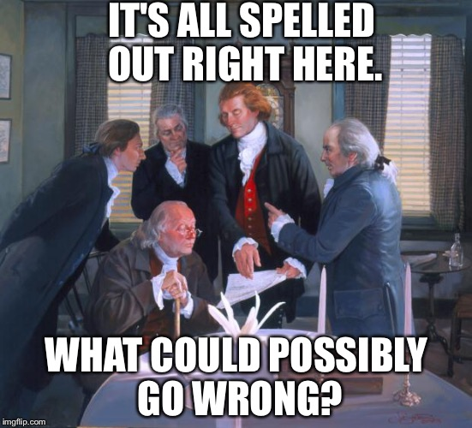
Personal
Social Media
Posts
George Washington
@GWash====
July 4, 1776
Implications may include:
Legal exposure for the city;
Discipline for the employee;
Backlash for public officials; and/or
Misunderstanding or confusion for the public.
General of the Continental Army.
Posts made while fighting for liberty. Please excuse any typos.
I got 99 problems but a king ain’t one
Notes:
We’ll discuss more specific examples shortly, but broadly speaking, implications of appearing to speak for the city when you are not authorized includes legal exposure for the city, discipline for the employee, and confusion for the public. How can we manage that risk and help employees protect themselves from the accusation that they are speaking on behalf of the city? Luckily, there is new case law to help us with this a bit…

Slide 9
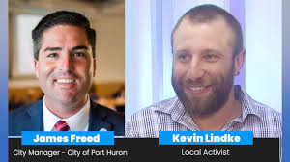
Personal Social Media Posts
United States Supreme Court Decision, March 15, 2024.
Lindke v. Freed
Freed deleted Lindke’s Facebook comments and blocked him.
Lindke sued alleging violation of his First Amendment right.
Notes:
Lindke v. Freed - (Intro basic facts of the case) James Freed was the city manager for Port Huron, MI. Kevin Lindke was a citizen there. Mr. Lindke made comments on Freed’s facebook page expressing his disagreement with Freed’s handling of covid-era restrictions. Freed deleted the comments and blocked Lindke. Lindke could then see Freed’s posts but could not comment. Lindke sued under 1983 arguing that Freed violated his First Amendment right. Lindke believed he had the right to comment on Freed’s page which he characterized as a public forum.

Slide 10
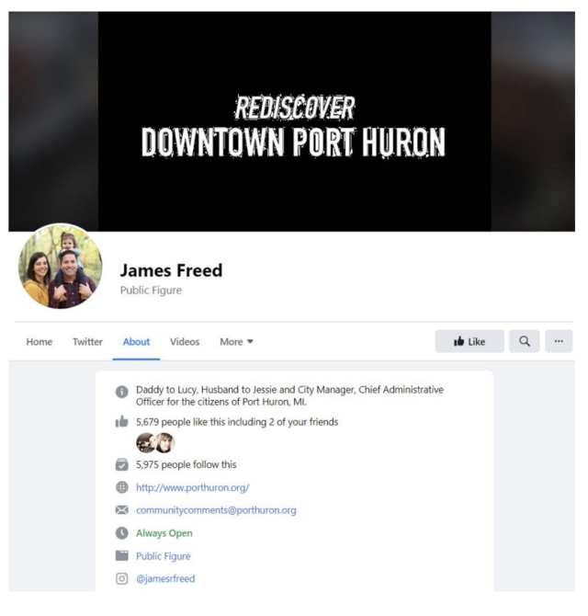
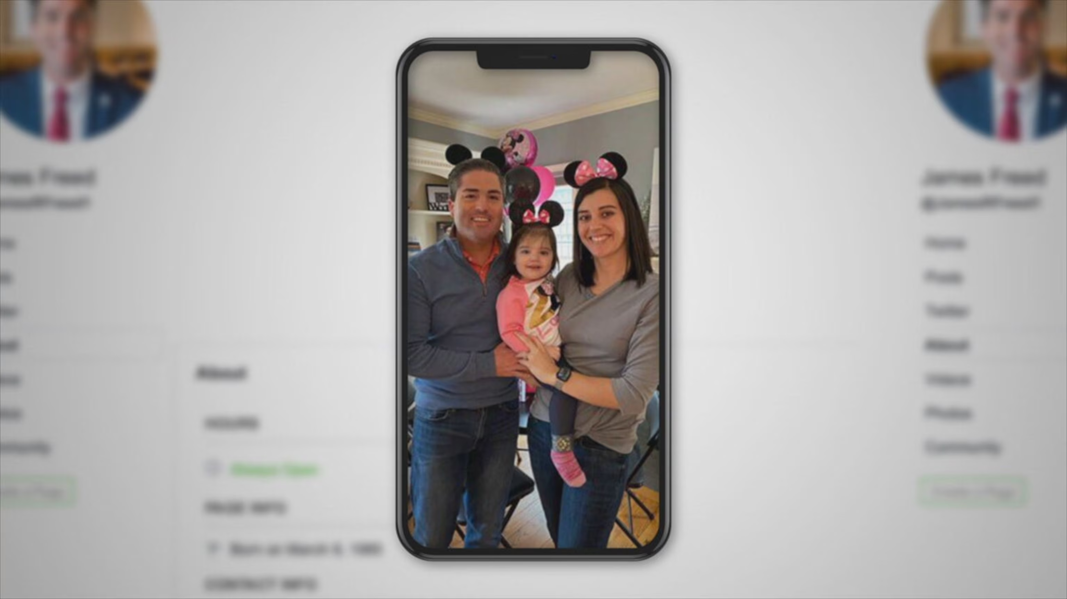
Personal Social Media Posts
Freed’s Facebook page Also Freed’s Facebook page
Notes:
Lindke v. Freed - (continued) Freed’s FB page was public not private - so it allowed public comments. It listed his job as city manager, provided the city’s website and general email address, his photo showed him in a suit with city lapel pin. The page also described Freed as “dad to Lucy and husband to Jessie”. He posted primarily about personal life. Posted hundreds of photos of his daughter. He also shared about his job, including press releases and surveys related to city business asking his audience to respond. Citizens would comment and ask questions, like asking if the city allows residents to have chickens. Freed would respond and point citizens to the proper department. Occasionally he would delete comments he thought were “derogatory” or “stupid”. Lindke argues that Freed’s page was governmental and amounted to a public forum for citizens to comment, ask questions, and have discussions. Lindke argued that Freed violated his 1st Amendment right to free speech when he deleted his comments and blocked him based on the fact that Freed did not like Lindke’s viewpoint. Freed claimed his page was personal and that allowed him to delete comments or block any user.

Slide 11
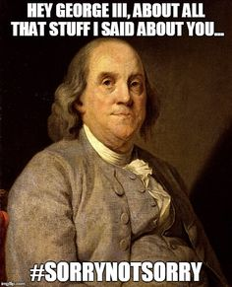
The difficulty with a “mixed use” account: Importantly, the Supreme Court warned: “A public official who fails to keep personal posts in a clearly designated personal account therefore exposes himself to greater potential liability.” Lindke v. Freed
Personal Social Media Posts
Notes:
The Supreme Court explained that: “Categorizing posts on an ambiguous page like Freed’s is a fact-specific undertaking in which the post’s content and function are considerations.” Lindke v. Freed
If a public employee or official posts job-related content on their personal account, it creates a fact question as to whether they are speaking in their official capacity or not - and resolving that fact question will require analyzing the account and the posts very closely. That is because if they are found to have been speaking in their official capacity, then there are legal implications if they delete comments or block users from their account.

Slide 12
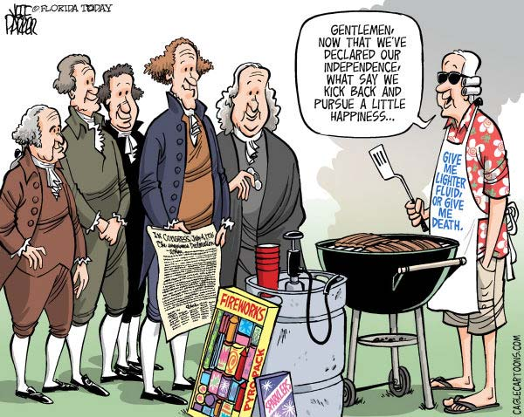
Personal Social Media Posts
Freed could have added a clear label or disclaimer to his page indicating that his account was personal.
The Court said:
“Markers like these give speech the benefit of clear context: Just as we can safely presume that speech at a backyard barbeque is personal, we can safely presume that speech on a ‘personal’ page is personal…”
Notes:
Of course public Employees/Officials have First Amendment rights too, and they can choose whether to speak as a private citizen or in their official capacity. When the context of their speech is clear, it is much easier to determine whether a public Employee or official is speaking in their official capacity or as a private citizen. The Court says labels and disclaimers would create a presumption (not irrefutable) that the account is personal. The court compares a clearly marked personal page to a backyard barbeque, and gives an example of a school board president at a BBQ telling friends that covid restrictions have been lifted (clearly personal). He can also announce this in his official capacity at a public meeting.

Slide 13
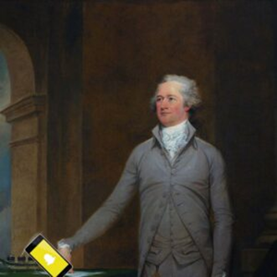
Personal Social Media Posts
Final Notes on Lindke v. Freed
Deleting comments from purely personal posts is likely OK.
Blocking users from entire page is more risky when context of page is unclear (like Freed’s)
Notes:
Additionally, the Court distinguished between deleting comments and blocking users:
When deleting comments, the only relevant posts are those from which the comments are removed.
Blocking, however, operates on a page-wide basis. A court would have to consider whether the employee/official had engaged in state action with respect to any post on which Lindke wished to comment. This highlights the cost of a “mixed use” account.
If blocking is the only option then an employee/official stops comments on his personal posts while risking liability for blocking comments on his official posts.

Slide 14
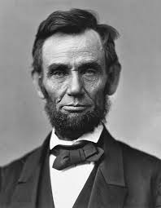
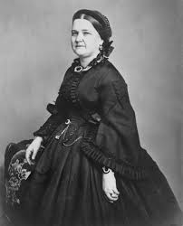
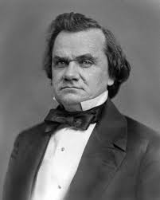
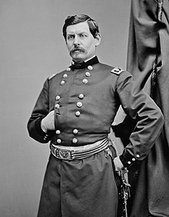
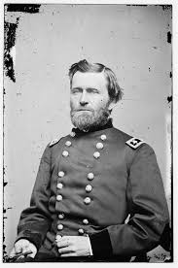
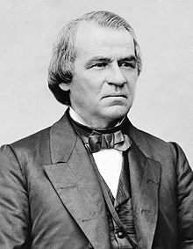
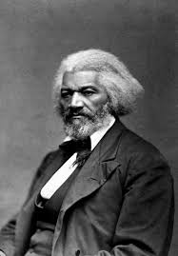
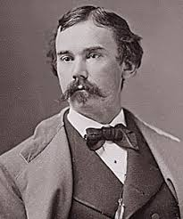
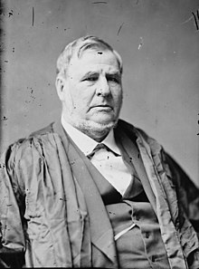
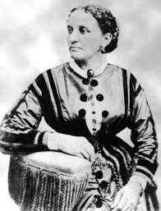
Facebook
Abraham Lincoln
Logout
Abraham Lincoln is wondering what his cabinet members will think of the proclamation he’s drafting...
Wall
Info
Photos
Videos
Write something…
type here.
Share
View photos of Abraham (5)
Send Abraham a message
Abraham Lincoln is wondering what his cabinet members will think of the proclamation he’s drafting…
July 1, 1862
Poke
Information
Mary Todd Lincoln to Abraham Lincoln I’m sure everyone will love it, sweetie!
July 1, 1862
Networks:
Washington D.C.
Birthday:
Feb 12, 1809
Political:
Republican
In a Relationship with:
Mary Todd Lincoln
Hometown:.
Stephen Douglas replying to Mary Todd Lincoln well that’s debatable! Get it? Debatable?!
July 2, 1862
Abraham Lincoln has had it UP TO HERE with @GeneralLee!!!
June 25, 1862
Friends
George McClellan to Abraham Lincoln you and me both, Boss.
June 25, 1862
Ulysses
Andrew
Frederick
Ulysses Grant to Abraham Lincoln put me in, Coach!
June 27, 1862
John
David
Elizabeth
Notes:
Just for fun! Not a founding father, but let’s pretend Abraham Lincoln had a Facebook page. Is it clear whether it’s personal or governmental? Do you think he could choose to delete Stephen Douglas’ snarky comment?
Analysis: We can see from the date of his most recent post (1862) that this is while he is President, and his latest post is job-related regarding the proclamation. We can see that his wife Mary commented using a more personal tone and emoji. Stephen Douglas posted a snarky comment. Douglas is not listed in the FB Friends list we can see and we know they were rivals so let’s assume Douglas is not among Lincoln’s FB friends - so the page must be open to the public for anyone to comment. Lincoln’s previous post is also job-related expressing frustration with Confederate General Lee. And there are two job-related responses from FB Friends - Gen. McClellan and Gen. Grant.
Conclusion: Possibly a mixed use page. Hard to tell if the page is personal or governmental. Deleting and blocking is risky.

Slide 15
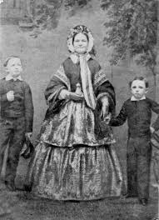
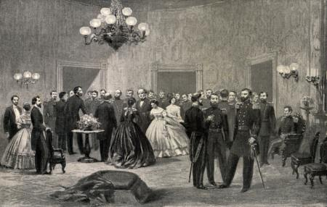
Facebook
Logout
Abraham Lincoln
Abraham Lincoln is wondering what his cabinet members will think of the proclamation he’s drafting...
Wall
Info
Photos
Videos
Basic Information
Networks: Washington D.C.
Sex: Male
Birthday: Feb 12, 1809
Hometown: Hodgenville, Kentucky
Relationship Status: Married to Mary Todd Lincoln
Political Views: Republican
Nicknames: Abe, Honest Abe
Prefers to be called: “Lincoln”
View photos of Abraham (5)
Send Abraham a message
Poke
Information
Networks:
Washington D.C.
Birthday:
Feb 12, 1809
Political:
Republican
In a Relationship with:
Mary Todd Lincoln
Personal Information
Activities: Commanding the Army, top hat shopping, abolishing slavery
Interests: Going to the theatre, setting trends in facial hair, reading
Favorite Music: Opera
Favorite Books: The Life of Benjamin Franklin, Aesop’s Fables, Robinson Crusoe
Best Known For: Being honest, being tall, being the 16th President of the United States
Photos
The Family
Updated last Tuesday
Contact Information
Address: The Presidential Mansion AKA “The White House” on
Pennsylvania Avenue, at a distance of over a mile west of the Capitol
Telegraphs: The War Department
White House
Updated two months ago
Notes:
Let’s see if the “Info” section of his FB page clears anything up. Here we see more references to his personal life - his relationship status, photo albums: one called The Family and one called White House (that doesn’t help). The Personal Information section also contains both job-related and personal content. His address is provided as the white house which doesn’t necessarily mean the page is governmental since that is where he lives, not just where he works. The page still feels like a mixed-use page.

Slide 16
Facebook
Abraham Lincoln
Logout
This is the personal page of Abraham Lincoln. Views expressed are strictly my own.
Abraham Lincoln is wondering what his cabinet members will think of the proclamation he’s drafting...
Wall
Info
Photos
Videos
Write something…
type here.
Share
View photos of Abraham (5)
Send Abraham a message
Abraham Lincoln is wondering what his cabinet members will think of the proclamation he’s drafting…
July 1, 1862
Poke
Information
Mary Todd Lincoln to Abraham Lincoln I’m sure everyone will love it, sweetie!
July 1, 1862
Networks:
Washington D.C.
Birthday:
Feb 12, 1809
Political:
Republican
In a Relationship with:
Mary Todd Lincoln
Hometown:.
Stephen Douglas replying to Mary Todd Lincoln well that’s debatable! Get it? Debatable?!
July 2, 1862
Abraham Lincoln has had it UP TO HERE with @GeneralLee!!!
June 25, 1862
Friends
George McClellan to Abraham Lincoln you and me both, Boss.
June 25, 1862
Ulysses
Andrew
Frederick
Ulysses Grant to Abraham Lincoln put me in, Coach!
June 27, 1862
John
David
Elizabeth
Notes:
Now imagine the page has a label or a disclaimer on it. Does that help? YES. Suddenly, you have context and when you read every post through the lens of the context provided, the tone of the page suddenly feels much more personal.
*Note: adding a disclaimer or label does not automatically make a page personal no matter what, the Court just said that it helps a whole lot when it otherwise appears to be a mixed-use account.

Slide 17
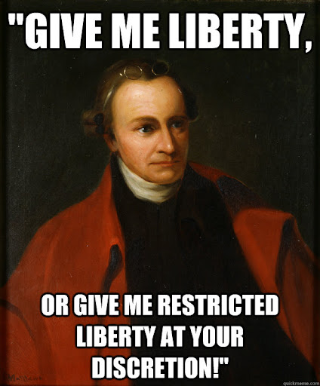
Employee Discipline
Notes:
Can a government employer ever discipline an employee for their online speech? Yes, but an employer who fails to carefully weigh their decision may face a claim under 42 U.S.C. § 1983 for First Amendment retaliation

Slide 18
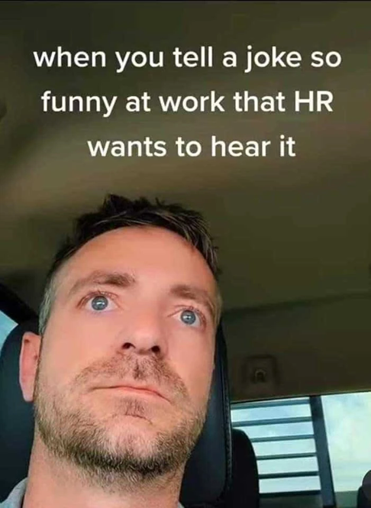
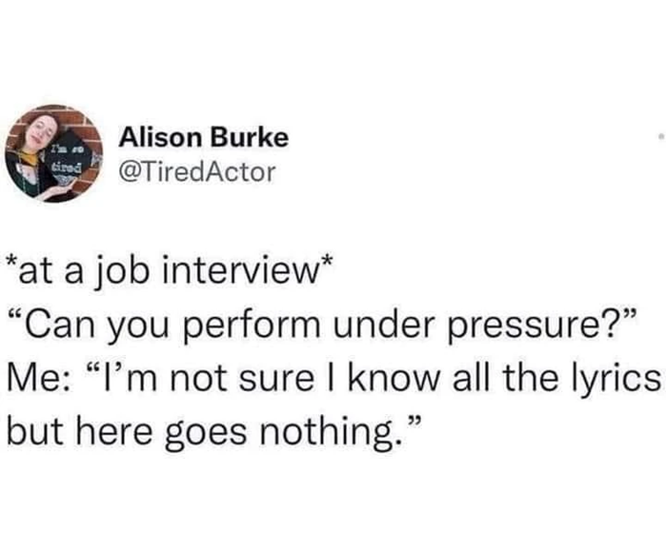
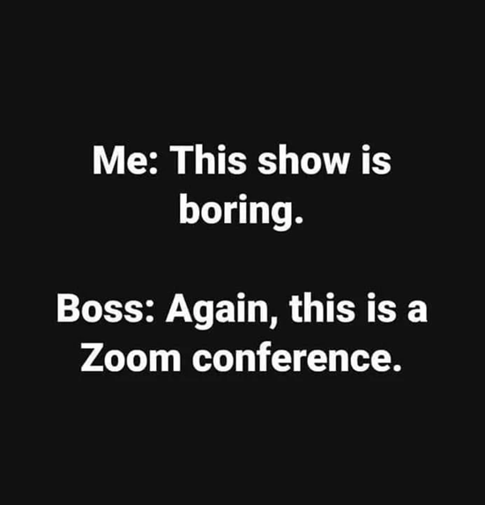
Employee Discipline
Remember:
Not all job-related posts are problematic.
Notes:
Employers should remember, not all job-related posts are problematic. In Lindke v. Freed, court said “…an official [or employee] might post job-related information for any number of personal reasons, from a desire to raise public awareness to promoting his prospects for reelection.”

Slide 19
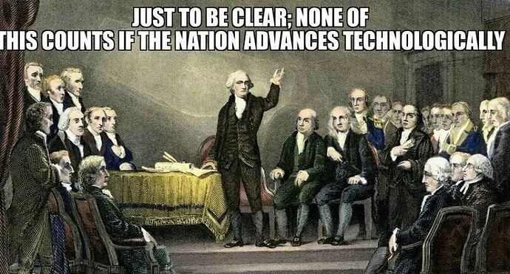
Employee Discipline
The First Amendment protects a public employee’s:
Freedom of expression
Right to be a whistleblower
Ability to engage in discourse on matters of public concern
Notes:
When considering disciplinary action, take a moment to remember that the First Amendment protects a public employee’s freedom of expression, right to be a whistleblower, and the right to speak as a citizen on matters of public concern.
“The First Amendment protects a public employee’s right, in certain circumstances, to speak as a citizen addressing matters of public concern.” Garcetti v. Ceballos, 547 U. S. 410, 417 (2006).

Slide 20
Employee Discipline
Courts must balance:
the right as an employer to regulate conduct of employees
versus
the employee’s right to speak freely.
Notes:
In determining whether a city employer’s regulation of an employee’s speech is reasonable, courts must balance the rights of each party.

Slide 21
Employee Discipline
Pickering – The Connick Three Part Test:
(1)Whether the employee spoke as a citizen on a matter of public concern;
(2)Whether the employee’s First Amendment interests in speaking outweigh the interest of the government, as an employer, in providing effective and efficient services; and
(3)Whether the employee has shown that the speech played a substantial part in the government’s employment decision.
Pickering v. Bd. of Educ. of Twp. High Sch. Dist. 205, Will County, 391 U.S. 563 (1968); Connick v. Myers, 461 US 138 (1983).
Notes:
Pickering Balancing Test
Pickering and the cases decided in its wake identify two inquiries to guide interpretation of the constitutional protections afforded to public employee speech. The first requires determining whether the employee spoke as a citizen on a matter of public concern. id., at 568, 88 S.Ct. 1731. If the answer is no, the employee has no First Amendment cause of action based on his or her employer's reaction to the speech. See Connick, supra, at 147, 103 S.Ct. 1684. If the answer is yes, then the possibility of a First Amendment claim arises. The question then becomes whether the relevant government entity had an adequate justification for treating the employee differently from any other member of the general public. See Pickering, 391 U.S., at 568, 88 S.Ct. 1731. This consideration reflects the importance of the relationship between the speaker's expressions and employment. A government entity has broader discretion to restrict speech when it acts in its role as employer, but the restrictions it imposes must be directed at speech that has some potential to affect the entity's operations. Garcetti v. Ceballos, 547 U.S. 410, 418, 126 S. Ct. 1951, 1958, 164 L. Ed. 2d 689 (2006)

Slide 22
Employee Discipline
We hold that when public employees make statements pursuant to their official duties, the employees are not speaking as citizens for First Amendment purposes, and the Constitution does not insulate their communications from employer discipline.
Garcetti v. Ceballos, 547 U.S. 410, 421, 126 S. Ct. 1951, 1960, 164 L. Ed. 2d 689 (2006)
Notes:
After Pickering, Garcetti case added:
We hold that when public employees make statements pursuant to their official duties, the employees are not speaking as citizens for First Amendment purposes, and the Constitution does not insulate their communications from employer discipline. Garcetti v. Ceballos, 547 U.S. 410, 421, 126 S. Ct. 1951, 1960, 164 L. Ed. 2d 689 (2006)

Slide 23
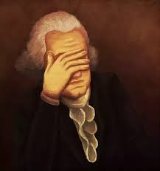
Employee Discipline
Kevin Colvin thought he could pull a fast one on his manager while interning at Anglo Irish Bank.
Colvin told his supervisor, Paul Davis, that he was going to miss work due to a “family emergency.” Turns out his “family emergency” was a Halloween party. Davis discovered this after Colvin posted a questionable image on his Facebook page.

Slide 24
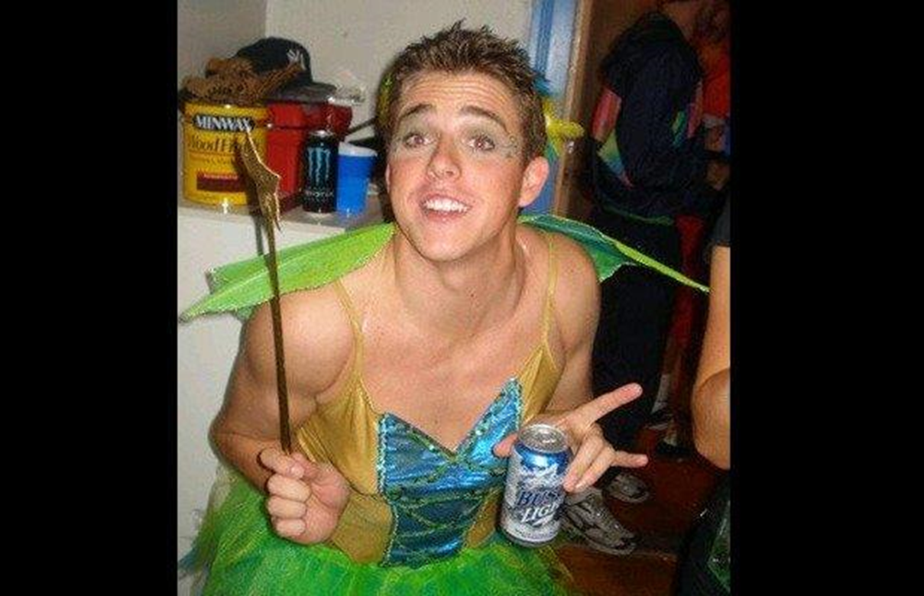
Employee Discipline
Is this post regarding a matter of public concern? No.
Employer would be within his rights to terminate this employee.
Notes:
Is that social media post first amendment protected? No, this was not a post about a matter of public concern. This employer would be within his rights to terminate this employee.

Slide 25
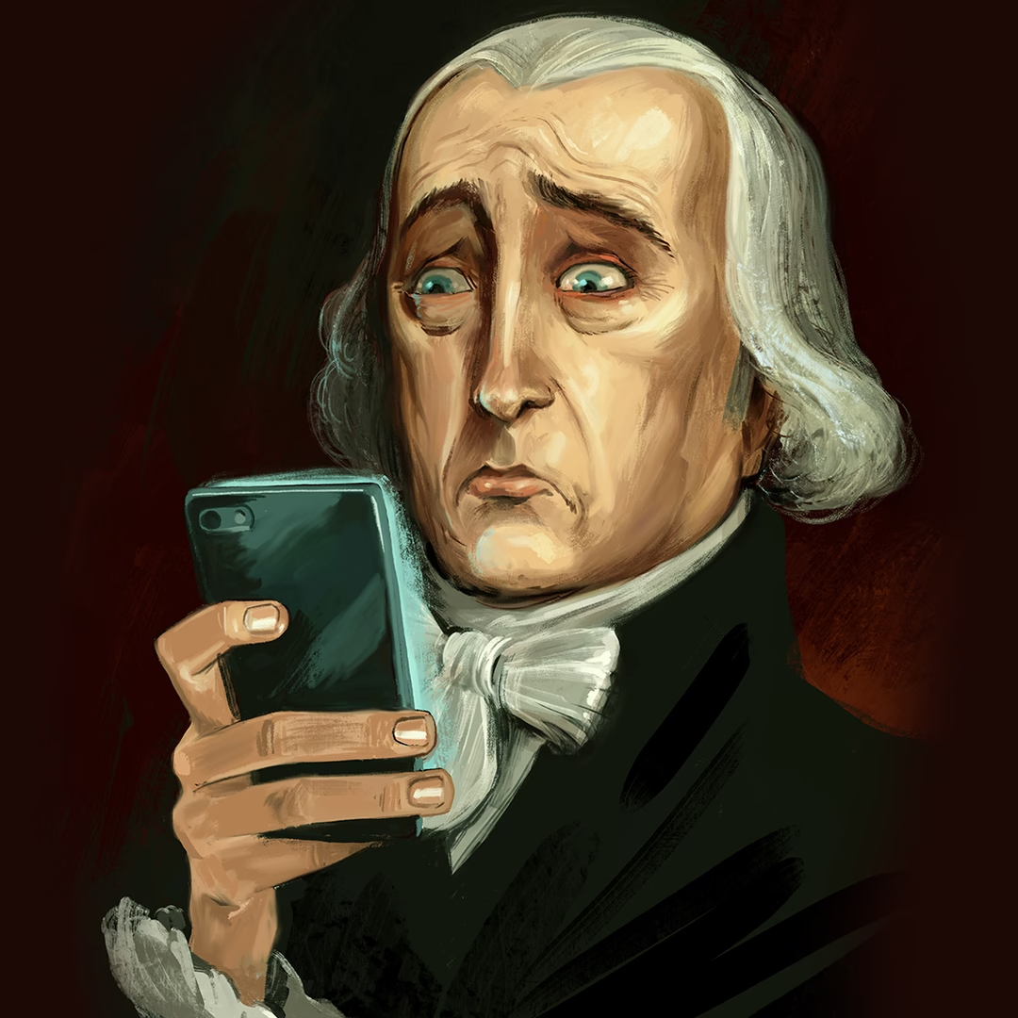
Employee Discipline
Can an employee be disciplined even if their post touches a matter of public concern?
facebook post
Rant: can we acknowledge the horrible school bus drivers? I'm in PA almost on the NY boarder [sic] bear [sic] Erie and they are hella scary. Daily I get ran [sic] off the berm of our completely wide enough road and today one asked me to t-bone it. I end this rant saying I don't give a flying s*** about those babies and I will gladly smash into a school bus[.]
Notes:
A Department of Transportation (“DOT”) employee posted a rant to Facebook. Her Facebook profile identified her as a DOT employee. The employee argued she was just expressing her personal opinion.
However, the Court ultimately concluded that even if Carr did not intend to drive her vehicle into a school bus as suggested by her social media post, her words alone served to erode the public’s trust in PennDOT’s mission and, therefore, could justify her discharge.
The court further found: “While there is no present dispute whether Carr's comments touched on a matter of public concern, they were essentially a rant based on her personal observation of a particular bus driver rather than an explanation of safety concerns that she became aware of as a Department employee. In light of the limited public importance of Carr's posts, see Sacks, and their detrimental effect on the Department, the Commonwealth Court erred in reversing the decision of the Commission. Carr v. Dep't of Transportation, 230 A.3d 1075, 1090 (Pa. 2020)

Slide 26
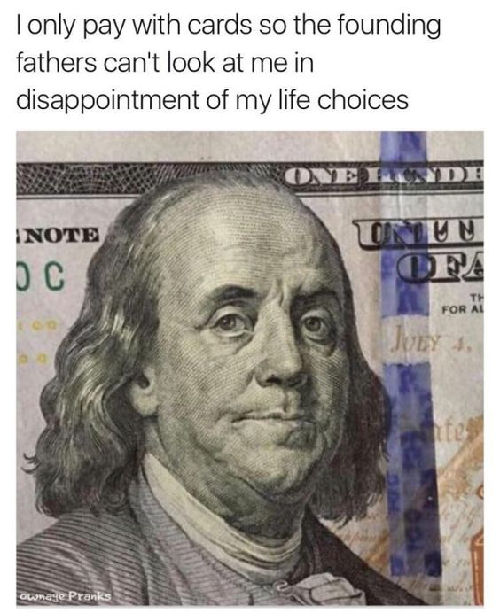
Employee Discipline
Maryland firefighter sued his employer, a county fire department, after it fired him for several of his social media posts about beating up a liberal (among other things) that the employer said violated its social media policy.
Grutzmacher v. Howard County, 851 F.3d 332 (4th Cir. 2017).
Notes:
In Howard County, Maryland, a fire department terminated a firefighter after discovering several social media posts it said were insensitive and derogatory, demonstrated the firefighter’s insubordination, and disrupted the fire department’s operations. The firefighter sued seeking reinstatement and damages and alleging that the fire department violated his First Amendment rights.
The Court ruled in favor of the fire department, and noted that for public employees there is a balancing test created by the U.S. Supreme Court (Pickering v. Board of Education, 391 U.S. 563 (1968)), that must be analyzed. In Pickering, the Court held that for public employees to have protection under the First Amendment, they must be: (1) speaking on a matter of public concern, (2) as a private citizen, and (3) they must prove their interest “in commenting upon matters of public concern” outweighs the “interests of the State, as an employer, in promoting the efficiency of the public services it performs through its employees.”

Slide 27
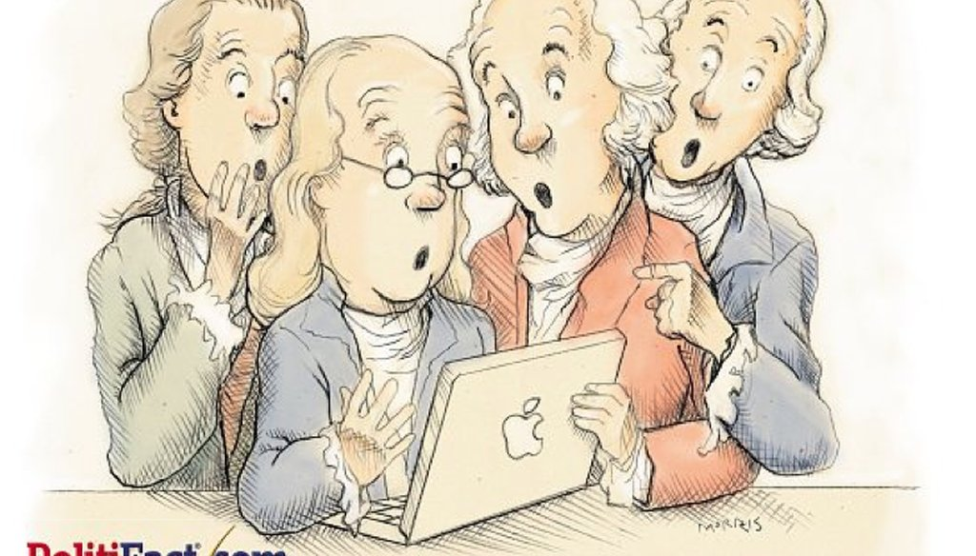
Employee Discipline
Facebook post
“Thank god we have more America loving rednecks. Red spread across all America. Even ***** and latinos voted for trump too!”
photo:politifact
Notes:
This example illustrates the importance placed on the balancing of the interests of the employee versus employer.
Bennett worked at the Metro Government Emergency Communications Center (ECC) for 16 years. On November 9, 2016, Bennett, a white woman, responded to someone else's comment on her public-facing Facebook profile, using some of the commenter’s words: “Thank god we have more America loving rednecks. Red spread across all America. Even ***** and latinos voted for trump too!” Bennett identified herself as an employee of Metro, the police department, and ECC in her Facebook profile. A constituent reposted part of Bennett’s statement and commented: If your skin is too dark your call may have just been placed on the back burner.
Here, the employee (Bennett) argued she was fired for political speech in support of a particular candidate, but employer asserted it was the racial slur and not the political subject matter that was the justification for the termination. Bennett sued Metro for First Amendment retaliation. The Sixth Circuit reversed a judgment in favor of Bennett, finding that the district court improperly analyzed the “Pickering” factors. The record indicated that the harmony of the office was disrupted; the court erred in discounting the importance of harmonious relationships at ECC. Although there were factors weighing in favor of Bennett, sufficient disruption was shown to tip the Pickering balance towards Metro. The Court said that in this case, the employer’s interest in maintaining an effective workplace with employee harmony that serves the public efficiently outweighs Bennett's interest in incidentally using racially offensive language in a Facebook comment.

Slide 28
Employee Discipline
What speech crosses the line?
Hate speech of any kind (regarding any protected classes);
Speech that is severe enough to constitute a hostile work environment (regarding any protected classes);
Threats to employee safety or of workplace violence;
Trade secrets; and
Confidential and proprietary company information.
Employee Social Media Posts During Turbulent Times (natlawreview.com)
Notes:
The National Law Review published this concise list of examples of speech that likely crosses the line and would not be afforded First Amendment protections.

Slide 29
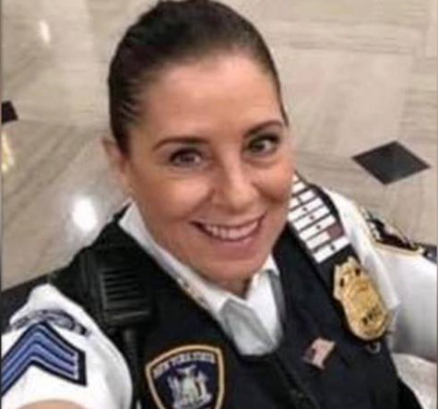
Employee Discipline
NYC Court Sgt. Terminated For Social Media Post
Notes:
Brooklyn Court Officer Suspended After Posting Racist Photo of Obama – NBC New York
In June 2020, a New York City Courts sergeant posted photos on Facebook, captioned “The True American Dream,” appearing to depict former President Barack Obama and Hillary Clinton being hanged. Although the post was made on a weekend and while off-duty, its maker was quickly identified as a court employee, appearing on her Facebook page in her court uniform. In a matter of days, the post caused a major uproar at the New York City Courts, and its closeness in time to the death of George Floyd did not help matters. Among other consequences, the sergeant’s post forced the court to endure extensive media scrutiny, conduct an internal investigation, and issue a court-wide memorandum condemning the sergeant’s statements. For the general public, the post sparked intense discussions of racial bias and prejudice in the criminal justice system. Though the post was of a political nature—and thus would be entitled to First Amendment protection by constitutional standards—it resulted in the sergeant’s firing after a lengthy disciplinary hearing. This result is typical in First Amendment cases involving controversial speech by government employees.

Slide 30
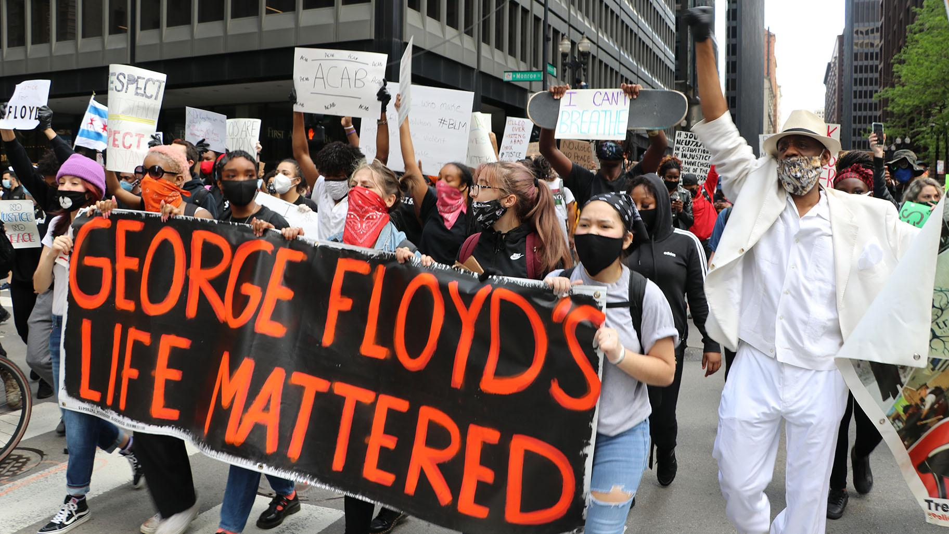
Employee Discipline
City worker fired for use of “N” word on social media
Notes:
City Worker Fired After Making Racist, Violent Facebook Comments During Protests: Watchdog | Chicago News | WTTW
City officials fired an employee of the Chicago Department of Transportation after he sent “unprovoked offensive, racist, harassing and violent” messages to a Chicagoan on Facebook during the protests sparked by the death of George Floyd in late May, according to a report from the city’s watchdog.
Inspector General Joseph Ferguson began investigating the employee, a laborer with the city’s transportation department, after their co-workers discovered the messages. The laborer's co-workers found the messages “offensive” and believed they created a “hostile work environment,” according to his office’s quarterly report, released Tuesday.
Ferguson recommended that the laborer be fired, and they were terminated, according to the report. The employee is appealing their termination, which will be considered by the city’s Human Resources Board.

Slide 31
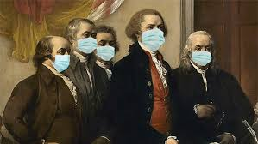
Employee Discipline
Truck driver urged his coworkers to “pray” that COVID-19 did not “touch” the truck driver’s life because they would “take” all of their co-workers with them.
Despite apology, he was terminated.
Notes:
City Worker Fired After Making Racist, Violent Facebook Comments During Protests: Watchdog | Chicago News | WTTW
In a separate case, a motor truck driver assigned to work at O’Hare International Airport was fired after the inspector general determined they posted a threat to harm their coworkers on a Facebook page for other airport truck drivers.
The truck driver was upset by the Chicago Department of Aviation’s handling of the COVID-19 pandemic, and believed their coworkers were reporting to work while sick. The truck driver wrote that “if they were to get COVID-19, they too would come to work while sick and infect their co-workers,” according to the report.
The truck driver edited the post three times during the 12 hours to make it “less threatening to their coworkers,” according to the report.
The revised version of the post urged the truck driver’s coworkers to “pray” that COVID-19 did not “touch” the truck driver’s life because they would “take” all of their co-workers with them, according to the report.
The truck driver quickly realized the problematic nature of the Facebook post. The truck driver is appealing their termination.

Slide 32
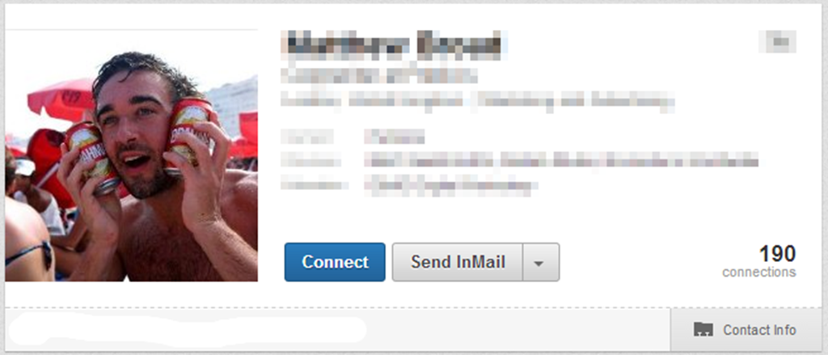
Employee Discipline
Unprofessional Behavior
Notes:
A few additional, quick examples of poor use of social media… This is someone’s profile picture on a popular networking site.

Slide 33
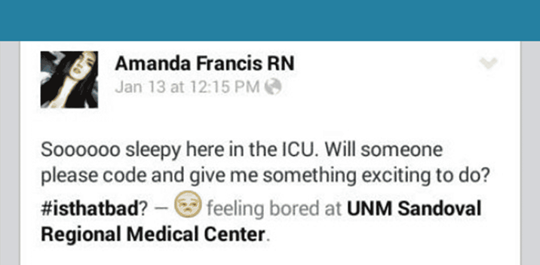
Employee Discipline
Unprofessional Behavior

Slide 34
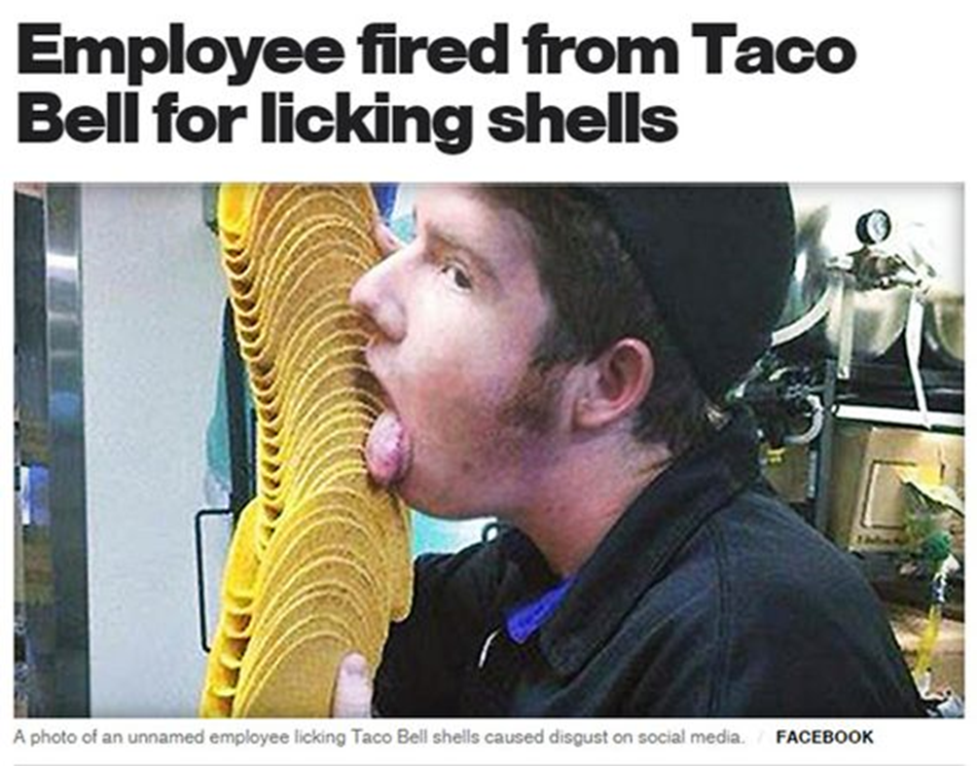
Employee Discipline
Unprofessional Behavior
Notes:
Jj O'Brien Nolan worked at Taco Bell, and after he posted this photo on his social media accounts, he was fired

Slide 35
Employee Discipline
Unprofessional Behavior
Notes:
Teacher fired for onlyfans account lost new job for violating social media. New job failed to google her.
Former high school teacher who resigned over her $1M OnlyFans account says she's been terminated from new job at healthcare provider despite disclosing her porn past, after staff didn't bother to check references or Google her | Daily Mail Online

Slide 36
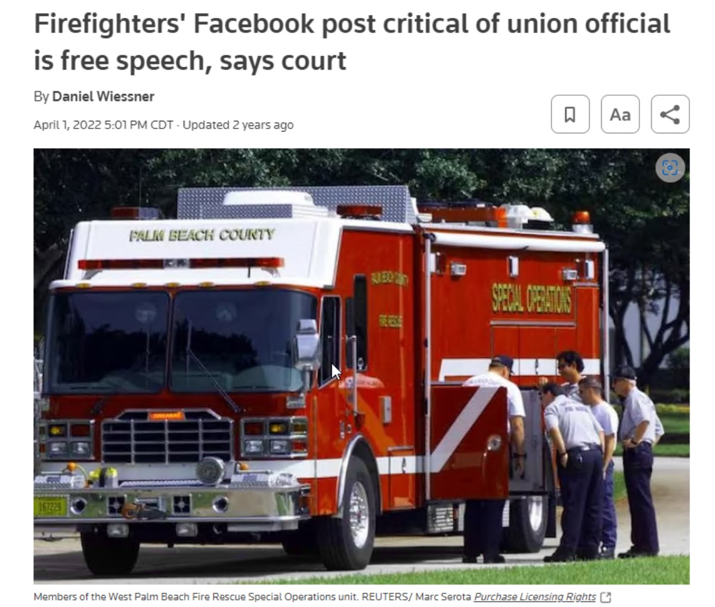
Employee Discipline
Firefighters posted to social media accusing a union official of misusing paid time off donated by firefighters.
They were disciplined. They sued.
11th circuit said the posts were clearly about a matter of public concern: misuse of taxpayer money.
Notes:
Firefighters' Facebook post critical of union official is free speech, says court | Reuters
O'Laughlin v. Palm Beach County, 11th U.S. Circuit Court of Appeals,
A U.S. appeals court on Friday said posts two Palm Beach County, Florida firefighters made in a private Facebook group criticizing a union official were protected free speech and revived their lawsuit claiming they should not have been disciplined for them.
A unanimous three-judge panel of the 11th U.S. Circuit Court of Appeals said a post by AJ O'Laughlin, who was running for president of the firefighters' union at the time, and a coworker's comment supporting him touched on matters of public concern even though they were made in an invitation-only Facebook group

Slide 37
Employee Discipline
O'Laughlin Balancing Test for Invalid Social Media Restrictions
(1) Speech in question is a matter of public concern.
(2) Speaker’s free speech interest outweighs employer’s interest in efficient fulfillment of responsibilities.
(3) Speech in question played a large role in the adverse employment action.
If (1)-(3) are true, then the employer must show by a preponderance of the evidence that it would have made the same employment decision in the absence of the protected speech.

Slide 38
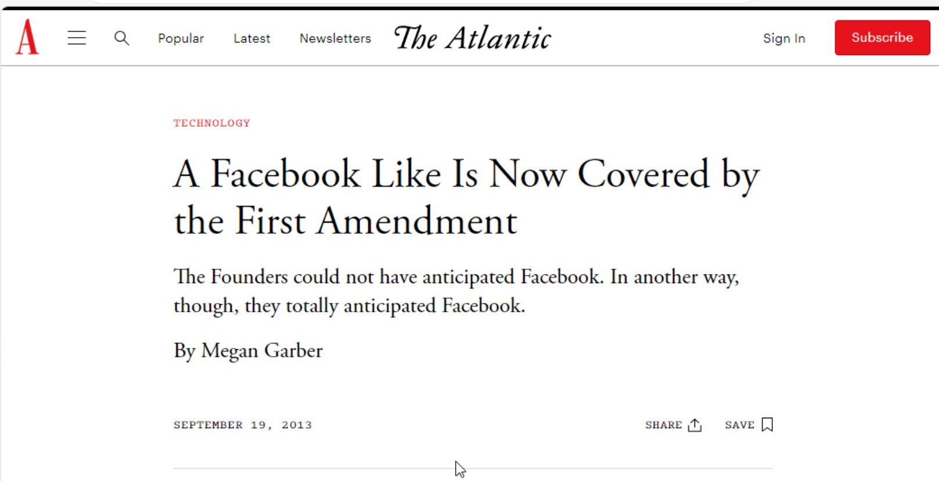
Employee Discipline
Notes:
A Facebook Like Is Now Covered by the First Amendment - The Atlantic
Bland v. Roberts, No. 12-1671 - South Carolina Law Review (sclawreview.org)
In November of 2009, B.J. Roberts, the sheriff of Hampton, Virginia, ran for re-election. A group of workers in Roberts' office, however, among them one Bobby Bland, weren't enthused about the prospects of their boss' continuation in his role. So they took to their Facebook accounts to protest the run: they Liked the campaign of Roberts' opponent, Jim Adams. Despite the minuscule mutiny, however, Roberts won the election. He then chose not to retain Bland and the others as his employees. The dismissals, Roberts said at the time, were the result not only of budgeting concerns, but also of the workers' hindrance of "the harmony and efficiency of the office." The sheriff had not liked his workers’ Likes. Bland and his colleagues took Roberts to court, arguing that, in the dismissals, Roberts had violated their First Amendment rights. In April of 2012, however, the U.S. District Court of Eastern Virginia dismissed the case on the grounds that a Like didn't involve an "actual statement," and therefore was “insufficient speech to merit constitutional protection.”
The appeals court reversed the decision. U.S. Circuit Judge William Traxler compared liking something on Facebook to displaying a political sign on your front yard, which the Supreme Court has found to be "substantive speech."

Slide 39
Employee Discipline
Police Officer Susan Graziosi’s initial social media post:
I just found out that Greenville Police Department did not send a representative to the funeral of Pearl Police Officer Mike Walter, who was killed in the line of duty on May 1, 2012. This is totally unacceptable. I don’t want to hear about the price of gas-officers would have gladly paid for and driven their own vehicles had we known the city was in such dire straights [sic] as to not to be able to afford a trip to Pearll, Ms. [sic], which, by the way, is where our police academy is located. The last I heard was the chief was telling the assistant chief about getting a group of officers to go to the funeral. Dear Mayor, can we please get a leader that understands that a department sends officers of [sic] the funeral of an officer killed in the line of duty? Thank you. Susan Grazios
Notes:
City’s Termination of Police Officer Over Facebook Posts Did Not (natlawreview.com)
Susan Graziosi made posts to Facebook when she was off-duty that were critical of her boss the police chief. After chief fired Susan Graziosi, she filed a lawsuit alleging she was engaging in protected free speech. The case made its way to the 5th circuit which said - not about public concern but rather about intra-departmental decisions plus department had greater interest in preventing insubordination.

Slide 40
Employee Discipline
City’s Termination of Police Officer Over Facebook Posts Did Not Violate First Amendment - Greenville, Mississippi (National Law Review)
facebook post
“If you don’t want to lead, can you just get the hell out of the way.”
Notes:
The Court noted that the City’s interest in preventing insubordination in the police department was adequate because the content of the posts indicated that Graziosi was likely to cause and engage in future disruption in the police department.

Slide 41
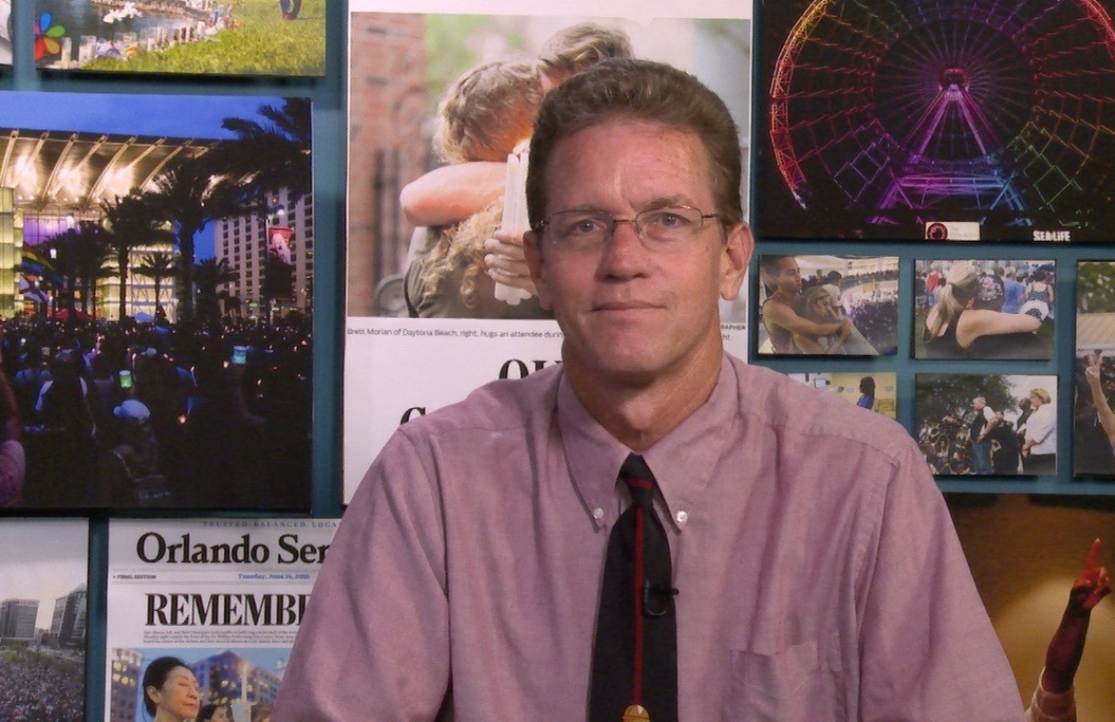
Employee Discipline
County Employee disagreed with State Attorney’s decision not to seek the death penalty for man accused of shooting a police officer.
He posted:
“Maybe SHE should get the death penalty”
and
“She should be tarred and feathered if not hung from a tree.”
Notes:
McCullars v. Maloy. The Court finds that in applying the Pickering balancing test to the specific facts of this case, Plaintiff's speech is not entitled to protection under the First Amendment to the United States Constitution.
McCullars v. Maloy, 369 F. Supp. 3d 1230, 1241
Like many people, assistant financial director Stan McCullars was angry about Orange-Osceola State Attorney Aramis Ayala’s decision not to seek the death penalty for accused cop killer Markeith Loyd. Unlike most people, though, he took to Facebook to declare: “Maybe SHE should get the death penalty.” And: “She should be tarred and feathered, if not hung from a tree.” The comments cost McCullars his job and he sued arguing his speech was protected by the first amendment.

Slide 42
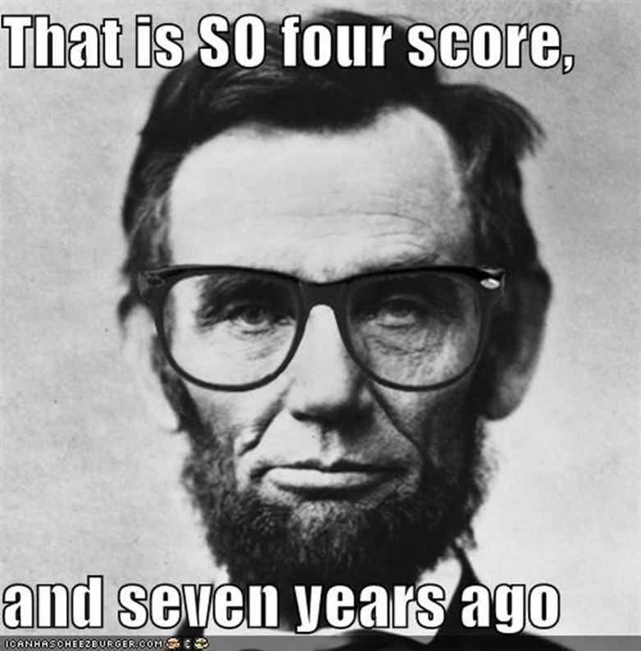
First Amendment Review
Conduct a thorough investigation
Was the employee posting to social media as a private citizen or public employee?
If post not made pursuant to employee’s official duties, was the employee speaking on a matter of public concern?
→If no, then no cause of action. →If yes, possibility of a claim arises
If post made pursuant to official duties, was the post accurate?
Did it comply with city policy?
Whether post was made as a citizen or employee, did it reveal confidential or sensitive information?
Did the post incite violence or was it harassing or discriminatory?
Notes:
Confirm existence of post itself and that it was actually written by the employee in question.
Consider how the post came to employer’s attention.
Confirm that the contents are objectively inappropriate or offensive.
Interview the employee in question in order to try to understand the context.

Slide 43
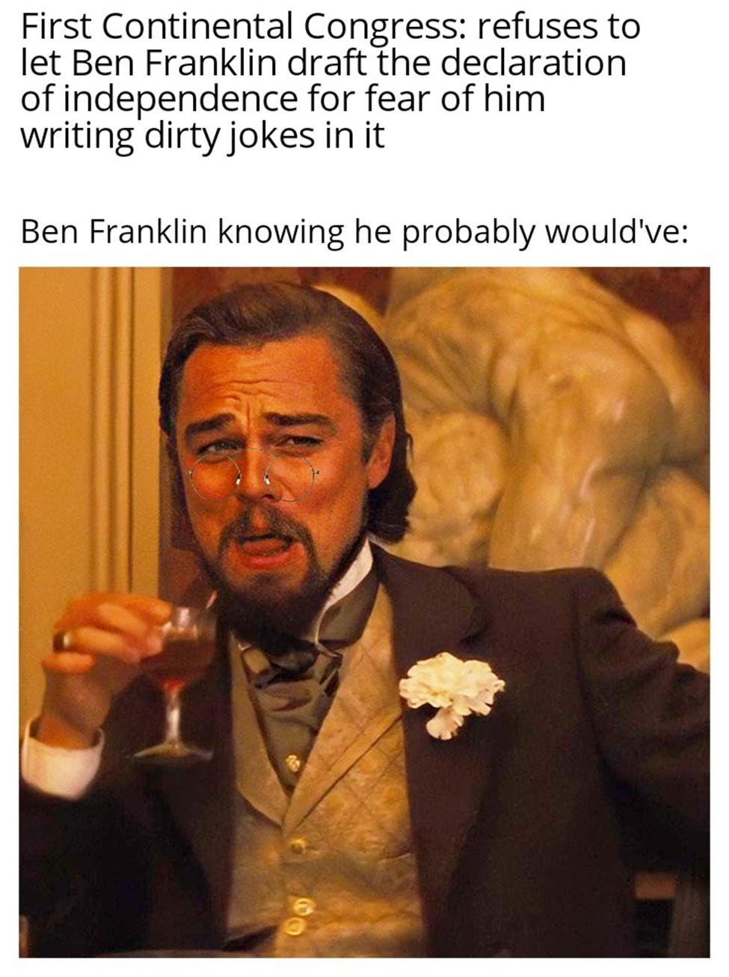
Government Accounts
Ben Franklin when someone says First Amendment analysis is easy
Notes:
Most cities have some sort of social media account these days where, at the very least, notices and information are posted. Many cities are very active on social media with accounts on several different platforms. Careful management of these accounts is critical. The social media manager really needs to pay attention to detail and keep current regarding the legal implications of how a governmental entity can use social media.

Slide 44
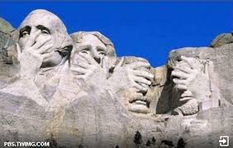
Government Accounts
Governmental entities, like private companies, should have policies and conduct training for employees entrusted with managing the entity’s social media accounts.
Mistakes can and do happen…

Slide 45
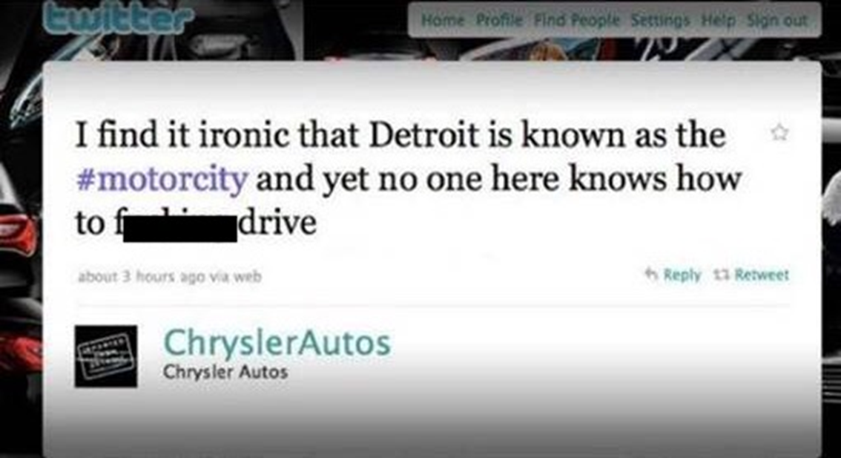
Government Accounts
Ensure the social media manager is diligent and cautious when posting
Notes:
Let’s start with some examples of social media managers not paying close enough attention to detail.
Mistakenly thinking he was on his own personal account, social media strategist Scott Bartosiewicz posted this tweet using the corporate account for Chrysler. Too bad he doesn't practice what he preaches when it comes to social media.

Slide 46
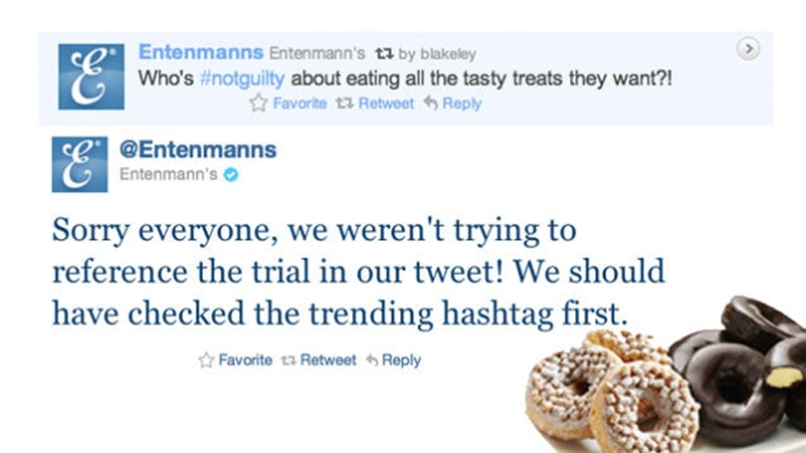
Government Accounts
Ensure the social media manager is diligent and cautious when posting
Notes:
Check hashtags to make sure you are not inappropriately using them and can be found to be not using them appropriately
This one was used during the Casey Anthony trial.

Slide 47
Government Accounts
Ensure social media managers understand the legal implications of managing a government account.
Hunt County Sheriff’s Office Facebook page was a public forum for purposes of the First Amendment and removing comments and users critical of the Sheriff’s Office constituted a constitutional violation.
Notes:
In Hunt County, Texas, a social media user named Deanna Robinson alleged that county sheriff's office engaged in viewpoint discrimination in violation of First Amendment after the office allegedly deleted her comment on its social media page and banned her from making future comments because she criticized the sheriff’s office.
And the 5th circuit said…that the sheriff’s office had configured the social media page to be open to public and allow page visitors to interact openly with the page, such that the page was a public forum or limited public forum, and that the defendant’s actions constituted viewpoint discrimination in violation of the First Amendment.
Importantly, the court said that the Facebook page was a public forum, and it didn't matter which kind (designated or limited), because either way viewpoint-based discrimination was impermissible. Robinson v. Hunt Cty., Texas, 921 F.3d 440 (5th Cir. 2019), reh'g denied (May 16, 2019)

Slide 48
Government Accounts
Tips for Managing a City Account
Carefully consider the implications of any joke, hashtag, or meme before posting.
Remain content-neutral in the moderation of any city social media page.
Do not delete comments or block users for being critical or for supporting/opposing a matter discussed on the page.
Consider seeking legal advice before deleting any comment or taking action to block any user.
Notes:
Today it is not practical for us to advise our client cities to just not have social media presence. It’s expected now by many citizens. So at a minimum I would advise…

Slide 49
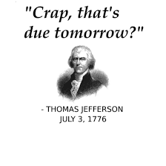
Social Media Policies
Notes:
Now for the part of the presentation that is written in your language – let’s talk policies. I’ll share some suggestions and some sample language, but you will want to ensure that your policy fits for your entity.

Slide 50
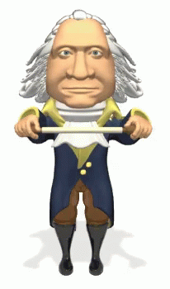
Social Media Policies
Policy Suggestions for Employee Social Media Use:
Prohibit or limit employee use of social media while on the job;
Prohibit release of confidential information;
Prohibit employees from holding themselves out as the city’s spokesperson (unless they are) or from maintaining an account or posting content that appears or purports to be official/governmental;

Slide 51
Social Media Policies
Continued…
Encourage employees and officials to add labels or disclaimers to personal social media accounts;
Extend any existing code of conduct to social media use;
Prohibit employees from posting photos wearing city uniform or insignia; and
Prohibit or limit the use of the city’s logo or letterhead.

Slide 52
Social Media Policies
Sample Language
(A) “Social Media” includes various forms of discussion and information sharing tools including social networking, blogs, video sharing, podcasts, wikis, message boards and online forums. Technologies include picture and video sharing, wall postings, e-mail, instant messaging, and music sharing, to name a few. Examples of Social Media applications include, but are not limited to, Google and Yahoo Groups, Wikipedia, My Space and Facebook, YouTube, Flickr, Twitter, LinkedIn, and blogging.
(B) City time and equipment should not be used for updating social media sites, including updating personal pages or profiles. Time spent on social media sites should be limited in the same manner as time spent on the telephone or internet when conducting personal business.

Slide 53
Social Media Policies
(C) Employees may not use the City’s logo, letterhead or other identifying material including pictures of themselves or co-workers wearing or displaying the City’s logo.
(D) Employees may not post discriminatory, defamatory, libelous or slanderous comments when discussing the City, its governing body, supervisors and employees.
(E) Employees must comply with City policies and personal sites may be monitored to determine compliance with City policies.
(F) Employees who fail to follow the policy regarding social media may be subject to disciplinary action, up to and including termination.

Slide 54
Other Legal Considerations

Slide 55
Prohibitions Against Certain Social Media on Government Devices
Notes:
You may be aware that the application TikTok was banned at the state level, and later SB 1893 was passed requiring cities to ban TikTok from city-owned devices and networks. The bill also requires the Department of Information Resources to issue a model policy for cities to use to implement this requirement. The bill says that cities must adopt a policy prohibiting TikTok not later than the 60th day after the model policy is made available.
The model policy is Texas Government Code Chapter 620, Section 620.003. It states a governmental entity shall adopt a policy prohibiting the installation or use of a covered application on any device owned or leased by the governmental entity and requiring the removal of covered applications from those devices.
The Department of Information Resources and the Department of Public Safety shall jointly develop a model policy for governmental entities to use in developing the policy.
Exceptions are found in Section 620.004, which provides for the installation and use of a covered application to the extent necessary for providing law enforcement or developing or implementing information security measures. However, any policy allowing the installation and use of a covered application must require the use of measures to mitigate risks posed to this state during the use of the covered application and the documentation of those measures.

Slide 56
Public Information Act
In Lindke, the status of Freed’s account as a personal account mattered. That does not matter under the PIA.
Lindke looked at the First Amendment and discussed the state-action doctrine to determine whether the city manager was making posts or taking action in his official capacity.
The PIA is an entirely different law regarding the release of public records or public information. The PIA defines public information and specifically includes communications (even social media posts!) if made “in connection with the transaction of official business.”
Notes:
“In connection with the transaction of official business” means it pertains to official business of the City, and it is created by, transmitted to, received by, or maintained by an officer or employee of a city in the officer’s or employee’s official capacity or as a person performing official business on behalf of the City.
“Official business” means any matter over which a governmental body has any authority, administrative duties, or advisory duties

Slide 57
Public Information Act
Information that may be subject to the Act:
E-mails in a personal account;
Text messages on a personal cell phone;
Posts to social media accounts, even if restricted to “friends” or “followers” only; or
Direct or private messages using a personal Facebook (or other social media) account.
Notes:
It bears repeating that the characterization of information as “public information” is not dependent on whether the requested records are in possession of an individual, rather than a governmental body. And, the Act does not distinguish between personal or employer-issued devices, but rather focuses on the nature of the communication or document. The bottom line is – it’s the content that matters, not the account from which the message was sent, or even the RECIPIENT.
The one saving grace for elected officials is that your private correspondence relating to matters the disclosure of which would constitute an invasion of privacy are exempt from the PIA. The test is the same as the common law tort of invasion of privacy. The two requirements for common law privacy are (1) the information must contain highly intimate or embarrassing facts the publication of which would be highly objectionable to a reasonable person, and (2) the information is not of legitimate concern to the public. However, this determination is made by the AG, and does not allow the City to automatically withhold these communications.

Slide 58
Public Information Act
Social Media Challenges under the PIA
How does the city know if information exists?
How does the city gather the information?
Notes:
Cooperation of officials required. Tip: Add requirement in personnel policy for employees to provide copies of information subject to the PIA.

Slide 59
Final Suggestions
● Analyze whether employee posts comply with city policy;
● Ensure the accuracy of all posts made on behalf of the city;
● Adopt or update social media policies that prohibit or limit on-duty use of cell phones and social media;
● Include provisions in your policies related to posts that may reveal sensitive or confidential information;
● Consider provisions that address whether the post or message is required to be maintained for records retention or public information purposes;
● When in doubt, call your attorney.

Slide 60
Questions?

