Slide 1
Civil Service & Labor Relations Workshop 2025
President’s Welcome
Notes:
Welcome! Glad you are here! Want this to be an enriching experience for each of you…content AND connection.
Who I am
# of participants

Slide 2
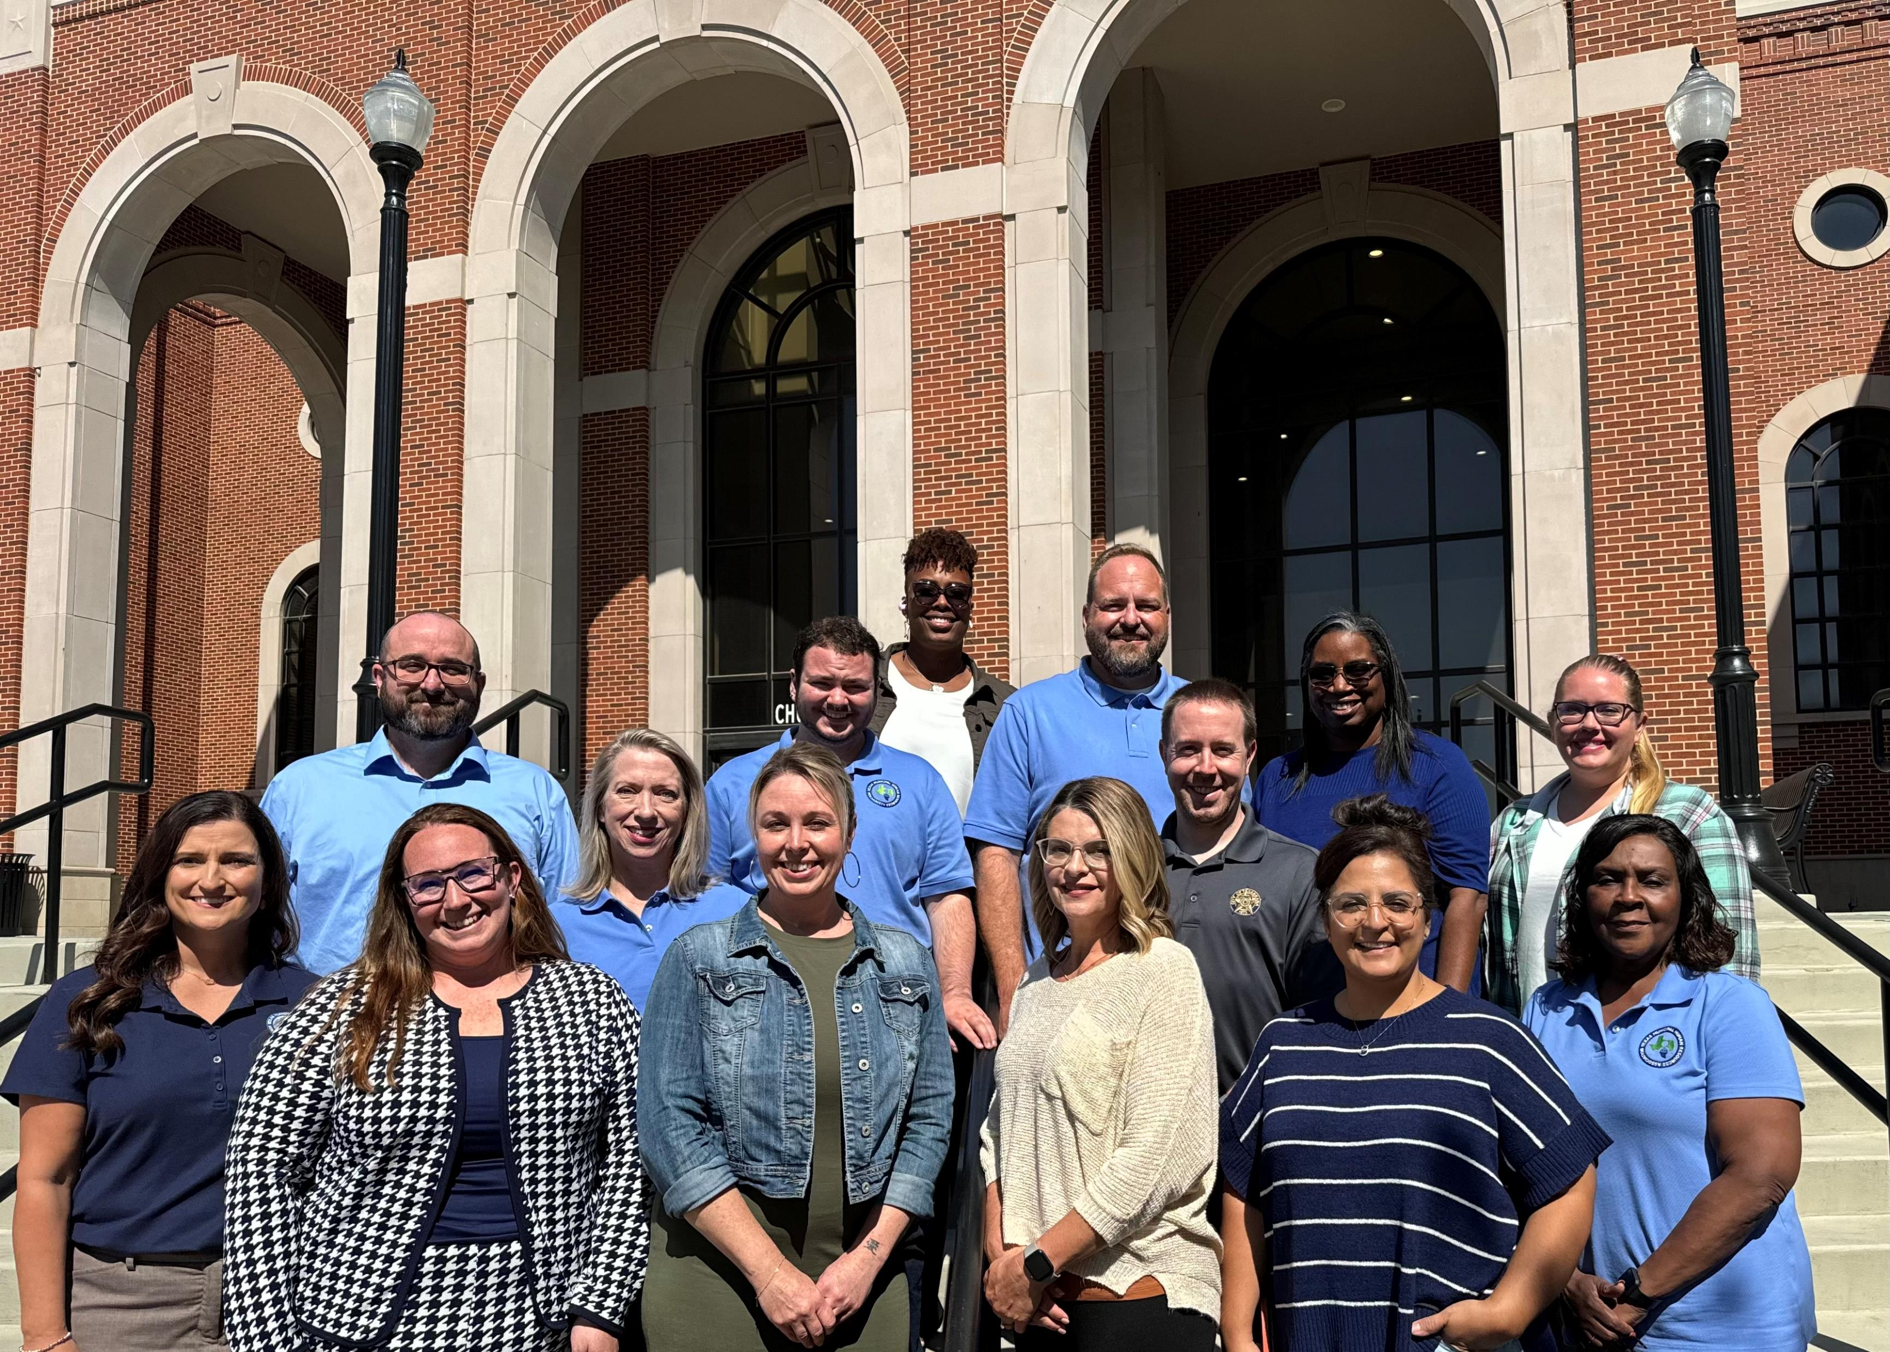
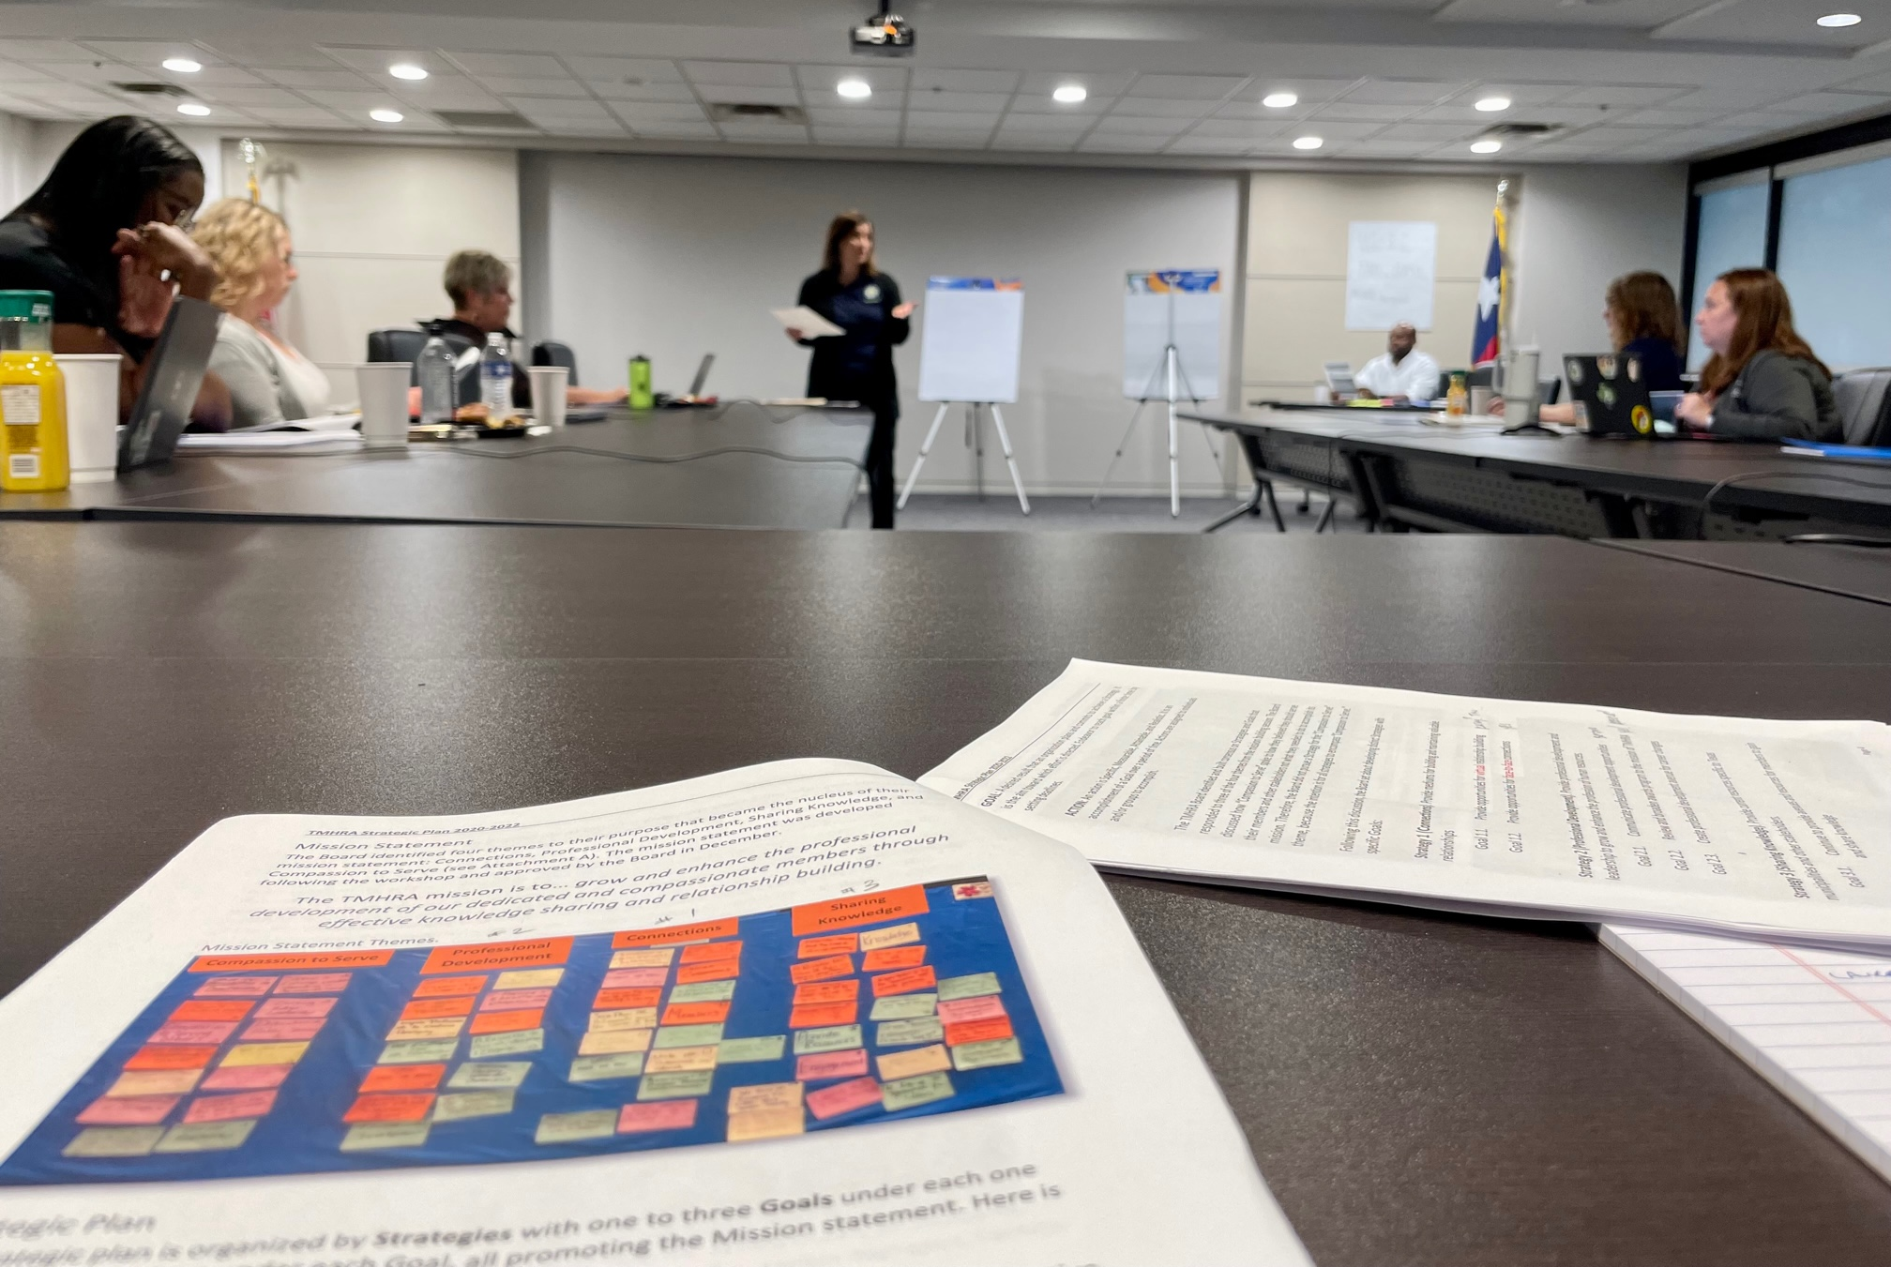
Your Board
Notes:
# of members
These folks give of their time to support members and these programs.. Name them

Slide 3
Your Program Committee
Jeriana Staton, Sanger
Kelly Rodriguez, Killeen
Lindsey Cox, New Braunfels
Elliott Harper, McKinney
Haley Archer, Burnett
Eyvon McHaney, Arlington
Rose Davis, Grapevine
Louis Alayon, Abilene
Melissa Sullinger, Pearland
Nicole Weaverling, Midland
Crane Petty & Lavern Gaines, TML

Slide 4
Awards
February 10th

Slide 5
Learning Library
Notes:
3 from our partners at TMLIRP
11 from our most recent annual conference
10 Specially curated compliance modules including content from Rodney Klein on ADA and EEO Investigations, and from Mark Stephens on FMLA

Slide 6
Municipal HR Certification Program
Weeklong training program assuring a generalist skillset in Texas Municipal Human Resources
Update at Annual Conference

Slide 7
75th Anniversary
Celebration during Annual Conference in San Antonio May 7-9, 2025

Slide 8
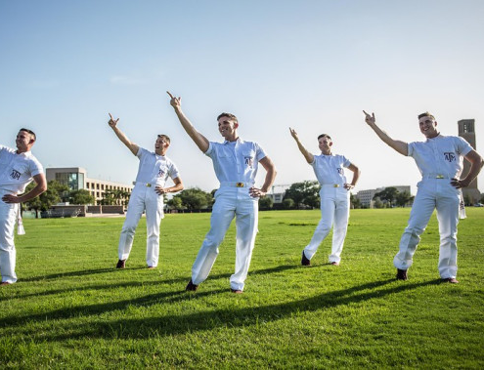
Conference Tips
DON’T mistake these guys for a boy band
Unlike them, DON’T walk on the grass
DO put yourself out there and meet new people!

