Slide 1
TMHRA: Legislative Update
Bennett Sandlin, TML
January 29, 2025
College Station, Texas

Slide 2
89th Legislative Session

Slide 3
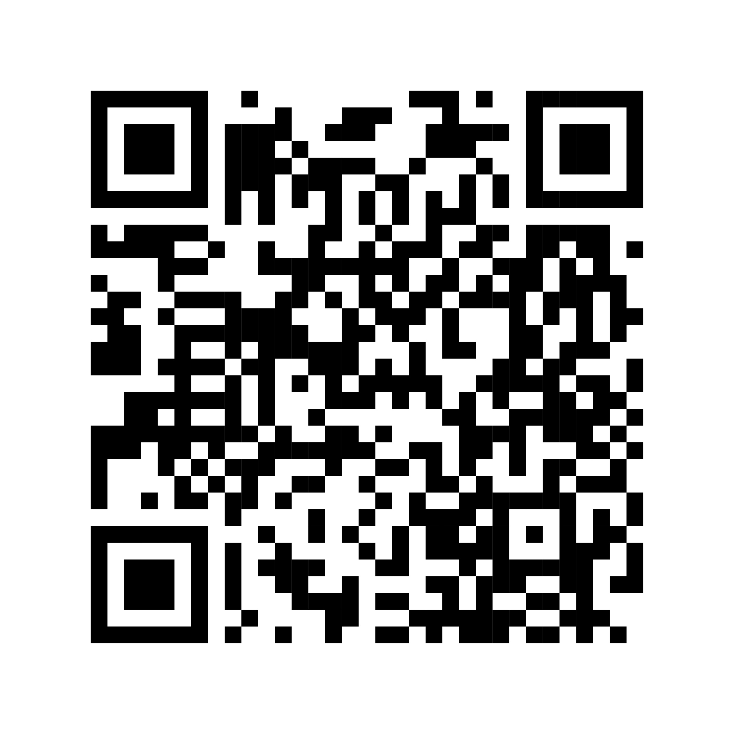
Get Engaged!
Now is the time to communicate with your senator and representative about issues important to your city!
TML Resources:
TML Legislative Update
Weekly-Updated bill summary list
TML Legislative Toolkit
Grassroots Involvement Program

Slide 4
TML Priorities
Defeat legislation that would erode city authority or be detrimental to cities, including legislation that:
preempts municipal authority in general
imposes further revenue and/or tax caps of any type
erodes the ability of a city to issue debt
erodes municipal authority related to development matters, including with respect to the following issues: (1) annexation; (2) eminent domain; (3) zoning, including legislation limiting a city’s ability to regulate accessory dwelling units; (4) regulatory takings; (5) building codes; (6) tree preservation; (7) short-term rentals; (8) the extraterritorial jurisdiction (ETJ); (9) manufactured housing; (10) parkland dedication ordinances; and (11) impact fees
erodes the authority of a city to be adequately compensated for the use of its rights-of-way and/or erode municipal authority over the management and control of rights-of-way
limits or prohibits the authority of city officials to use municipal funds to communicate with legislators
Reduces the ETJ or abolishes the concept of the ETJ

Slide 5
TML Priorities
Seek introduction and passage of legislation that:
Increases street maintenance sales tax flexibility
HB 884 (C. Hernandez)
SB 178 (Menendez)
Allows cities alternate methods for publications of legal notices
HB 1028 (Shaheen)
HB 1080 (Curry)
Promotes of “Pay-as-you-go” financing through property tax rate calculation adjustment
Increases the competitive bidding threshold to account for increased costs to cities
HB 1998 (Spiller)
SB 830 (Parker)
Creates new law enforcement grant programs or expands current law enforcement grant programs

Slide 6
Employment
HB 2098 (Armando Martinez) – Automatic police and fire civil service in cities over 25,000 population
HB 792 (Leach) – Limits severance agreements to 20 weeks pay
HB 881 (Thompson) – Progressive disciplinary matrix for police in non-civil service cities
HB 1677 (Canales) – City over 10,000 population must conduct investigation before taking punitive action against a firefighter
SB 280 (Miles) – civilian complaint board for police misconduct in cities over 200,000 population
HB 1985 (Hickland) – Raises maximum age for new firefighters in civil service cities from 35 to 44.

Slide 7
Land Use Bills
Housing Affordability and Zoning Reform
HB 878 (Vasut) – Minimum lot size restrictions for certain cities; accessory dwelling units by right in all cities
SB 673 (Hughes)/HB 1779 (Bucy) – Accessory dwelling units by right
HB 369 (Tepper) – No city regulations allowing for more than one single family dwelling on a lot zoned for single family dwellings on 9/1/2023
SB 840 (Hughes) – Certain cities must allow mixed use and multifamily in commercial zones
SB 844 (Hughes) – Modifies protest procedures for zoning changes; authorizes civil action against city to compel city to adopt zoning changes making residential development less restrictive
SB 854 (Middleton) – City must permit multifamily and mixed-use on religious land
HB 1742 (Hickland) – Zoning protest threshold from 20% of area property owners to 50%; ¾ vote of city council down to simple majority
HB 1835 (Guillen) – Limits city ability to regulate or restrict installation of new HUD-code manufactured homes

Slide 8
Land Use Bills
Annexation/Disannexation/ETJ
HB 950 (Hayes) – Requires a city to provide full municipal services to annexed property within four years
HB 377 (Cortez) – Any agreement that authorizes a city to annex property may not waive a written service agreement requirement
HB 1901 (Cook) – Limits ETJ release to areas far from city limits or to areas identified in certain long-range plans
HB 2024 (Turner) – No ETJ release if release would cause ETJ to be noncontiguous or if the city has spent at least $1 million to develop the property
Platting and Permitting
HB 987 (Toth) – Moves building permit shot clock from 45 days to 30 days
HB 993 (Toth) – Only commercial property owners can agree to extend 45 day shot clock for building permit approval
HB 1322 (Hopper) – Extends plat approval shot clock from 30 days to 90 days for cities under 10,000 population
SB 210 (West) – Expedited building permit review in cities over 100,000 population for affordable housing projects

Slide 9
City Finance Bills
Property Tax
HB 250 (Harrison) – Eliminates 3.5% multiplier for VAR calculation and de minimis rate
HB 416 (Tepper) – Adjusts various property tax deadlines
HB 217 (Harrison) – 60 percent required to approve tax rate at an election
HB 763 (Cain)/HB 1131 (Oliverson) – City can’t exceed VAR without election following a disaster
HB 1433 (Hickland) – Efficiency audits when city adopts rate over NNR for five years
HB 291 (C. Bell) – Sales price disclosure to appraisal districts
HB 21 (Gates)/SB 867 (Bettencourt) – HFCs with limited ability to operate outside their boundaries
Sales Tax
HB 924 (Schofield) – Local sales taxes sourced to location where item stored before delivery/transfer

Slide 10
City Finance Bills
Debt
HB 1453 (Tepper)/SB 470 (Sparks) – Largely eliminates use of certificates of obligation
HB 1514 (Schofield)/SB 393 (Sparks) – No debt for tangible personal property if useful life of property ends before maturity date
HB 1519 (Schofield)/SB 533 (Sparks) – All bond elections on November election date
Budget
HB 325 (Cain) – Expenditure caps
SB 427 (J. Hinojosa) – Must file/publish annual financial statement or city cannot receive state grants
HB 774 (Harrison) – Any city surplus revenue must be used for property tax relief

Slide 11
Public Safety Bills
Police Procedures
HB 656 (Thompson) – Cite and release
HB 909 (Thompson) – City liability for action of a peace officer under color of law
HB 1765 (J. Jones) – Limitation on no-knock entry by peace officer
Other Public Safety
HB 1715 (Cain) – No contract provision limiting carrying of handguns on public property
SB 241 (Flores) – City must implement a process allowing complaints regarding a violation of a public camping ban; must act on complaints or be penalized.
HB 1511 (Hickland) – City may adopt a juvenile curfew ordinance

Slide 12
Other City-Related Bills
Community Censorship
SB 239 (Middleton)/HB 309 (Leo-Wilson)/HB 1189 (Troxclair)/HB 1294 (Patterson) – Political subdivision may not spend public funds to hire lobbyist or to pay a nonprofit state association that hires a lobbyist
HB 571 (Cain)/HB 671 (Shaheen) – Political subdivision may not spend public funds to hire lobbyist, but exception for nonprofit state association to provide legislative services, communicate with legislators, and testify for or against legislation
Miscellaneous
HB 1227 (Gates) – Limits city solid waste franchise fees to two percent
HB 294 (Cortez)/SB 141 (Hall) – City can’t prohibit six or fewer chickens or rabbits on single family lot
SB 506 (Bettencourt)/HB 1783 (Paul) – Ballot proposition language for home rule cities reviewed by SOS
HB 524 (Tepper) – AG review of home rule city initiative and referendum petitions
HB 1522 (Gerdes) – Open Meetings Act notice three business days in advance instead of 72 hours; notice for budget-related meeting must include physical copy of budget
HB 1335 (Gerdes)/SB 501 (Kolkhorst) – City utilities must participate in “call before you dig”
HB 1844 (Guillen)/SB 878 (Birdwell) – Chapter 380 agreement transparency reforms

Slide 13
Questions?

