Slide 1
Hiring and Developing High EQ Employees for Public Safety Positions
DANIEL KISTNER, DLS
MICHAEL BOESE, MPA

Slide 2
introduction
Public safety professionals face unique challenges that require not only technical expertise but also emotional intelligence (EQ). EQ the ability to recognize, understand, and manage emotions in ourselves and others has become a critical skill in fostering trust, collaboration, and resilience in high-pressure environments. In this session, we will explore practical strategies for hiring and developing high-EQ employees and discuss how building a supportive organizational culture can enhance emotional well-being, improve performance, and attract the right talent.

Slide 3
Emotional Intelligence
"Emotional intelligence is the ability to recognize, understand, and manage your own emotions while also being able to recognize, understand, and influence the emotions of others."
This concept is often broken into five key components:
Self-Awareness: Recognizing your own emotions and their impact.
Self-Regulation: Managing your emotions constructively and controlling impulses.
Motivation: Being driven to achieve goals with a focus on growth and resilience.
Empathy: Understanding and sharing the feelings of others.
Social Skills: Building and maintaining positive relationships through communication and collaboration.
Goleman, Daniel. Emotional Intelligence: Why It Can Matter More Than IQ. Bantam Books, 1995.

Slide 4
Emotional Intelligence (EQ) is a critical skill in public safety, enhancing communication, crisis response, decision-making, and team dynamics.
The unique challenges faced by public safety professionals.
Organizations that prioritize EQ foster trust, fairness, and legitimacy within their communities.
Emotional literacy can save lives, strengthen relationships, and improve career satisfaction in public safety roles, as discussed in Dignity in Policing by Marcel Brunel and Dan Newby.
E.Q.

Slide 5
Our Personal Journey in Public Safety
Challenges we faced
The impact of organizational culture on emotional well-being and leadership.
Key takeaway: The culture we build determines employee retention and success.

Slide 6
Influences
Sensemaking
What makes you, you.
Phenomenology
Access
Training, equipment, education

Slide 7
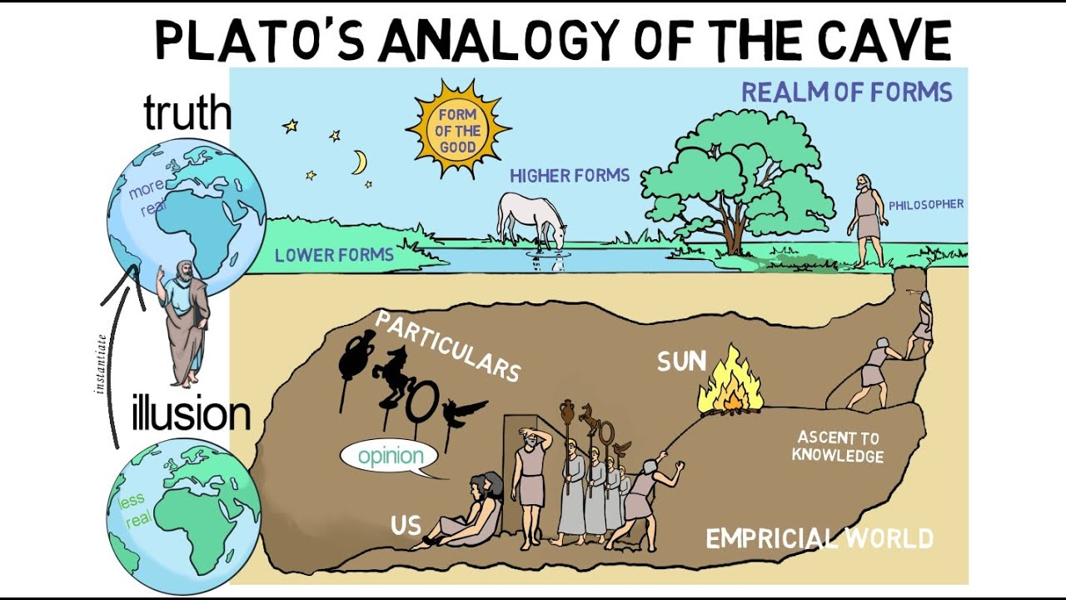
Our Personal Journey in Public Safety
A point may also be made that the familiar is so powerful that individuals/groups remain with the familiar despite the potential for harm.

Slide 8
Culture change is difficult for any organization, perhaps amplified for public safety entities. Behaviors and attitudes may be influenced not only by identity and organizational culture, but also by the persona archetype. According to Carl Jung, the persona archetype can be likened to a series of masks used to project a particular image to a specific audience. Public safety organizations such as law enforcement and the fire service have institutionalized behaviors and attitudes that are difficult to modify, partly because these behaviors and attitudes may have been successful in the past and partly because of ego. Behaviors and attitudes are defended in spite of adaptive attempts to influence the status quo. Challengers to the status quo may consequently be discredited, ridiculed, or even allegorically attacked. Challengers are not necessarily those with positional authority but may be any individual with a position counter to the pervasive identity and culture of the organization. To maintain personal safety, a persona may be adopted to project an image to colleagues and another to the public that is consistent with the existing culture. Behaviors inconsistent with progressive industry best practice may therefore persist.
Our Personal Journey in Public Safety

Slide 9
Our Personal Journey in Public Safety
Pressure
Pressure
Action
Occupational and/or Personal Exposure
Emotional Competency
Desired Behavior Modification
Risk*
Moral Injury
Inaction/Modified Action
Pressure
Pressure
*Level of Risk = Commensurate to the perceived threat.
The Change Dilemma Model _{(Kistner, 2023)}
9

Slide 10
EQ in Action
Examples of EQ across fire, EMS, and law enforcement.

Slide 11
Hiring for EQ in Public Safety
Strategies for Integrating EQ into Hiring Processes for Both Civil Service and Non-Civil Service Systems:
Develop clear competencies for emotional intelligence aligned with job roles, such as conflict resolution, adaptability, and empathy.
Implement EQ-focused interviews, using role-playing exercises or situational judgment tests, to evaluate candidates in real-life scenarios during the interviews.
Provide training for hiring managers to recognize EQ traits during interviews and evaluations, emphasizing behaviors like active listening and self-regulation.

Slide 12
Hiring for EQ in Public Safety
Crafting Interview Questions and Scenarios to Assess EQ
Behavioral Questions:
"Describe a time when you had to handle a conflict in the workplace. How did you address it, and what was the outcome?"
"Can you provide an example of when you had to adapt quickly to a changing situation in a high-pressure environment?"
Situational Scenarios:
"Imagine a team member is visibly upset during a critical incident. How would you approach and support them while ensuring operational effectiveness?"
"How would you handle a situation where you receive negative feedback from your supervisor or a team member?"
These questions are crafted to observe the candidates’ ability to empathize, communicate, and regulate their emotions under pressure.

Slide 13
Toxic Culture
vs.
Supportive Culture
Consequences of toxic cultures: Suppressed emotions, high turnover, and burnout.
Benefits of supportive cultures: Higher retention, stronger morale, and better performance.
Key traits of supportive organizations: Empathy, transparency, and collaboration.

Slide 14
DEVELOPING A CULTURE
OF
EQ GROWTH
Strategies for encouraging EQ development:
Mentorship, training, and open communication.
Link EQ growth to performance
The ripple effect: Culture shapes the entire department and public perception

Slide 15
Health and Wellness Initiatives
Physical wellness programs: Fitness, nutrition, and stress management.
Mental wellness initiatives: Counseling, peer support, and mindfulness training.
Real-life examples of successful programs in various public safety sectors.

Slide 16
Lessons learned
Understand Resistance: Initial skepticism about EQ in public safety can be overcome by demonstrating tangible results like better team dynamics and decision-making.
Cultural Buy-In is Key: Building a culture that prioritizes EQ starts from the top leadership and filters through the entire organization.
Long-Term Investment: Developing EQ takes time and requires continuous training, mentorship, and wellness programs.
Community Impact: Enhanced EQ improves trust, transparency, and relationships with the public.

Slide 17
Questions

Slide 18
Thank You
Daniel Kistner, DLS
Vice President
(903) 258-4651
Danny@clearcareerpro.com
Michael Boese, MPA
President
(972) 837-0916
Michael@clearcareerpro.com
www.clearcareerpro.com

