Slide 1
Handle with Care: Managing Behavior and Building Teams Culturally
Rodney Klein
Rodney Klein EEO Training, LLC

Slide 2
CARE
Which stands for…

Slide 3
C A R E …just care

Slide 4
Care as Culture
About being right
About being in the relationship
Caring about both of those things passionately will help us find the balance between them
The job and the people we work with

Slide 5
Care as Culture
Caring adds context to all our conversations
So does uncaring
Care is individual, not a group activity
The old coaching adage: “They don’t care what you know until they know that you care.”

Slide 6
Care as Culture
It’s not complicated
It’s not a technique
It’s simple, human interaction
And it helps you balance your priorities
The problem is, it’s not always easy to care

Slide 7
Care as Culture
Being right and being in the relationship is a balance.
At times being right causes friction in the relationship.
At times being in the relationship impedes our ability to be fully right.

Slide 8
Care as Culture
Formal and informal rules governing how we behave toward each other.
It’s through culture that we teach our employees what we value and what we don’t.
We teach those lessons whether we mean to or not.
We must be intentional about the culture we create.

Slide 9
Effective Teams: Why Culture Matters

Slide 10
TEAMS
Psychological Safety (Trust)
Teams work best when everyone contributes equally
Promotes collaboration and productive disagreement

Slide 11
TEAMS –
Psychological Safety
Relationships matter so behavior matters

Slide 12
We Disagree

Slide 13
TEAMS –
Psychological Safety -
Managing Disagreement
Psychological Safety ramps up task conflict and tamps down relationship conflict
It’s not personal
Build areas of consensus first
Ask lots of questions
Behavior issues kill psychological safety

Slide 14
Have you ever set up a team function and then had an employee refuse to participate (or try really hard not to)?
Have you ever taken a professional disagreement personally?
Have you ever had a team member pitch an idea that you highly suspected would not work?

Slide 15
TEAMS –
Psychological Safety -
Managing Disagreement
Managing workplace behavior is the first step in recruitment
It’s about attracting, developing, and keeping talent

Slide 16
Managing Disagreement –
Culture
Zero complaints is not the goal
Kindness is irresistible
We teach culture through accountability (So, set the bar and mean it)
Behavior – Not negotiable

Slide 17
Managing Disagreement –
Culture –
Development
As an employee moves up within an organization, they use fewer cognitive skills (problem solving) and rely more on social/emotional skills (working with people)
It’s a skill
Individual assessment and development

Slide 18
C A R E …just care

Slide 19
Respect to Purpose

Slide 20
Managing Disagreement –
Culture
PURPOSE
VALUE
RESPECT
PURPOSE
VALUE
RESPECT

Slide 21
We get what we give If we want respect, we must give it

Slide 22
Have you worked for supervisors that respected you?
Have you worked for supervisors who didn’t?
Were you a better employee for the supervisors who respected you?
Why? And what did they do to make you feel respected?
What do you do to make your employees feel respected?

Slide 23
Managing Disagreement –
Culture -
Respect
Respect is hard work
How do you make it part of your day?
How do you make it part of your quarter?
How do you make it part of your year?

Slide 24
Managing Disagreement – Culture –
Respect
Partner with someone to create accountability
Set deadlines for plan, but be flexible
Have a real (but not too real) penalty for failing to meet goals

Slide 25
Setting the Bar for Behavior

Slide 26
Managing Disagreement –
Culture -
Setting the Bar for Behavior
If respect is the standard, set the bar at disrespect
Constant interrupting
Not respecting a person’s space or time
Email hand grenades
Insulting or demeaning others
Ignoring people
Corrosive over time and is gateway drug to worse behavior

Slide 27
Managing Disagreement –
Culture -
Setting the Bar for Behavior
80% employees subjected to uncivil behavior lose work time worrying about the behavior
Studies show we lose up to 30% of our cognitive skills after we are treated disrespectfully or witness disrespectful behavior happening to others

Slide 28
Managing Disagreement –
Culture -
Setting the Bar for Behavior
Yes, holding people (and ourselves) accountable is caring.
And accountability is how we teach culture to our employees.
We also teach culture with what we don’t hold people accountable for.

Slide 29
Empathy: Can’t Lead Without It

Slide 30
Empathy
Remember, we don’t have to agree
Get out of our own heads for a little while
(Grocery store check-out line - David Foster Wallace)
Division is usually a lack of perspective

Slide 31
Tell one story about yourself that you believe was important in making you who you are today.
And listen to one story from your partner.
(Does this help you better understand who this person is? Our experiences are not the same, but importance usually is: family, friendship, compassion, connection)
Why? Care about me and I’ll Care about you.

Slide 32
Empathy
Putting our own point of view aside for a moment is incredibly educational and even liberating.
If people draw different lessons from their experiences than we do from ours, then we should be curious as to why.
It’s about problem solving (i.e. effective teams)

Slide 33
Empathy
We all have different experiences, so we all have different perspectives (subjectivity).
When people with different perspectives clash, it can have impacts on the team.
It’s not a question of right or wrong. It’s a question of impact.

Slide 35
Empathy
Small events (slights, snubs, insults, isolating events) can have weight over time.
Can be based on race, sex, religion, disability, age, ethnicity, LGBTQ
A balloon we slowly fill with air (Manny Gallegos)
The individual can feel isolated from the team

Slide 36
Jane and Bob are hired for a difficult and highly stressful job. The job is crucial to the operation of the company. As a result, people in this job are expected to produce and produce quickly or they are fired and replaced.
There are eight people in the department. Jane is the only woman. Six months after they are hired Bob passes his probation and is given a nice raise. Jane is fired for low productivity and poor performance (making errors). HR can’t figure out why women have historically not performed well in this position, since no one in the department is overtly sexist and women are held to the same performance standards as men.
How could small, isolating events led to Jane’s demise?

Slide 37
C A R E …just care

Slide 38
Radical Candor: Caring and Direct

Slide 39
Care -
Manager’s Problem
Sometimes we must decide who’s right
How do we have those conversations?

Slide 40
Care -
Radical Candor
Conversations that are both caring and direct
Can work only if underlying relationship is trusting and solid (must lay the groundwork first)

Slide 41
Have you ever had an employee who just wouldn’t trust you, wouldn’t trust their co-workers, and was a drag on the team?

Slide 42
Care –
Radical Candor
Founded on trust (psychological safety)
Trust is earned through consistency
Sharing risk and breaking bread

Slide 43
Conversation Ground Rules

Slide 44
Conversation Ground Rules
We get what we give
Conversation isn’t about winning a battle. It’s about furthering relationships.
Assume good intent – always
Ask teachable questions
Find truth in what you hear even if you don’t agree with it

Slide 45
Conversation Ground Rules
To communicate with each other we must understand each other. This requires that we have a shared understanding of the terms we use and what they mean. This takes context.
Communication is all context. None of us communicate in a vacuum.
If I’m the communicator, I must keep adding context until I’m understood. It is my responsibility.
This is why impact is more important than intent.

Slide 46
Conversation Ground Rules
Intent isn’t in anyone’s performance evaluation.
Communication is in everyone’s performance evaluation

Slide 47
Conversation Ground Rules
Don’t judge whether a person should or should not be upset.
You can only deal with the world as it is, not as you want it to be.

Slide 48
C A R E …just care

Slide 49
Conversation Ground Rules (Disagreement vs Hate)

Slide 50
Conversation Ground Rules -
Disagreement v Hate
People don’t always express disagreement well. Sometimes they express it in hateful terms.

Slide 51
Conversation Ground Rules -
Disagreement v Hate
The difference between disagreement and hate is the psychologically safe space created so people can still interact and be productive.
If no safe space is created, it’s hate.

Slide 52
Conversation Ground Rules -
Disagreement v Hate
Remember, we’re not trying to create an environment where everyone agrees
Disagreements are productive. Hate is destructive.
Good behavior is non-negotiable

Slide 53
Bob and John are two of your employees. One day you hear the following conversation.
Bob: Hey, John, did you hear? It’s Pride month. What pronouns should I call you?
John: Stop
Bob: Those people are sick and disgusting. There are only two sexes, and we don’t get to pick.
John: I don’t want to get into this.
Bob: I’m just stating my opinion. Free speech is my right.

Slide 54
Bob and John are two of your employees. One day you hear the following conversation.
John: Bob, you believe in God, don’t you?
Bob: Yes.
John: Religious people are delusional, believing in a little invisible friend. Almost all the evil in the world comes from religion. Only weak people believe in something they can’t see.
Bob: I’ll pray for you.

Slide 55
Jane and Betty are two of your employees. One day you hear the following conversation.
Jane: The Spurs are the greatest basketball team ever!! Go Spurs Go!
Betty: Although the Spurs are a very good organization and have achieved a lot of success, I believe the Lakers have won more NBA titles. On what do you base your claim? I would like to hear your perspective.

Slide 56
C A R E …just care

Slide 57
Policies and Goals (Culture is More than Individual Behavior)

Slide 58
Culture –
Policies and Goals
They are how we teach culture to our staffs
How do our policies and goals line up with our mission?
Reflected in performance standards and accountability

Slide 59
Culture –
Policies and Goals
We often let policies and goals make decisions for us
So, if we want to create and implement culture, we need to make sure our policies and goals reflect our stated beliefs
Culture is what we do, not what we say
The Good People Myth

Slide 60
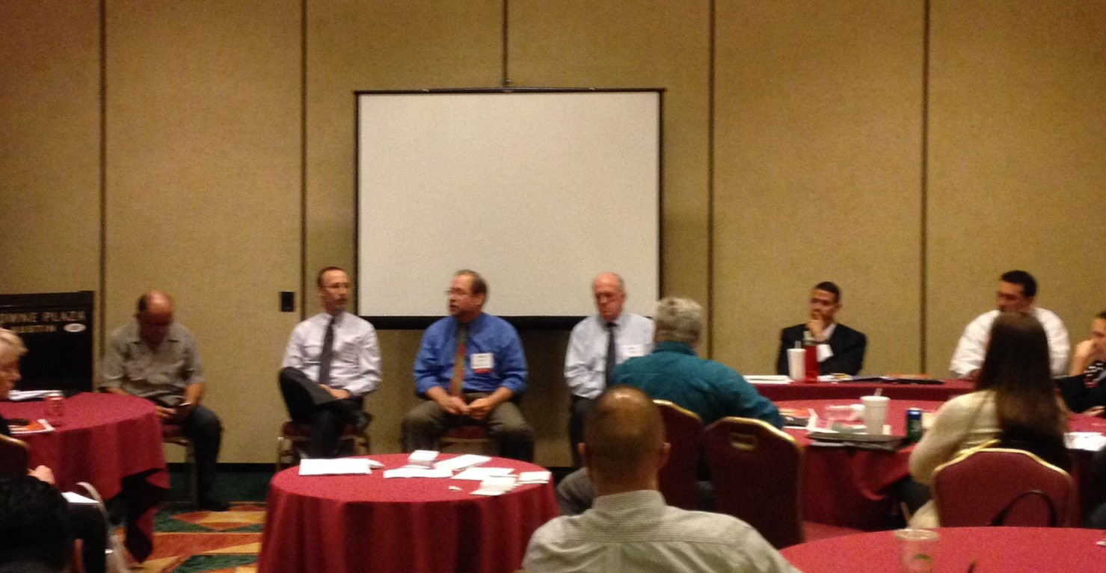

Slide 61
Teams –
Policies
“How many times do I have to say this? Put some women on the damn panel!”
It’s not just about being reformed. We must also alter or dismantle the institutional mechanisms that have historically given us bad results, they will continue to do so, as if on auto-pilot.

Slide 62
Culture –
Policies
What is the #1 goal of most behavior policies?

Slide 63
Culture –
Policies
Most policies focus only on individual behavior
Most policies discourage complaints

Slide 64
Culture –
Policies
Studies show that organizational traits lead to workplace harassment more than individual traits (In other words, harassment issues are not isolated incidents, they are systemic).
In other words, Johnny doesn’t harass his co-workers because he is a bad person. He harasses them because he believes the organization gives him license to do so.

Slide 65
Culture –
Policies
70% of employees who believe they were harassed never complain
#1 reason: fear of retaliation

Slide 66
Culture –
Policies
Should be about promoting good behavior
Recognize that all behavior problems are to some extent cultural
Encourage proactive work (team building, recognizing issues, setting the bar)
Reinforce psychological safety (encourage employees to come forward)

Slide 67
Culture –
Goals
”We couldn’t figure out what was important to measure, so we made what we could measure important.”
Goals should support mission
Goals should be continually evaluated to make sure they align with mission
Performance standards and accountability (teaches employees what we value)

Slide 68
Culture is simply who we are. If our culture is effective, efficient and productive, people will gravitate toward it and consent to be influenced by it.

Slide 69
C A R E …just care

Slide 70
210-827-0991 (cell)
rk@rodneykleineeotraining.com
Connect with me on: Linkedin
https://rodneykleineeotraining.com
Attempts: Brief Observations on Civil Rights, EEO, and the Difficulties of Difference
Buy on Amazon

