Slide 1
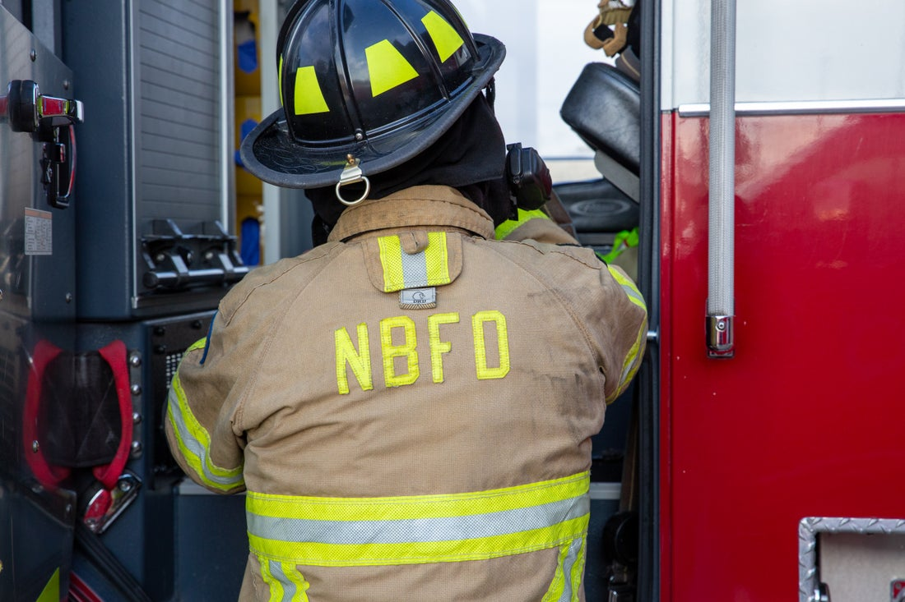
New Braunfels Fire Department
New Braunfels Chamber Board
Presentation
2024

Slide 2
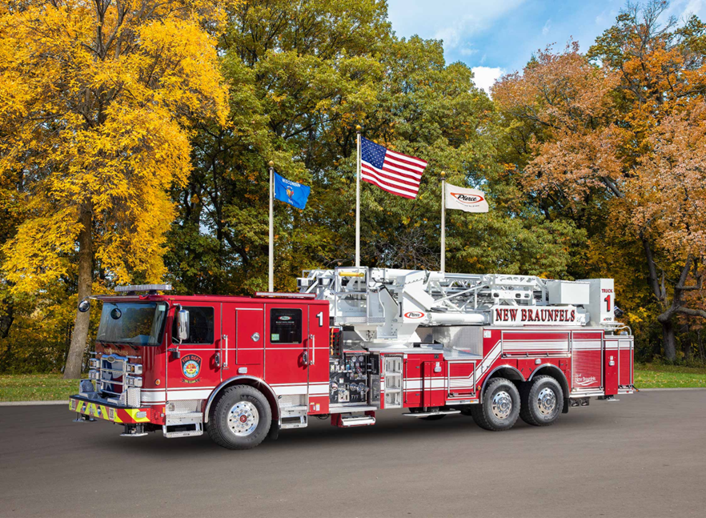
New Braunfels Fire Department
2024

Slide 3
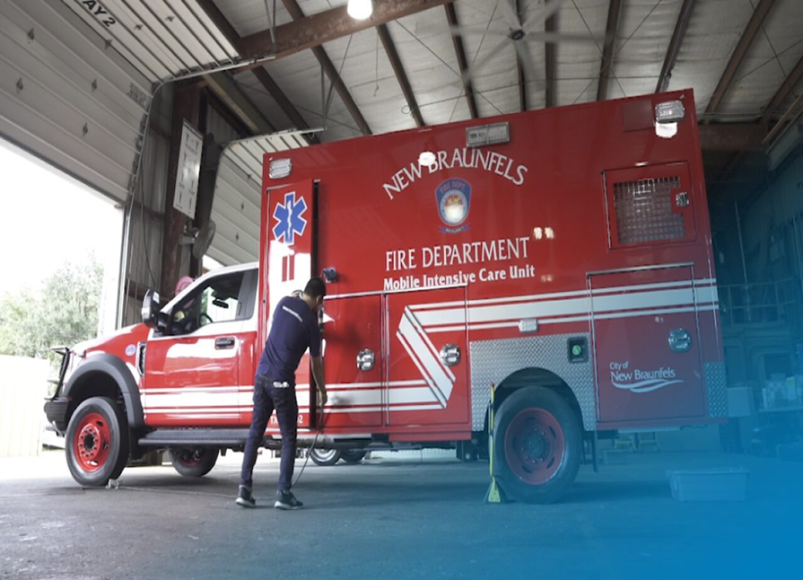
New Braunfels Fire Department
2024

Slide 4
NBFD responded to 13,053 calls for service in 2023
Fire | 251 | 1.9%
False alarms | 895 | 6.9%
EMS | 10,449 | 80.1%
HazMat | 242 | 1.9%
Tech Rescue | 32 | 0.2%
Misc. | 1,184 | 9.1%
Total | 13,053 | 100%
Emergency Medical Service calls the highest call volume
Second highest identifiable calls were False Alarms

Slide 5
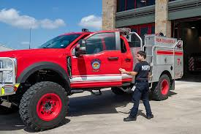
New Braunfels Fire Department Squad program
Approximately a 70% reduction in Heavy Apparatus mile accumulation

Slide 6
New Braunfels Fire Department Squad Program
During the 1-year pilot program, one squad vehicle responded to calls totaling 4,264 miles. Previously, these calls would have required three firefighters in a fire truck.
The cost per mile for a fire truck is approximately $2.92, whereas the cost per mile for a squad vehicle is only $0.32.
4,264*($2.92/0.32)=$ 11,086.4 per squad per year
Extends the Life of heavy apparatus and reduces the maintenance cost

Slide 7
Multi-Use Vehicles in the Fire Service: Wildland Interface
Hybrid Vehicle can also be used for Wildland Interface Fires

Slide 8
Multi-Use Vehicles in the Fire Service : Flood Response
Hybrid Vehicle converts into Flood response and Evacuation Vehicle

Slide 9
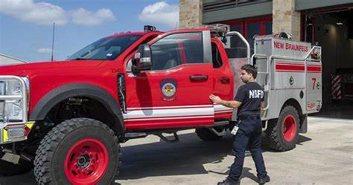
Multi-Use Vehicles in the Fire Service
Multi-use vehicles in the fire service offer several advantages that can significantly enhance emergency response capabilities. Here are some key benefits:
Cost-Effective: Multi-use vehicles reduce the need for multiple specialized vehicles
Versatility: These vehicles can handle a wide range of emergency situations
Rapid Response: Lighter and more agile than traditional fire trucks, multi-use vehicles can navigate through traffic and tight spaces more easily, allowing for quicker response times.
Resource Optimization: By combining multiple functions into a single vehicle, departments can make better use of their personnel and equipment, improving overall efficiency.

Slide 10
Questions

