Slide 1
Financial Wellness into Retirement
January 2025

Slide 2

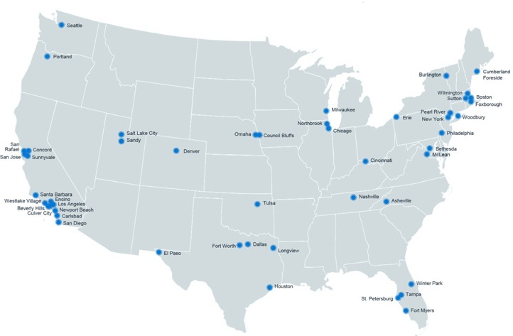

HUB Retirement & Private Wealth
We help you get ready for tomorrow
Who We Serve
HUB
By the
Numbers
When you work with us, you’re at the center of a vast network of retirement, wealth management, and financial wellness specialists ready to bring clarity to a changing world with tailored solutions and unrelenting advocacy.
Organizations
For-Profit companies, Not-for-profit organizations and governmental entities
National Reach | Local Leadership
Individuals and Families
Mass affluent and high net worth individuals and families
450+
Locations in North America
Employees
Workforce and executives
17,000+
Employees
Austin
Main TCG Office
Advisory
$172B+
Retirement plan assets under advisement*
Retirement Plans
9,000+
Retirement plans under advisement
*HUB owned RIAs provide investment advisory and management services to clients. All HUB RIAs reflect an aggregated amount of $105,369,032,198 in regulatory assets under advisement. This includes $74,817,452,822 in nondiscretionary institutional assets under advisement, primarily comprised of ERISA qualified retirement plans where we act as a 3(21) fiduciary, and $24,392,640,791 in discretionary institutional assets under management, comprised of qualified retirement assets where our RIA acts as an ERISA 3(38) investment manager, and other institutional client assets and nonqualified plans, as well as $2,936,425,431 in total Wealth Client assets under advisement. HUB Retirement and Private Wealth employees are Registered Representatives of and offer Securities and Advisory services through various Broker Dealers and Registered Investment Advisers, which may or may not be affiliated with HUB International.Insurance services are offered through HUB International, an affiliate.

Slide 3
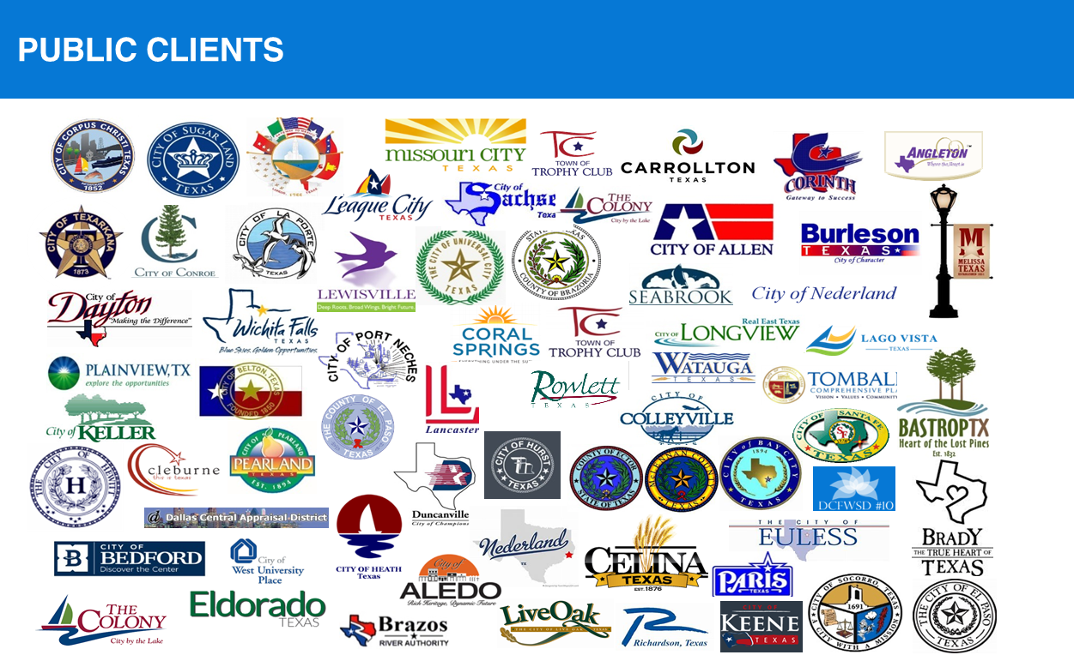







Public Sector Experience
TCG, a HUB International company is proud to work with some of the most notable public organizations across Texas.
TCG, a HUB International company is not legally affiliated with any of the companies above.

Slide 4
Agenda
Introduction
Understand your Retirement Benefits
Financial Wellness Facts
Solutions
Next Steps
Questions

Slide 5
TMRS
5, 6, or 7% Employee Contributions
1, 1.5 or 2 to 1 match from City or Town
Retire 20, 25 years service or age 60/5 years
Lifetime Annuity Benefits/Lump Sum
Understand Salary Replacement & Taxes
Questions

Slide 6
457b Benefits
Amount of Contributions
Supplement your TMRS
Understand your Portfolio
Self Directed Investments
Questions

Slide 7
Social Security
Age 62 Early Benefits
Full Benefits based on your DOB – 65 to 68+
Secure Act 2.0 RMD to age 73
Medicare age 65 – Medicare Supplement, Advantage Plan
NO Social Security participation – Windfall and GPO-changes passed!
Questions

Slide 8


Slide 9
In the United States, 7 in 10 Americans admit to high levels of financial stress.
Financial stress has become the norm in the US, with almost 70% of Americans reporting that they feel stressed about money. Stagnant wage growth, mounting debt, and financial struggles of friends and family members only make it more difficult to break a cycle of poor financial health.
You don’t have to go far to see and feel the effects of poor financial health. You can find a victim of financial stress in corner. Your boss, your coworker, your family, your friends.
¹Stress in America: Paying with our health. (n.d.). Retrieved from http://www.apa.org/news/press/releases/stress/2014/highlights.aspx

Slide 10
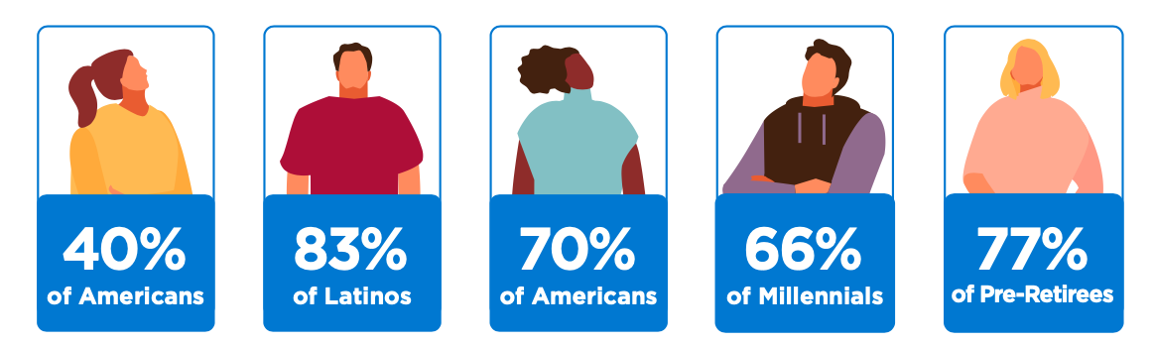
Did you know…
40%
of Americans
83%
of Latinos
70%
of Americans
66%
of Millennials
77%
of Pre-Retirees
are providing financial assistance for a family member¹
working in the US have $0 in savings for retirement²
have less than $1,000
of savings for a rainy day³
working in the US have $0 in savings for retirement⁴
express high concern about their savings keeping up with inflation⁵
1, 2, 3, 4, 5 - Citations on page 41

Slide 11
Financial Wellness
Student loans, credit cards, and other outstanding debt cause heavy financial stress on individuals
Life expectancy has increased over recent decades and people are spending more years in retirement without working
Workers are not saving enough for emergency funds or to live a comfortable life beyond their working years
Medical costs keep rising and health savings accounts are not being funded accordingly

Slide 12
Financial Wellness
Inadequate solutions like payday loans, bad car loan deals, and high-interest mortgages place a heavy financial burden on people
Boomers, Gen X and Millennials are all helping either their parents as they retire —or kids as they come back home—making it difficult to break a cycle of poor financial health
People are often forced to turn to commission-based sales agents for financial advice because they do not have other resources

Slide 13



Areas of Focus
Emergency Savings
From day one, we work hard to help individuals prepare for the next financial shock with a solid emergency savings strategy.
Credit Score Improvement
Credit worthiness is crucial to financial success. We work to identify areas of opportunity to improve credit scores.
Budgeting & Spending
Financial success doesn’t require a lot of money—it just requires a little extra planning. We help give each dollar a purpose.
Low-Interest Loans
If faced with an emergency expense, payday loans and pulling from retirement savings is often the answer. We provide a better alternative.
Debt Management
Piling debt can make it hard to move forward. We help explore potential debt forgiveness options and create a plan to pay down debt.
Security & Protection
No plan is complete without protection. We help identify areas of need and encourage individuals to seek coverage.

Slide 14
Financial Wellness

Slide 15
Having your Money Work Smarter
Automate your Finances
Create Specific Financial Goals
Plan for Each Dollar
Get Rid of High-Cost Debt (Credit Cards)
Invest in Retirement (TMRS, 457, Social Security, other investments)

Slide 16
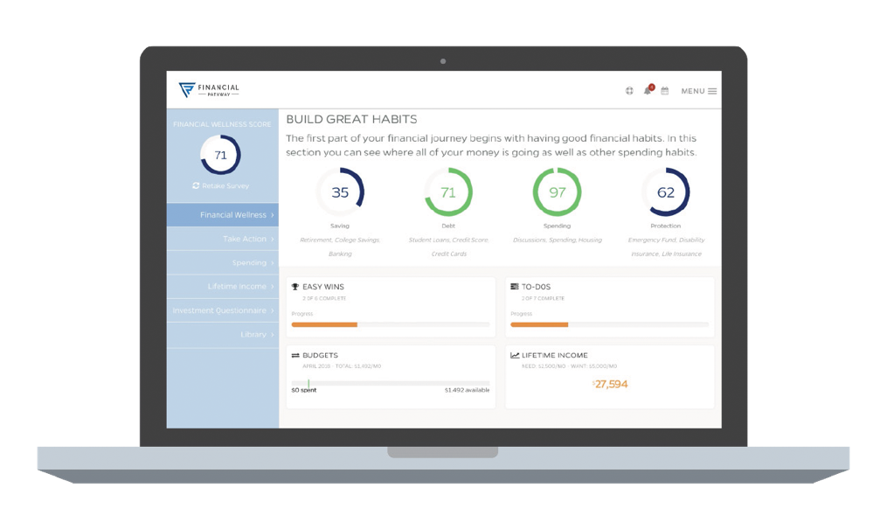



Fin Path Financial Wellness Solution
Fin Path is a financial wellness program designed to help individuals take control of their money with the help of trusted financial coaches and powerful online tools.
Fin Path University
Wellness Coaches
Score Tracker
30+ interactive courses focused on foundational topics
Live workshops, small group trainings, and virtual webinars
Breaks down complex financial topics using everyday situations
Financial wellness coaches available to answer any questions with fiduciary advisors assigned to each program
Connect via phone, chat, or live video
On-site or online
Personalized assessment analyzes determines individual Wellness Score
Tool provides tips to improve Wellness Score by completing tasks
Budgeting tools help set goals and keep track of progress

Slide 17
Questions?

Slide 18




David Rodriguez
Director of Government Services
512-695-2132
david.rodriguez@hubinternational.com
900 S Capital of Texas Hwy, Suite 350
Austin, TX 78746
Learn more at www.tcgservices.com

Slide 19
Important Disclosures
TCG Advisory Services LLC (“TCG Advisors”) is a registered investment advisor regulated by the U.S. Securities and Exchange Commission (SEC) subject to the Rules and Regulations of the Investment Advisor Act of 1940. Registration with the U.S. Securities and Exchange Commission does not imply a certain level of skill or training.
TCG Advisors, LP is a part of TCG Group Holdings, LLP. TCG Group Holdings, LLP, and is a part of Hub International. TCG Group Holdings, LLP, owns and operates several other entities which provide various services to employers across the U.S. Those affiliates (wholly‐owned subsidiaries of TCG Group Holdings, LLP) sometimes provide services to TCG Advisors’ Clients. These affiliates are Total Compensation Group Consulting, LP and TCG Administrators, LP (f/k/a JEM Resource Partners, LP). The business activities of these companies are discussed in its ADV Part 2A. TCG Advisors is located in Austin, Texas, and a copy of its Form ADV Part 2 is available upon request.
This presentation is not authorized for use as an offer of sale or a solicitation of an offer to purchase investments in any of the plans discussed or an affiliated entity. An investment in the plans carries the potential for loss.
This presentation is for informational purposes only and does not constitute an offer to sell, a solicitation to buy, or a recommendation for any security, or as an offer to provide advisory or other services in any jurisdiction in which such offer, solicitation, purchase or sale would be unlawful under the securities laws of such jurisdiction.
Past performance may not be indicative of any future results. No current or prospective client should assume that the future performance of any investment or investment strategy referenced directly or indirectly in this report will perform in the same manner in the future. Different types of investments and investment strategies involve varying degrees of risk—all investing involves risk—and may experience positive or negative growth. Nothing in this presentation should be construed as guaranteeing any investment performance.

Slide 20
Important Disclosures (continued)
An investment in the plans discussed will involve a significant degree of risk, and there can be no assurance that the investment objectives will be achieved or that an investment therein will be profitable. The hypothetical performance presented herein reflects the reinvestment of dividends and other earnings, the deduction of all management fees, performance-based allocations, brokerage fees and other expenses applicable to the Fund. Investors will experience individual returns that vary materially from those illustrated in this presentation depending on various factors, including but not limited to, the timing of their investment, the level of fees, and the effects of additions and withdrawals from their capital accounts. Certain of the performance information presented herein are unaudited estimates based upon the information available to the Firm as of the date here of and are subject to subsequent revision as a result of the Fund’s audit. Past performance is not necessarily indicative of the future performance or the profitability of an investment in a plan. An investment in a plan will be subject to a wide variety of risks and considerations as detailed in the offering documents. The information set forth herein will be qualified in its entirety by the information set forth in the offering documents.
This presentation includes forward-looking statements. All statements that are not historical facts are forward-looking statements, including any statements that relate to future market conditions, results, operations, strategies or other future conditions or developments and any statements regarding objectives, opportunities, positioning or prospects. Forward-looking statements are necessarily based upon speculation, expectations, estimates and assumptions that are inherently unreliable and subject to significant business, economic and competitive uncertainties and contingencies. Forward-looking statements are not a promise or guaranty about future events.

