Slide 1
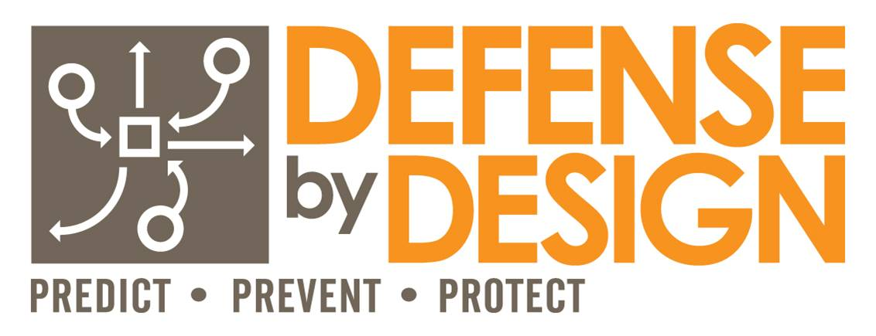
Presented By Jeff McKissack
Broadening Security Concerns In
City Management
Copyright © 2025

Slide 2
Physical Risks

Slide 3
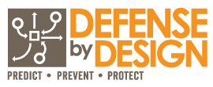
Two Key Questions To Begin:
What do we have that others might want?
Money
Property/Equipment
Data / IP / Personal Info
Access
Etc.
Who do we have that others might seek to harm?
Employees
Owners/Management
Customers/Clients/Patients
Etc.

Slide 4
Three Basic Paradigms
Internal Employee Concerns
External Employee Concerns
Hybrid of the Above Concerns

Slide 5
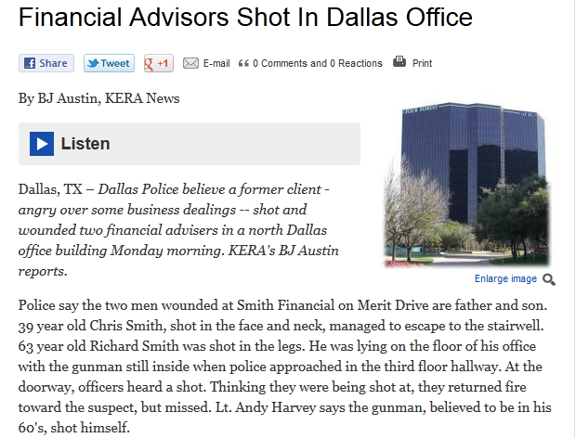
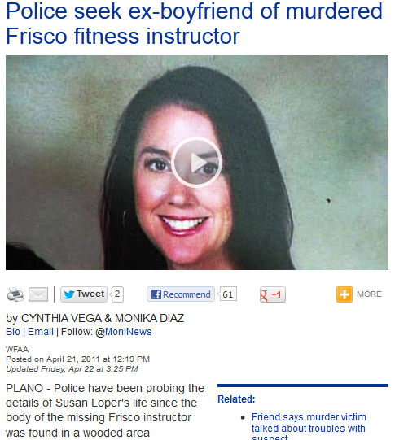
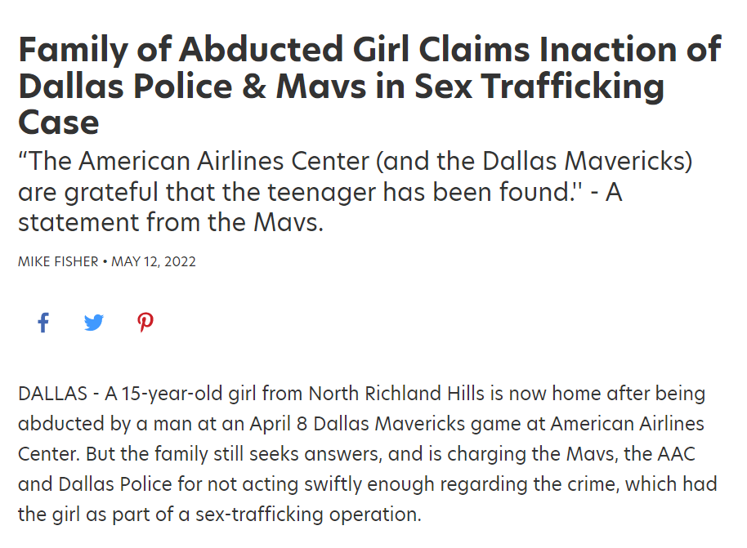
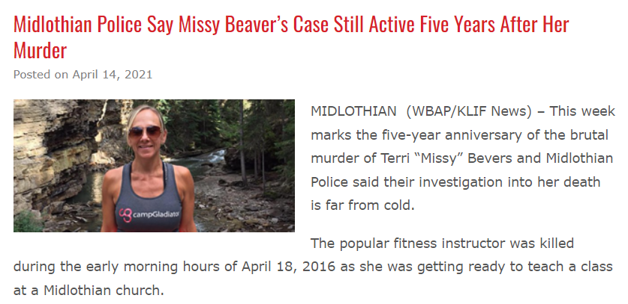
Examples

Slide 6
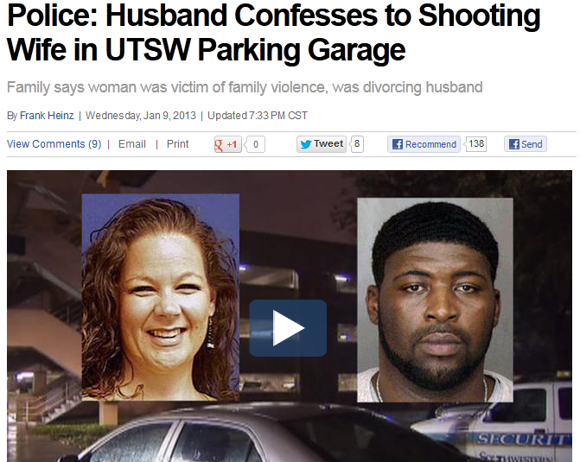
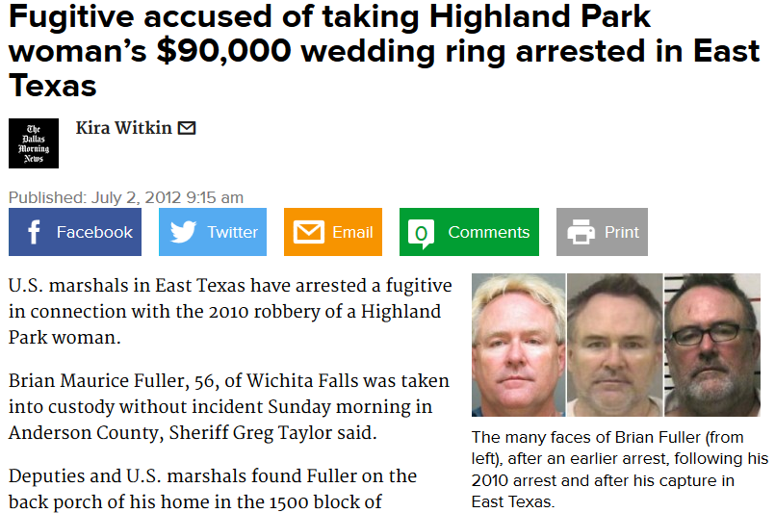
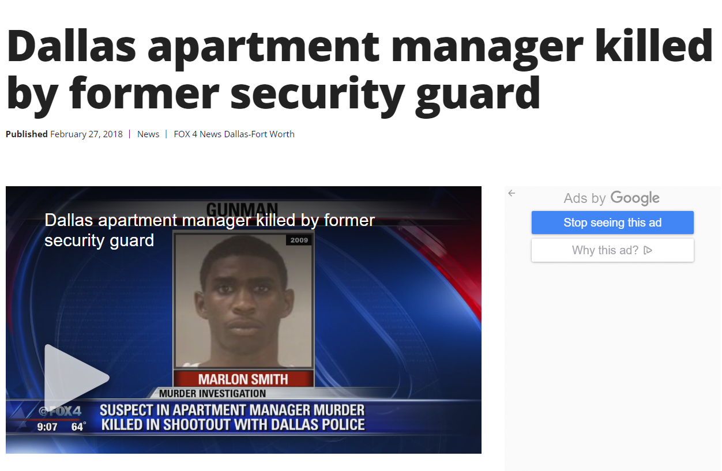
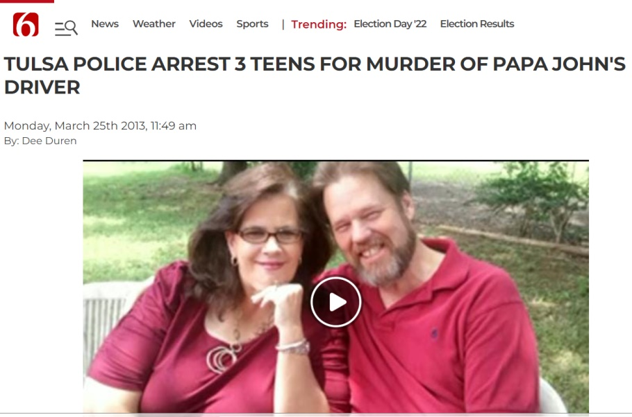

Slide 7
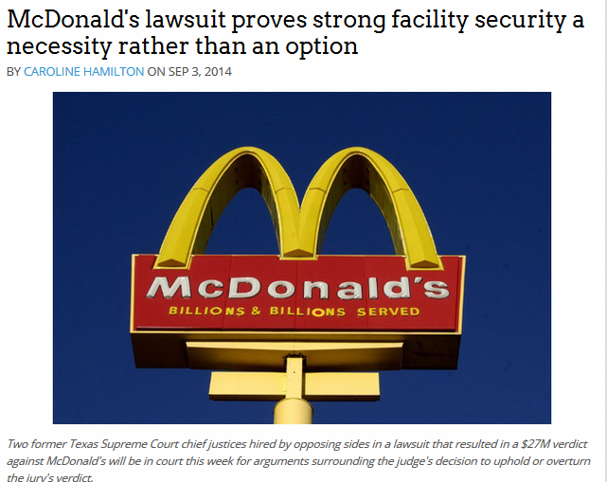

Slide 8
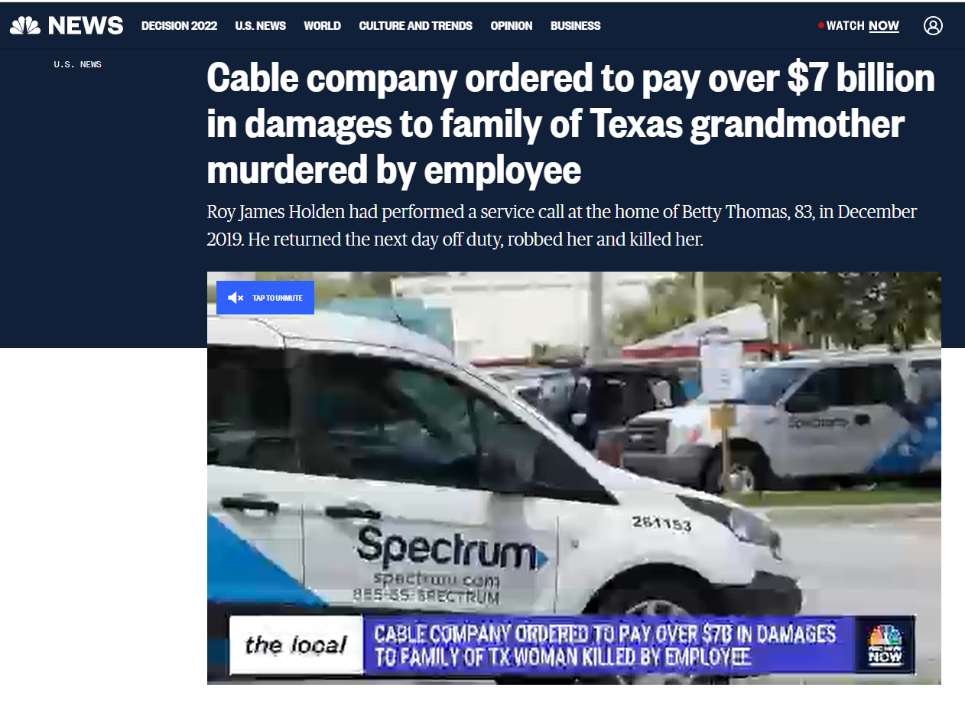

Slide 10
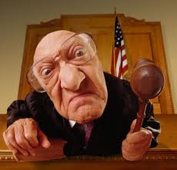
Making The Case For Negligence
Prove that victims were created as a result of the crime
Prove corporate responsibility
Prove corporate negligence
Prove “Deep Pockets”

Slide 11
Strategies For Mitigation
Common measures of security
Less-common measures of security -- training
Documentation of all the above
Training to account for turnover
“Above-and-Beyond”

Slide 12
Data Risks

Slide 13
Cyber Security vs. Data Security
Data Security may or may not involve instances where data is compromised via technological means. In fact, it may often take on the role of “social engineering” to facilitate internal access to company information.
Cyber Security typically entails instances where data is compromised via technological means of viruses, hackers, phishing scams or similar means of external access to company information.

Slide 14
Impersonation

Slide 15
Bribery & Blackmail
Fiscal vulnerabilities
Family vulnerabilities
Emotional vulnerabilities
Sexual vulnerabilities
Vice vulnerabilities
Ego vulnerabilities

Slide 16
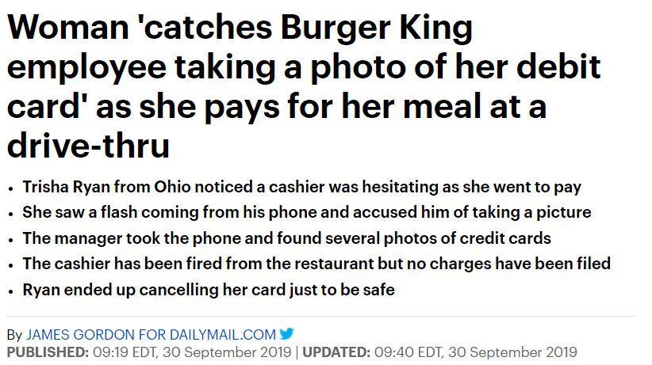
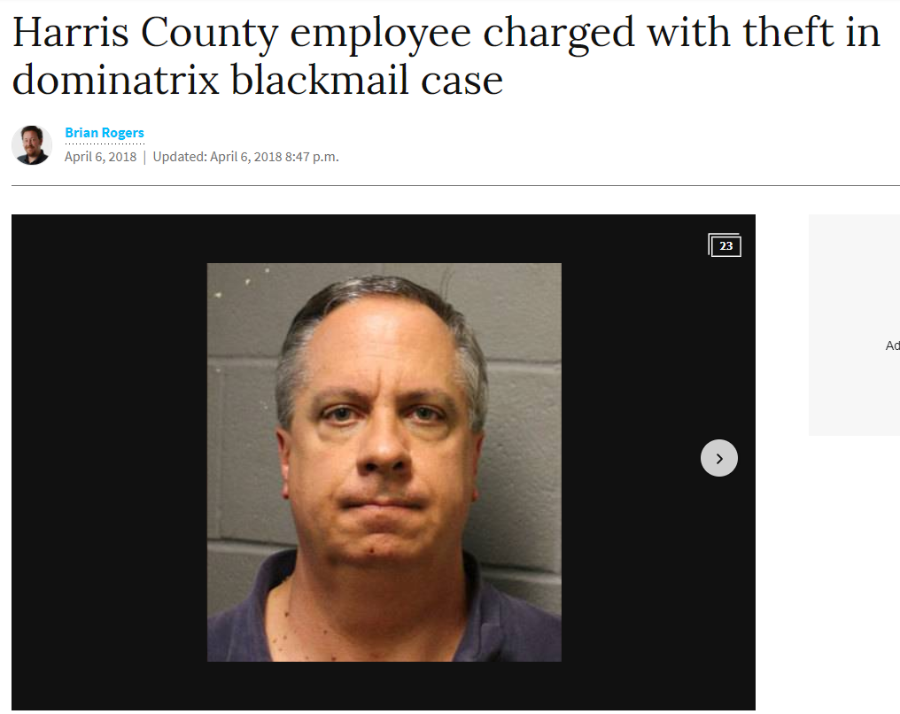
Examples

Slide 17
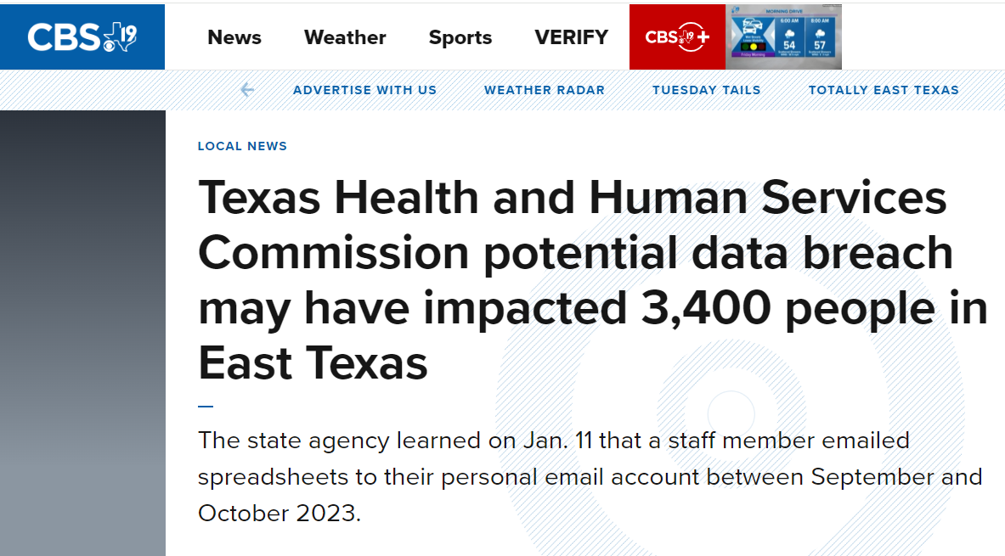

Slide 18
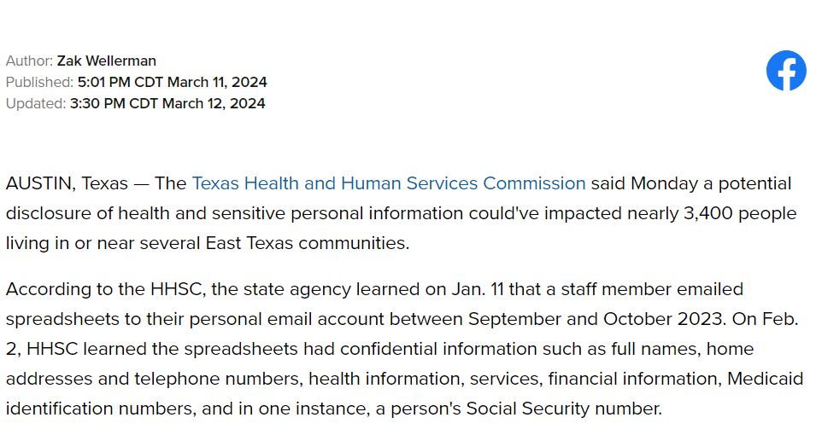

Slide 19
Strategies For Mitigation
Common measures of cyber/software security
Less-common measures of security – training
Documentation of all the above
Training to account for turnover
“Above-and-Beyond”

Slide 20
Reputational Risks

Slide 21
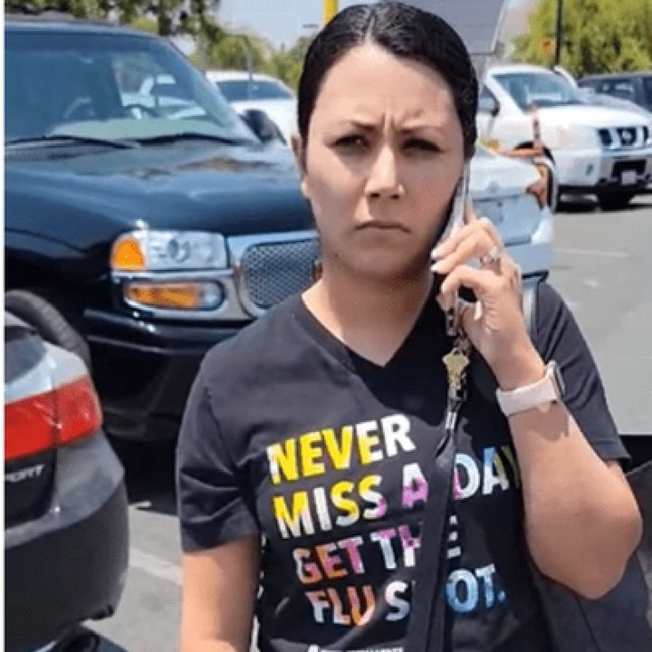
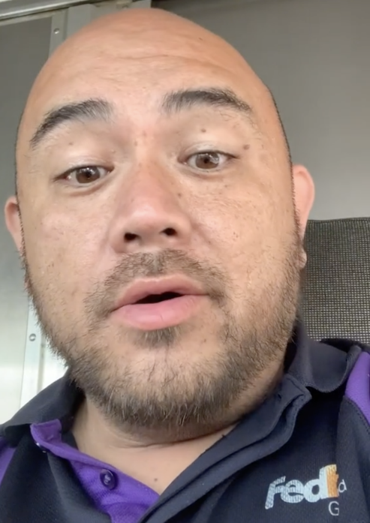
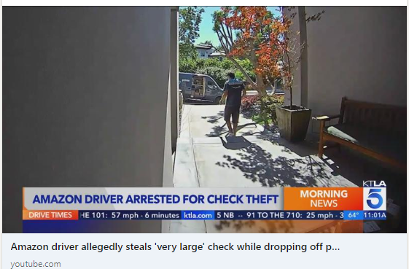
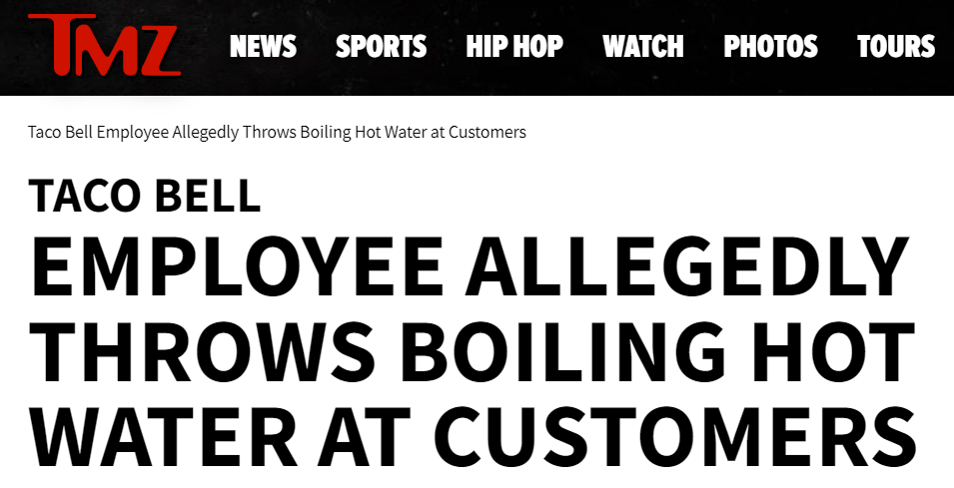
The Court of Public Opinion
Actions on the part of on-the-clock employees
Actions on the part of off-the-clock employees
Actions of either on the part of ownership or management

Slide 22
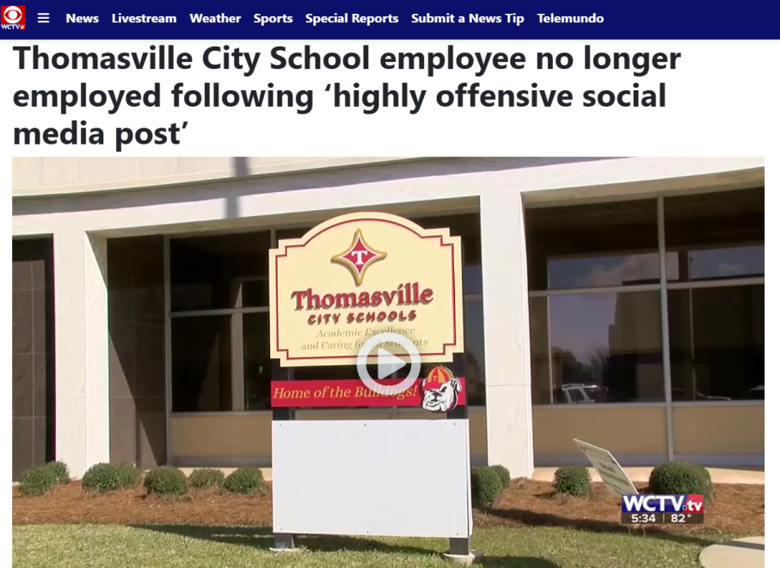
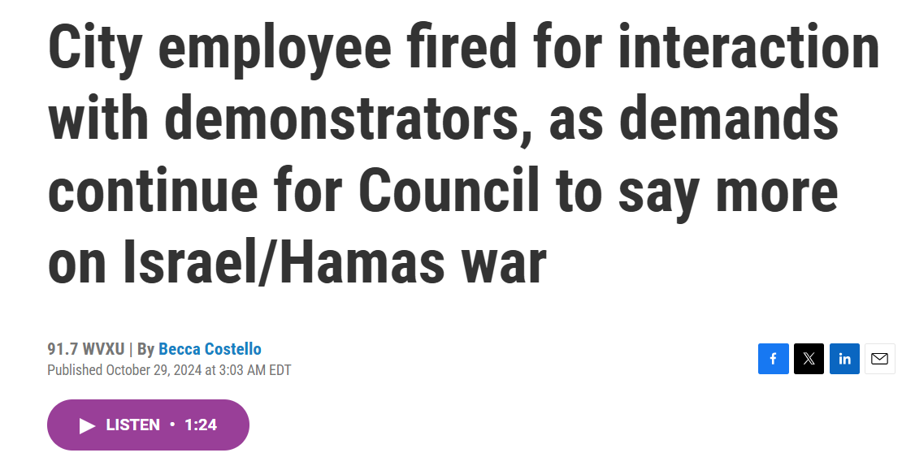
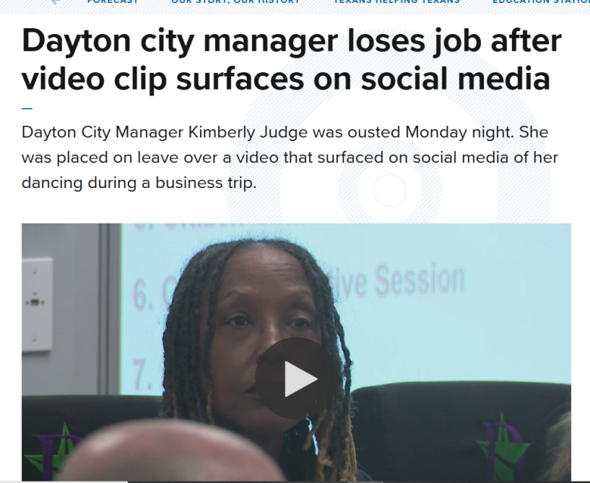
Other Examples

Slide 23
“But ‘OUR’ people know better….”
Standard Corporate Response…

Slide 27
Strategies For Mitigation
Education & Training
Employee Handbook add-ons
Company “Code of Conduct” language
Training to account for turnover
“Above-and-Beyond”

Slide 29
DefenseByDesignAcademy.com
Training for both Internal
& External Employees

Slide 30
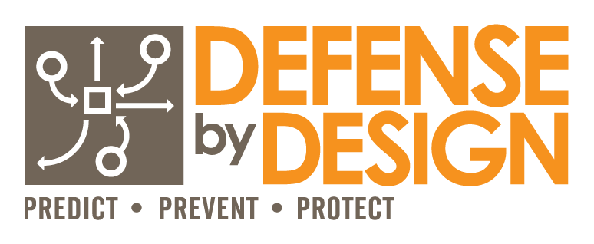
Jeff McKissack

