Slide 1
Welcome!
HERE WE GO!

Slide 2
Disclaimer
This presentation is intended as general information only and
does not carry the force of legal opinion.
This information and related materials are presented to give access to information on the Family and Medical Leave Act. Much of the information contained herein is adapted from the Department of Labor’s “The Employer’s Guide to The Family and Medical Leave Act,” to meet the needs of Human Resources Professionals in Municipal Government. Therefore, we make no express or implied guarantees.
The Federal Register and the Code of Federal Regulations remain the official source for regulatory information published by the Department of Labor. We will make every effort to keep this information current and to correct errors brought to our attention.

Slide 3
Module Five The End of the FMLA Road

Slide 4
Objectives
In this module we are:
Reviewing the certification process for Military Caregiver Leave,
Examining how the FMLA affects health care insurance coverage for those on paid and unpaid FMLA leave,
Understanding the right of “Job Restoration” for employees who have been on FMLA leave,
Reviewing an employer’s recordkeeping requirements for those on the Family and Medical Leave Act, and,
Discussing some important FMLA concepts such as the “12-Month Period,” “Spouses Working for the Same Employer,” “Calculating FMLA Leave Use,” and “Causes of Action” for violating the FMLA.

Slide 5
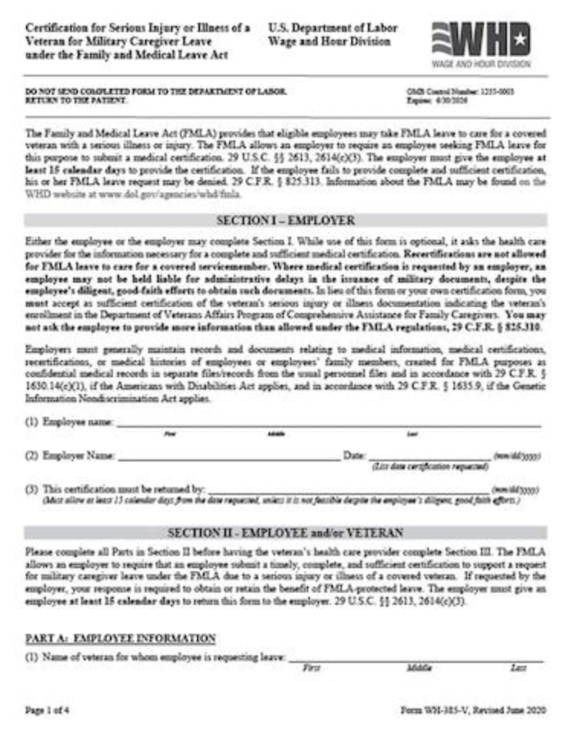
Certification for Military Caregiver Leave
An employer may require that a request for military caregiver leave be supported by a certification.
The employee may not be held liable for administrative delays in the issuance of military documents, where the employee has exercised diligent, good-faith efforts to obtain such documents.
An employer may choose to use the Wage and Hour Division Military Caregiver Leave certification forms that are available on the Department’s website or from the nearest Wage and Hour Division office.
An employer may create its own version of the certification form containing the same information; however, no additional information can be requested.
However, if the covered servicemember is seeking care from a private (non-DOD) health care provider, the employer may request a second or third opinion.

Slide 6
Health Insurance Benefits
What is a “Group Health Plan”?
Group health plan means any plan (including a self-insured plan) of, or contributed to by, an employer to provide health care (directly or otherwise) to employees, former employees, or the families of employees or former employees.

Slide 7
Health Insurance Benefits - Employer Responsibilities
An employee is entitled to the continuation of group health insurance coverage during FMLA leave on the same terms as if he or she had continued to work.
This rule also applies to benefits provided in a supplement to a group health plan, whether or not, provided through a flexible spending account or other component of a cafeteria plan.
=
NEW PLAN
OR
A CHANGE
The employee is entitled to the new or changed plan/benefits to the same extent as if the employee were not on leave.
Notice of any opportunity to change plans or benefits must also be given to an employee on FMLA leave.
Benefit coverage during FMLA leave for medical care, surgical care, hospital care, dental care, eye care, mental health counseling, substance abuse treatment, and other coverage must be maintained during leave if provided in an employer's group health plan.

Slide 8
Health Insurance Benefits – Employee Responsibilities
During the FMLA leave period, an employee must continue to pay whatever share of group health plan premiums that the employee paid prior to FMLA leave.
If the employee is substituting accrued paid leave for the unpaid FMLA leave, the employee's share of premiums must be paid by the method normally used during any paid leave, presumably as a payroll deduction.
Maintenance of health insurance policies which are:
Not Part of the Employer’s Group Plan
=
Employee’s Sole Responsible
If premiums are raised or lowered, the employee would be required to pay the new premium rates.

Slide 9
Health Insurance Benefits – Employee Responsibilities
If FMLA leave is unpaid, the employer may require employees to pay their share of premium payments in any of the following ways:
The employer may require that payment be made to the employer or to the insurance carrier, but:
Payment would be due at the same time as it would be made if by payroll deduction,
Payment would be prepaid pursuant to a cafeteria plan at the employee's option, or
Existing rules for payment by employees on “leave without pay” may be followed, provided that such rules do not require prepayment of the premiums that will become due during a period of unpaid FMLA leave or payment of higher premiums than if the employee had not taken leave.
no additional charge may be added to the employee's premium payment for administrative expenses.

Slide 10
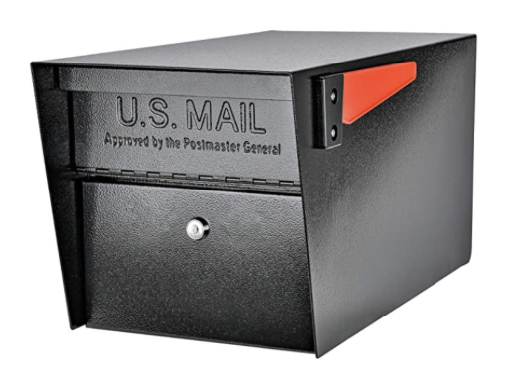
Health Insurance Benefits - Employee Failure to Pay Health Plan Premium Payment
In order to drop insurance coverage for an employee whose premium payment is late, an employer must provide written notice to the employee that the payment has not been received,
and that his or her insurance coverage will end at a specified date at least 15 days after the date of the written notice unless payment is received by that date.
If an employee’s premium payment is more than 30 days late, an employer may drop the employee’s health insurance coverage unless the employer has a policy of allowing a longer grace period.
This notice must be mailed to the employee at least 15 days before coverage is to cease.

Slide 11
Health Insurance Benefits - Employee Failure to Pay Health Plan Premium Payment
Equivalent benefits include the same level of group health insurance benefits as prior to the leave
Even when an employer ceases health insurance coverage due to an employee’s failure to pay his or her premium payments,
WITHOUT
all other obligations under the FMLA would continue, including the obligation to:
reinstate the employee upon return from leave to their original position or to an equivalent position,
with equivalent pay, benefits, terms, and conditions of employment.
any qualifying period, physical examination, and the exclusion of pre-existing conditions.

Slide 12
Health Insurance Benefits - Issues
TERMINATES
If the employer chooses to maintain health benefits during the leave by paying an employee’s share of premiums during the employee’s unpaid FMLA leave,
If an employer an employee’s health insurance in accordance with the FMLA, and
fails to restore the employee’s health insurance upon employee’s return – :
LIABLE
Benefits lost by reason of the violation,
Actual monetary losses sustained as a direct result of the violation, and
Appropriate equitable relief tailored to the harm suffered.
At the conclusion of leave, the employer is entitled to recover only costs incurred for paying the employee’s share of any premiums whether or not the employee returns to work.

Slide 13
Health Insurance Benefits
When an employee fails to return to work, any health and non-health benefit premiums that the FMLA permits the employer to recover are a debt owed by the non-returning employee.
Under some circumstances, the employer may elect to maintain other benefits (for example, life insurance, disability insurance, etc.) by paying the employee's share of premiums during periods of unpaid FMLA leave.
The existence of this debt does not alter an employer’s responsibilities for health benefit coverage, and under a self-insurance plan, payment of claims incurred during the period of FMLA leave.

Slide 14
Health Insurance Benefits - When an Employee Fails to Return to Work
EMPLOYER MAY RECOVER ITS SHARE OF PREMIUMS PAID - IF EMPLOYEE FAILS TO RETURN TO WORK AFTER THE FMLA LEAVE HAS BEEN EXHAUSTED OR EXPIRES
UNLESS:
The continuation, recurrence, or onset of a serious health condition of the employee or the employee's family member,
or a serious injury or illness of a covered servicemember that would otherwise entitle the employee to leave under FMLA, or
Other circumstances beyond the employee's control.
Review the Guidelines to be aware of what may be defined as circumstances beyond the employee’s control.

Slide 15
Health Insurance Benefits - When an Employee Fails to Return to Work
The employer may recover the costs through deduction from any sums due to the employee, provided such deductions do not otherwise violate applicable federal or state wage payment or other laws.
RETURNS AND RETIRES
RETURNS TO WORK
An employee who transfers directly from taking FMLA leave to retirement, or retires during the first 30 days after returning to work is considered to have returned to work.
Alternatively, legal action may be initiated against the employee to recover such costs.

Slide 16
Job Restoration
An “equivalent job” means a job that is virtually identical to the original job in terms of pay, benefits, and other employment terms and conditions (including shift and location).
NOT GAURANTEED
THE ACTUAL JOB THEY HAD
SAME JOB OR
EQUIVALENT JOB
An employer must grant pay increases conditioned upon seniority, length of service, or work performed if employees taking the same type of leave (i.e., paid or unpaid leave) for non-FMLA reasons receive the increases.
The same or equivalent pay premiums, such as a shift differential, and the same opportunity for overtime pay premium as the job held prior to FMLA leave.
An employee is entitled to any unconditional pay increases that occurred while he or she was on FMLA leave, such as cost of living
increases.
EQUIVALENT PAY

Slide 17
Job Restoration
Any benefits an employee accrues prior to a period of FMLA leave must be available to the employee when he or she returns from leave.
These benefits provided to employees must be resumed in the same manner and at the same level as when the leave began, subject to any changes in benefit levels affecting the entire workforce.
An employee returning from FMLA leave cannot be required to requalify for any benefits the employee enjoyed before the leave began.

Slide 18
Recordkeeping Requirements
An employer keeping records:
need not retain the records in any particular form,
may maintain the records electronically or in any other computer format, as long as all of the required information is included,
must keep records for no less than three years,
are not required to submit records to the Department of Labor unless specifically requested by a Department official.
Employers must make records available for inspection, copying, and transcription by representatives of the Department upon request.

Slide 19
Contents of FMLA Records
Covered employers who employ FMLA-eligible employees must maintain records that include the following -
Basic payroll and identifying employee data, including:
Name, address, and occupation,
Rate or basis of pay and terms of compensation,
Daily and weekly hours worked each pay period,
Additions to and deductions from wages, and
Total compensation paid.
Dates FMLA leave is taken (which must be designated in the records as FMLA leave), and
Hours of FMLA leave used if leave is taken in increments of less than a day,

Slide 20
Contents of FMLA Records
Copies of FMLA notices provided by an employee to the employer and by the employer to its employees concerning the FMLA (including any written request for leave from the employee as well as any required notice provided to the employee concerning FMLA leave),
Any documents, including electronic records, describing employee benefits or employer policies and practices regarding the taking of paid or unpaid leave,
Premium payments for employee benefits, and
Records of any dispute between the employer and an employee regarding the designation of leave as FMLA leave, such as emails or other written statements regarding a disagreement on the designation of the employee’s FMLA leave request.

Slide 21
Confidentiality of FMLA Records
Covered employers are required to maintain records and documents relating to FMLA medical certifications and recertifications of employees or their family members as confidential medical records. Such records are to be maintained in separate files from the usual personnel files.
An employer must maintain records in conformance with the confidentiality requirements of the Americans with Disabilities Act (ADA), as amended, if applicable,
And ,the Genetic Information Nondiscrimination Act, if applicable. Supervisors and managers may be informed of necessary restrictions on work duties and necessary accommodations.

Slide 22
Display the FMLA poster & provide General Notice
Determine if employee is eligible
3
4
Employee
2
Employee asks for FMLA or employer learns leave may be for FMLA qualifying reason
Provide Eligibility and Rights & Responsibilities to the employee
1
THE END OF THE FMLA ROADMAP
7
Let employee know that Certification will be required
5
Determine if leave is for an FMLA-qualifying reason
Certification Process (question - required or not)
8
6
Grant or deny leave request & provide Designation notice to employee
9
11
12
Restore the employee to same or similar job
Maintain Records
Maintain Health Benefits During Leave
10

Slide 23
The 12-Month Leave Year
The employer may select any one of the following four methods for determining the 12-month period during which eligible employees may take up to 12 workweeks of leave:
1. The calendar year (January 1st through December 31st),
2. Any fixed 12 months, such as a fiscal year or a leave year beginning on the first day of an employee’s employment,
3. A 12-month period measured forward from the first date an employee takes FMLA leave (the next 12-month period would begin the first time the employee takes FMLA leave after the completion of the prior 12-month period),

Slide 24
The 12-Month Leave Year
4. A rolling 12-month period measured backward from the date an employee uses FMLA leave (each time an employee takes FMLA leave, the remaining leave is the balance of the 12 workweeks not used during the immediately preceding 12 months).
Whichever method an employer chooses the employer must apply it uniformly and consistently to all employees.

Slide 25
Spouses Working for the Same Employer
Eligible spouses who work for the same employer are limited to a combined total of 12 workweeks of leave in a 12-month period to share for the following FMLA-qualifying reasons:
Eligible spouses who work for the same employer are also limited to a combined total of 26 workweeks in a single 12-month period to care for a covered servicemember with a serious injury or illness if each spouse is a parent, spouse, son or daughter, or next of kin of the servicemember (commonly referred to
as “military caregiver leave”).
The birth of a son or daughter and bonding with the newborn child,
This limitation also applies to a combination of military caregiver leave and leave for the other qualifying reasons listed above.
The placement of a son or daughter with the employee for adoption or foster care, and bonding with the newly-placed child, and
The care of a parent with a serious health condition.

Slide 26
Spouses Working for the Same Employer (Limitations)
This limitation does not apply to leave:
For one’s own serious health condition, such as with the recovery period following the birth of a child;
To care for a spouse, son, or daughter with a serious health condition; or
For any qualifying exigency arising out of the fact that the employee’s spouse, son, daughter, or parent is a military member on “covered active duty.”
These limitations do not apply to two employees working for the same employer who are not legally married, even if they are living together or have a child or children together.
Where a spouse uses a portion of his or her leave for an FMLA-qualifying reason that is subject to the combined 12-workweek limit, that employee has the remainder of his or her 12 workweeks of entitlement for leave for an FMLA-qualifying reason that is not subject to the combined limit.
If only one of the spouses is eligible for FMLA leave, that individual is entitled to the full 12 workweeks of leave.

Slide 27
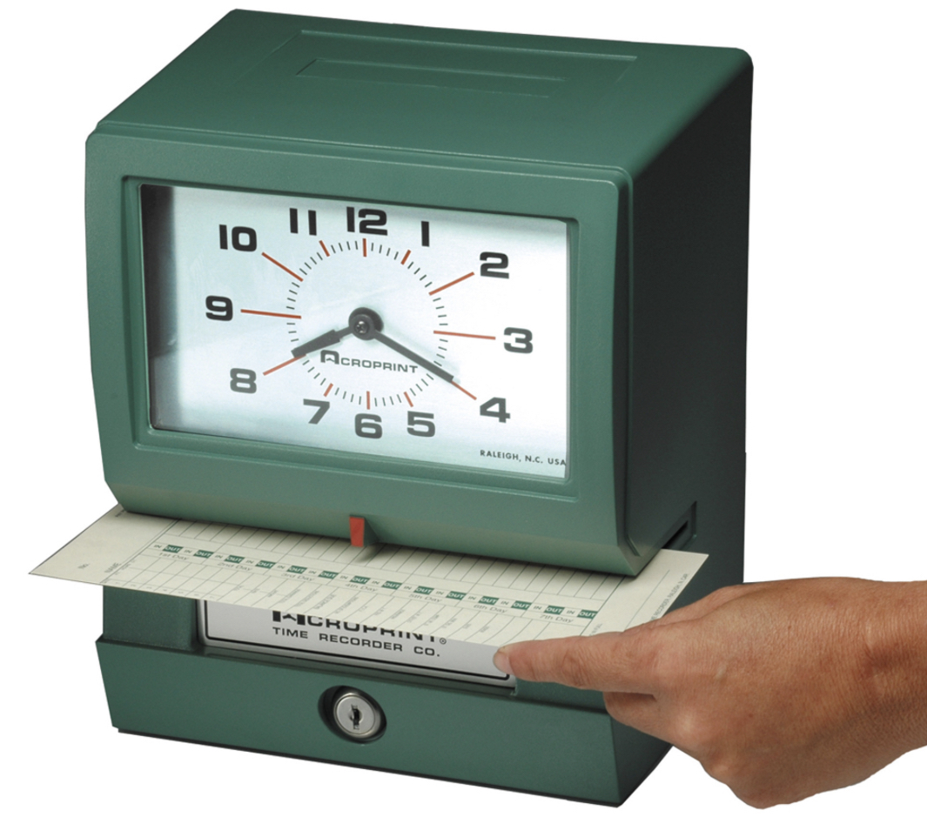
Calculating FMLA Leave
Time that an employee is not scheduled to report for work may not be counted as FMLA leave. Only the amount of leave actually taken may be counted against the employee’s leave entitlement.
However, when a holiday falls during a week when an employee is taking less than the full week of FMLA leave, the holiday is not counted as FMLA leave, unless the employee was scheduled and expected to work on the holiday and used FMLA leave for that day.
When a holiday falls during a week in which an employee is taking the full week of FMLA leave, the entire week is counted as FMLA leave.
An employee does not accrue FMLA leave at any particular hourly rate.

Slide 28
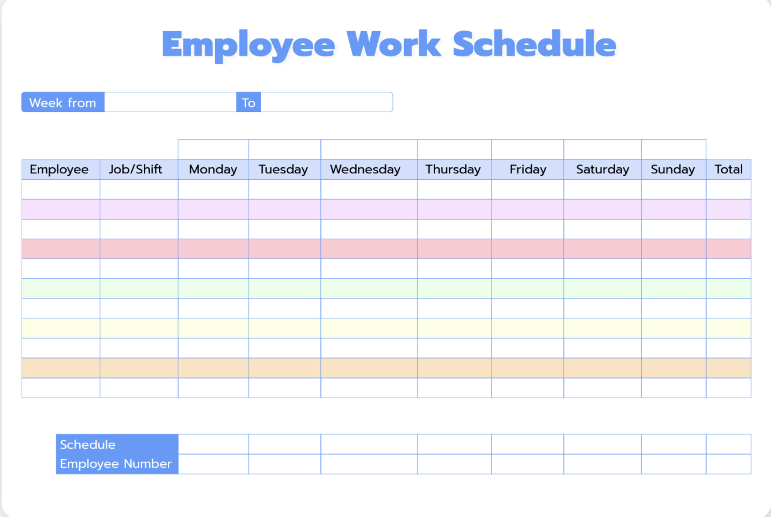
Calculating FMLA Leave
An employee may take FMLA leave in periods of weeks, days, hours, and in some cases even less than an hour.
For example, an eligible employee whose actual workweek is always 32 hours per week is entitled to 384 hours (12 workweeks x 32 hours per week) of FMLA leave in a 12-month period.
When an employee takes leave for less than one full workweek, the amount of FMLA leave used is determined as a proportion of the employee’s actual workweek. An employer may convert fractions of a workweek to their hourly equivalent as long as the conversion fairly reflects the employee’s total hours.
An eligible employee whose actual workweek is always 48 hours per week is entitled to 576 hours (12 workweeks x 48 hours per week) of FMLA leave in a 12-month period.

Slide 29
Calculating Leave
Employees may use FMLA leave in the smallest increment of time the employer allows for the use of other forms of leave, as long as the smallest increment is no more than one hour. If the employer uses different increments for different types of leave.
(for example, accounting for sick leave in 15-minute increments and vacation leave in one-day increments), the employer must allow FMLA leave to be used in the smallest increment used for any type of leave.
The weekly average is determined by the hours scheduled over the 12 months prior to the beginning of the leave and includes any hours for which the employee took any type of leave.
When an employee’s schedule varies from week to week so much that it is not possible to determine how many hours the employee would have worked during the week had he or she not taken FMLA leave, an employer may use a weekly average to calculate the employee’s FMLA leave entitlement.

Slide 30
FMLA Causes of Action
Employers are prohibited from discriminating or retaliating against an employee or prospective employee for having exercised or attempted to exercise any FMLA right.
Examples include:
Employers are prohibited from interfering with, restraining, or denying the exercise of, or the attempt to exercise, any FMLA right.
Any violations of the FMLA or the Department’s regulations constitute interfering with, restraining, or denying the exercise of rights provided by the FMLA. Examples include:
Using the taking of FMLA leave as a negative factor in employment actions, such as hiring, promotions, or disciplinary actions;
Counting FMLA leave under “no fault” attendance policies, or
Failing to provide benefits to an employee on unpaid FMLA leave if the employer provides those benefits to employees who use other types of unpaid leave.
Refusing to authorize FMLA leave, or
Discouraging an employee from using such leave.

Slide 31
FMLA Causes of Action
All persons, whether or not employers, are prohibited from discharging or in any other way discriminating against any person, whether or not an employee, because that person has:
Filed any charge, has instituted, or caused to be instituted, any proceeding under or related to the FMLA,
Given, or is about to give, any information in connection with an inquiry or proceeding relating to any right under the FMLA, or
Testified, or is about to testify, in any inquiry or proceeding relating to a right under the FMLA.

Slide 32
End of Module Five and The FMLA Overview Thank you! Mark Stephens www.mstephenstc.com 817-368-7494

