Slide 1
Welcome!
Let’s Get Going!

Slide 2
Disclaimer
This presentation is intended as general information only and
does not carry the force of legal opinion.
This information and related materials are presented to give access to information on the Family and Medical Leave Act. Much of the information contained herein is adapted from the Department of Labor’s “The Employer’s Guide to The Family and Medical Leave Act,” to meet the needs of Human Resources Professionals in Municipal Government. Therefore, we make no express or implied guarantees.
The Federal Register and the Code of Federal Regulations remain the official source for regulatory information published by the Department of Labor. We will make every effort to keep this information current and to correct errors brought to our attention.

Slide 3
Module Three Moving On Down the FMLA Road

Slide 4
Objectives
In this module we are:
Reviewing circumstances that qualify for FMLA leave.
Understanding what a family member is for FMLA leave purposes.
Examining what a serious health condition is under the Family and Medical Leave Act.
Discussing taking leave for bonding with your child in connection with the birth, the adoption or the fostering of that child.
Discovering the application of the FMLA to military service members regarding the need for leave for exigency or to care based upon and serious health condition and/or an injury.

Slide 5
The FMLA Qualifying Reasons
An employee who meets the FMLA eligibility requirements may take leave for certain FMLA-qualifying reasons.
Here are the circumstances that qualify for FMLA Leave:
The placement with the employee of a child for adoption or foster care and to bond with the newly-placed child within one year of placement,
A serious health condition that makes the employee unable to perform the functions of his or her job, including incapacity due to pregnancy and for prenatal medical care,
The birth of a child and to bond with the newborn child within one year of birth,
To care for the employee’s spouse, son, daughter, or parent who has a serious health condition, including incapacity due to pregnancy and for prenatal medical care.

Slide 6
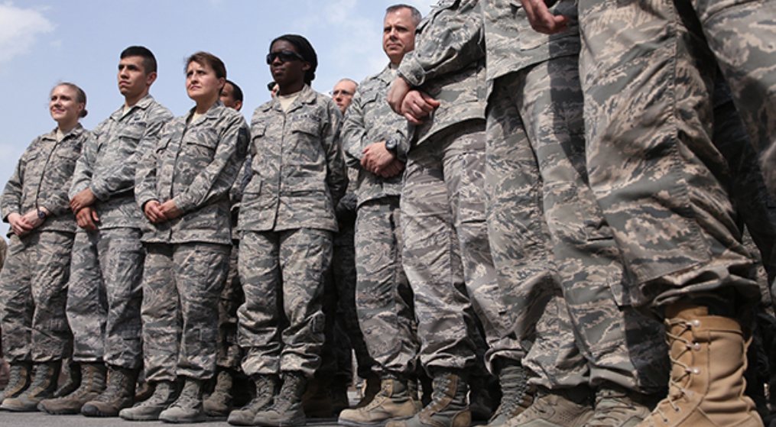
The FMLA Qualifying Reasons
Military Exigency Leave
Any qualifying exigency arising out of the fact that the employee’s spouse, son, daughter, or parent is a military member on covered active duty or called to covered active duty status.
Military Caregiver Leave
In addition, eligible employees may take up to 26 workweeks of leave in a single 12-month period to care for a covered servicemember. The servicemember must have a serious injury or illness. If the employee is the spouse, son, daughter, parent, or next of kin of the servicemember, leave may be taken. This is referred to as military caregiver leave.
An eligible employee is limited to a combined total of 26 workweeks of leave for any FMLA-qualifying reason during the single 12-month period.

Slide 7
The FMLA Qualifying Reasons -Who
Let’s take a closer look at all of these qualifying reasons down -
First – the eligible employee for their own serious health condition - then
Employees can take FMLA leave due to a serious health condition of the following immediate family members:
Spouse
Parent
Son or Daughter
Spouse
Spouse means a husband or wife as defined or recognized in the state where the individual was married, including in a common law marriage or same-sex marriage.
Spouse also includes a husband or wife in a marriage that is validly entered into outside of the United States, if the marriage could have been entered into in at least one state.

Slide 8
The FMLA Qualifying Reasons - Who
Parent
Parent means a biological, adoptive, step or foster father or mother, or any other individual who stood in loco parentis to the employee when the employee was a child. This term does not include “parents-in-law.”
Son or Daughter
Son or daughter means a biological, adopted, or foster child, a stepchild, a legal ward, or a child of a person standing in loco parentis, who is under 18 years of age or who is 18 years of age or older and incapable of self-care because of a mental or physical disability.
The onset of a disability may occur at any age for purposes of the definition of an adult “child” under the FMLA.

Slide 9
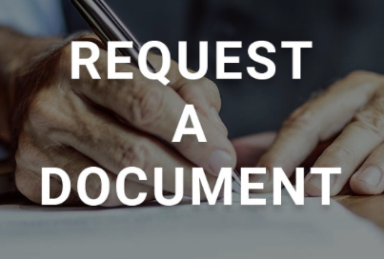
Let’s Talk – Bonding With A Child & Documentation
Let’s talk bonding with a new-born, adopted or foster child within the family.
Employers may not request a certification for leave to bond with a healthy newborn or a child placed for adoption or foster care. However, employers may request documentation to confirm the family relationship.
An employer may, but is not required, to request that an employee provide reasonable documentation of the qualifying family relationship.
Employers may not use a request for confirmation of a family relationship in a manner that interferes with an employee’s exercise or attempt to exercise his or her FMLA rights.
EMPLOYEE’S CHOICE
It is the employee’s choice whether to provide a simple statement or other documentation.

Slide 10
A Child Who Is 18 Years of Age and Older
In order for a parent to take FMLA leave for a child who is 18 or over, the son or daughter must:
Have a disability as defined by the Americans with Disabilities Act (ADA) at the time the leave is to commence,
Have a serious health condition, and
Need care because of the serious health condition.
Be incapable of self-care because of the disability,

Slide 11
The in loco parentis relationship exists when an individual intends to take on the role of a parent.
An individual stands in loco parentis to a child if he or she has day-to-day responsibilities to care for or financially support the child. The person standing in loco parentis is not required to have a biological or legal relationship with the child.
Although no legal or biological relationship is necessary, grandparents or other relatives, such as siblings, may stand in loco parentis to a child under the FMLA where all other requirements are met.
In Loco Parentis

Slide 12
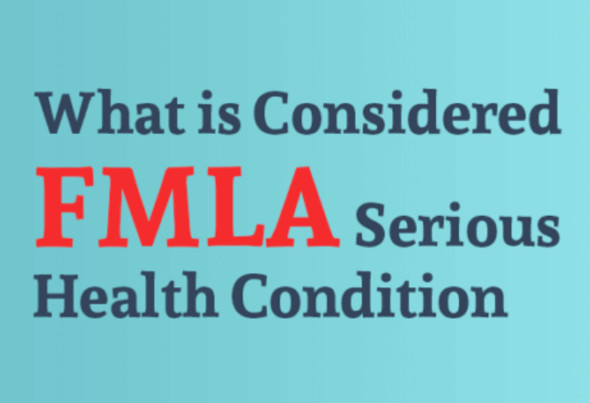
What Is A Serious Health Condition
An illness, injury, impairment, or physical or mental condition that involves inpatient care or continuing treatment by a health care provider.
The FMLA does not apply to routine medical examinations, such as a physical, or to common medical conditions, such as an upset stomach or a cold, unless complications develop.

Slide 13
What is A Serous Health Condition – Incapacity and Treatment
For all conditions “incapacity” means:
Inability to work, including being unable to perform any one of the essential functions of the employee’s position, or
The term “treatment” includes, but is not limited to, examinations to determine if a serious health condition exists and evaluations of the condition.
Inability to attend school, or
Perform other regular daily activities due to the serious health condition, treatment of the serious health condition, or recovery from the serious health condition.

Slide 14
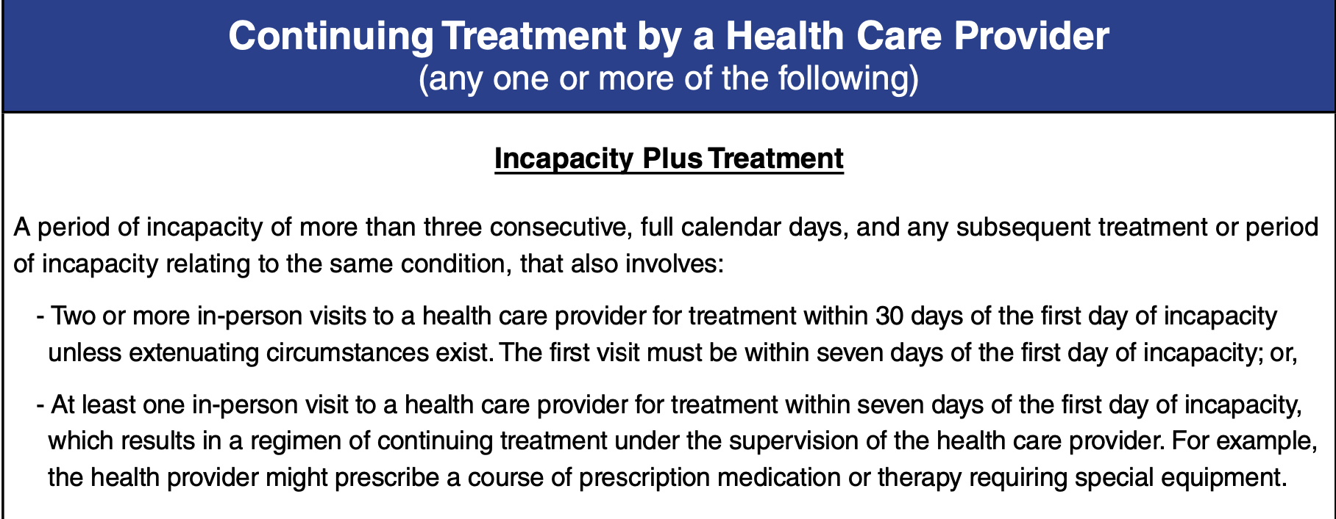
Serious Health Conditions – Let’s Break Them Down
Serious health conditions may include conditions that involve:

Slide 15
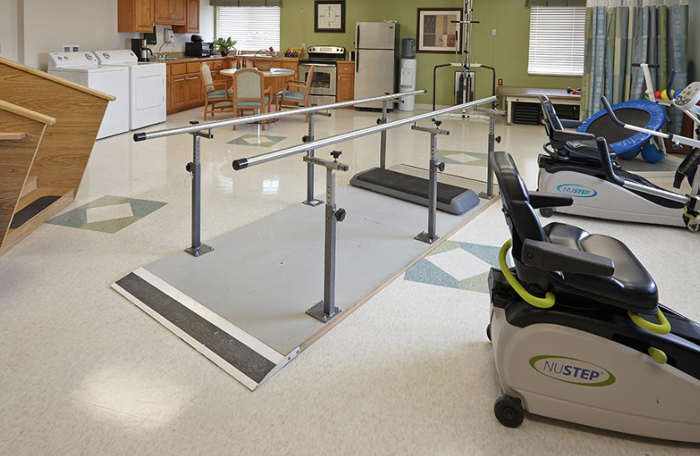
Serious Health Conditions – Let’s Break Them Down
or,

Slide 16
Serious Health Conditions – Let’s Break Them Down

Slide 17
Serious Health Conditions – Let’s Break Them Down
Continuing Serious Health Condition
If an eligible employee requests FMLA leave for surgery which requires and/or results in an overnight stay in the hospital, the leave request would meet the definition of a serious health condition under the inpatient care criteria, even if the surgery is considered elective.

Slide 18
The FMLA and Military Leave (Exigency and Military Caregiver Leave)
To take qualifying exigency leave, the military member must be the employee’s spouse, parent, or son or daughter.
Unlike non-military FMLA leave, for purposes of qualifying exigency leave, an employee’s son or daughter on covered active duty refers to a son or daughter of any age.

Slide 19
Qualifying Military Exigency Leave
An eligible employee with a family member on covered active duty may take FMLA leave for the following:
Here is a non-exhaustive list of qualifying exigencies -
Issues arising from the military member’s short notice of deployment (i.e., deployment within seven or fewer days of notice).
To make or update financial and legal arrangements to address a military member’s absence.
To attend counseling for the employee, the military member, or a child of the military member when the need for that counseling arises from the covered active duty or a call to covered active duty status of the military member, and the counseling is provided by someone other than a health care provider.

Slide 20
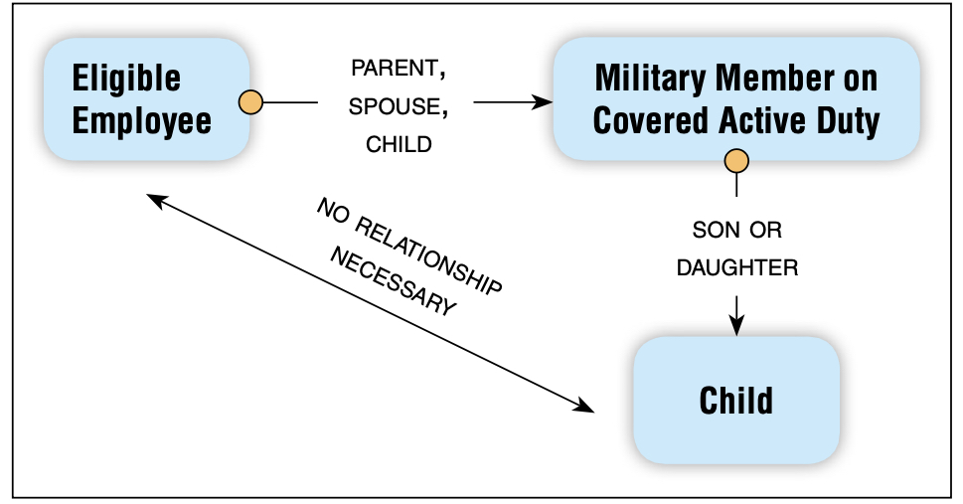
Qualifying Military Exigency Leave – Cont’d
To attend military events and related activities, including official military ceremonies and programs or informational briefings related to the military member’s covered active duty sponsored or promoted by the military or military service organizations.
The employee does not need to be related to the military member’s child to take qualifying exigency leave for this purpose.
To spend up to 15 calendar days with a military member who is on rest and recuperative leave.
But,
the military member must be the parent, spouse, or child of the employee taking leave; and
the child for whom the employee is arranging for or providing childcare must be the child of the military member.
Childcare and school-related activities for the military member’s child while the military member is on covered active duty.

Slide 21
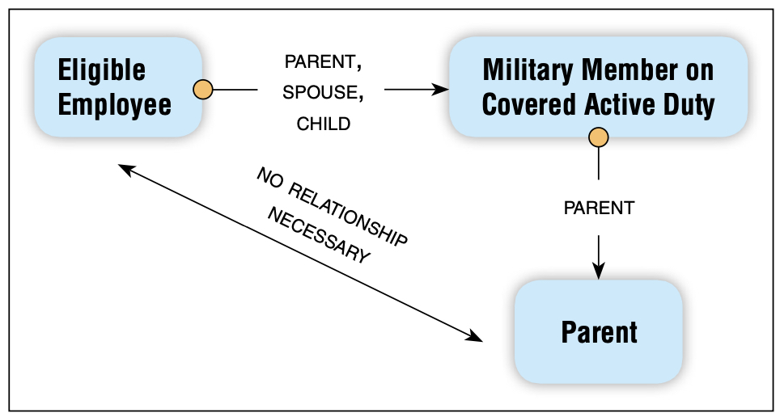
Qualifying Military Exigency Leave – Cont’d
To attend post-deployment activities within 90 days of the end of the military member’s covered active duty or to attend to issues arising from the death of a military member while on covered duty.
An eligible employee military member could be a child, parent, or spouse. A child means son or daughter.
Certain parental care activities for the military member’s parent who is incapable of self-care, and
the employee does not need to be related to the military member’s parent to take qualifying exigency leave for this purpose.
But, (1) the military member must be the parent, spouse, or child of the employee taking FMLA leave; and (2) the parent receiving assistance must be the parent of the military member.
Any other event that the employee and employer agree is a qualifying exigency.
Both the employee and employer must agree to the timing and duration of the leave.

Slide 22
Certification for Military Exigency Leave
When an eligible employee requests qualifying exigency leave, the employer may request the following information and documentation:
An employer may contact the Department of Defense to request verification that the military member is on covered active duty.
A statement or description of the appropriate facts regarding the qualifying exigency.
The approximate date on which the leave began (or will begin), and how long and/or how often leave will be needed, and
The contact information for any meeting with a third party and a brief description of the purpose of the meeting.

Slide 23
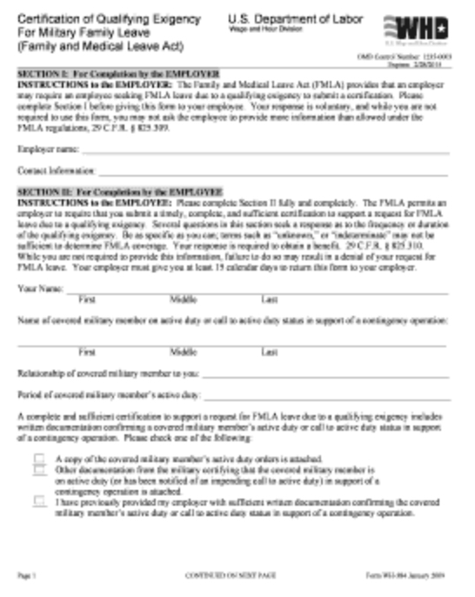
Certification for Military Exigency Leave
The employer may choose to use the Wage and Hour Division form which is available on the Department’s website, or from the nearest Wage and Hour Division office,
or may create its own version of the certification containing the same basic information; however, no additional information can be requested.

Slide 24
Military Caregiver Leave – Who Is Covered
Military caregiver leave allows an eligible employee who is the spouse, son, daughter, parent, or next of kin of a covered servicemember with a serious injury or illness to take up to a total of 26 workweeks of unpaid leave during a “single 12-month period” to provide care for the servicemember.
A covered servicemember is either:
A Current Servicemember: A covered servicemember means a current member of the Armed Forces, including a member of the U. S. National Guard or Reserves, who is undergoing medical treatment, recuperation, or therapy, is otherwise in outpatient status, or is otherwise on the temporary disability retired list, for a serious injury or illness; or
A Veteran: A covered servicemember means a veteran who is undergoing medical treatment, recuperation, or therapy for a serious injury or illness, and who was discharged within the previous five years before the employee takes military caregiver leave to care for the veteran.

Slide 25
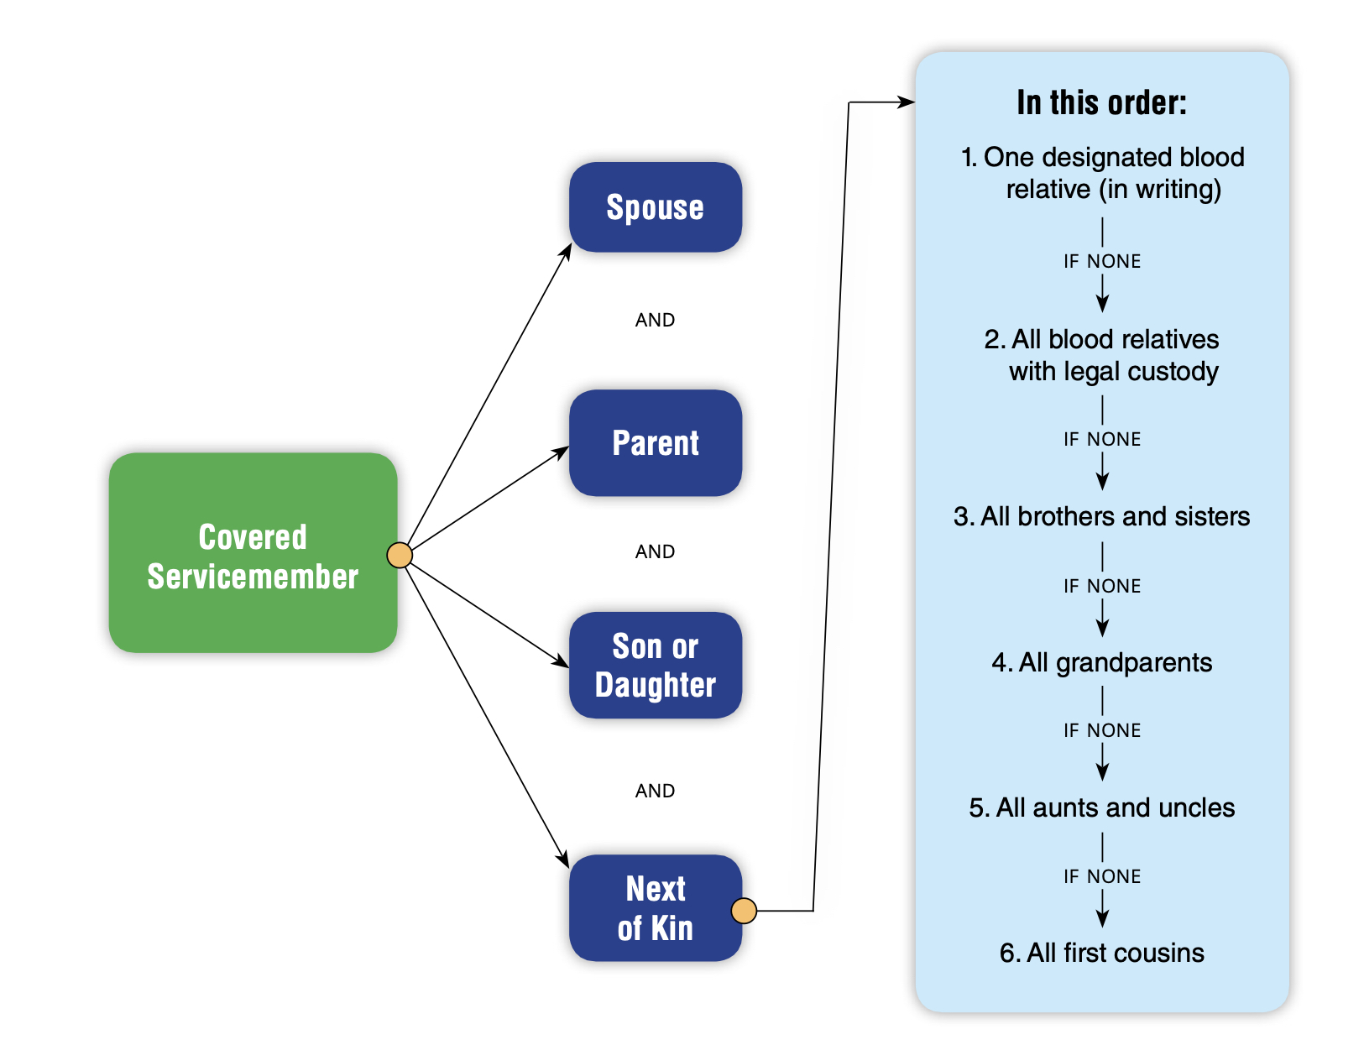
Military Caregiver Leave – Who Is May Take It
To take military caregiver leave, the eligible employee must be the spouse, parent, son or daughter, or next of kin of the covered servicemember. For purposes of military caregiver leave, a son or daughter refers to the servicemember’s son or daughter of any age.

Slide 26
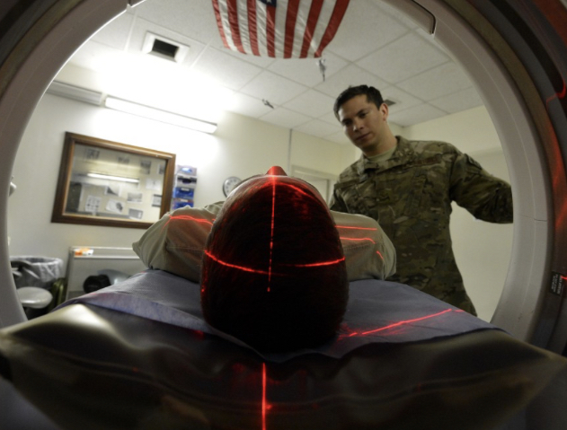
Military Caregiver Leave – What Is A Serious Injury or Illness
A serious injury or illness for a current servicemember is an injury or illness that was incurred by the servicemember in the line of duty on active duty that may render the servicemember unfit to perform the duties of his or her office, grade, rank, or rating.
A serious injury or illness may also result from the aggravation of a pre-existing condition in the line of duty on active duty.

Slide 27
Military Caregiver Leave – What Is A Serious Injury or Illness
A serious injury or illness of a veteran must be either:
A continuation of a serious injury or illness that was incurred or aggravated when the covered veteran was a member of the Armed Forces and rendered the servicemember unable to perform the duties of the servicemember’s office, grade, rank, or rating, or
A physical or mental condition for which the veteran has received a United States Department of Veterans Affairs Service Related Disability Rating (VASRD) of 50% or more and the need for care is related to that condition, or
A physical or mental condition because of a disability or disabilities related to military service that substantially impairs the veteran’s ability to work, or would do so absent treatment, or
An injury for which the veteran is enrolled in the Department of Veterans Affairs Program of Comprehensive Assistance for Family Caregivers.

Slide 28
End of Module Four Thank you! Mark Stephens www.mstephenstc.com 817-368-7494

