Slide 1
Welcome!
Let’s Get Started!

Slide 2
Disclaimer
This presentation is intended as general information only and
does not carry the force of legal opinion.
This information and related materials are presented to give access to information on the Family and Medical Leave Act. Much of the information contained herein is adapted from the Department of Labor’s “The Employer’s Guide to The Family and Medical Leave Act,” to meet the needs of Human Resources Professionals in Municipal Government. Therefore, we make no express or implied guarantee.
The Federal Register and the Code of Federal Regulations remain the official source for regulatory information published by the Department of Labor. We will make every effort to keep this information current and to correct errors brought to our attention.

Slide 3
Module Three Moving On Down the FMLA Road

Slide 4
Objectives
In Module Three, we are:
Reviewing the processes involved in completing the FMLA medical certification form;
Understanding the concepts of Authentication and Clarification for validating an employee’s completed medical certification form;
Examining the process surrounding how second and third medical opinions may be used to validate the employee’s completed medical certification form, and,
Reviewing the last step in the certification process – the information included in the Designation Notice;
The timing and methodology for FMLA recertification.

Slide 5
The FMLA Medical Certification - Completeness
What happens when the medical certification form is not filled out appropriately?
“Incomplete”
or
“Insufficient”
The employer must give the employee a written notice stating what additional information is necessary to make the certification complete and sufficient.

Slide 6
The FMLA Medical Certification - Completeness
A certification is considered incomplete if:
If an employee fails to provide a complete and sufficient certification despite the opportunity to cure the deficiency, an employer may deny the employee’s request for FMLA leave.
This denial must be completely paper-trailed.
Have not been completed;
or
The information provided is vague, ambiguous, or non-responsive.
If the seven-day period is not practical with the employee’s diligent good faith efforts, the employer should provide additional time.
Or more of the entries:
The employer provides the employee with at least seven calendar days to correct any deficiency in the certification.

Slide 7
Authentication and Clarification
The employer has a couple of more options to ensure that the certification is accurate. One of these options includes the terms:
Authentication and Clarification
After the employer has given the employee the opportunity to cure any deficiencies, the employer may contact the health care provider only for purposes of authentication and/or clarification of the medical certification.
Under no circumstances may the employee’s direct supervisor contact the employee’s health care provider.
A human resources professional, a leave administrator, or a management official must make the contact.

Slide 8
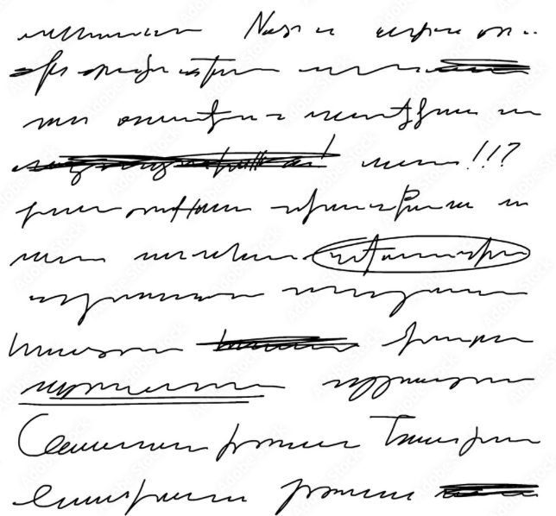
Authentication and Clarification
Authentication means:
providing the health care provider with a copy of the certification and confirming that on the information contained on the certification form was completed and/or authorized by the health care provider who signed the document.
An employer may not ask health care providers for additional information beyond that in the certification form.
Did you sign this document?
Clarification means:
contacting the health care provider to understand the handwriting on the medical certification or to understand the meaning of a response.
What does this say?
What does this mean?

Slide 9
How Does HIPAA Fit In The Medical Certification Process?
(HIPAA) governs this process, and
HIPAA requirements must be satisfied for a HIPAA-covered entity to share an employee’s or (an employee’s family member’s) individually-identifiable healthcare information with an employer.
HIPAA requires, among other things:
Written Authorization
Release Information for
Clarification Purposes
It’s the employee’s responsibility to provide the employer with a complete and sufficient certification and to clarify the certification, if necessary.
Employee may authorize
to provide clarification directly to the employer
If the employee chooses not to provide such authorization to the employer or clarify the certification -
health care provider
Employer may deny the FMLA leave request if the certification is unclear.
FMLA Leave Request

Slide 10
The Certification Process (Second and Third Medical Opinions)
What constitutes a valid reason to doubt the validity of the FMLA medical certification?
In order to request second and third medical opinions, the employer must have a valid reason to doubt the information within the medical certification form.
What is a valid reason to doubt?
Doubting the validity means either:
We have reason to think it’s a fraudulent form (for example, not finding record of a doctor by that name anywhere).
We have independent facts that conflict with the information on the form (for example, if an employee engages in activities that the form says they’re unable to do).
If an employer has received a complete and sufficient certification but has a reason to doubt that it is valid, the employer may require the employee to obtain a second medical opinion at the employer’s expense.

Slide 11
Second and Third Medical Opinions – The Process
While waiting for the second (or third) opinion, the employee is provisionally entitled to FMLA leave, including the right to maintain his or her group health benefits.
If the certifications do not ultimately establish that the employee is entitled to FMLA leave, the leave is not considered FMLA leave and may be treated as paid or unpaid leave under the employer’s established leave policy.
In these cases, a second opinion can be obtained and the employer must make all arrangements and find an appropriate provider and pay for the visit.
ORIGINAL CERTIFICATION
CONFLICTS
Getting the third opinion isn’t mandatory, but if the first two opinions conflict, then there’s a factual discrepancy and the employer has less ground to stand on if they follow only the second opinion.
Employer may get a third medical opinion
The opinion of the third health care provider is final.
Employer pays for the third medical opinion

Slide 12
Second and Third Medical Opinions – The Process
If the employee requests it, the employer must provide copies of second and third opinions within five business days, absent extenuating circumstances.
If a second or third opinion health care provider requests information relevant to the serious health condition at issue from the employee’s or his or her family member’s health care provider; and,
The employee or their family member does not authorize their health care provider to release such information ----
FMLA leave may be denied.
Strong documentation is needs to support a request for a second or third medical opinion.

Slide 13
The Recertification Process
If the initial certification indicates that the minimum duration of the serious health condition will be more than 30 days, an employer must generally wait until that minimum duration expires before requesting recertification.
In general, an employer may request the employee provide a recertification no more often than every 30 days and only when the employee is actually absent or has requested to be absent.
An employer may request that an employee “recertify” his or her serious health condition or the serious health condition of his or her family member within the same leave year.
Notes:
The poster must be displayed in plain view where all employees and applicants can readily see it and must have text large enough so it can be easily read.
The information displayed on the poster must explain the FMLA provisions and provide information on how to file a complaint with the Wage and Hour Division.
If a significant portion of employees do not read and write English, the employer must provide the general notice in a language in which they can read and write.

Slide 14
The Recertification Process
An employer may request a recertification in connection with an absence by the employee in less than 30 days only if:
The employee requests an extension of leave,
The circumstances described by the previous certification have changed significantly, or
The employer receives information that casts doubt on the employee’s stated reason for the absence or the continuing validity of the existing medical condition.

Slide 15
The Recertification Process
If the initial medical certification indicates that the employee will need:
intermittent or reduced schedule leave for longer than six months –
including cases where the serious health condition has no anticipated end,
The employer may request a recertification every six months, but only in connection with an absence by the employee.

Slide 16
The Recertification Process
As with the initial certification, in most circumstances, the employee has 15 calendar days after the employer’s request to provide a complete and sufficient recertification.
An employer may ask for the same information in a recertification as that permitted in the initial medical certification.
The employee is responsible for paying for the cost of a recertification.

Slide 17
Recertification Process
During recertification an employer may provide the health care provider with:
a record of the employee’s absence pattern, such as an attendance record of FMLA leave use, and
may ask the health care provider if the serious health condition and need for leave is consistent with the absence pattern provided.
For serious health conditions, an employer may contact the health care provider to authenticate or clarify recertification, but cannot require second or third opinions for recertification.
GOOD IDEA

Slide 18
Annual Medical Certification
New
Where the serious health condition lasts beyond a single leave year, i.e., is a chronic condition –
the employer may require a new certification in each subsequent FMLA-leave year.
That means the employer may request a new medical certification with the first absence in a new 12-month year.
Because it’s a new certification and not a recertification,
an employer may seek second and third medical opinions for these new medical certifications, as well as authenticate or clarify the certification with the health care provider.

Slide 19
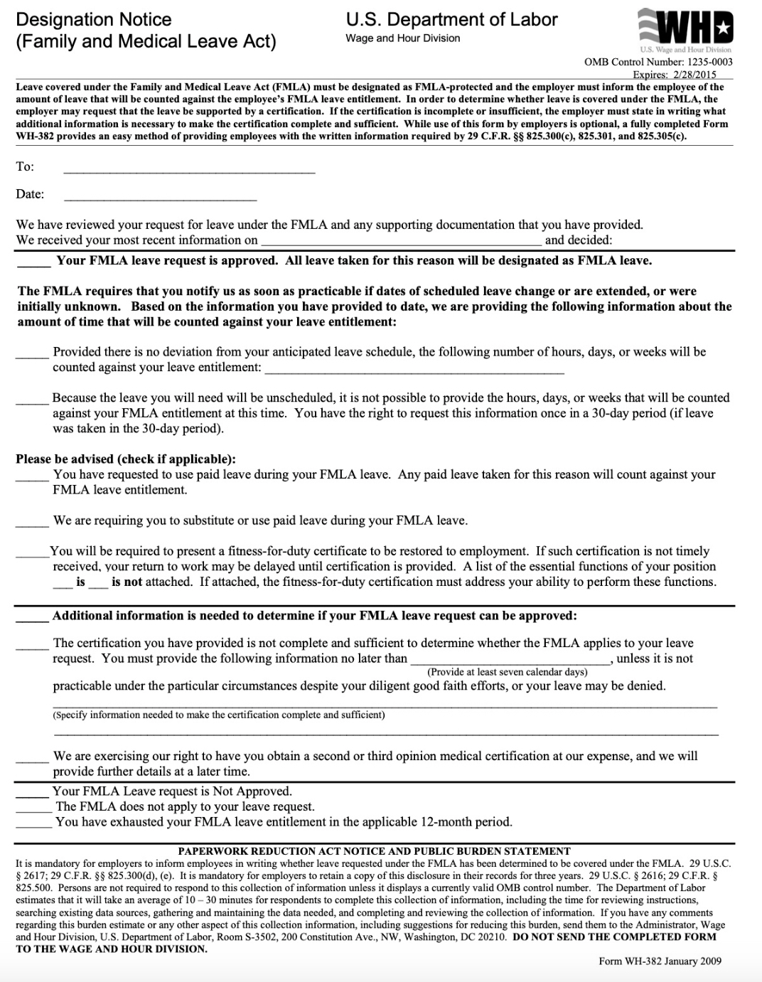
The FMLA Designation Notice
The employer is responsible in all circumstances for designating leave as FMLA-qualifying and giving a Designation Notice to the employee.
The Designation Notice informs the employee that the requested leave will be designated as FMLA leave and sets out the requirements applicable while the employee is on leave.

Slide 20
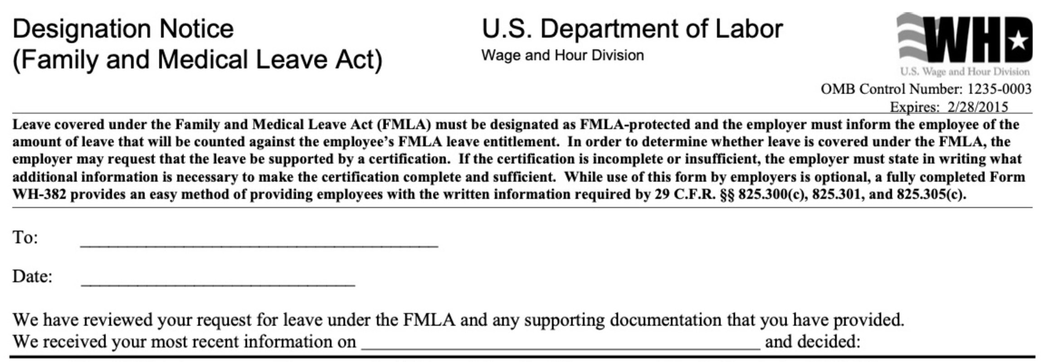
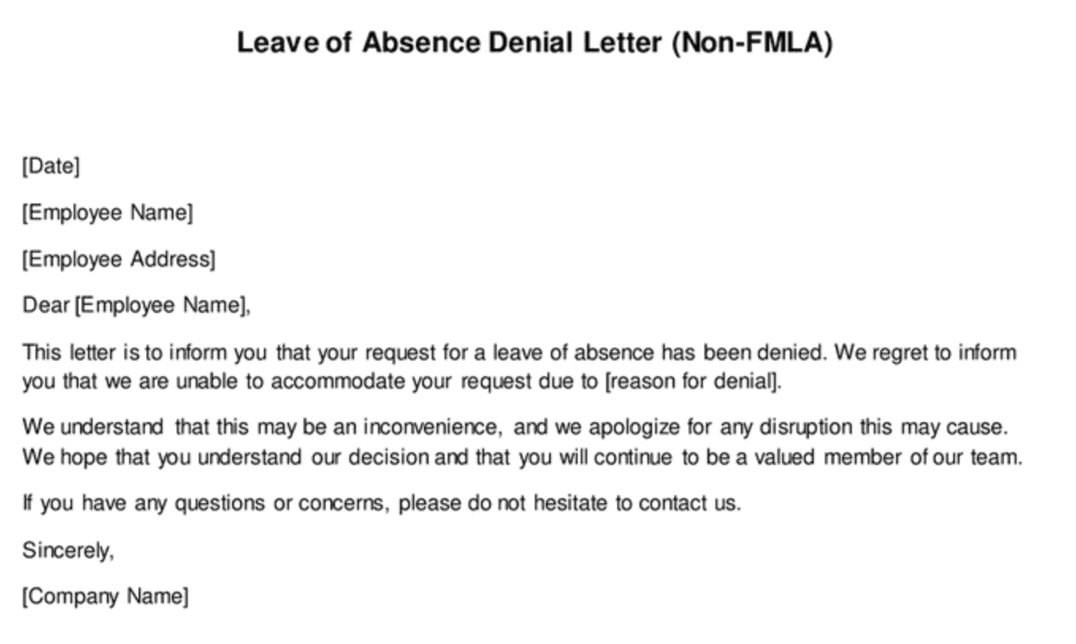
The FMLA Designation Notice
Once the employer has enough information to determine that the employee’s requested leave qualifies as FMLA leave, the employer must provide the employee with a written Designation Notice within no more than five business days, absent extenuating circumstances.
If the leave does not qualify as FMLA leave, the employer must notify the employee, in writing, that the leave is not FMLA-protected. Such notice can be a simple written statement.

Slide 21
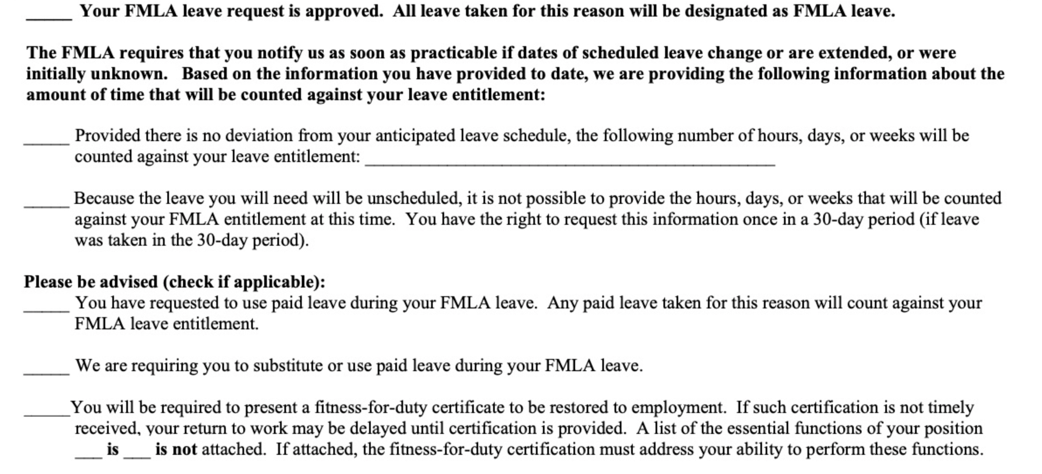
The FMLA Designation Notice
In addition to designating leave as FMLA qualifying, the written Designation Notice must include all of the following:
Amount of Leave
Paid Leave
Fitness-for-Duty

Slide 22
The FMLA Designation Notice
Employers may use the Wage and Hour Division form or may create their own Designation Notice or use, as long as it meets the Designation Notice requirements.

Slide 23
The FMLA Designation Notice
Although a medical certification will often provide the information needed to determine that the leave is FMLA-qualifying,
if the employer has enough information to designate the leave as FMLA leave immediately after receiving the notice of the need for leave, the employer may provide the employee with the Designation Notice at that time.
If the employee requests leave and the information provided in the Designation Notice changes (for example, the employee exhausts his or her FMLA entitlement),
the employer must provide the employee written notice of the changes within five business days of receiving the employee’s leave request subsequent to any change.
Only one “Designation Notice” for each
FMLA – qualifying reason for leave in a 12-month leave year.

Slide 24
The Failure to Give An FMLA Designation Notice
All of these processes regarding:
review,
authentication,
clarification, and
second and third medical options
all revolve around the information within the certification form that will show the employee or the employee’s family member has a qualifying serious health condition.
Failure to provide a timely Designation Notice to an employee may be considered:
interference with,
restraint, or
denial of the exercise of the employee's FMLA rights.
These are all causes of action under the FMLA.

Slide 25
“Qualifying Serious Health Condition”
is a very important issue and in Module 4 - we will start with what are qualifying reasons for leave under the FMLA!
Notes:
Oral or written: once- approved may be required to refer to that FMLA
The first time the employee requests leave for a qualifying reason, he or she is not required to specifically mention the FMLA
Leave that is foreseeable – employee must give at least 30 days advance notice of need to take FMLA leave when they know about the need for the leave in advance if possible and practical to do so surgery example the employer may delay the leave for thirty days however, employee may not discriminate against the employee for requesting if 30 days advance is not practical – must provide as soon as possible and practical if an advance surgery employee should consult with employer to try and schedule the medical procedure at a time that minimizes the disruption to operations FMLA
Leave that is not foreseeable
An employer may waive the employee’s notice requirement or its own internal rules about leave requests
In ruling for Blue Cube, the 5th Circuit emphasized that an employee must give their employer enough information for a reasonable employer to know that the employee needs leave or intends to take leave. The plaintiff’s comment about “getting FMLA for her Dad” was not sufficient to put the company on notice that she intended to take leave and that the leave was for a qualifying reason.
The appellate court further noted that an employer may condition approval of FMLA-protected leave on the worker’s compliance with the employer’s usual notice and procedural requirements, absent unusual circumstances. In this case, Blue Cube prevailed based on the facts that the plaintiff had taken FMLA leave previously and thus was aware of the process, but failed to follow Blue Cube’s procedures for requesting leave after she made a comment about FMLA in passing to the HR professional.
One more thing helped Blue Cube—the supervisor expressly referred the plaintiff to contact the HR professional. The 5th Circuit noted that the supervisor’s knowledge of the father’s ailments coupled with his knowledge that the plaintiff was missing some work might have been enough to trigger the employer’s FMLA obligations, if the supervisor had not instructed her to contact HR.

Slide 26
End of Module Three Thank you! Mark Stephens www.mstephenstc.com 817-368-7494

