Slide 1

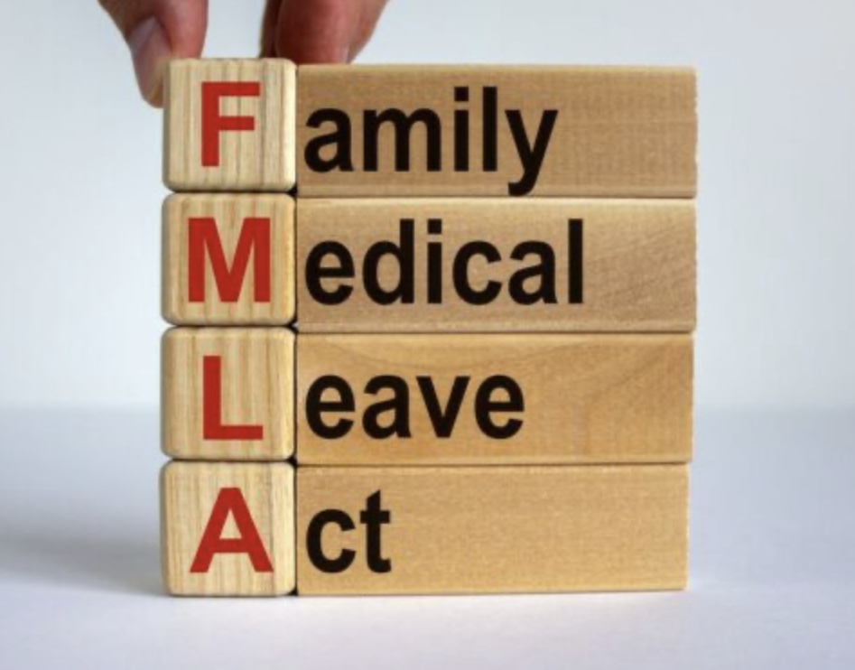


Welcome!
Module TWO

Slide 2
Disclaimer
This presentation is intended as general information only and
does not carry the force of legal opinion.
This information and related materials are presented to give access to information on the Family and Medical Leave Act. Much of the information contained herein is adapted from the Department of Labor’s “The Employer’s Guide to The Family and Medical Leave Act,” to meet the needs of Human Resources Professionals in Municipal Governments. Therefore, we make no express or implied guarantees.
The Federal Register and the Code of Federal Regulations remain the official source for regulatory information published by the Department of Labor. We will make every effort to keep this information current and to correct errors brought to our attention.

Slide 3

Module Two
Moving On Down the FMLA Road

Slide 4

Objectives
In Module Two, we will be reviewing:
  Employee’s eligibility requirements for the protections and benefits of the FMLA;
  The information included within the written Rights and Responsibilities Notice given to the employee; and
  Begin a review of what is involved with the FMLA medical certification process.

Slide 5



Employee Eligibility
First Step
Criteria:
An eligible employee is one who:
Let’ go a little deeper into thee requirements!
1) Works for a covered employer;
Municipalities are a covered employer
2) Has worked for the employer for at least 12 months as of the date the FMLA leave is to start;
3) Has at least 1,250 hours of service for the employer during the 12-month period immediately before the date the FMLA leave is to start.

Slide 6

How is the term “12 Months of Employment” Defined
The “12 months of employment” do not have to be consecutive:
Part-time, temporary, or seasonal work generally counts towards the 12 months of employment;
If an employee is maintained on the payroll for any part of a week, that week counts as a week of employment
Any combination of 52 weeks equals 12 months.

Slide 7



How is the term “12 Months of Employment” Defined
If the employee has a break in employment that lasted seven years or more,
the employer is not required to count the time worked prior to the break, unless:
If the employee does not meet the eligibility requirements, an employer may not designate the leave as FMLA even if the leave would otherwise qualify for FMLA protection.
If the employee is not eligible for FMLA leave, the employer may grant the employee leave under the employer’s policy.
1) The break in employment is due to service covered by the Uniformed Services Employment and Reemployment Rights Act (USERRA), or
3) Any employer may voluntarily consider periods of employment prior to a break of more than seven years, but it must do so uniformly for all employees with similar breaks in employment.
2) A written agreement, including a collective bargaining agreement, outlining the employer’s intention to rehire the employee after the break in employment exists;

Slide 8

What “1250 Hours of Service” Means
The hours of service requirement will be met if an employee has worked a total of 1,250 hours of service in the 12 months immediately preceding the start of the FMLA leave.
This averages to a little more than 24 hours of work a week in the 12-month period.

Slide 9
What “1250 Hours of Service” Means
Only the time actually worked, including overtime hours worked, is counted.
Time not actually worked, including:
Vacation,
Personal leave,
Sick leave,
Holidays, and
Any other form of paid time off (PTO) is not counted towards the 1,250 hours of service.
Further, unpaid leave of any kind or periods of layoff also are not counted.
Time worked as a part-time, temporary, or seasonal employee counts toward the requirement.

Slide 10

How Does Military Service Apply to the “1250”?
There is a USERRA military element here as well.
An employee returning from fulfilling a USERRA-covered military service obligation is credited with the hours of service that would have been performed, but for, the period of military service.
The employee’s pre-service work schedule can generally be used for calculations to determine hours that would have been worked during the period of military service.
The employer is obliged to maintain accurate time records of hours worked by all employee regarding the Family and Medical Leave Act, because the employer has the burden of showing that the employee has not met the “hours of service” requirement.

Slide 11

If the Employee Does Not Meet the Eligibility Requirements
If the employee is not eligible for FMLA leave, the employer may grant the employee leave under the employer’s policy.
If the employee does not meet the eligibility requirements, an employer may not designate the leave as FMLA - even if the leave would otherwise qualify for FMLA protection.

Slide 12


The Rights and Responsibilities Notice
If the employee’s leave has already begun, the Rights and Responsibilities Notice should be mailed to the employee’s address of record.
The Rights and Responsibilities Notice details the specific expectations and obligations of the employee relating to his or her FMLA leave.
Once an employee is determined to be eligible for FMLA leave, the employer must provide a written Rights and Responsibilities Notice -
within five business days of having notice of the employee’s need for leave.

Slide 13
The Rights and Responsibilities Notice
If information provided in the Rights and Responsibilities Notice changes, the employer must inform the employee of the changes,
in writing,
within five business days of the first time subsequent to the changes that the employee gives notice of need for leave.
CHANGES
Notes:
The poster must be displayed in plain view where all employees and applicants can readily see it and must have text large enough so it can be easily read.
The information displayed on the poster must explain the FMLA provisions and provide information on how to file a complaint with the Wage and Hour Division.
If a significant portion of employees do not read and write English, the employer must provide the general notice in a language in which they can read and write.

Slide 14
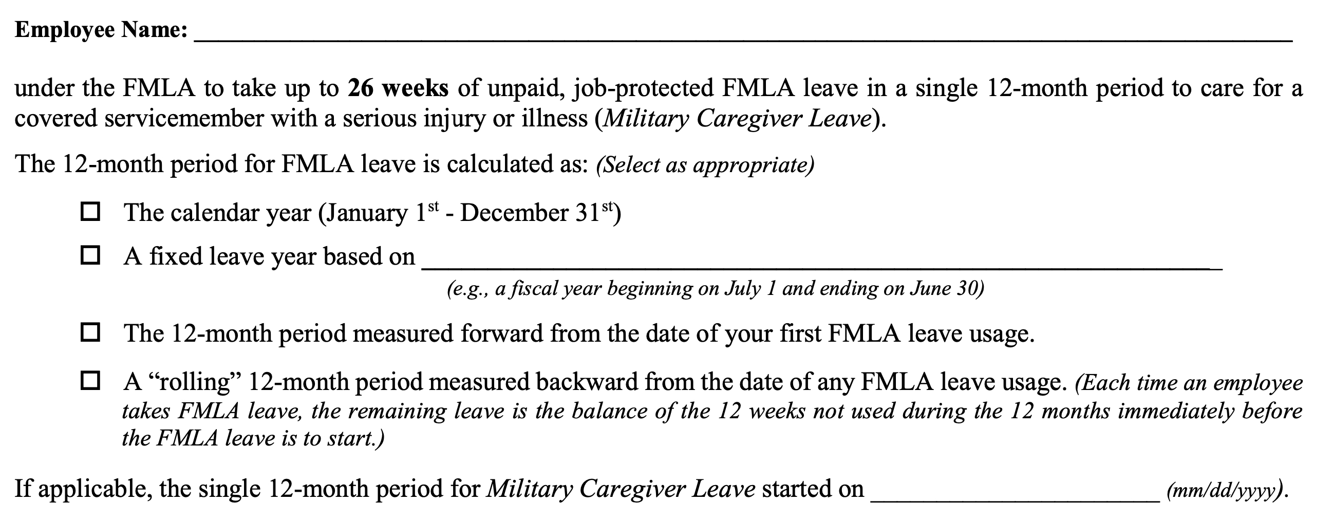
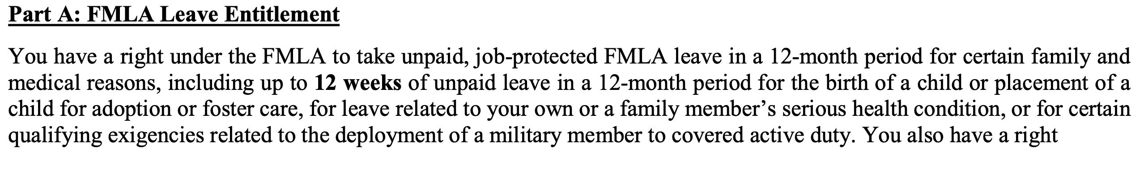
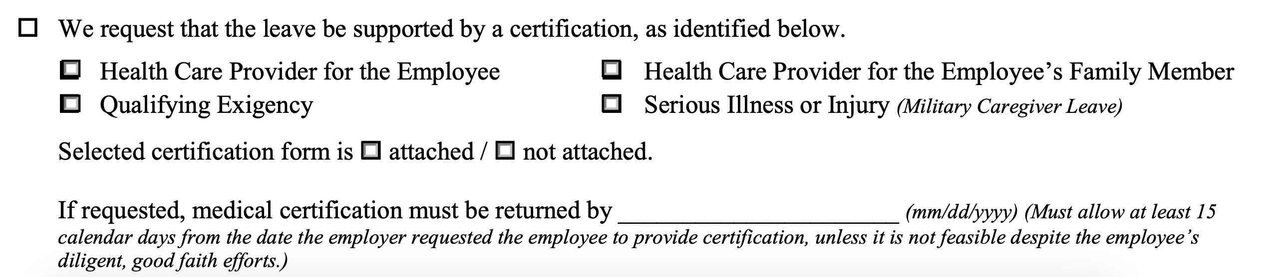
The Information Within the Rights and Responsibilities Notice
The Rights and Responsibilities Notice must be in writing and must include all of the following information, as appropriate/applicable:

Slide 15
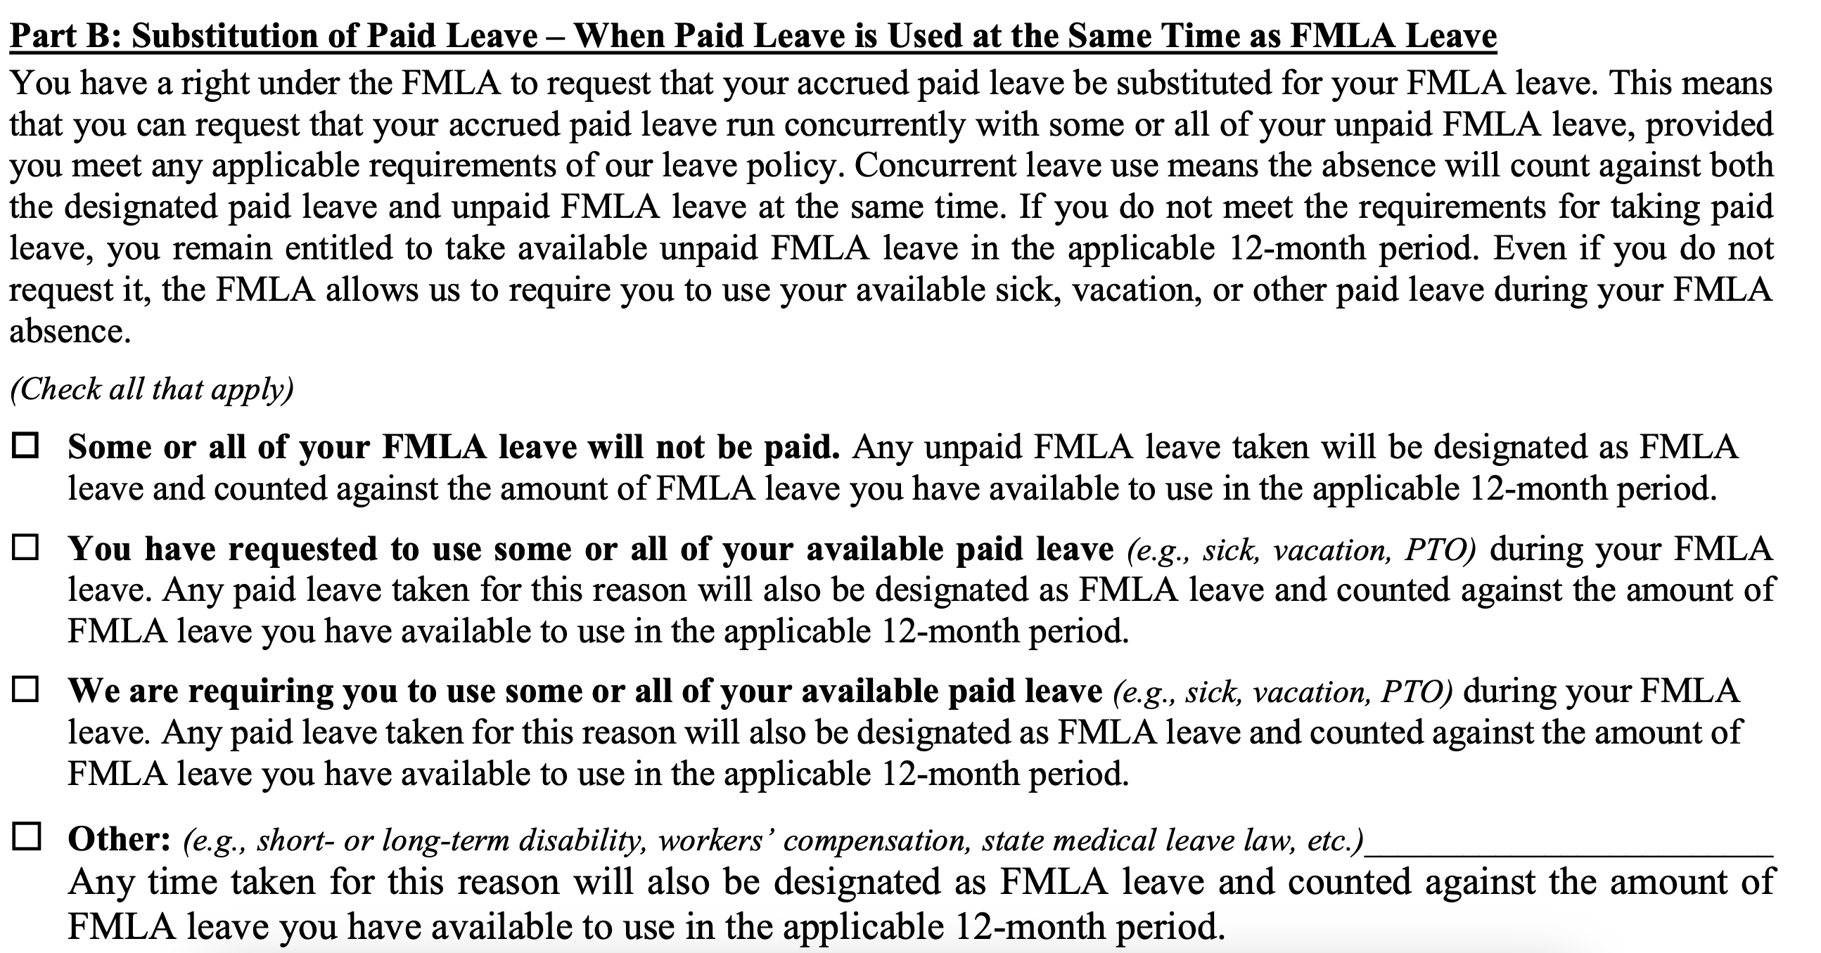
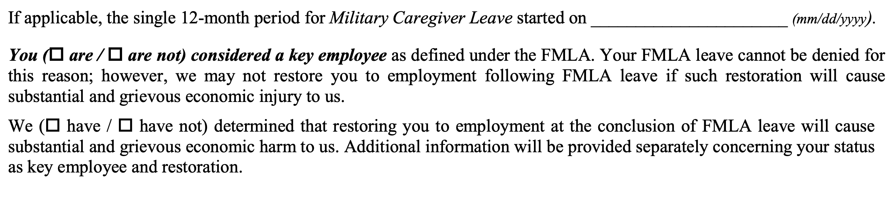
The Information Within the Rights and Responsibilities Notice, Cont’d

Slide 16
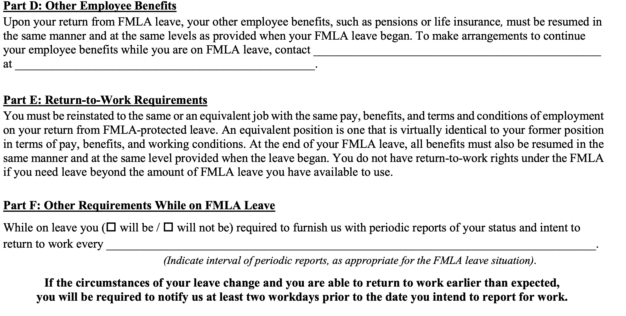
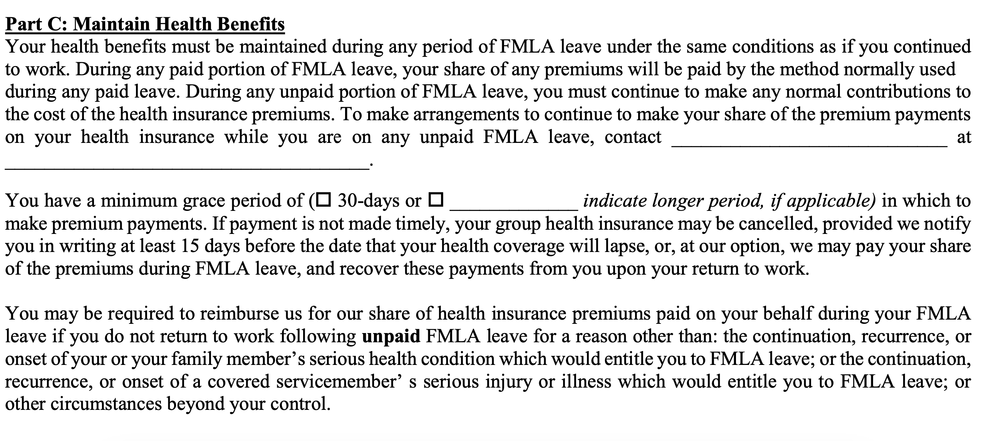
The Information Within the Rights and Responsibilities Notice, Cont’d.
Notes:
Employers’ Responsibilities
On June 28, 2016, the Court issued its opinion in the case of Vannoy v. The Federal Reserve Bank of Richmond, in which it held that an employer may be liable for a violation of the FMLA even if it grants an employee’s request for medical leave. The Court found that a defective “Rights and Responsibilities” notice which omitted information about the right to reinstatement may have interfered with the employee’s understanding and exercise of his rights under the FMLA.
Vannoy, an employee of the Federal Reserve Bank of Richmond, was battling depression and alcoholism. The bank was aware of this condition and made efforts to accommodate his condition. In November 2010, Vannoy was hospitalized for psychiatric treatment where it was recommended that he complete a 30-day inpatient rehabilitation program. Around this time, the bank granted his request for one month of leave under the FMLA (which was submitted as an application for short term disability). The bank sent Vannoy a notice of his FMLA rights and responsibilities, but the notice did not include any reference to job protection rights under the FMLA. Vannoy returned to work with a doctor’s note before the expiration of the month of approved FMLA leave and did not enter into the recommended inpatient treatment program. Vannoy testified that he was fearful that taking extended time off from work would result in termination. Vannoy was subsequently terminated after failing to report for a three-day work assignment in Baltimore. In his suit against the bank, Vannoy claimed that he would have stayed on leave longer if he was aware of his restoration rights.
The Fourth Circuit reversed the district court’s finding of summary judgment in favor of the bank, and held that there was sufficient evidence to show that Vannoy would have exercised his rights under the FMLA differently had he known his job would be protected. Thus, the Fourth Circuit found that the evidence presented was sufficient to show prejudice to Vannoy for the bank’s failure to provide the requisite notice of the right to reinstatement under the FMLA.

Slide 17
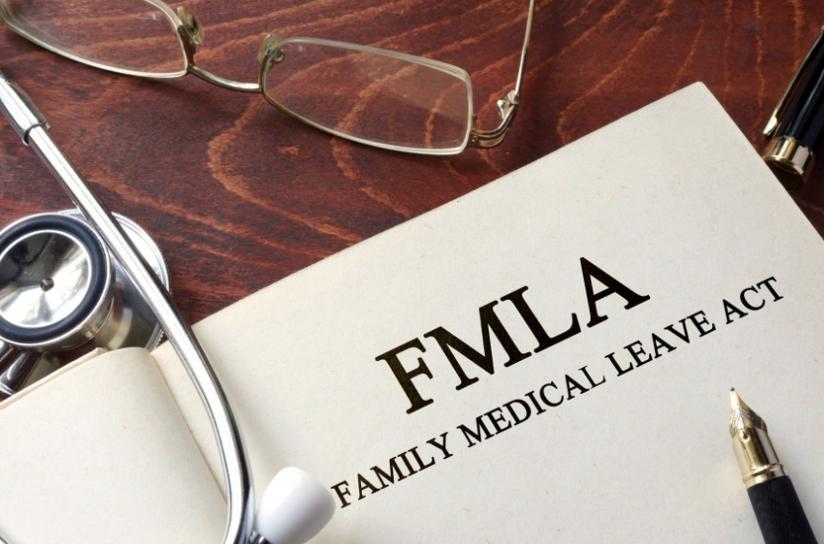

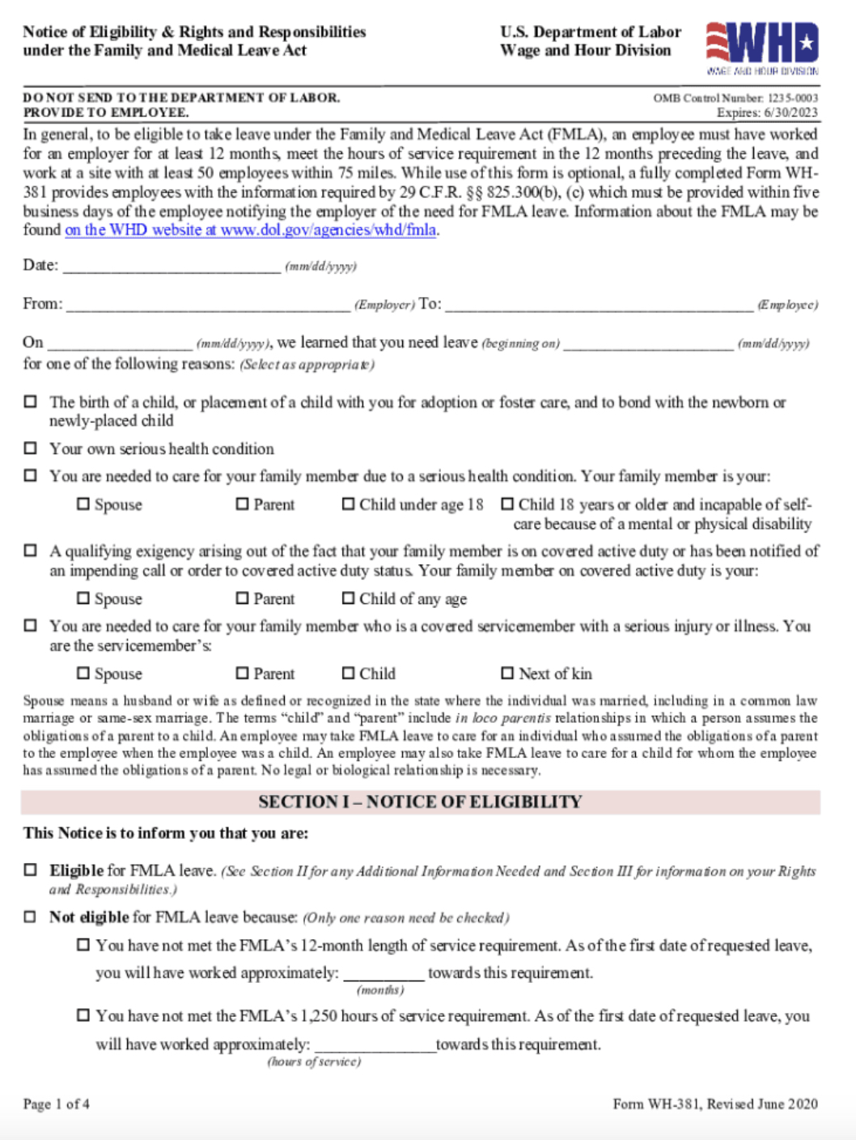




The Case of the Failure to Send the Rights and Responsibilities Notice

Slide 18
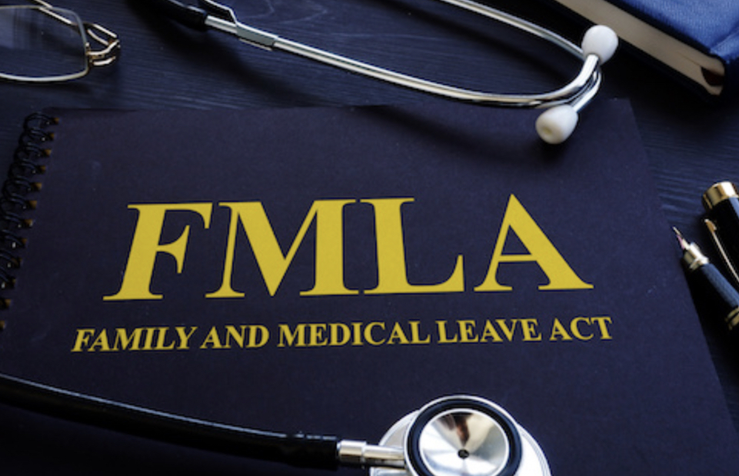
The FMLA Certification Process
The Certification Process
An employer may require a certification when an employee requests leave for:
The employee’s own serious health condition,
The serious health condition of the employee’s parent, spouse, son or daughter, and
Military family leave we will talk about this a little later.
Notes:
Oral or written: once- approved may be required to refer to that FMLA
The first time the employee requests leave for a qualifying reason, he or she is not required to specifically mention the FMLA
Leave that is foreseeable – employee must give at least 30 days advance notice of need to take FMLA leave when they know about the need for the leave in advance if possible and practical to do so surgery example the employer may delay the leave for thirty days however, employee may not discriminate against the employee for requesting if 30 days advance is not practical – must provide as soon as possible and practical if an advance surgery employee should consult with employer to try and schedule the medical procedure at a time that minimizes the disruption to operations FMLA
Leave that is not foreseeable
An employer may waive the employee’s notice requirement or its own internal rules about leave requests
In ruling for Blue Cube, the 5th Circuit emphasized that an employee must give their employer enough information for a reasonable employer to know that the employee needs leave or intends to take leave. The plaintiff’s comment about “getting FMLA for her Dad” was not sufficient to put the company on notice that she intended to take leave and that the leave was for a qualifying reason.
The appellate court further noted that an employer may condition approval of FMLA-protected leave on the worker’s compliance with the employer’s usual notice and procedural requirements, absent unusual circumstances. In this case, Blue Cube prevailed based on the facts that the plaintiff had taken FMLA leave previously and thus was aware of the process, but failed to follow Blue Cube’s procedures for requesting leave after she made a comment about FMLA in passing to the HR professional.
One more thing helped Blue Cube—the supervisor expressly referred the plaintiff to contact the HR professional. The 5th Circuit noted that the supervisor’s knowledge of the father’s ailments coupled with his knowledge that the plaintiff was missing some work might have been enough to trigger the employer’s FMLA obligations, if the supervisor had not instructed her to contact HR.

Slide 19
Certification Notice and Timing
Employers must notify employees each time they require a medical certification.
In some instances, an employer may request a medical certification at a later date if the employer has reason to question the appropriateness of the leave or its duration.
When requesting a medical certification, the employer must advise the employee of the consequences of failing to provide a complete and sufficient certification.
The employer’s notice that a certification is required must be included in the written Rights and Responsibilities Notice that the employer gives the employee within five business days of becoming aware of the employee’s need for FMLA leave. Call back sound
Notes:
Oral or written: once- approved may be required to refer to that FMLA
The first time the employee requests leave for a qualifying reason, he or she is not required to specifically mention the FMLA
Leave that is foreseeable – employee must give at least 30 days advance notice of need to take FMLA leave when they know about the need for the leave in advance if possible and practical to do so surgery example the employer may delay the leave for thirty days however, employee may not discriminate against the employee for requesting if 30 days advance is not practical – must provide as soon as possible and practical if an advance surgery employee should consult with employer to try and schedule the medical procedure at a time that minimizes the disruption to operations FMLA
Leave that is not foreseeable
An employer may waive the employee’s notice requirement or its own internal rules about leave requests
In ruling for Blue Cube, the 5th Circuit emphasized that an employee must give their employer enough information for a reasonable employer to know that the employee needs leave or intends to take leave. The plaintiff’s comment about “getting FMLA for her Dad” was not sufficient to put the company on notice that she intended to take leave and that the leave was for a qualifying reason.
The appellate court further noted that an employer may condition approval of FMLA-protected leave on the worker’s compliance with the employer’s usual notice and procedural requirements, absent unusual circumstances. In this case, Blue Cube prevailed based on the facts that the plaintiff had taken FMLA leave previously and thus was aware of the process, but failed to follow Blue Cube’s procedures for requesting leave after she made a comment about FMLA in passing to the HR professional.
One more thing helped Blue Cube—the supervisor expressly referred the plaintiff to contact the HR professional. The 5th Circuit noted that the supervisor’s knowledge of the father’s ailments coupled with his knowledge that the plaintiff was missing some work might have been enough to trigger the employer’s FMLA obligations, if the supervisor had not instructed her to contact HR.

Slide 20
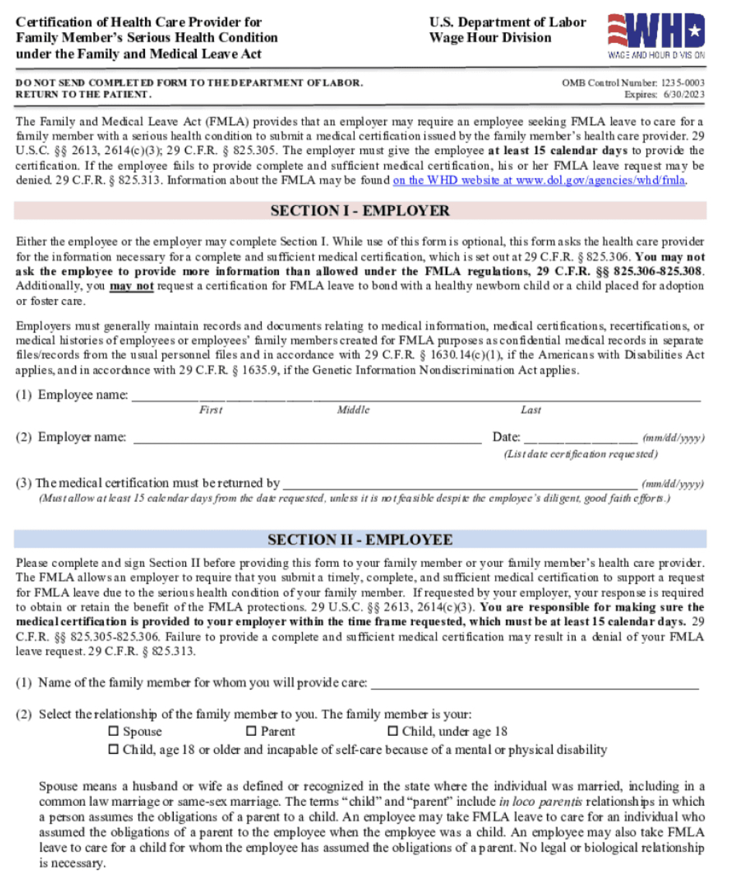
Contents of Medical Certification
A complete and sufficient certification need only include the following information:
Contact information for the health care provider, including name, address, telephone number, fax number, and type of medical practice/specialty;
When the serious health condition began,
How long the serious health condition is expected to last,
If the employee is the patient, whether the employee is unable to work, and the likely duration of this inability.
Notes:
Oral or written: once- approved may be required to refer to that FMLA
The first time the employee requests leave for a qualifying reason, he or she is not required to specifically mention the FMLA
Leave that is foreseeable – employee must give at least 30 days advance notice of need to take FMLA leave when they know about the need for the leave in advance if possible and practical to do so surgery example the employer may delay the leave for thirty days however, employee may not discriminate against the employee for requesting if 30 days advance is not practical – must provide as soon as possible and practical if an advance surgery employee should consult with employer to try and schedule the medical procedure at a time that minimizes the disruption to operations FMLA
Leave that is not foreseeable
An employer may waive the employee’s notice requirement or its own internal rules about leave requests
In ruling for Blue Cube, the 5th Circuit emphasized that an employee must give their employer enough information for a reasonable employer to know that the employee needs leave or intends to take leave. The plaintiff’s comment about “getting FMLA for her Dad” was not sufficient to put the company on notice that she intended to take leave and that the leave was for a qualifying reason.
The appellate court further noted that an employer may condition approval of FMLA-protected leave on the worker’s compliance with the employer’s usual notice and procedural requirements, absent unusual circumstances. In this case, Blue Cube prevailed based on the facts that the plaintiff had taken FMLA leave previously and thus was aware of the process, but failed to follow Blue Cube’s procedures for requesting leave after she made a comment about FMLA in passing to the HR professional.
One more thing helped Blue Cube—the supervisor expressly referred the plaintiff to contact the HR professional. The 5th Circuit noted that the supervisor’s knowledge of the father’s ailments coupled with his knowledge that the plaintiff was missing some work might have been enough to trigger the employer’s FMLA obligations, if the supervisor had not instructed her to contact HR.

Slide 21







Contents of Medical Certification (Who are Health Care Providers)
Health Care Providers
If an employer requires a medical certification, part of it must be completed by a health care provider, which is defined as:
Notes:
Oral or written: once- approved may be required to refer to that FMLA
The first time the employee requests leave for a qualifying reason, he or she is not required to specifically mention the FMLA
Leave that is foreseeable – employee must give at least 30 days advance notice of need to take FMLA leave when they know about the need for the leave in advance if possible and practical to do so surgery example the employer may delay the leave for thirty days however, employee may not discriminate against the employee for requesting if 30 days advance is not practical – must provide as soon as possible and practical if an advance surgery employee should consult with employer to try and schedule the medical procedure at a time that minimizes the disruption to operations FMLA
Leave that is not foreseeable
An employer may waive the employee’s notice requirement or its own internal rules about leave requests
In ruling for Blue Cube, the 5th Circuit emphasized that an employee must give their employer enough information for a reasonable employer to know that the employee needs leave or intends to take leave. The plaintiff’s comment about “getting FMLA for her Dad” was not sufficient to put the company on notice that she intended to take leave and that the leave was for a qualifying reason.
The appellate court further noted that an employer may condition approval of FMLA-protected leave on the worker’s compliance with the employer’s usual notice and procedural requirements, absent unusual circumstances. In this case, Blue Cube prevailed based on the facts that the plaintiff had taken FMLA leave previously and thus was aware of the process, but failed to follow Blue Cube’s procedures for requesting leave after she made a comment about FMLA in passing to the HR professional.
One more thing helped Blue Cube—the supervisor expressly referred the plaintiff to contact the HR professional. The 5th Circuit noted that the supervisor’s knowledge of the father’s ailments coupled with his knowledge that the plaintiff was missing some work might have been enough to trigger the employer’s FMLA obligations, if the supervisor had not instructed her to contact HR.

Slide 22
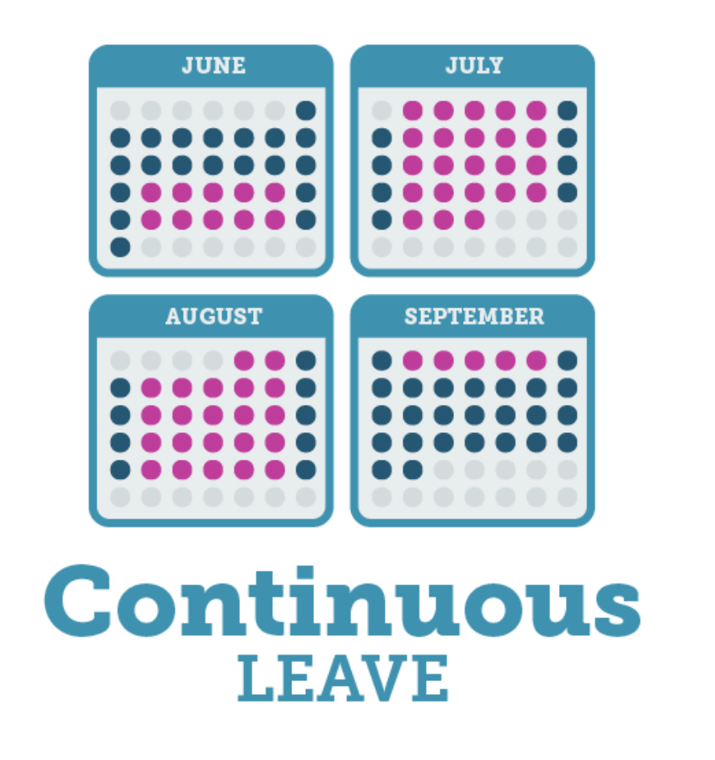
Contents of Medical Certification (What if it’s a Family Member
Family Member
If a family member is the patient, whether the family member needs care, and an estimate of the frequency and duration of the leave required to care for the family member;
Is needed leave continuous or intermittent, and
Appropriate medical facts about the condition.
What are “Appropriate Medical Facts”?
At the health care provider’s discretion, the medical facts may include information on symptoms, doctor’s visits, or a diagnosis.
Whether a diagnosis is included in the certification form is left to the discretion of the health care provider, and
An employer may not reject a complete and sufficient certification because it lacks a diagnosis.
Notes:
Leave that is not foreseeable when need for leave is unexpected, the employee must provide notice of leave that is unforeseeable as much as possible to follow the employer’s notices for leave once employer has enough information that indicates an employees need for leave may be fmla qualifying reason, the employer should begin the fmla process. Managers assistant managers supervisors must be able to recognize an fmla qualifying reason for leaveand properly initiatethe reuired notificaitons and eligibity checks its all abut compliance
An employer may waive the employee’s notice requirement or its own internal rules about leave requests

Slide 23
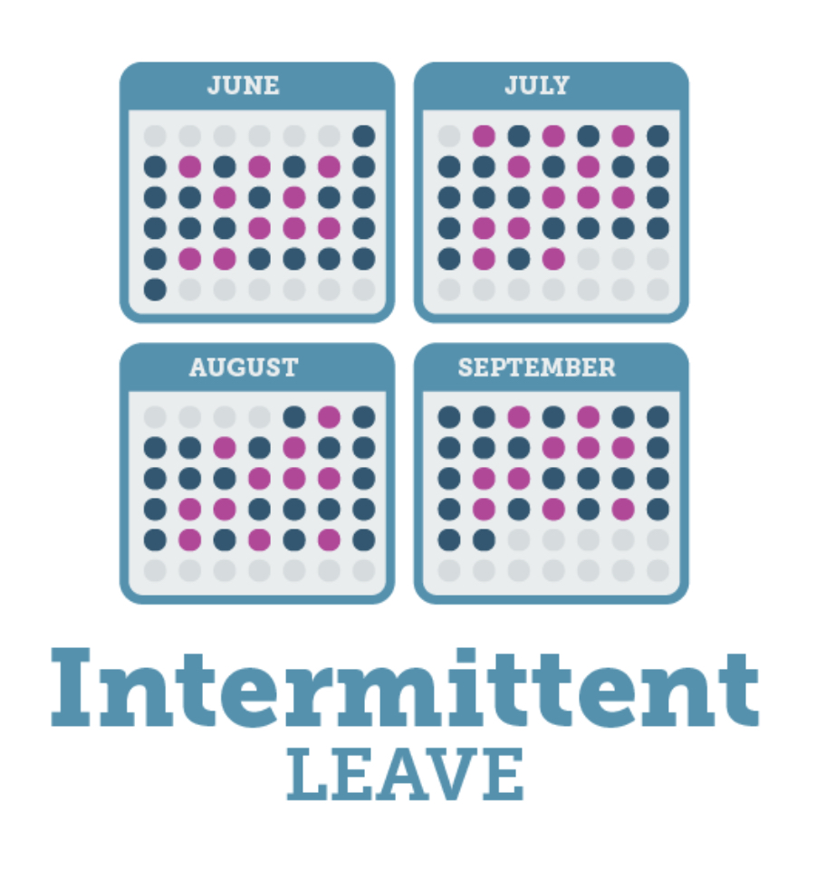

Medical Certification Information (Intermittent Leave)
Besides taken leave in a block of time (consecutive leave, other leave that may be taken under the FMLA is intermittent leave or reduced schedule leave.
For intermittent or reduced schedule leave, the employer may require certain additional information in the certification:
Information that establishes the medical necessity of intermittent or reduce schedule leave, and
An estimate of the dates and duration of such treatment and periods of recovery, and
Information that establishes the medical necessity of intermittent or reduced schedule leave.
Notes:
Oral or written: once- approved may be required to refer to that FMLA
The first time the employee requests leave for a qualifying reason, he or she is not required to specifically mention the FMLA
Leave that is foreseeable – employee must give at least 30 days advance notice of need to take FMLA leave when they know about the need for the leave in advance if possible and practical to do so surgery example the employer may delay the leave for thirty days however, employee may not discriminate against the employee for requesting if 30 days advance is not practical – must provide as soon as possible and practical if an advance surgery employee should consult with employer to try and schedule the medical procedure at a time that minimizes the disruption to operations FMLA
Leave that is not foreseeable
An employer may waive the employee’s notice requirement or its own internal rules about leave requests
In ruling for Blue Cube, the 5th Circuit emphasized that an employee must give their employer enough information for a reasonable employer to know that the employee needs leave or intends to take leave. The plaintiff’s comment about “getting FMLA for her Dad” was not sufficient to put the company on notice that she intended to take leave and that the leave was for a qualifying reason.
The appellate court further noted that an employer may condition approval of FMLA-protected leave on the worker’s compliance with the employer’s usual notice and procedural requirements, absent unusual circumstances. In this case, Blue Cube prevailed based on the facts that the plaintiff had taken FMLA leave previously and thus was aware of the process, but failed to follow Blue Cube’s procedures for requesting leave after she made a comment about FMLA in passing to the HR professional.
One more thing helped Blue Cube—the supervisor expressly referred the plaintiff to contact the HR professional. The 5th Circuit noted that the supervisor’s knowledge of the father’s ailments coupled with his knowledge that the plaintiff was missing some work might have been enough to trigger the employer’s FMLA obligations, if the supervisor had not instructed her to contact HR.

Slide 24



Medical Certification Information - Employers
The employer cannot refuse:
Notes:
Oral or written: once- approved may be required to refer to that FMLA
The first time the employee requests leave for a qualifying reason, he or she is not required to specifically mention the FMLA
Leave that is foreseeable – employee must give at least 30 days advance notice of need to take FMLA leave when they know about the need for the leave in advance if possible and practical to do so surgery example the employer may delay the leave for thirty days however, employee may not discriminate against the employee for requesting if 30 days advance is not practical – must provide as soon as possible and practical if an advance surgery employee should consult with employer to try and schedule the medical procedure at a time that minimizes the disruption to operations FMLA
Leave that is not foreseeable
An employer may waive the employee’s notice requirement or its own internal rules about leave requests
In ruling for Blue Cube, the 5th Circuit emphasized that an employee must give their employer enough information for a reasonable employer to know that the employee needs leave or intends to take leave. The plaintiff’s comment about “getting FMLA for her Dad” was not sufficient to put the company on notice that she intended to take leave and that the leave was for a qualifying reason.
The appellate court further noted that an employer may condition approval of FMLA-protected leave on the worker’s compliance with the employer’s usual notice and procedural requirements, absent unusual circumstances. In this case, Blue Cube prevailed based on the facts that the plaintiff had taken FMLA leave previously and thus was aware of the process, but failed to follow Blue Cube’s procedures for requesting leave after she made a comment about FMLA in passing to the HR professional.
One more thing helped Blue Cube—the supervisor expressly referred the plaintiff to contact the HR professional. The 5th Circuit noted that the supervisor’s knowledge of the father’s ailments coupled with his knowledge that the plaintiff was missing some work might have been enough to trigger the employer’s FMLA obligations, if the supervisor had not instructed her to contact HR.

Slide 25
Employees Must Provide Notice of Need for Leave to Employer
The FMLA does not require employees to use any specific certification form. An employer may provide employees with the Department of Labor’s optional-use forms for obtaining certification.
https://www.dol.gov/agencies/whd/fmla/forms or from the nearest Wage and Hour Division office.
An employer may also develop its own certification forms, but it may not request any additional information beyond what is specified in the FMLA and its regulations.
The forms are listed below:
- WH-380-E, Employee’s Serious Health Condition;
- WH-380-F, Family Member’s Serious Health Condition;
- WH-384, Certification of Qualifying Exigency for Military Family Leave;
- WH-385, Certification for Serious Injury or Illness of a Covered Servicemember – for Military Family Leave;
- WH-385-V, Certification for Serious Injury or Illness of a Veteran for Military Caregiver Leave.
Notes:
Oral or written: once- approved may be required to refer to that FMLA
The first time the employee requests leave for a qualifying reason, he or she is not required to specifically mention the FMLA
Leave that is foreseeable – employee must give at least 30 days advance notice of need to take FMLA leave when they know about the need for the leave in advance if possible and practical to do so surgery example the employer may delay the leave for thirty days however, employee may not discriminate against the employee for requesting if 30 days advance is not practical – must provide as soon as possible and practical if an advance surgery employee should consult with employer to try and schedule the medical procedure at a time that minimizes the disruption to operations FMLA
Leave that is not foreseeable
An employer may waive the employee’s notice requirement or its own internal rules about leave requests
In ruling for Blue Cube, the 5th Circuit emphasized that an employee must give their employer enough information for a reasonable employer to know that the employee needs leave or intends to take leave. The plaintiff’s comment about “getting FMLA for her Dad” was not sufficient to put the company on notice that she intended to take leave and that the leave was for a qualifying reason.
The appellate court further noted that an employer may condition approval of FMLA-protected leave on the worker’s compliance with the employer’s usual notice and procedural requirements, absent unusual circumstances. In this case, Blue Cube prevailed based on the facts that the plaintiff had taken FMLA leave previously and thus was aware of the process, but failed to follow Blue Cube’s procedures for requesting leave after she made a comment about FMLA in passing to the HR professional.
One more thing helped Blue Cube—the supervisor expressly referred the plaintiff to contact the HR professional. The 5th Circuit noted that the supervisor’s knowledge of the father’s ailments coupled with his knowledge that the plaintiff was missing some work might have been enough to trigger the employer’s FMLA obligations, if the supervisor had not instructed her to contact HR.

Slide 26
End of Module Two
Thank you!
Mark Stephens www.mstephenstc.com
817-368-7494

