Slide 1
www.txlocalgovlaw.com

Slide 2
Presented by: George Hyde, Managing Partner
The Government Information You Share
May be Held Against You!

Slide 3
No Legal Advice or Attorney-Client Relationship
The materials and information provided at and for this conference have been prepared by Hyde Kelley LLP for educational and informational purposes only and are not legal advice or a substitute for legal counsel. This information is not intended to create, and receipt of it does not constitute, an attorney-client relationship. You should not rely or act upon this information without seeking professional counsel.
While we would like to hear from you, we cannot represent you until we know that doing so will not create a conflict of interest legally or otherwise. Do not send us any confidential information until you speak with one of our attorneys and receive our authorization to send that information to us. Hyde Kelley LLP is under no duty of confidentiality to persons who send unsolicited any information by any means to our firm, its lawyers or staff.
Web: www.txlocalgovlaw.com | Voice: 512-686-0700 | Email: info@txlocalgovlaw.com

Slide 4
“§ 39.06. Misuse of Official Information”
(a) A public servant commits an offense if, in reliance on information to which the public servant has access by virtue of the person's office or employment and that has not been made public, the person:
(1) acquires or aids another to acquire a pecuniary interest in any property, transaction, or enterprise that may be affected by the information;
(2) speculates or aids another to speculate on the basis of the information; or
(3) as a public servant, including as a school administrator, coerces another into suppressing or failing to report that information to a law enforcement agency.

Slide 5
“§ 39.06. Misuse of Official Information”
(b) A public servant commits an offense if with intent to obtain a benefit or with intent to harm or defraud another, he discloses or uses information for a nongovernmental purpose that:
(1) he has access to by means of his office or employment; and
(2) has not been made public.
(c) A person commits an offense if, with intent to obtain a benefit or with intent to harm or defraud another, he solicits or receives from a public servant information that:
(1) the public servant has access to by means of his office or employment; and
(2) has not been made public.

Slide 6
“§ 39.06. Misuse of Official Information”
(d) In this section, “information that has not been made public” means any information to which the public does not generally have access, and that is prohibited from disclosure under Chapter 552, Government Code.
(e) Except as provided by Subsection (f), an offense under this section is a felony of the third degree.
(f) An offense under Subsection (a)(3) is a Class C misdemeanor.

Slide 7
“The Seeker of Information….”
A citizen journalist (“CJ”) in Laredo, Texas publishing stories on her Facebook page.
Uses a cell phone to live-stream video footage of crime scenes and traffic accidents. The reporting frequently includes colorful—and often unfiltered—commentary.
Considered by some to be one of Laredo's most popular news sources, CJ has more than 120,000 Facebook followers.
CJ is not shy about criticizing law enforcement.
Local law enforcement officials were less than enthused with CJ’s reporting.

Slide 8
“The Instrument of Corruption….”
In April 2017, CJ did a story about a man who committed suicide.
The man by name was revealed and that he was an agent with the U.S. Border Patrol.
CJ states the info was first uncovered from talking to a janitor who worked near the scene of the suicide.
She then contacted LPD Officer Barbara Goodman, who confirmed the man's identity.
A month later, CJ published the last name of a family involved in a fatal car accident in Laredo.
She first learned the family's identity from a relative of the family who saw a video that CJ posted.
Again, Villarreal contacted Officer Goodman, and again, the officer verified this information.

Slide 9
“First Violation – “POP”….”
Six months later, two arrest warrants were issued for CJ for violating Texas Penal Code § 39.06(c).
Local officials have never brought a prosecution under § 39.06(c) in the nearly three-decade history of that provision.
It was alleged that CJ Villarreal solicited or received the names of the suicide victim and the traffic accident victims (“nonpublic” information).
It was further alleged that Villarreal benefitted from publishing this information before other news outlets, by gaining additional followers on her Facebook page.

Slide 10
“§ 39.06. Misuse of Official Information”
(c) A person commits an offense if, with intent to obtain a benefit or with intent to harm or defraud another, he solicits or receives from a public servant information that:
(1) the public servant has access to by means of his office or employment; and
(2) has not been made public.

Slide 11
“You can beat the rap, but not the ride….”
After learning about the warrant, CJ turned herself in.
During the booking process, CJ states LPD officers took pictures of her in handcuffs with their cell phones, mocked, and laughed at her when detained at the Webb County Jail.
Villarreal filed a petition for a writ of habeas corpus in the Webb County district court. In March 2018, a trial judge granted her petition and held that § 39.06(c) was unconstitutionally vague. The government did not appeal.

Slide 12
“Going on the offensive….”
In April 2019, Villarreal sued Laredo police officers, the Doe defendants, the Laredo Chief of Police (Claudio Treviño, Jr.), Webb County prosecutors, the county, and the city in federal court under § 1983 for violating the First, Fourth, and Fourteenth Amendments.
She alleged multiple counts, including direct and retaliatory violations of free speech and freedom of the press, wrongful arrest and detention, selective enforcement in violation of equal protection, civil conspiracy, and supervisory and municipal liability.

Slide 13
“Immunity shall set one free….”
The defendants moved to dismiss on the basis of qualified immunity and for failure to state a claim. The U.S. District Court Judge dismissed all claims. Villarreal appealed, excepting her claims against Laredo and Webb County.
Fifth Circuit Judges Owen (Chief Judge), Graves and Ho reversed in part and held principally that the defendants were not entitled to qualified immunity because the arrest was “obviously” unconstitutional.
On Motion for Rehearing, the three-judge panel vacated its opinion and replaced its opinion with a new one but reached the same result. (the new) Chief Judge Richman concurred in part and dissented in part.7.
The new panel opinion was then vacated and ordered to be reheard en banc.

Slide 14
“The Final Answer….”
The 16 Judge En Banc Panel on rehearing en banc, the Court of Appeals, Edith H. Jones, Circuit Judge, held that:
1 police officer's affidavit in support of arrest warrant supported finding of probable cause to arrest;
2 fact that journalist already knew information from tips did not preclude finding that she “benefited” from confirming information through her source in police department;
3 affidavits supporting arrest warrant were not required to identify specific exception to Texas Public Information Act (TPIA);

Slide 15
“Tune in next time….”
4 Texas statute was presumed constitutional and was not a gross or flagrant violation of First Amendment;
5 independent intermediary rule shielded police officers from liability;
6 journalist did not have clearly established First Amendment right to ask questions of a government official; and
7 journalist failed to plead First Amendment retaliatory arrest claim.

Slide 16
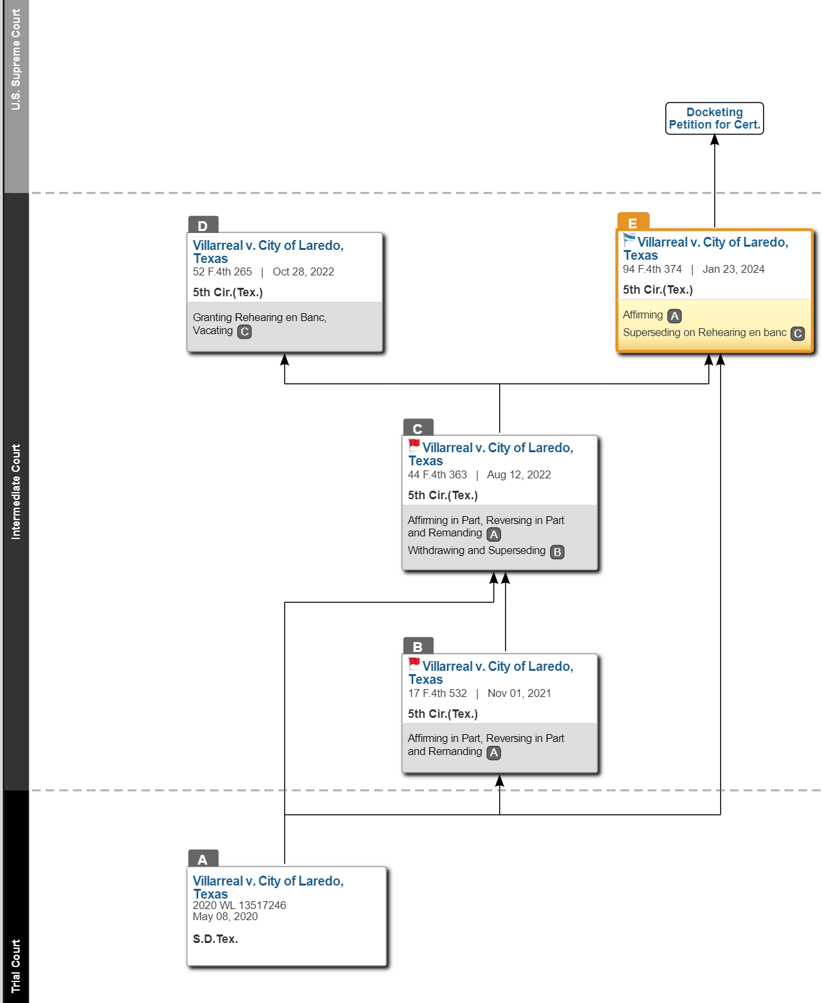
“Breaking the Law, Breaking the law….”

Slide 17
“What will SCOTUS do?”
4 Texas statute was presumed constitutional and was not a gross or flagrant violation of First Amendment;
5 independent intermediary rule shielded police officers from liability;
6 journalist did not have clearly established First Amendment right to ask questions of a government official; and
7 journalist failed to plead First Amendment retaliatory arrest claim.

Slide 18
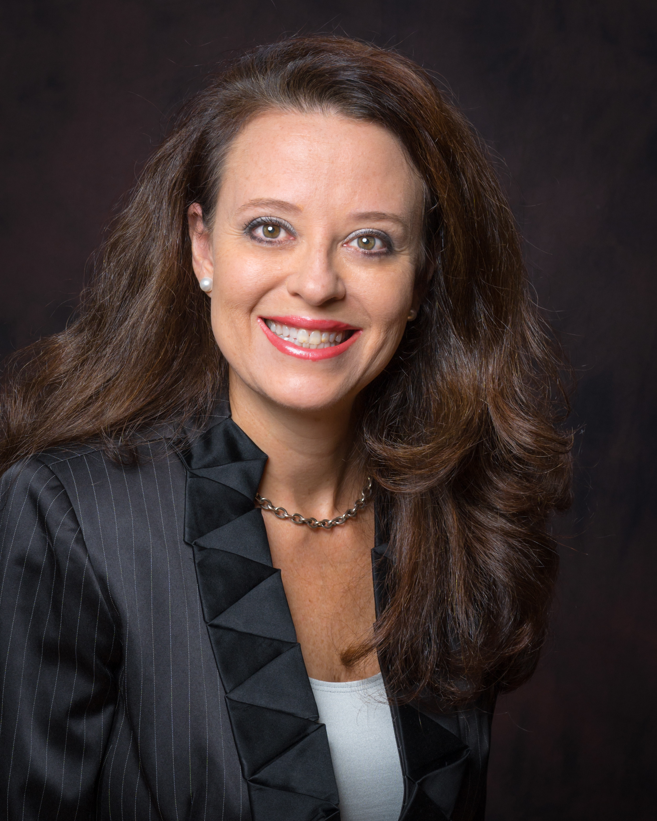
GET HELP!
www.txlocalgovlaw.com
512-686-0700 Office
---------------------------------
210-325-4330 Mobile
ghyde@txlocalgovlaw.com

