Slide 1
WHAT IT MIGHT BE, WHAT IT DEFINITELY ISN’T AND WHAT HR’S ROLE SHOULD BE

Slide 2
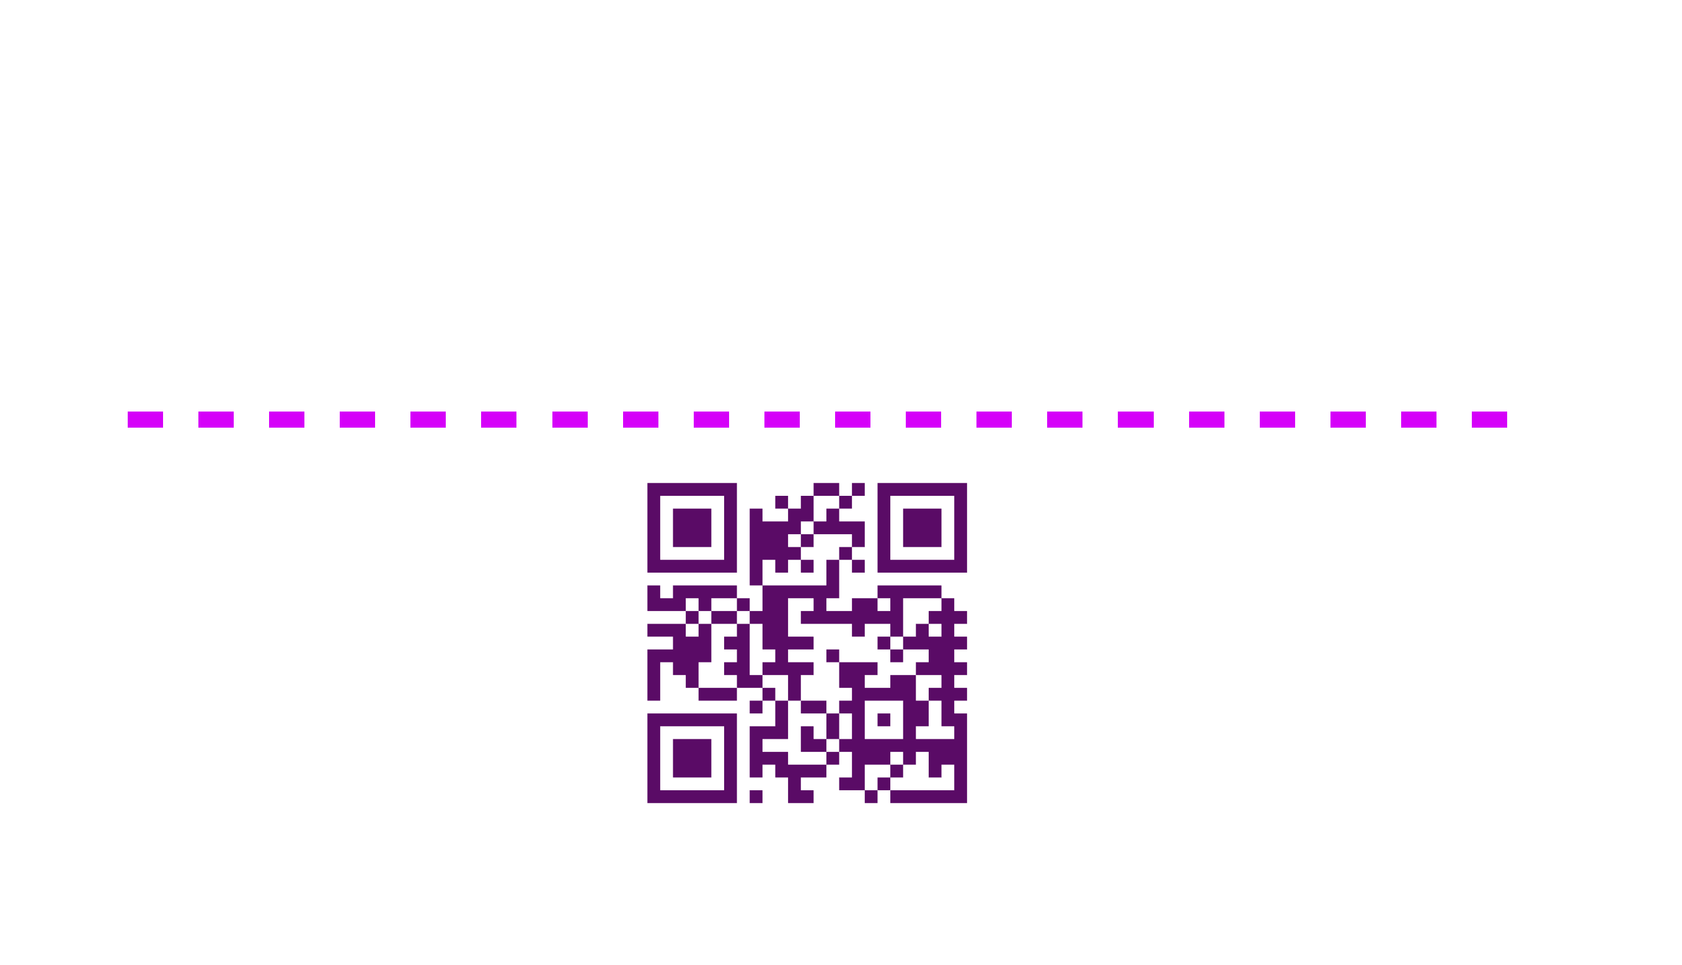

Slide 3
Notes:
Poll Title: Do not modify the notes in this section to avoid tampering with the Poll Everywhere activity. More info at polleverywhere.com/support How engaged and energetic are you feeling about this session? https://www.polleverywhere.com/multiple_choice_polls/wPKgTPKjlKKN6uZaPY79k?state=opened&flow=Default&onscreen=persist

Slide 4
98.3 MILLION

Slide 5
MCKINSEY & CO ATTRITION RESEARCH STUDY; SEPTEMBER 2021
GALLUP TURNOVER AND ENGAGEMENT SURVEY SUMMARY; JAN 2022
US BUREAU OF LABOR STATISTICS, “JOLTS” SURVEY; JAN 2022

Slide 6
Lack of Opportunity/
Job Instability
MCKINSEY & CO ATTRITION RESEARCH STUDY; SEPTEMBER 2021
GALLUP TURNOVER AND ENGAGEMENT SURVEY SUMMARY; JAN 2022
US BUREAU OF LABOR STATISTICS, “JOLTS” SURVEY; JAN 2022

Slide 8
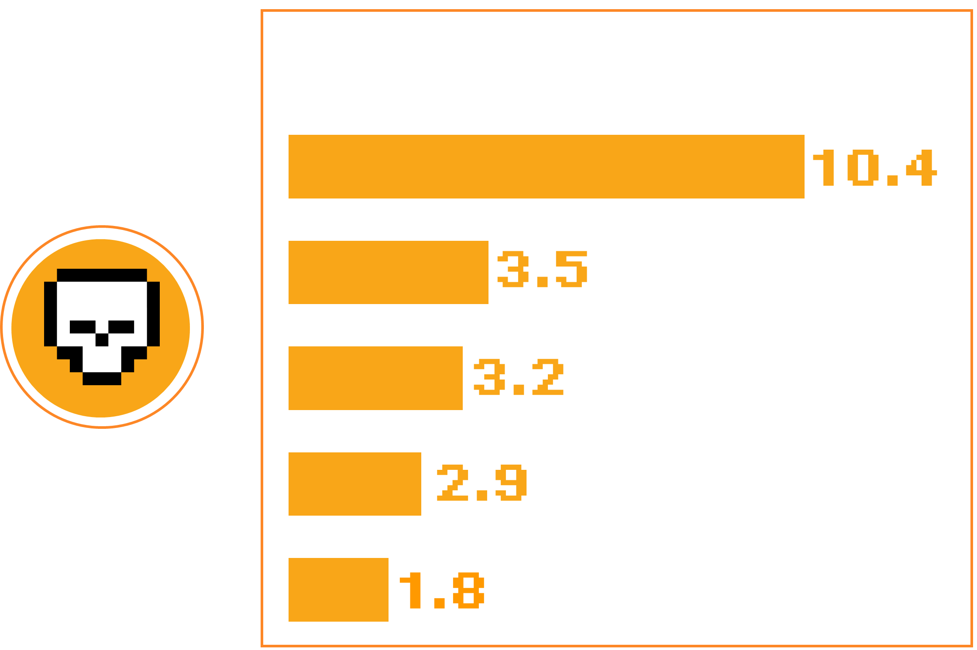
MIT SLOAN; TOXIC CULTURE IS DRIVING THE GREAT RESIGNATION; JAN 2022
REVELIO LABS; CULTURE 500 INDEX; JAN 2022

Slide 10
WHAT IT DEFINITELY ISN’T

Slide 11
WWW.POLLEV.COM/JRYAN306

Slide 12
Notes:
Poll Title: Do not modify the notes in this section to avoid tampering with the Poll Everywhere activity. More info at polleverywhere.com/support What do you think we get wrong about "culture"? https://www.polleverywhere.com/free_text_polls/JCyq0bKMoYGLv6ct6Wfhb

Slide 14
WWW.POLLEV.COM/JRYAN306

Slide 15
WWW.POLLEV.COM/JRYAN306

Slide 16
Notes:
Poll Title: Do not modify the notes in this section to avoid tampering with the Poll Everywhere activity. More info at polleverywhere.com/support What Do You Think Culture Might Be (For Better or Worse)? https://www.polleverywhere.com/free_text_polls/dcQnxUz899qox1EMhZRgx

Slide 17
WHAT HR’S ROLE SHOULD BE

Slide 18
WHAT CAN WE DO ABOUT IT?

Slide 20
RETHINK.
RECONSIDER.
RETRY.

