Slide 1
Performance Management Reimagined
Performance Management with a Purpose
Notes:
Today I get to talk about something near & dear to me. Too often, performance management is when someone is struggling, or it is time to determine raises. Today, I’m going to talk about what it looks like when it becomes an integral part of managing your business.

Slide 2
Goals
Understand performance management
Get the right people in the right seats
Improve outcomes
Notes:
I want you to walk out of here today with an understanding of what performance management is, how to get the right people in the right seats, and how to keep them engaged

Slide 3
Outcomes
Know what the right fit looks like
Know how to measure performance
Refine processes and procedures (best practices) for improved productivity
Notes:
To do that, you need to start by knowing what the right fit looks like. Then, you have to know how to measure performance and be willing to continually refine processes. “We’ve always done it that way” is a common message in organizations but it isn’t a good one. Want to lose employee buy in quickly? Give them outdated processes, or worse yet, discount their areas of expertise.
Let’s start by talking about employee buy-in

Slide 4
Employee buy-in
understand the importance of their work
agree with the organization’s mission
willing to go above and beyond
Notes:
To buy in, employees must feel valued. They have to believe they are making a difference. And when they do, they are usually willing to go above and beyond to make that happen.

Slide 5
Corporate Leadership Council (CLC)
87%
29%
18%
15%
less likely to leave their organizations
Actively engaged
Decrease turnover
Are satisfied with advancement opportunities
Notes:
Why do we care? The CLC tells us that highly engaged employees
are 87% less likely to leave their organizations than disengaged employees.
Yet Only 15% of employees are actively engaged at work and only 29% are satisfied with advancement opportunities
Businesses that actively engage their employees can see an 18% decrease in staff turnover

Slide 6
Performance Management
Notes:
When we hear this term, we tend to think about performance improvement plans and annual reviews. Personally, I hate both. Anyone else?
I promise, I’m not here to teach you a better way to do them. If you fix the process, annual reviews can go away… or if you still need them for your raise and promotion process they become much easier and more transparent.

Slide 7
What it is & What it isn’t
IT ISN’T
Something that should only come out when employees aren’t doing what they are supposed to
Something we should focus on once a year
IT IS
a systematic process that involves employees in improving the effectiveness of an organization to achieve its goals
This Photo by Unknown Author is licensed under CC BY

Slide 8
It is about managing & improving performance
Notes:
It is about creating career paths for employees – even when those paths don’t end in your organization

Slide 9
Start with Mission Vision & Values
Do you know what they are?
Do you use them for decision making?
Do your employees know what they are?
Do your employees use them for decision making?
Notes:
Who in here can tell me what their city’s MVV are?
How do you disseminate and use this information?
For a government entity, this should be fairly simple. At a high level, you are there to serve your citizens.

Slide 10
Mission
The Texas Municipal Human Resources Association mission is to grow and enhance the professional development of our dedicated and compassionate members through effective knowledge sharing and relationship building.
Purpose
The purpose of this Association shall be to promote excellence in personnel and human resource administration in Texas municipalities. Organized in 1950 to promote, encourage, and advance the professional development of public personnel practitioners throughout the state of Texas. Today TMHRA continues to offer its members a unique forum where the interests, concerns, and problems affecting civil service and personnel professionals can be shared and discussed.
Notes:
Of course, I had to look up TMHRA, and they seem to be doing a great job with applying their mission.

Slide 11
Lewisville, Texas
To improve the quality of life for its community and provide effective municipal services.
The city's values are "Value People,” "Build Our Future,” and "Serve Every Day“
The city's strategic plan includes:
Being a values-driven organization
Maintaining a stable, high-performing workforce
Being a data-driven city
Notes:
But I also wanted to look at a city. Since I’m in the great city of Lewisville, I had to choose it. Anyone here from Lewisville?

Slide 12
Does your hiring align?
Job Descriptions (formal & informal)
Interview Practices
Onboarding
Management
Notes:
Are you putting emphasis on culture critical abilities? Do your job postings define your mission? Are you talking about them during interviews and does leadership exemplify your mission, vision and values? Again, are we making decisions with them at the forefront?

Slide 13
Define your Differentiator
What makes you an attractive employer?
Notes:
~ What is your differentiator as an employer? Focus on this. It isn’t just about the money. As a matter of fact, this environment is NOT about the money. More money helps short term but it won’t fix your overall issues.

Slide 14
Culture
An organization's culture defines the proper way to behave within the organization.
…
Organizational culture sets the context for everything an enterprise does.
~ Society For Human Resource Management (SHRM) ~
Notes:
Get clear – and real – about your culture.
You determined your differentiator when you were in the recruiting phase, now it is time to walk the walk. Be prepared to talk about the culture
Be realistic. We all have “warts” in our organization. Own them. Improve them where you can, but bring them out in the open. Hiding challenges creates more problems than it solves.
Focus on what matters to you and your employees. What are your non negotiables. Get clear about ensuring every employee meets those. When hiring candidates, ask them what their non negotiables are. Be upfront in how you can meet them.

Slide 15
Effective Job Descriptions
Abilities vs Skills
Eliminate unnecessary requirements
This Photo by Unknown Author is licensed under CC BY-SA-NC
Notes:
Create job descriptions that focus on the right things
Think about the industries that have been most impacted like hospitality. What does the existing job seeker look like? How can YOU use those talents? We’ve gotten lazy as hiring managers because our candidate pool has become so large. We are looking for our purple squirrel. Instead, try to focus on soft skills and be willing to train the right personality when possible. Giving someone a chance can create a great employee.
Once you have figured out why someone would want to work for you, it is time to figure out who you truly need.
https://www.linkedin.com/pulse/stop-making-tactical-excuses-strategic-hiring-problem-lou-adler/
For example, too many HR and talent leaders believe that job descriptions must include laundry lists of skills, experiences, and generic competencies in order to be considered objective in the eyes of the law.
Do they really need 5 years experience in your industry? Are your educational requirements legitimate? Etc
Go through existing job descriptions. Is it accurate?

Slide 16
JOB POSTING vs JOB AD

Slide 17
Right People in the Right Seats
Notes:
Now that you have the right people in the right seat, it is time to put measures in place to protect them.

Slide 18
Employee Onboarding
This Photo by Unknown Author is licensed under CC BY-ND
This Photo by Unknown Author is licensed under CC BY-SA-NC
Notes:
#1 piece of advice here is to be prepared on their first day. Make sure they have everything they need the second they walk through the door.
Have their hiring paperwork ready
Have a mentor or a buddy ready to take them through the first day
Too many new employees are thrown in the deep end, left to figure it out for themselves. Don’t be that employer. Training doesn’t have to be overly formal, but it is necessary for every. Single, new. Hire.
How are things done? How does the company software work? Where’s the bathroom? Who do they need to know? What’s the chain of command for questions?
HOW YOU START IS HOW YOU CONTINUE. If you don’t feel valued on day 1, how long does it take to become disengaged?

Slide 19
Your Goals
Align
Align employees with Mission & Vision
Document
Document Processes to track
Produce
Produce Playbooks
Institute
Institute conversations to continuously improve
Create a culture of Continuous Improvement
Notes:
There is a concept called Kaizen. It is a brilliant concept and one we should always be employing. And that is the idea of continuous improvement.
Your goals, as HR professionals should be to hire employees who align with the city’s mission and vision, help leaders document processes and track results, use that information to create playbooks, then institute regular, ongoing conversations to help each department continuously improve.
If you don’t know where to start, start with your department. Other leaders will see it and become interested. To date, that hasn’t not happened, but if they aren’t organically stepping up, there is always a department that knows it needs change. Start there.

Slide 20
What is a Playbook?
By Department
Functions
Job Descriptions
SOPs
Metrics / KPIs
Goals
Career Paths
Notes:
We all know that communication is key – at the individual level, but also at the organizational level. How do we ensure everyone understands their purpose and what is expected of them? I love to c
It starts with your department, then you push this out throughout your organization. This is a process, it happens one leader and one department at a time
I don’t care what you call this, if you don’t have this information readily available and at the fingertips of all employees, it is time to put it in place.

Slide 21
Do you know what your organizational goals are?
Key Performance Indicators
Do you know how to track your goals?
Notes:
Start small. Start by tracking how long tasks should take. Is the accounting department getting the books closed by the 10th of every month? That is a metric. Are your life guards and swim instructors showing up and ready to work at their scheduled time? All all certifications current? All of these are easy metrics. If you don’t have them in a department, start by tracking what is already there. Deeper metrics come with time, and of course, there are consultants like me that can help you determine what they are. Oh… and they should align with your mission!

Slide 22
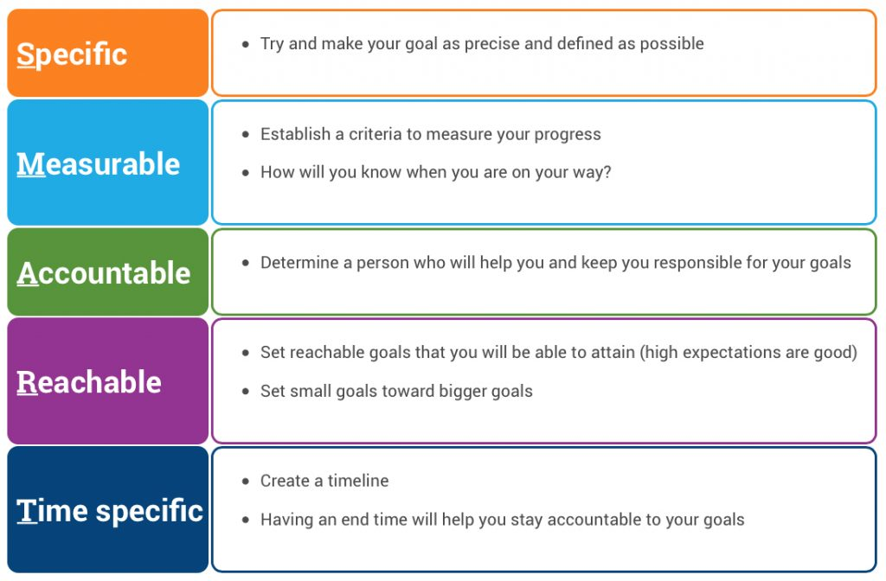
GET S.M.A.R.T.
This Photo by Unknown Author is licensed under CC BY-SA-NC
Notes:
I’m working with a client who just took over an HR department of 1. 20% of her salary depends on a bonus – but that bonus isn’t clearly defined. While I know her employer means well and wants her to succeed, how do we know when she met them?
Setting goals also helps us to determine what our department metrics should be.
I know most of us have heard of these – but are we using them? It truly can be this simple if we choose to use it. But… how do we set these goals in a fair manner, that benefits the organization?

Slide 23
Improve Organizational Outcomes
Notes:
Through accomplishment, success, clear vision and direction

Slide 24
Create Clear Expectations
Notes:
We so often expect our employees to read our minds. What comes naturally to us though isn’t always natural to others.
How many people here have kids? Do your kids sometimes misinterpret things you say in the craziest of ways? It is because they don’t know. They haven’t been exposed to this thing yet. Sometimes our employees are the same way.
I see that a lot with acronyms on resumes from people who have been in an organization for a long time. They put these indecipherable acronyms and expect everyone must know what they mean because they are so clear to them. But they aren’t always, are they?
We have to spell out our expectations.

Slide 25
Performance Based Leadership
Notes:
Oh look, here are those smart goals again. I know they can feel cliché, but leading – and following – is so much easier when expectations are clear!

Slide 26
This Photo by Unknown Author is licensed under CC BY-SA-NC
Notes:
When rolling this process out, I like to start with existing employees.
Have employees provide an overview of how they spend their time (a loose job description). Everyone should do this – we are looking for discrepancies.
This saves the leader time but also makes misunderstandings very obvious.

Slide 27
Aligns all employees with common goals
Job descriptions & expectations based on actual work
Quick & effective onboarding
Process for continuous improvement
More exact Talent Acquisition
Specific training
Uncover efficiencies and savings
Focuses performance on metrics
Teach employees how to find best practices
Notes:
Now I know we aren’t revenue generating entities here, but what would you do with a budget even twice the size of your existing one?
And how much easier would our jobs be if we could find and train the right people with less effort?
When we know exactly what is expected of each role,

Slide 28
Capture / Review Process, JD’s, KPIs
4-Step Process
Update Process In Playbook
Identify Ways to Improve Process
Test & Confirm Improvement
Notes:
The hard part is getting started. I always recommend getting started in HR. Then use the results to influence other departments to get started. Always start with the “low hanging fruit”. There are departments actively looking for help to improve and become more efficient. If you start with those leaders, others will fall in line when they start to see results – whether willingly or not!

Slide 29
This Photo by Unknown Author is licensed under CC BY-SA
Notes:
Teaching EE to manage their careers
Focus on teams as well as individuals
Phased approach with multiple meetings and check-ins

Slide 30
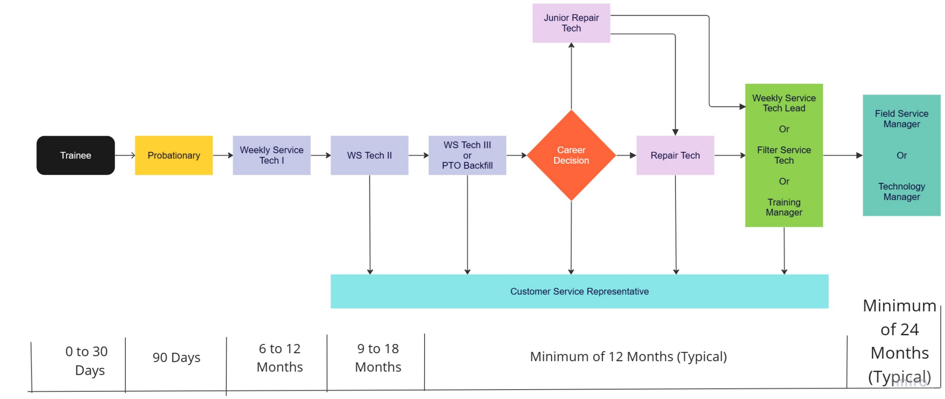
Pool Care Career Progression Options

Slide 31
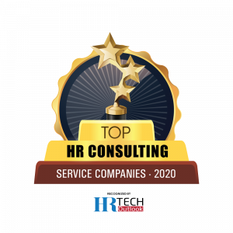
Krystal Yates
SPHR, SHRM-SCP
Krystal@IntegrityPeopleGroup.com
www.IntegrityPeopleGroup.com

