Slide 1
Non-Traditional Pathways to the City Management Suite:
How HR Professionals are Uniquely Poised for City Leadership
PRESENTERS:
Claire Powell, City Manager, City of Lewisville
Shanté Akafia, Asst. City Manager, City of Lewisville
Notes:
Introduce ourselves & frame presentation

Slide 2
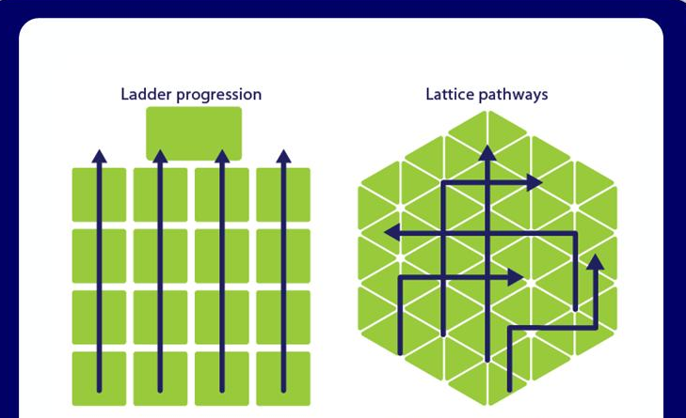
PROFESSIONAL GROWTH
Notes:
Differentiating traditional and non-traditional pathways
Career ladder--- (chart out traditional pathway to CMO-historical perspective)
Career lattice---Introduction to non-traditional pathways (mention advancement is not always connected to a promotion or a higher classification- across and sometime down—lower level of position)

Slide 3
ACCESS
Notes:
HR has more access to c suite than others. Story of how Claire got her opportunity in City Management. Importance of showing up for the team. Who is in the fox hole with you? Who do you count on?

Slide 4
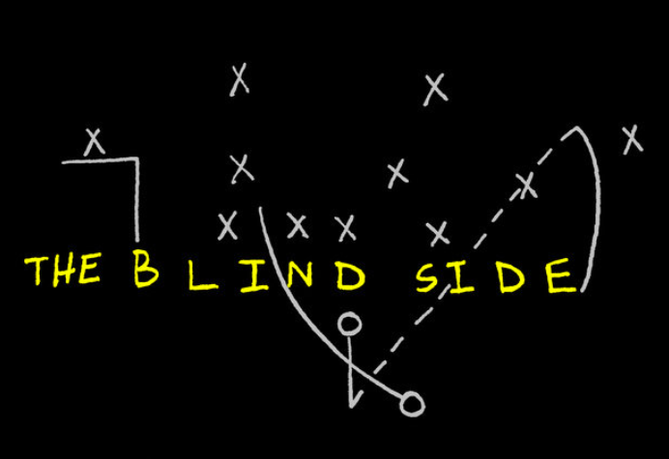
Notes:
Covering your blindside

Slide 5
TRANSITIONING TO C-SUITE
Notes:
My view of the ACM’s role (coach---moving in the direction expected from CM and Council, support—advocacy---not in their seat)
Weight of the position and unspoken authority it brings to the room (be sure not to overpower the room)

Slide 6
Notes:
HR Superhero– transferable skills
Highlight unique skills of HR professionals
Address politics– linkage to employee relations/engagement (engaging with diverse stakeholders----employee perspective (including police/fire associations) and the employer perspective----translates to the CMO understanding the needs-desires of Council, residents/community and CM)
developing and executing strategic plans within organizations, which is transferable to the CMO for addressing complex municipal issues, long range planning and achieving long-term goals
Policy/Process development=

Slide 7
TED LASSO EFFECT
1. BE A GOLDFISH
2. BE AUTHENTIC
3. NEVER TAKE THINGS PERSONALLY
4. TELL THE TRUTH TO THOSE YOU LEAD
5. BELIEVE
6. EMPOWERMENT, THEN CONFIDENCE
7. NOBODY IS BIGGER THAN THE TEAM
8. POSITIVE THINKING
9. HUMOR HELPS EASE TENSIONS
10. LOVE CHANGE

Slide 8
What Got you Here
Will Not Get you There!
Notes:
What HR Directors can do to prepare?
What got you here (your current role) will not get you there (must have a mindset of continuous improvement and a willingness to learn and grow---
Discuss opportunities I volunteered for that were outside of the HR realm
explore programs outside of HR (CPM, ICMA programs, etc.) ---

Slide 9
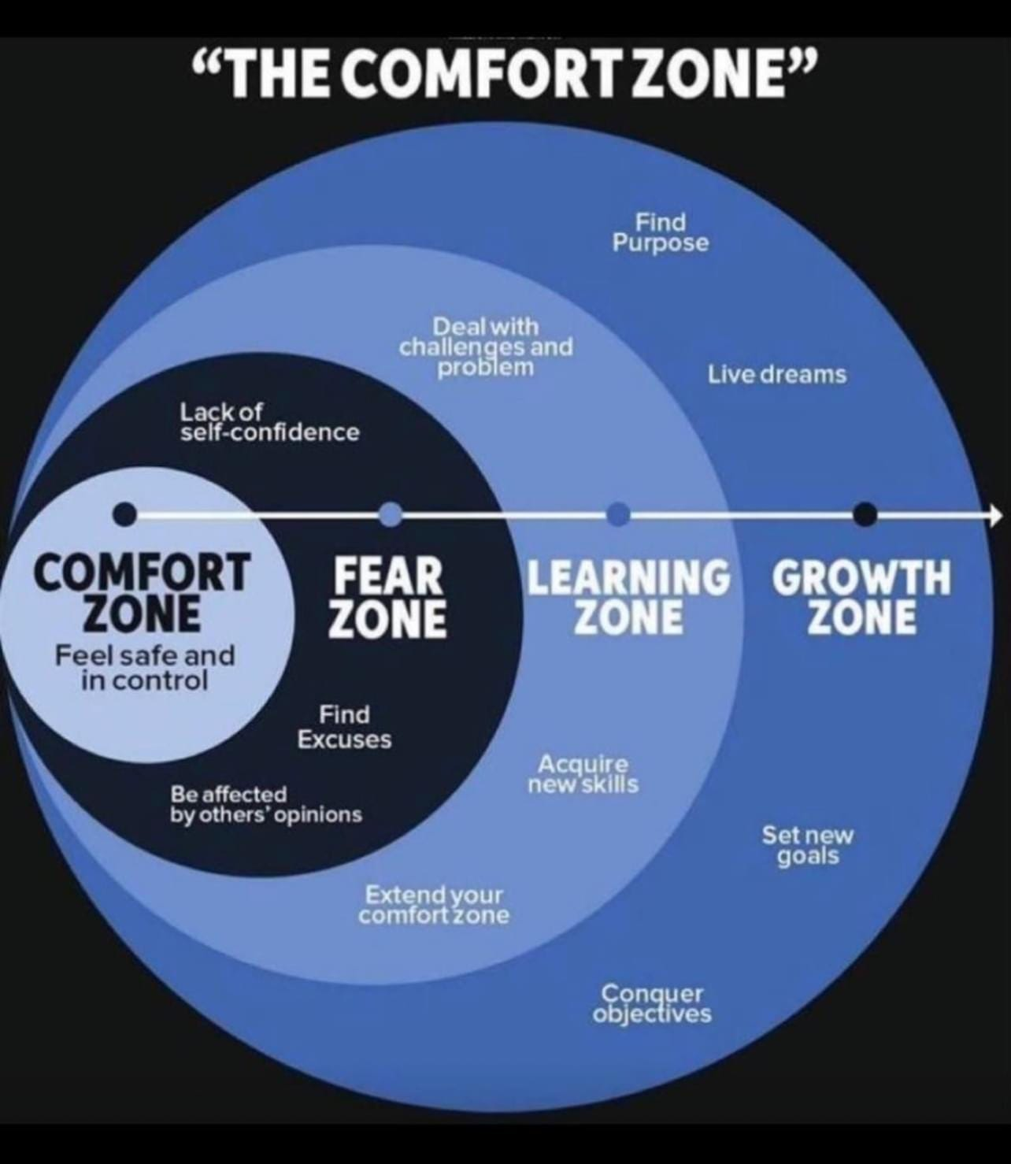
Notes:
Accept stretch opportunities (importance of a growth mindset and preparing yourself for the future)

Slide 10
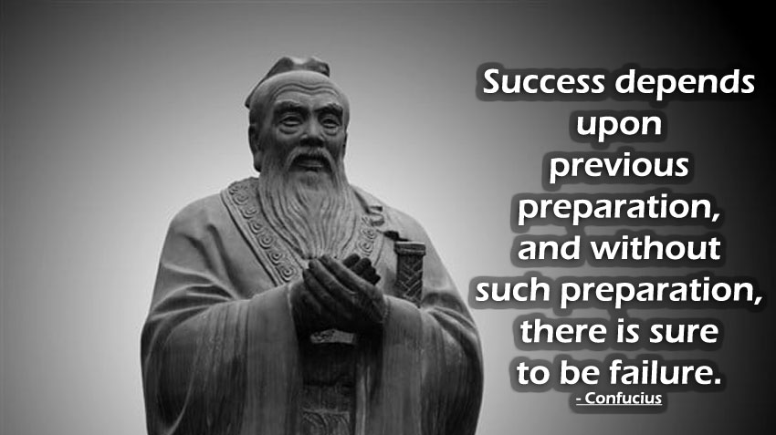
Notes:
Success occurs when opportunity meets preparation

