Slide 1


NAVIGATING THE CHALLENGES
OF
PUBLIC SAFETY EXECUTIVE RECRUITMENT
A Nuanced Approach
Chief Chris Connealy (Ret.) M.S., Associate Vice President
and
Michael Boese, M.P.A., President

Slide 2

REFLECT ON YOUR PREVIOUS ENCOUNTERS WITH RECRUITING A PUBLIC SAFETY LEADER AND THE RESULTS THAT FOLLOWED.
Were the candidates able to meet your expectations in terms of their resume, cover letter, and interview?
Did the candidate's previous performance set a high standard for aligning with the organization's needs and potentially surpassing expectations?

Slide 3
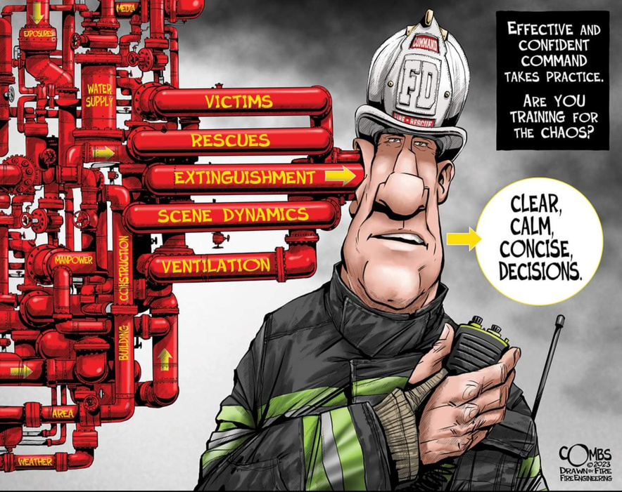
ORGANIZATIONAL NEEDS
It is critical to know and understand the organization’s needs in order to recruit and select a successful leader.

Slide 4
QUALIFICATIONS VS. DELIVERING RESULTS
Qualifications:
Education, Certifications, Experience - Positions held
While this information is crucial and forms the basis for job postings, it is only a portion of what employers must pin down to choose the ideal candidate.

Slide 5
QUALIFICATIONS VS. DELIVERING RESULTS
Distinguish knowledge from experience
IQ vs. EQ: Assessing Candidates' Emotional Intelligence
  Previous Experiences
  Communication Skills
  Empathy
Candidates need to showcase a history of achieving results that have brought about positive changes within organizations in various roles and over their career.
  Cultivate Organizational Culture
  Drive Continuous Improvement
  Minimize Risk Exposure

Slide 6
CANDIDATE CHECKLIST
Create a checklist for candidates to identify the following crucial traits:
Serving on organizational committees and the deliverables brought about through the committee. What was their role on the committee?
Serving in different positions in the organization and documentation of accomplishments achieved through that service.
Seeking opportunities to make organizational improvements and subsequent results.
Involvement in addressing organizational challenges/failures to minimize risk going forward. They run toward challenges to make things better versus avoiding them. “Being in the Arena”.

Slide 7
CANDIDATE CHECKLIST
Volunteering in the Community and notable accomplishments.
Taking on difficult assignments and outcomes defined.
Project management experiences and results.
Creation of new programs and verifiable outcomes through data.
Presenting at conferences on various topics/endeavors that document organizational improvement and assist other organizations to make needed changes.
Awards received related to accomplishments to make the organization/profession better.

Slide 8
EXAMPLES THAT GO BEYOND QUALIFICATIONS
  Receiving awards for accomplishments during your career
  Serving on NFPA and other work-related committees and results from that service
  Creating programs that are recognized as a best practice to improve that area of the profession – Examples: Texas Fire Chiefs Association Best Practices Program, Science Advisory Workgroup to improve fire investigations and recommended as a national best practice in NIST-OSAC report, Teen Advocates for Community Safety
  Outreach to 68 counties after West Fertilizer Plant Explosion
  ISO Class Improvements, Center for Public Safety Excellence Accreditation
  Organizational improvements that brought about positive results

Slide 9
ORGANIZATIONS ARE NOT THE SAME
Cultural Priorities: One organization may prioritize innovation, encouraging creative thinking and new ideas, while another may enforce rigid adherence to established methods, stifling independent thought and initiative.
Employee Development Focus: Some organizations invest heavily in employee training and professional growth, seeing it as essential to success, whereas others may neglect development opportunities, focusing solely on immediate productivity.
Accountability: In certain environments, strict adherence to rules and accountability is fundamental, ensuring transparency and consistency, while others might operate with lax oversight, leading to a culture of unpredictability and potential ethical issues.
Leadership Style: Leadership in one organization can be empowering and supportive, actively fostering a collaborative and engaging atmosphere; in contrast, another might be autocratic, with decisions made unilaterally and little input from staff.

Slide 10
EMOTIONS & LEADERSHIP
Emotionally Aware Leadership: Candidates should recognize their own emotions and those of others. Emotionally aware leaders create an environment where feelings are planned for, acknowledged and respected, rather than ignored or suppressed.
Emotionally Attuned Change Management: When implementing changes within the organization, a skilled leader will consider the emotional impact these changes may have on employees. Planning change processes that include transparent communication, and support structures. The ability to manage anxiety and uncertainty, making transitions smoother and more inclusive.
Lead from the front: Ability to work alongside those in the organization, exemplifying inspired leadership by directly engaging in the tasks others perform, enhancing his understanding of impactful decisions.

Slide 11
CANDIDATE INTERVIEWS:
Holistic Understanding: Allowing candidates to express their personal and professional experiences gives the selection committee a comprehensive view of how well-rounded their capabilities are for the position.
Leadership Evaluation: Interviews should include scenario-based questions that require candidates to demonstrate their leadership style and decision-making process.
Demonstrating Competency: Encourage candidates to discuss specific past projects or challenges they've managed.
Assessing Emotional Intelligence: Incorporate questions that explore their level of emotional intelligence, including self-awareness, empathy, and social skills.
Culture Fit: Give candidates a platform to discuss their values and motivations, and how these align with the organization’s culture.

Slide 12
TRUST BUT VERIFY THE CANDIDATE’S REPORTED RESULTS/OUTCOMES WHERE POSSIBLE
  Internet search for articles validating reported results/awards
  Seek feedback from organizational sources – not just friends of the applicant
  Does the resume match actual results?
  Change agents should have some road rash experiences because implementing organizational change is never easy, but critical to organizational progress.
  Some failures/controversy in a career should not necessarily be a disqualifier!
  You want leaders that seek continuous improvement versus just keeping the lights on…

Slide 13
WHAT DO YOU DO IF YOUR CURRENT CHIEF IS NOT MEETING EXPECTATIONS?
Provide coaching, mentoring, and expected outcomes. Attain better results in a defined time period. This cannot be a career project! If not achieved fairly quickly, make a leadership change. You are only as good as your leadership team.

Slide 14

Q & A
TIME

Slide 15



CLEAR CAREER PROFESSIONALS
THE CLEAR CHOICE
THANK YOU
CHIEF CHRIS CONNEALY (RET.) M.S.
MICHAEL BOESE (RET.) M.P.A.
(512) 961-2999
(972) 837-0916
chiefconnealy@clearcareerpro.com
michael@clearcareerpro.com
www.clearcareerpro.com

