Slide 1
Money Talks: Multigenerational Financial Planning
May 8, 2024

Slide 2
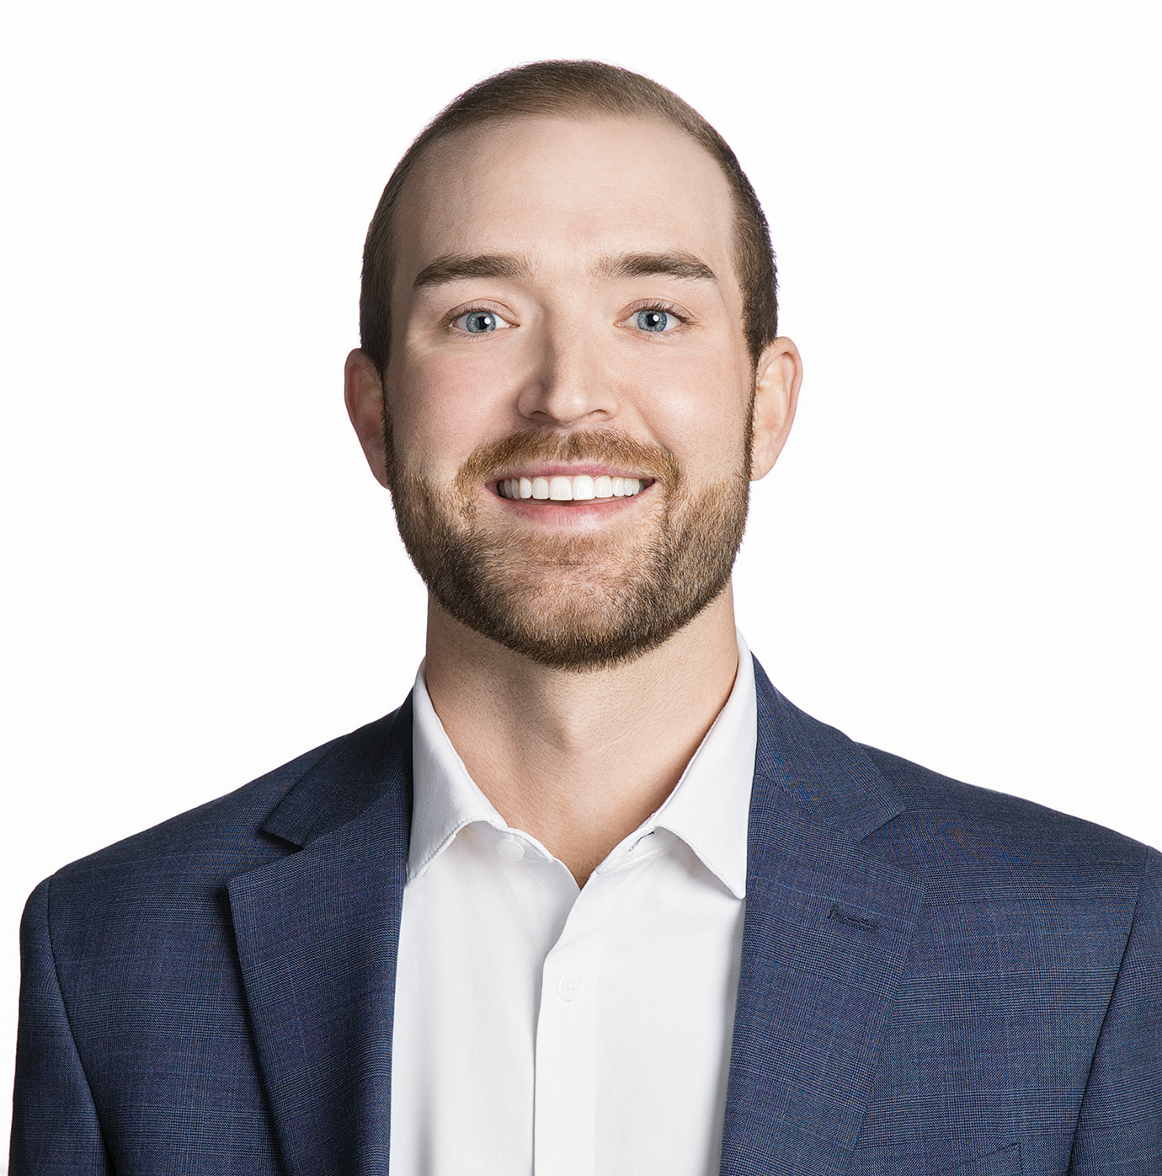
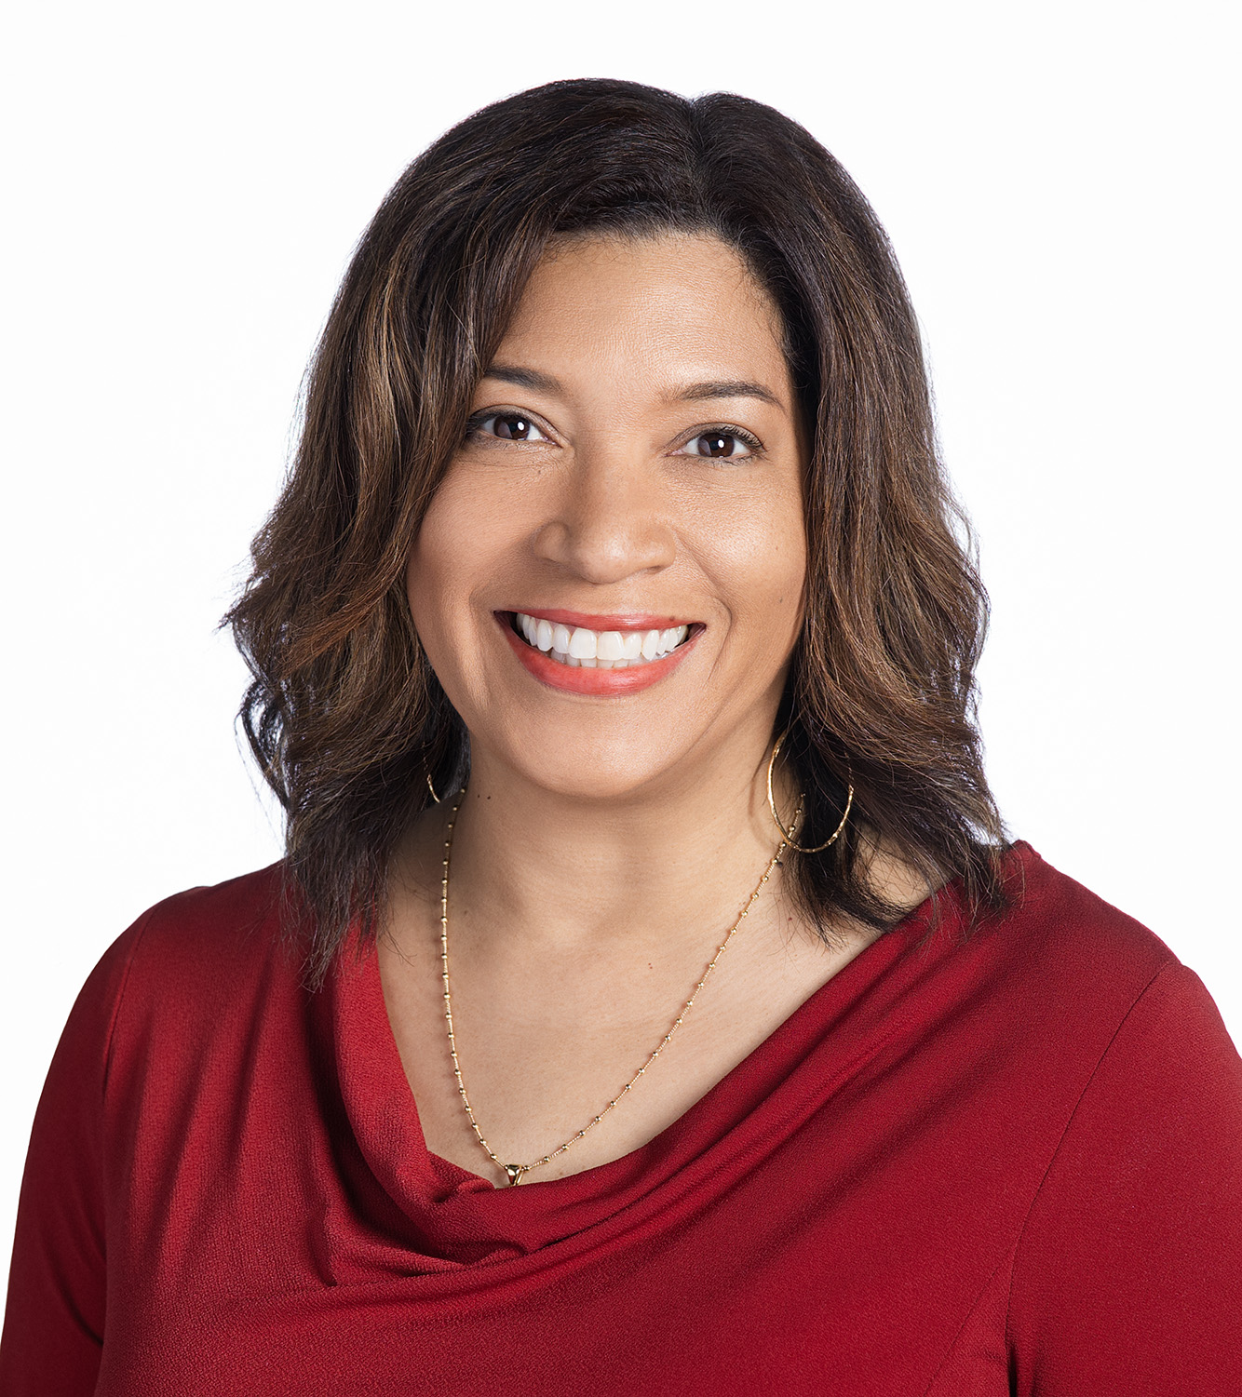
Your HUB Retirement and Wealth Management Team
Darrell Ellisor, ChFC®, AIF®, CLU®
SVP - Retirement Practice Leader darrell.ellisor@hubinternational.com
Janine Moore, AIF®, CFS, CPFA®
SVP - Retirement Practice Leader janine.moore@hubinternational.com
Joe Conzelman, MS, CRPS®, CPFA®
VP - Retirement Plan Advisor joe.conzelman@hubinternational.com
Blake Hiett, CPFA®
AVP - Retirement Plan Advisor blake.hiett@hubinternational.com
Susan Blassingame
Senior Account Manager
susan.blassingame@hubinternational.com
Alicia Alba
Account Manager alicia.alba@hubinternational.com
Kristin Baker, CPFA®
AVP – Retirement Plan Advisor
kristin.baker@hubinternational.com
Abbie Cone
Account Manager abbie.cone@hubinternational.com

Slide 3
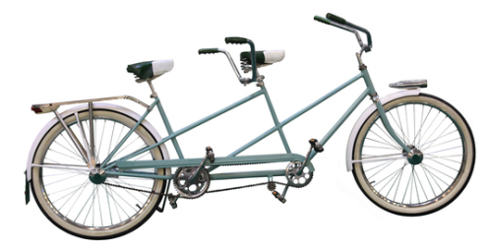
The Traditional Retirement Story
Notes:
While the context of retirement has changed dramatically, the story of retirement has not. The traditional retirement narrative goes something like this: The protagonist is most often a man, sometimes a couple. A lifetime of work is punctuated with a clear end date and captured by the image of an office retirement party. Today’s retirement story presents life after work as a reward for decades of 9 to 5 hours and long commutes. The reward is time – earned time to relax. The feeling is all about freedom, although the choices reflect a narrow range of sunset beach walks – sometimes mixed with an occasional bicycle ride or golf course view. Our happy retiree, perennially tanned and youthful, is sometimes mixed with equally happy grandchildren, at a resort or on a theme cruise.
This story is not altogether incorrect, but it is woefully incomplete.
Source: Inventing a new story for 8,000 days of retirement, Bank Investment Consultant, 9/7/16.

Slide 4
The NEW Retirement Story
Notes:
Today’s retirement story fails to capture the differences of the next generation retiree and the context of their life. For example, while there is often a male figure portrayed as planning for the future with a financial professional, this story narrative ignores the vast number of baby boomer and Gen X women that have their own careers. Moreover, women, not men, are most likely to be the primary consumer and caregiver of the household, making them the most knowledgeable on what future financial demands are likely to be. (Source: The Sate of Women and Caregiving, Caregiving.com 03/2021)
Other realities missed in that traditional view include lower fertility rates and gray divorce. With fewer children per family than previous generations, future retirees will have fewer adult children to provide physical, emotional, social or financial support in older age. Even retirees with offspring may find that their adult children live many miles or time zones away. According to Merrill Lynch, the divorce rate for people over 50 years old has increased an estimated 700 percent since 1960. (Source: Family & Retirement: The Elephant in the Room, Merrill Lynch, 2015. Most recent data available used)
Unlike past generations, retirement is no longer a relatively brief period at the end of our lives. Indeed, for those with greater education and income, there is likely to be an even greater period of well-being in retirement giving far more time to do more than walk an endless beach.

Slide 5
Age is just a number
María Branyas Morera 117 (as of 03/29/24)
Jeanne Calment 122
Kathrine Switzer 75
Julia 'Hurricane' Hawkins 107
Notes:
María Branyas Morera
María Morera took the title of oldest living woman upon the death of Lucile Randon, a Catholic nun also referred to as Sister Andre. Maria, born March 4 1907 was aged at 115 years 319 days as of January 17, 2023. Born in San Francisco, California, Maria moved to Catalonia in 1914 where she has lived since. She attributes her longevity to an orderly life that is socially pleasant and without excesses.
(Source: Oldest Person Living, Guinness World Record, 01/17/23)
Kathrine Switzer - First Woman to Enter Boston Marathon Runs It Again, 50 Years Later
Fifty years ago, a runner officially entered as K.V. Switzer participated in the Boston Marathon. On Monday, April 17, 2017 she did it again at age 70.
(Source: First Woman to Enter Boston Marathon Runs It Again, 50 Years Later, The New York Times, The New York Times, 4/17/17)
Jeanne Calment
Jeanne Calment, born in 1875, a year before Alexander Graham Bell patented his telephone and 14 years before Alexandre Gustave Eiffel built his tower, died in 1997 in a nursing home in Arles. At 122, she was the oldest person whose age had been verified by official documents. But a new investigation claims her daughter actually assumed her identity in 1934. The French, who celebrated her as the doyenne of humanity, had their own theories about why she lived so long, noting that she used to eat more than two pounds of chocolate a week and treat her skin with olive oil, rode a bicycle until she was 100, and only quit smoking at age 117.
Source: Was the World’s Oldest Person Ever Actually Her 99-Year-Old Daughter? Smithsonian.com, 1/2/19.
Julia 'Hurricane' Hawkins
104-year-old Julia “Hurricane” Hawkins set a new Senior Games record for the 50-meter dash in the women’s 100 plus division. Hawkins says running is what has kept her mind and body sharp, and every time she steps on the track she has one goal in mind. “I hope I’m inspiring them to be healthy and to realize you can still be doing it at this kind of an age,” Hawkins says.
Source: 103-year-old runner Julia "Hurricane" Hawkins breaks new record, CBS News, 6/19/19

Slide 6
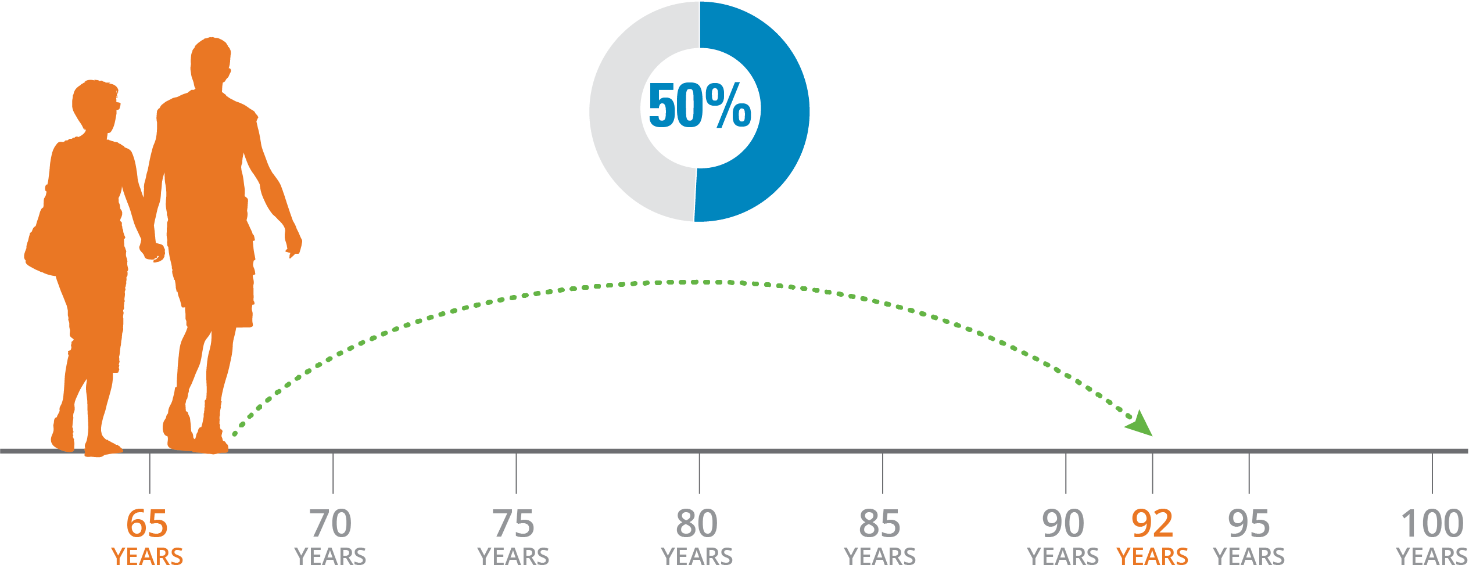
Longevity
Likelihood that one or both partners age 65 will survive to at least age 92
Source: How Much Do You Need for Retirement if You Live to Be 100?, newretirement.com, 6/20
Notes:
Social Security data, which measures the overall U.S. population, now shows that for a couple who are 65 today, there’s a 50% chance that one of them will be alive at age 92.¹
Raise your hand if your parents or grandparents lived to age 85. Anybody in the room? How about age 90? Past age 95? Age 100?
In 2016, there were 82,000 centenarians in the United States. This figure is expected to increase to 589,000 in the year 2060.²
Why? Life expectancies are increasing because of advances in medical therapies and technologies and healthier lifestyles. Generally speaking, when we look at demographic trends the fact that we’re living longer is no accident.
The U.S. is already among the top quarter of oldest countries, and with an aging baby boomer population and advances in medicine and technology that help people live longer, the country is only getting older. It’s expected that by 2050, more than 1 in 5 people will be over the age of 65 in the U.S.³
The Census Bureau predicts that by 2035, the demographic scales will tip further, as adults (especially those over age 65) are expected to outnumber children for the first time in US history!³
Longevity trends are not only increasing in the United States, but around the world.
¹How Much Do You Need for Retirement if You Live to Be 100?, newretirement.com, 6/20
²Number of people aged 100 and over (centenarians) in the United States from 2016 to 2060, statista.com, 1/21
³Aging in America, in 5 Charts, usnews.com, 9/19

Slide 7
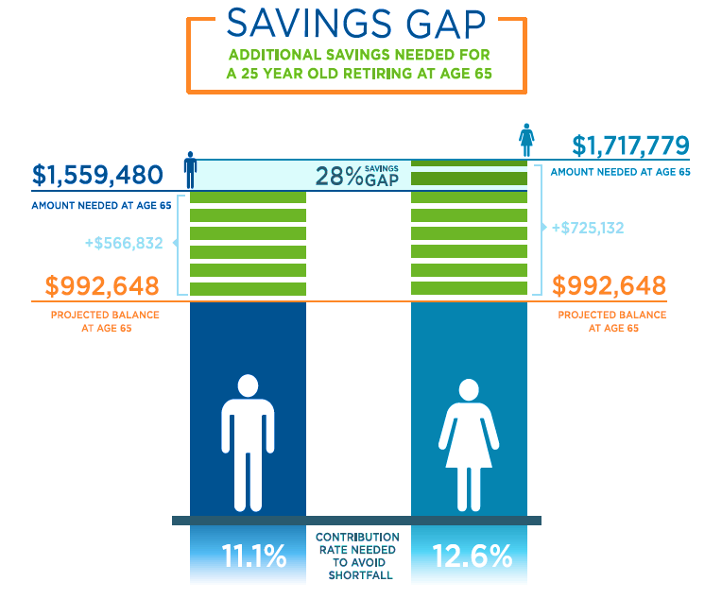
Savings Gap
7
© 2024 HUB International Limited.

Slide 8
Gender Gaps and Shortfalls

Slide 9
Save Early
Save aggressively during your early career to prep for future breaks
Build your future retirement savings before the kids’ college funds
Save in an IRA even if you take a break from your career

Slide 10
Agenda
8,000 Days
Four Phases of Retirement
Preparing for Your 8,000 Day Retirement

Slide 11
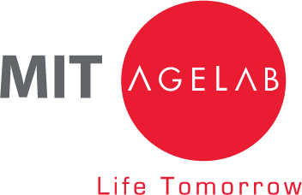
Challenges and opportunities of longevity
Consumer behavior and decision-making
Trends in demographics, technology, and lifestyles
The future of retirement
11
Notes:
This presentation was built on research from the MIT AgeLab.
The MIT AgeLab was created in 1999 to invent new ideas and creatively translate technologies into practical solutions that improve people’s health and enable them to “do things” throughout their lifespan.
The MIT AgeLab applies consumer-centered systems thinking to understand the challenges and opportunities of longevity and emerging generational lifestyles to catalyze innovation across business markets.
The Hartford, our parent company, was a founding partner of the MIT AgeLab in 1999.
The MIT AgeLab provides insights to Hartford Funds about consumer behavior and decision-making, and trends in demographics, technology, and lifestyles. These trends shape the future of retirement and impact the way people do business with financial-services providers.

Slide 12
“We have a longevity paradox. Now that we have achieved what humankind has tried to achieve since it has walked—living longer—we really don’t have a good idea of what to do with all that additional time.”
— Dr. Joe Coughlin,
Director of the MIT AgeLab
Notes:
Read Quote

Slide 13
Life in 8,000 Day Segments
Source: 8,000 Days, MIT AgeLab, 2017
Notes:
Let’s begin with 8,000 days.
Dr. Joe Coughlin explains how we can consider our lives in four 8,000 day segments, “Here is some basic math about time, not finances, in retirement. A person’s life can be divided into four periods averaging nearly 8,000 days each. Birth to college graduation is about 7,700 days. College graduation to midlife crisis is another 8,700 days. Midlife to the retirement age is another 7,300 days. And, add about another 8,000 days from your retirement party to life’s end. In sharp contrast to retirement being a brief period of relaxation and reward, it is an entire life stage waiting to be invented.”
Source: MIT AgeLab, 2017

Slide 14
Four Phases of Retirement
Notes:
Now let’s look at our second area—the four phases of retirement.

Slide 15
Four Phases of Retirement
2.
The Big Decision Phase
3.
Navigating Longevity Phase
1. The Honeymoon Phase
4.
The Solo Journey
Phase
Notes:
Here are the four phases of retirement

Slide 16
1. The Honeymoon Phase
Managing ambiguity
The role of work
Income
Family dynamics
Notes:
1. The Honeymoon Phase
Shifting responsibilities, desire to pursue existing and new interests, and additional healthy life years often allow for more freedom. For this reason, many see the first retirement as a ‘honeymoon stage.’ That is, a stage that is not quite your ‘father’s retirement’ but one that is filled with travel and participation in other leisure activities, perhaps with a balance of work, part-time employment or volunteering to remain engaged and to ensure adequate income to support loved ones.
For decades, retirement had a clear definition: Retirement was life after work. Today, however, retirement first takes a more ambiguous form. Now retirement may mean employment remaining constant, dropping to part-time, or even leading to a career change. The trend of working longer is more than anecdotal: As of February 2019, about 20% of Americans over age 65—a total of 10.6 million people—are either working or looking for work, representing a 57-year high.*
The Honeymoon Phase is characterized by resources and well-being comparable to life during full-time work. Shifting responsibilities, desire to pursue existing and new interests, and additional healthy life years often allow for more freedom. It is also the opportune time to anticipate and safe-guard against potential decreases in resources in the future through planning.
*Source: Millions of Americans are working past 65, and it's not because they can't afford to retire, Business Insider, 4/29/19

Slide 17
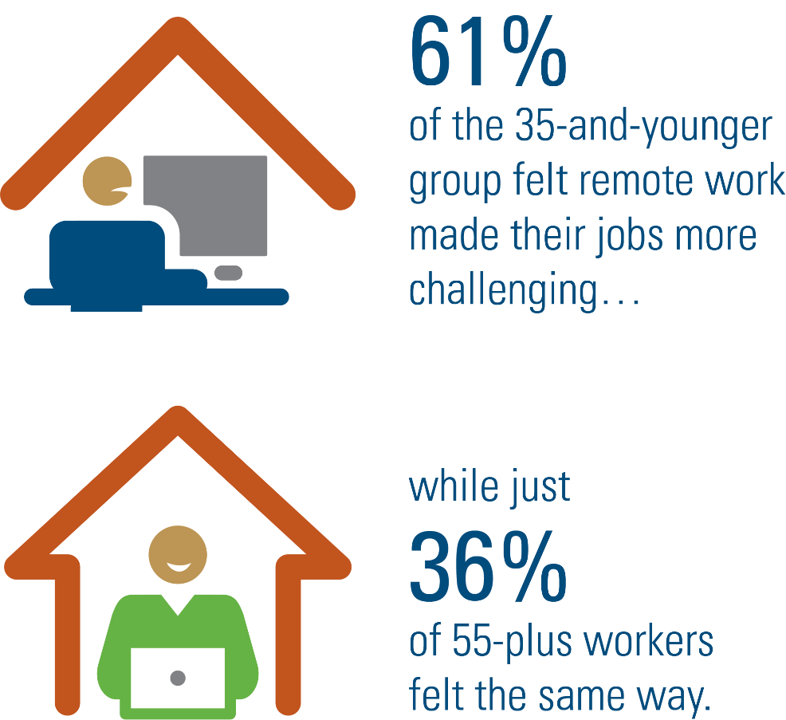
Remote Work May Actually Favor Older Workers
“With companies embracing remote work and flexible hours…it’s easier for many older people to remain employed.”
Jack Rowe, professor of public health at Columbia University.
Source: Remote Work Generation Gap May Actually Favor Older Workers, BISNOW, 2/15/21
Notes:
Discuss quote and infographic
How the pandemic affected people’s decision to retire
A Harris poll for Ameritrade found that among boomers, 9% have retired because of the pandemic, and an additional 14% are considering retirement for that reason. Retirement earlier than anticipated will mean loss of income, and in many cases, earlier drawdown of retirement income and taking Social Security at an earlier time and in a lower amount than they had planned.
On the other hand, the pandemic has caused many older workers to delay or consider delaying retirement.
The same Harris poll said that 16% of boomers reported delaying retirement, and an additional 21% reported they are considering taking that step.
Source: COVID-19 And The Future Of Aging: Prospects For Older Workers, Forbes, 10/25/20

Slide 18
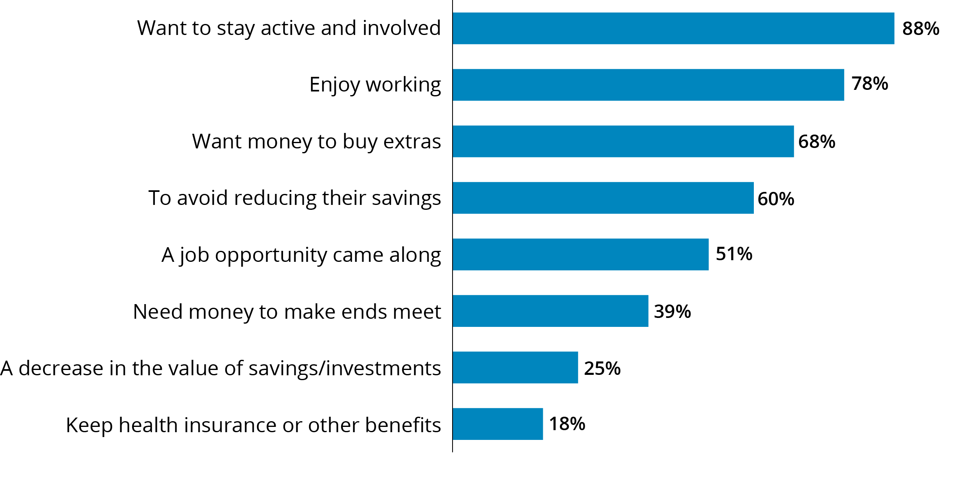
Reasons for Working in Retirement, Among Retirees Who Worked in Retirement
Source: 2022 RCS Fact Sheet #2: Expectations About Retirement, EBRI/Greenwald Retirement Confidence Survey, 2022
Notes:
Almost all retirees who worked for pay in retirement in the 2022 Employee Benefit Research Institute’s (EBRI) Retirement Confidence Survey give a positive reason for doing so. Most recent data available used. Read slide statistics.
88% of retirees surveyed said they work to stay active and involved.
If you're considering working in retirement, you're not alone. The majority of American workers (57 percent) plan to work during retirement, with 37 percent opting for part time and 20 percent full time.*
The good news is that working from home has quickly gained acceptance in recent years. AARP identified the most common part-time jobs held by workers over age 55:*
1. Bookkeeper
2. Registered nurse
3. Administrative assistant
4. Paralegal
5. Nanny
6. Receptionist
7. Customer service representative
8. Sales Associate
*Source: 8 Part-Time Jobs Retirees Can Do From Home, AARP, 6/15/22

Slide 19
More Financial Help from Parents to Adult Children than from Children to Aging Parents
79%
20%
79% of parents provide financial help to their adult children*
20% of adult millennials provide financial help to their aging parents**
*Source: How to stop financially supporting your adult kids — and feel OK about it, NBC News, 2/26/19
**Source: Why So Many Millennials Are Financially Supporting Their Parents, HuffPost, 12/6/17. Most recent data available.
Notes:
The number of Americans ages 65 and older is projected to nearly double from 52 million in 2018 to 95 million by 2060, and the 65-and-older age group’s share of the total population will rise from 16 percent to 23 percent.
Many of these aging adults are providing financial support to their adult kids. [read graph on slide]
Source: Demographic Turning Points for the United States: Population Projections for 2020-2060, census.gov. 02/20

Slide 20
Pension Expectation vs. Pension Reality*
*Source: The 2021 Retirement Confidence Survey: Summary Report, Employee Benefit Research Institute, 2021
Notes:
Although 60% of workers say they expect to receive benefits from a defined benefit plan in retirement, only 40% of workers have a pension.

Slide 21
2. The Big Decision Phase
Where will you live?
Finding your purpose
Maintaining access to the things you enjoy
Notes:
2. The Big Decision Phase
While the second retirement phase is best characterized by more ‘free’ time, it is often unstated that it is a key time for making big decisions. It takes shape as work truly fades from view.
While health status may be less vibrant than before, the second retirement phase does provide greater opportunity to make or renew social connections. Friends now have more time to socialize and even travel together. Work may be replaced by increased volunteering, grand parenting, travel plans, or hobbies.
Where to Go? Individuals and couples are confronted in the second retirement phase by tactical questions. “Now that we are fully ‘retired,’ should we buy a new car for both transportation and personal reward? Should we stay in our hometown or move somewhere warmer? Will life be easier if we downsize? Can we afford our current lifestyle for the long term?”
As empty nesters face issues regarding changing housing needs, the option to downsize may be appealing. 46% of boomer movers will downsize, either by moving to a smaller home or spending less for a home of the same size. *
For many, concerns about the cost of home maintenance, proximity to family, access to services, and livability of their existing home (such as having a master bedroom and other necessities on the first floor when stairs are no longer manageable) are reason enough to leave the house, the town, or even the state.
Changing Income Sources Retirees in the second retirement phase are drawing a greater share of their income from different sources. When asked to identify major sources of income in retirement, 92% of retirees surveyed said Social Security, 66% said personal retirement savings or investments, and 58% said defined benefit or traditional pension.**
Financial decisions become time-sensitive, as does the need for estate planning.
*Source: Not All Baby Boomers Are Downsizing Their Homes, Sun Sentinel, 04/05/22.
**Source: The 2021 Retirement Confidence Survey, Employee Benefit Research Institute, 2019

Slide 22
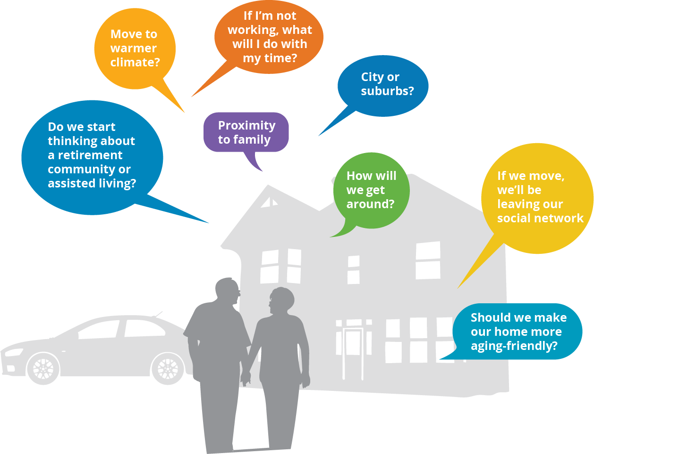
2. The Big Decision Phase
Notes:
2. The Big Decision Phase
While the second retirement phase is best characterized by more ‘free’ time, it is often unstated that it is a key time for making big decisions. It takes shape as work truly fades from view.
While health status may be less vibrant than before, the second retirement phase does provide greater opportunity to make or renew social connections. Friends now have more time to socialize and even travel together. Work may be replaced by increased volunteering, grand parenting, travel plans, or hobbies.
Where to Go? Individuals and couples are confronted in the second retirement phase by tactical questions. “Now that we are fully ‘retired,’ should we buy a new car for both transportation and personal reward? Should we stay in our hometown or move somewhere warmer? Will life be easier if we downsize? Can we afford our current lifestyle for the long term?”
As empty nesters face issues regarding changing housing needs, the option to downsize may be appealing. 46% of boomer movers will downsize, either by moving to a smaller home or spending less for a home of the same size. *
For many, concerns about the cost of home maintenance, proximity to family, access to services, and livability of their existing home (such as having a master bedroom and other necessities on the first floor when stairs are no longer manageable) are reason enough to leave the house, the town, or even the state.
Changing Income Sources Retirees in the second retirement phase are drawing a greater share of their income from different sources. When asked to identify major sources of income in retirement, 92% of retirees surveyed said Social Security, 66% said personal retirement savings or investments, and 58% said defined benefit or traditional pension.**
Financial decisions become time-sensitive, as does the need for estate planning.
*Source: Not All Baby Boomers Are Downsizing Their Homes, Sun Sentinel, 04/05/22.
**Source: The 2021 Retirement Confidence Survey, Employee Benefit Research Institute, 2019

Slide 23
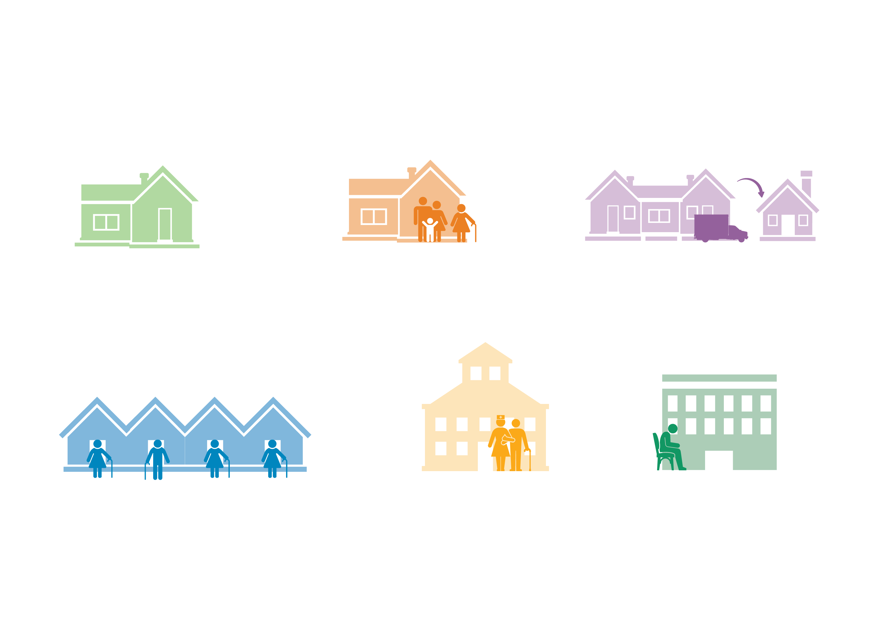
2. The Big Decision Phase
Move in with family member
Upsize or downsize
Stay in my home
50+ community
Assisted living
Continuing Care Retirement Community (CCRC)
Notes:
2. The Big Decision Phase
While the second retirement phase is best characterized by more ‘free’ time, it is often unstated that it is a key time for making big decisions. It takes shape as work truly fades from view.
While health status may be less vibrant than before, the second retirement phase does provide greater opportunity to make or renew social connections. Friends now have more time to socialize and even travel together. Work may be replaced by increased volunteering, grand parenting, travel plans, or hobbies.
Where to Go? Individuals and couples are confronted in the second retirement phase by tactical questions. “Now that we are fully ‘retired,’ should we buy a new car for both transportation and personal reward? Should we stay in our hometown or move somewhere warmer? Will life be easier if we downsize? Can we afford our current lifestyle for the long term?”
As empty nesters face issues regarding changing housing needs, the option to downsize may be appealing. 46% of boomer movers will downsize, either by moving to a smaller home or spending less for a home of the same size. *
For many, concerns about the cost of home maintenance, proximity to family, access to services, and livability of their existing home (such as having a master bedroom and other necessities on the first floor when stairs are no longer manageable) are reason enough to leave the house, the town, or even the state.
Changing Income Sources Retirees in the second retirement phase are drawing a greater share of their income from different sources. When asked to identify major sources of income in retirement, 92% of retirees surveyed said Social Security, 66% said personal retirement savings or investments, and 58% said defined benefit or traditional pension.**
Financial decisions become time-sensitive, as does the need for estate planning.
*Source: Not All Baby Boomers Are Downsizing Their Homes, Sun Sentinel, 04/05/22.
**Source: The 2021 Retirement Confidence Survey, Employee Benefit Research Institute, 2019

Slide 24
2. The Big Decision Phase
Who will change my light bulbs?
How will I get an ice cream cone?
Who will I have lunch with?
Notes:
2. The Big Decision Phase
While the second retirement phase is best characterized by more ‘free’ time, it is often unstated that it is a key time for making big decisions. It takes shape as work truly fades from view.
While health status may be less vibrant than before, the second retirement phase does provide greater opportunity to make or renew social connections. Friends now have more time to socialize and even travel together. Work may be replaced by increased volunteering, grand parenting, travel plans, or hobbies.
Where to Go? Individuals and couples are confronted in the second retirement phase by tactical questions. “Now that we are fully ‘retired,’ should we buy a new car for both transportation and personal reward? Should we stay in our hometown or move somewhere warmer? Will life be easier if we downsize? Can we afford our current lifestyle for the long term?”
As empty nesters face issues regarding changing housing needs, the option to downsize may be appealing. 46% of boomer movers will downsize, either by moving to a smaller home or spending less for a home of the same size. *
For many, concerns about the cost of home maintenance, proximity to family, access to services, and livability of their existing home (such as having a master bedroom and other necessities on the first floor when stairs are no longer manageable) are reason enough to leave the house, the town, or even the state.
Changing Income Sources Retirees in the second retirement phase are drawing a greater share of their income from different sources. When asked to identify major sources of income in retirement, 92% of retirees surveyed said Social Security, 66% said personal retirement savings or investments, and 58% said defined benefit or traditional pension.**
Financial decisions become time-sensitive, as does the need for estate planning.
*Source: Not All Baby Boomers Are Downsizing Their Homes, Sun Sentinel, 04/05/22.
**Source: The 2021 Retirement Confidence Survey, Employee Benefit Research Institute, 2019

Slide 25
3. Navigating Longevity Phase
Managing health
Administrivia
Caregiving
Notes:
In the third retirement phase, Navigating Longevity, the logistics of health management may become a full-time job with increased medical appointments, medication management, and increasing mobility challenges. Spending per capita on healthcare increases steeply after 65. (Source: U.S. Personal Health Care Spending By Age and Sex 2020 Highlights, CMS.gov, 2020)
A Bitter Pill
It’s estimated that 92% of older adults are managing at least one chronic condition and 77% are managing the complexities of two or more chronic conditions (National Council on Aging, 2014) . Chronic conditions can make handling other health issues more difficult or make health in general more complex and thus likely to be mismanaged.
For example, what may seem like a straightforward routine, medication adherence, becomes a key and challenging aspect of managing health. A look at the numbers shows how increased age leads to juggling more medications. Three out of four adults over the age of 50 take one or more prescription medications on a regular basis. In fact, 86% of those age 65 and above regularly take prescription drugs, with 53 percent taking four or more on a regular basis. (Source: Taking Multiple Medications? Beware of Side Effects, AARP, 2022).
I’ll Be There For You
Due to changes in health, individually or as a couple, social well-being may change. Fewer opportunities to join friends and family may be available. Additionally, friends in the same age cohort managing their own health-related issues make maintaining connections a greater challenge.
Complexity also arises in the need for suitable housing and occasional or daily assistance from a friend or family member to help run routine errands and maintain the home. While many legal affairs haven’t yet come into play, such as a health care proxy or power of attorney, this phase of retirement phase often highlights the growing importance to have these legal contingencies established so that they are available when necessary.
In such scenarios, trusted people are selected to make decisions on one’s behalf, and it is in one’s best interest to put these plans in place while cognitive and physical functions are adequate and desires can be communicated clearly.

Slide 26
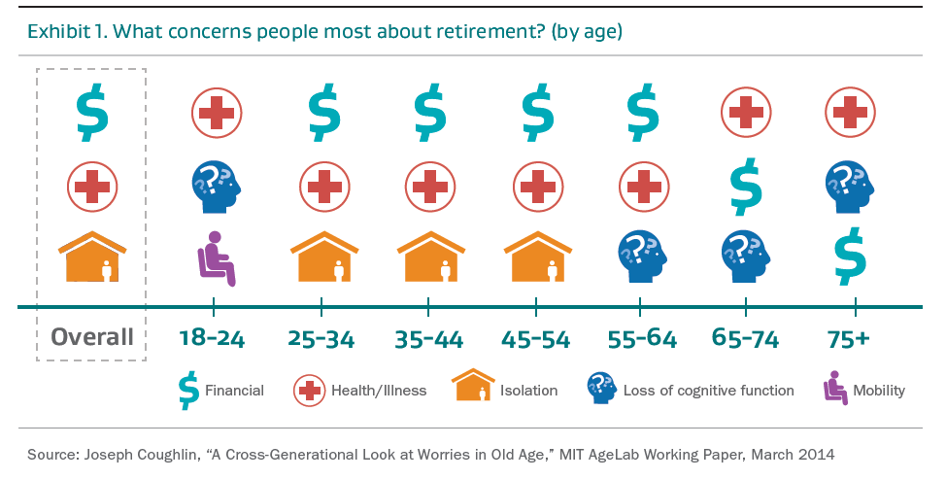
3. Navigating Longevity Phase
Notes:
In the third retirement phase, Navigating Longevity, the logistics of health management may become a full-time job with increased medical appointments, medication management, and increasing mobility challenges. Spending per capita on healthcare increases steeply after 65. (Source: U.S. Personal Health Care Spending By Age and Sex 2020 Highlights, CMS.gov, 2020)
A Bitter Pill
It’s estimated that 92% of older adults are managing at least one chronic condition and 77% are managing the complexities of two or more chronic conditions (National Council on Aging, 2014) . Chronic conditions can make handling other health issues more difficult or make health in general more complex and thus likely to be mismanaged.
For example, what may seem like a straightforward routine, medication adherence, becomes a key and challenging aspect of managing health. A look at the numbers shows how increased age leads to juggling more medications. Three out of four adults over the age of 50 take one or more prescription medications on a regular basis. In fact, 86% of those age 65 and above regularly take prescription drugs, with 53 percent taking four or more on a regular basis. (Source: Taking Multiple Medications? Beware of Side Effects, AARP, 2022).
I’ll Be There For You
Due to changes in health, individually or as a couple, social well-being may change. Fewer opportunities to join friends and family may be available. Additionally, friends in the same age cohort managing their own health-related issues make maintaining connections a greater challenge.
Complexity also arises in the need for suitable housing and occasional or daily assistance from a friend or family member to help run routine errands and maintain the home. While many legal affairs haven’t yet come into play, such as a health care proxy or power of attorney, this phase of retirement phase often highlights the growing importance to have these legal contingencies established so that they are available when necessary.
In such scenarios, trusted people are selected to make decisions on one’s behalf, and it is in one’s best interest to put these plans in place while cognitive and physical functions are adequate and desires can be communicated clearly.

Slide 27
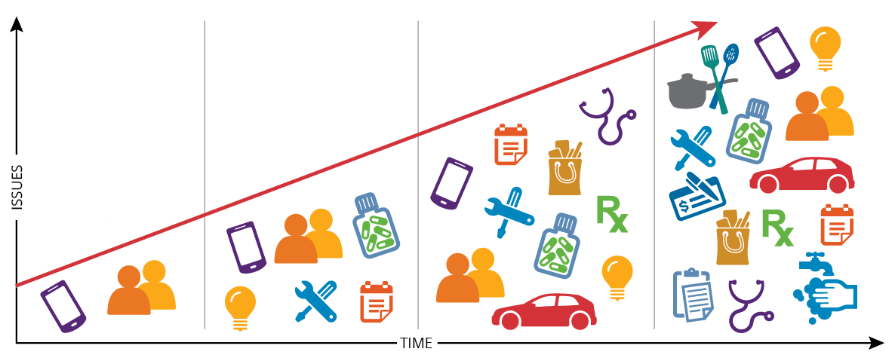
3. Navigating Longevity Phase
Administrivia
Notes:
In the third retirement phase, Navigating Longevity, the logistics of health management may become a full-time job with increased medical appointments, medication management, and increasing mobility challenges. Spending per capita on healthcare increases steeply after 65. (Source: U.S. Personal Health Care Spending By Age and Sex 2020 Highlights, CMS.gov, 2020)
A Bitter Pill
It’s estimated that 92% of older adults are managing at least one chronic condition and 77% are managing the complexities of two or more chronic conditions (National Council on Aging, 2014) . Chronic conditions can make handling other health issues more difficult or make health in general more complex and thus likely to be mismanaged.
For example, what may seem like a straightforward routine, medication adherence, becomes a key and challenging aspect of managing health. A look at the numbers shows how increased age leads to juggling more medications. Three out of four adults over the age of 50 take one or more prescription medications on a regular basis. In fact, 86% of those age 65 and above regularly take prescription drugs, with 53 percent taking four or more on a regular basis. (Source: Taking Multiple Medications? Beware of Side Effects, AARP, 2022).
I’ll Be There For You
Due to changes in health, individually or as a couple, social well-being may change. Fewer opportunities to join friends and family may be available. Additionally, friends in the same age cohort managing their own health-related issues make maintaining connections a greater challenge.
Complexity also arises in the need for suitable housing and occasional or daily assistance from a friend or family member to help run routine errands and maintain the home. While many legal affairs haven’t yet come into play, such as a health care proxy or power of attorney, this phase of retirement phase often highlights the growing importance to have these legal contingencies established so that they are available when necessary.
In such scenarios, trusted people are selected to make decisions on one’s behalf, and it is in one’s best interest to put these plans in place while cognitive and physical functions are adequate and desires can be communicated clearly.

Slide 28
3. Navigating Longevity Phase
Caregiver Responsibilities
Help to shop and buy groceries
Prepare meals, clean house or do laundry
Aid with transferring the recipient in and out of bed
Help with activities of daily living such as dressing, bathing, administering medications
Assist with physical therapy, injections, feeding tubes or other medical processes
Arrange the medical appointments and transportation to the doctor or clinic
Order and pick up medications at the drugstore
Discuss the care plan and needs with the doctors and care managers
Handle a crisis or medical emergency
Fill the designated “on-call” position for the family member
Source: Caregiving Roles and Responsibilities, Science Care, 3/15. Most recent available data used.
Notes:
In the third retirement phase, Navigating Longevity, the logistics of health management may become a full-time job with increased medical appointments, medication management, and increasing mobility challenges. Spending per capita on healthcare increases steeply after 65. (Source: U.S. Personal Health Care Spending By Age and Sex 2020 Highlights, CMS.gov, 2020)
A Bitter Pill
It’s estimated that 92% of older adults are managing at least one chronic condition and 77% are managing the complexities of two or more chronic conditions (National Council on Aging, 2014) . Chronic conditions can make handling other health issues more difficult or make health in general more complex and thus likely to be mismanaged.
For example, what may seem like a straightforward routine, medication adherence, becomes a key and challenging aspect of managing health. A look at the numbers shows how increased age leads to juggling more medications. Three out of four adults over the age of 50 take one or more prescription medications on a regular basis. In fact, 86% of those age 65 and above regularly take prescription drugs, with 53 percent taking four or more on a regular basis. (Source: Taking Multiple Medications? Beware of Side Effects, AARP, 2022).
I’ll Be There For You
Due to changes in health, individually or as a couple, social well-being may change. Fewer opportunities to join friends and family may be available. Additionally, friends in the same age cohort managing their own health-related issues make maintaining connections a greater challenge.
Complexity also arises in the need for suitable housing and occasional or daily assistance from a friend or family member to help run routine errands and maintain the home. While many legal affairs haven’t yet come into play, such as a health care proxy or power of attorney, this phase of retirement phase often highlights the growing importance to have these legal contingencies established so that they are available when necessary.
In such scenarios, trusted people are selected to make decisions on one’s behalf, and it is in one’s best interest to put these plans in place while cognitive and physical functions are adequate and desires can be communicated clearly.

Slide 29
4. The Solo Journey
Living alone
Revisiting the first three phases
Maintain social network
Notes:
In the third retirement phase, Navigating Longevity, the logistics of health management may become a full-time job with increased medical appointments, medication management, and increasing mobility challenges. Spending per capita on healthcare increases steeply after 65. (Source: U.S. Personal Health Care Spending By Age and Sex 2020 Highlights, CMS.gov, 2020)
A Bitter Pill
It’s estimated that 92% of older adults are managing at least one chronic condition and 77% are managing the complexities of two or more chronic conditions (National Council on Aging, 2014) . Chronic conditions can make handling other health issues more difficult or make health in general more complex and thus likely to be mismanaged.
For example, what may seem like a straightforward routine, medication adherence, becomes a key and challenging aspect of managing health. A look at the numbers shows how increased age leads to juggling more medications. Three out of four adults over the age of 50 take one or more prescription medications on a regular basis. In fact, 86% of those age 65 and above regularly take prescription drugs, with 53 percent taking four or more on a regular basis. (Source: Taking Multiple Medications? Beware of Side Effects, AARP, 2022).
I’ll Be There For You
Due to changes in health, individually or as a couple, social well-being may change. Fewer opportunities to join friends and family may be available. Additionally, friends in the same age cohort managing their own health-related issues make maintaining connections a greater challenge.
Complexity also arises in the need for suitable housing and occasional or daily assistance from a friend or family member to help run routine errands and maintain the home. While many legal affairs haven’t yet come into play, such as a health care proxy or power of attorney, this phase of retirement phase often highlights the growing importance to have these legal contingencies established so that they are available when necessary.
In such scenarios, trusted people are selected to make decisions on one’s behalf, and it is in one’s best interest to put these plans in place while cognitive and physical functions are adequate and desires can be communicated clearly.

Slide 30
Over 75 and living alone¹
Women
Men
The average age of widowhood is 59 years old²
Since 1990s, divorce rate of 50+ has doubled³
¹Source: Historical Living Arrangements of Adults, US Census Bureau, 12/20
²Source: You just got married. It's time to prepare for divorce and death (sorry), USA Today, 3/19/19. Most recent data available.
³Source: ‘Gray Divorce’ Rates Are Exploding Due to This Perfect Storm, Kiplinger, 4/12/21
Notes:
[Read slide]

Slide 31
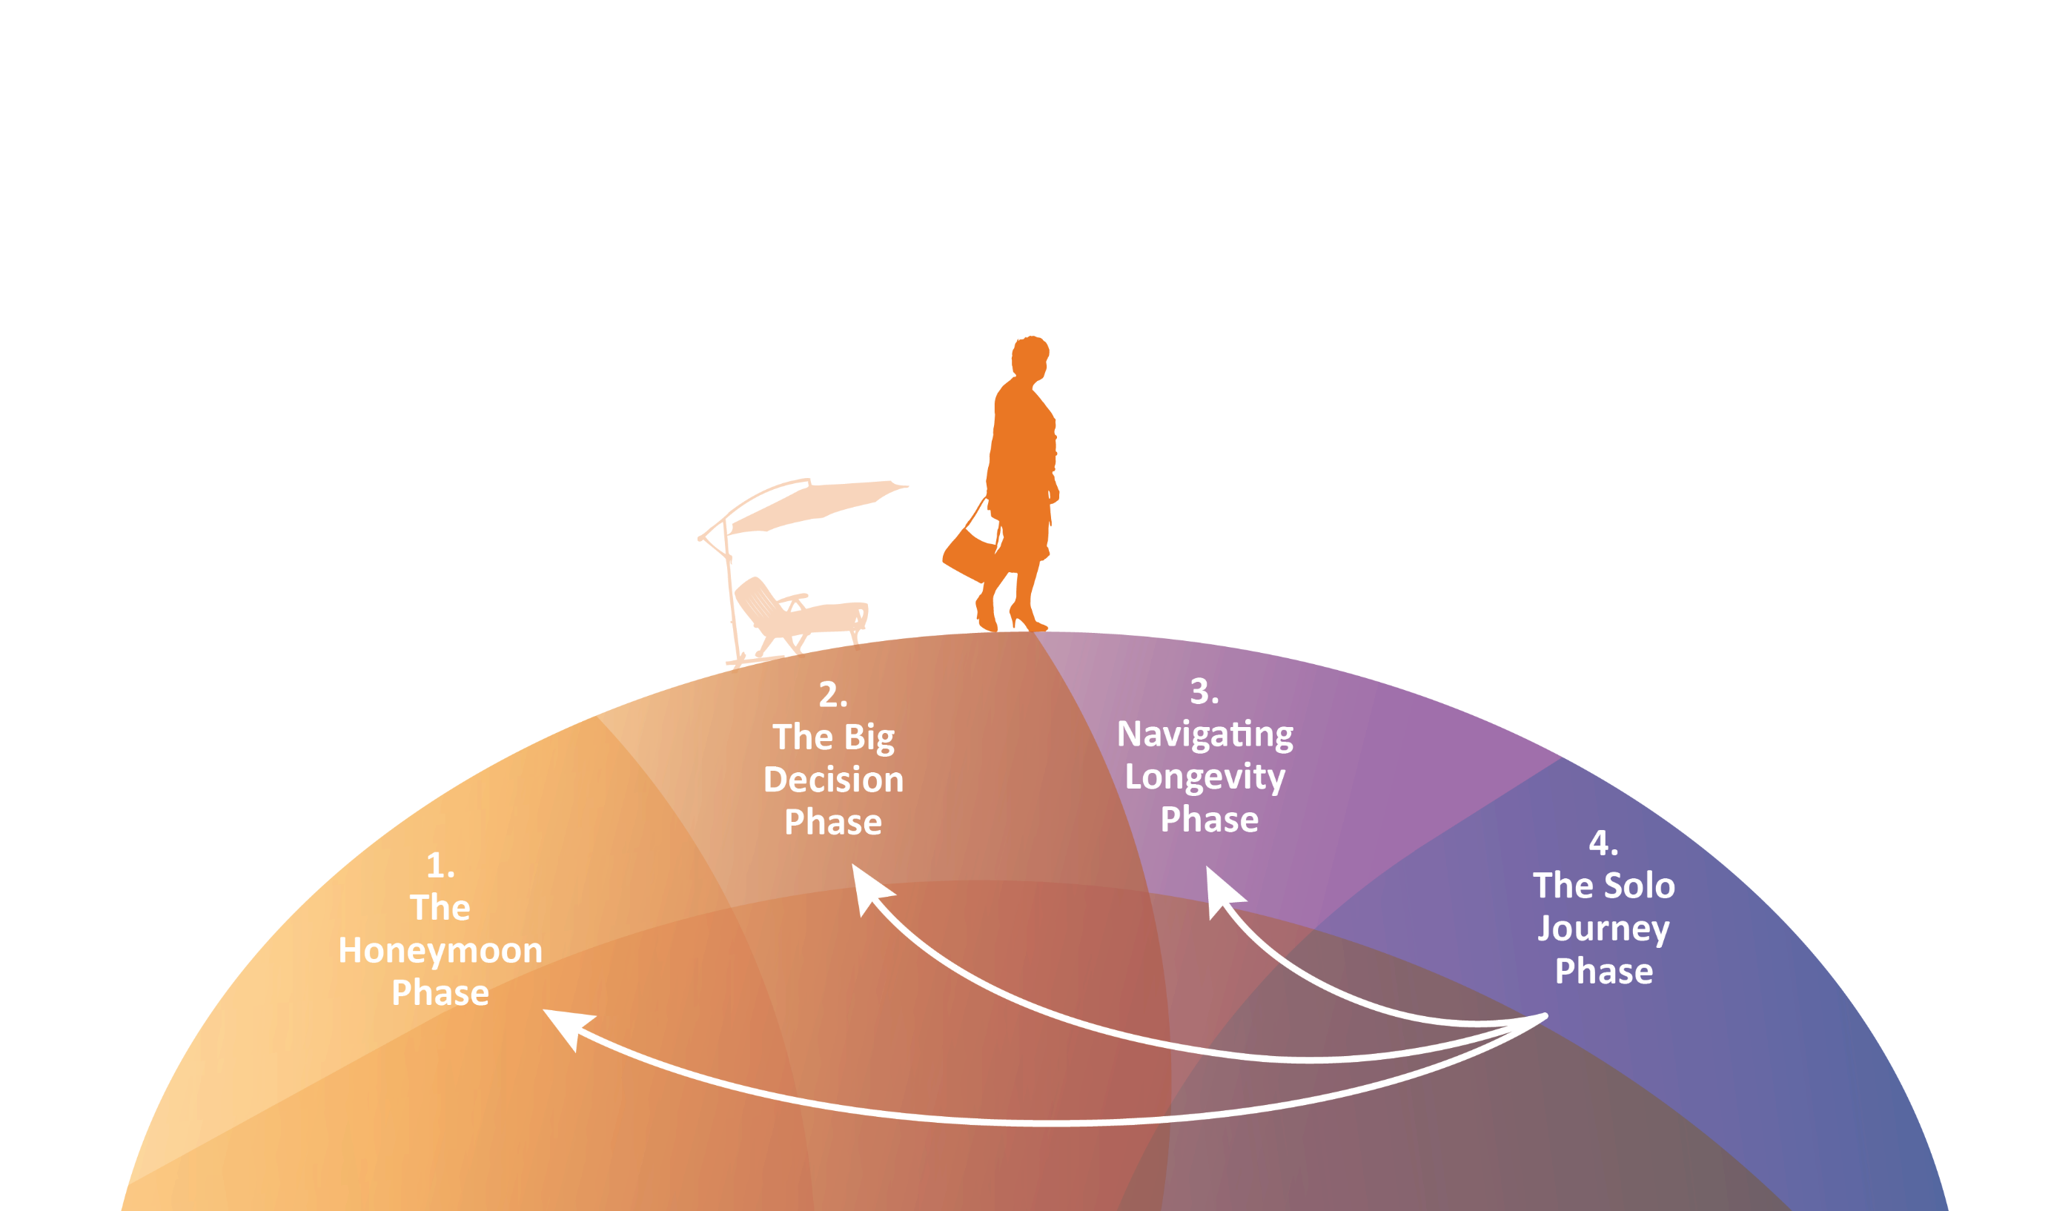
4. The Solo Journey
Revisiting the First Three Phases
Notes:
In the third retirement phase, Navigating Longevity, the logistics of health management may become a full-time job with increased medical appointments, medication management, and increasing mobility challenges. Spending per capita on healthcare increases steeply after 65. (Source: U.S. Personal Health Care Spending By Age and Sex 2020 Highlights, CMS.gov, 2020)
A Bitter Pill
It’s estimated that 92% of older adults are managing at least one chronic condition and 77% are managing the complexities of two or more chronic conditions (National Council on Aging, 2014) . Chronic conditions can make handling other health issues more difficult or make health in general more complex and thus likely to be mismanaged.
For example, what may seem like a straightforward routine, medication adherence, becomes a key and challenging aspect of managing health. A look at the numbers shows how increased age leads to juggling more medications. Three out of four adults over the age of 50 take one or more prescription medications on a regular basis. In fact, 86% of those age 65 and above regularly take prescription drugs, with 53 percent taking four or more on a regular basis. (Source: Taking Multiple Medications? Beware of Side Effects, AARP, 2022).
I’ll Be There For You
Due to changes in health, individually or as a couple, social well-being may change. Fewer opportunities to join friends and family may be available. Additionally, friends in the same age cohort managing their own health-related issues make maintaining connections a greater challenge.
Complexity also arises in the need for suitable housing and occasional or daily assistance from a friend or family member to help run routine errands and maintain the home. While many legal affairs haven’t yet come into play, such as a health care proxy or power of attorney, this phase of retirement phase often highlights the growing importance to have these legal contingencies established so that they are available when necessary.
In such scenarios, trusted people are selected to make decisions on one’s behalf, and it is in one’s best interest to put these plans in place while cognitive and physical functions are adequate and desires can be communicated clearly.

Slide 32
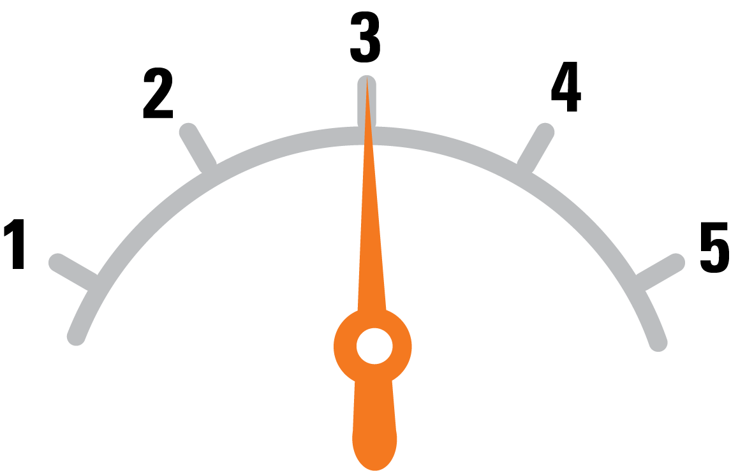
Social Activity Can Protect Against Age Related Decline
Rush University Medical Center study of 906 seniors, average age 80
Those surveyed were asked how often they participated in social activities
A one-point difference in social activity corresponded to a five-year difference in motor function
(including walking in a straight line, standing one-legged and on tiptoes, turning full circle without falling, and placing pegs on a board)
Several times a month
Several times a year
Several times a week
Once a year or less
Almost every day
Source: In Old Age, Friends Can Keep You Young. Really. Time, 6/24/09. Most recent data available.
Notes:
But what has social activity got to do with motor skills? A study by Dr. Aron Buchman, a neurologist at the Rush University Medical Center in Chicago, looked at 906 seniors, average age 80, in northeastern Illinois over a five-year period. The study revealed that increased social activity was associated with adeptness in a range of physical tasks, including walking in a straight line, standing one-legged and on tiptoes, turning full circle without falling and placing pegs on a board.
On a social-activity scale of 1 to 5 — with 1 indicating participation in various social activities once a year, and 5 showing activity every day or nearly every day — a one-point difference in social activity corresponded to a five-year difference in motor function. With each one-point drop on the social-activity scale, study participants' rate of physical decline increased 33%. In participants whose score fell one point over the course of a single year, that translated to a 40% increased risk of death and a 65% higher risk of a disability.
Study background: Buchman’s researchers used a composite measure of late-life social activity in these analyses. Frequency of participation in social activity was assessed with a previously established scale based on 6 items about activities involving social interaction (1, go to restaurants, sporting events or teletract [off-track betting], or play bingo; 2, go on day trips or overnight trips; 3, do unpaid community or volunteer work; 4, visit relatives or friends houses; 5, participate in groups, such as senior center, Knights of Columbus, Rosary Society, or something similar; and 6, attend church or religious services).
Each activity was rated on a 5-point scale, with 1 indicating participation in the activity once a year or less; 2, several times a year; 3, several times a month; 4, several times a week; and 5, every day or almost every day. Responses on each item were averaged to yield the composite measure used in analyses as previously described.
Source: In Old Age, Friends Can Keep You Young. Really. Time, 6/24/09. Most recent data available.

Slide 33
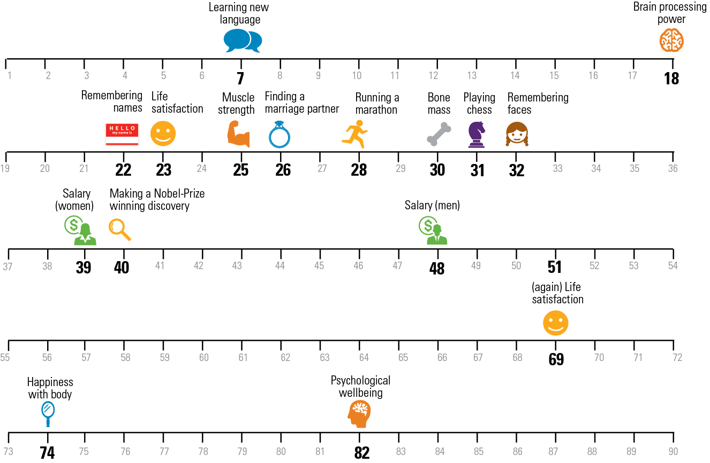
The Age You Peak at Everything
Source: Here are the ages you peak at everything throughout life, Business Insider, 3/16/17. Most recent data available.
Notes:
Aging can seem like a scary prospect, but a wealth of scientific studies have found that youth isn't all it's cracked up to be. There are plenty of cases in which human beings peak well into middle and old age.
Teenagers, for instance, may have vitality on their side, but older people are generally more psychologically stable. And so it goes with several phenomena people experience as they age.
Many of the points mark the middle of an age range that scientists have identified, which means they are all determined by averages. Some are also surveys, not controlled trials, so there is a possibility the self-reports don't capture the most accurate picture.
But in many cases, the numbers keep cropping up for a reason, which is that life isn't a downhill slide from youth.
Source: Here are the ages you peak at everything throughout life, Business Insider, 3/16/17. Most recent data available.

Slide 34
Preparing for Your 8,000 Day Retirement
Notes:
Let’s look at our last area…

Slide 35
How Much Will Retirement Cost?
What Will I Do in Retirement?
Vs.
35
Notes:
Discuss the difference between how much will retirement cost vs. what will I do in retirement?
Many companies offer their employees tools that help with the quantitative aspects of retirement, such as budgeting and understanding income needs in retirement.
Perhaps we could all do a better job helping people plan for the qualitative aspect, which may help ensure that people consider what will give them a sense of purpose and belonging in later life.

Slide 36
Notes:
Robo advisors are becoming more and more popular these days. Robo advisors excel in complexity, speedy computation and can even take a few inputs on well-defined priorities. Their one weakness? Robo advisors make terrible conversationalists. Therein lies the human financial professional’s advantage. Only human financial professionals can provide an empathetic, informed and engaging conversation about life tomorrow.

Slide 37
8,000 Days
A life stage waiting to be invented
Four Phases of Retirement
A new framework
Preparing for Your 8,000 Day Retirement
What will I do in retirement?
Notes:
To summarize, we’ve discussed (read slide)

Slide 38
The Bottom Line
“The four phases of retirement enable a clear vision to plan and to anticipate what is likely to come. Effective preparation can thereby reduce the stress of uncertainty and boost prolonged independence and control in the life so many wish to lead tomorrow.”
—Dr. Joe Coughlin,
Director of the MIT AgeLab
Notes:
Here’s the bottom line…

Slide 39
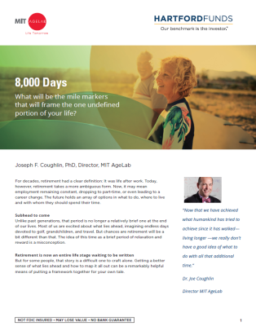
Next Steps
Get a copy of our client white paper
If you’re retired, consider which of the four phases of retirement you’re in. If you’re helping a friend or family member as they age, decide what phase they’re in.
Talk to your financial professional about how to plan for the four phases of retirement
Client white paper MAI083
The information in this presentation is provided for informational purposes only. Hartford Mutual Funds may or may not be invested in the companies referenced herein; however, no endorsement of any product or service is being made. Hartford Funds is not associated with the entities referenced in this presentation.
Hartford Funds Distributors, LLC, Member FINRA.
The MIT AgeLab is not an affiliate or subsidiary of Hartford Funds.
SEM_8000 1023 3144056 218180 V
Notes:
Here’s how we start…

Slide 40
Darrell Ellisor - darrell.ellisor@hubinternational.com
Janine Moore - janine.moore@hubinternational.com
Joe Conzelman - joe.conzelman@hubinternational.com
Kristin Baker – kristin.baker@hubinternational.com
Blake Hiett – blake.hiett@hubinternational.com
Susan Blassingame – susan.blassingame@hubinternational.com
Alicia Alba – alicia.alba@hubinternational.com
Abbie Cone- abbie.cone@hubinternational.com
Dina Ellisor - dina.ellisor@hubinternational.com

