Slide 1

HR’s Role in Organizational Culture
Dr. G. M. Cox, Chief (Ret.)
TMHRA Annual Conference
May 9, 2024
Denton, Texas

Slide 2

AGENDA
Thank you to the TMHRA for inviting me to attend the Annual Conference.
I am delighted to be here with you.
I am also thrilled to be able to visit with you on a topic that has grown to not only near and dear to my heart, but has huge implications for our missions, across the board, to serve the public

Slide 3

Culture: How does it feel to work in your organization?
This Photo by Unknown Author is licensed under CC BY-SA

Slide 4
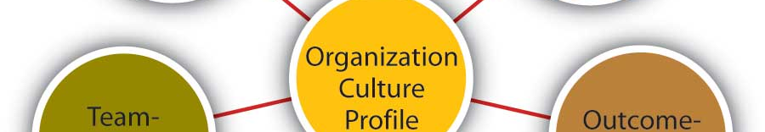
Core indicators of organizational culture
Artifacts – what people see
Share beliefs and values – what you say and how you say it basic assumptions – world view
This Photo by Unknown Author is licensed under CC BY-SA-NC

Slide 5

How many cultures does your organization have?
At least 3:
The one you say you have
The one your employees say you have
The one the citizens say you have
GOAL: That they all are the same and that it is great!

Slide 6

Employees Engaged?

Slide 7

What is that exactly?
This means that employees are physically and mentally present and prepared to work towards the stated goals and objectives of the organization in a positive way
This Photo by Unknown Author is licensed under CC BY-SA-NC

Slide 8

HR’s role
Aid city elected and appointed officials to work towards, achieve and maintain a positive, effective, efficient, and economical organizational culture
That is aimed at achieving the stated goals and objectives of the organization
Works to the benefit of the external stakeholders and the internal stakeholders – your employees

Slide 9
Vision mission value statements
Core ingredients for organizational culture: Can you help?

Slide 10

Human resources is uniquely situated
You see what is going on in the city
You know the various interests you know the relative strengths and weaknesses of each unit in the city
You have an idea of the needs

Slide 11

HR professionals are the go to resources for long range goals and objectives of the city related to personnel and org culture
This Photo by Unknown Author is licensed under CC BY-SA-NC

Slide 12

HR professionals can assist with creating an environment where greatness happens…as a product of effort, not chance
This Photo by Unknown Author is licensed under CC BY-SA

Slide 13
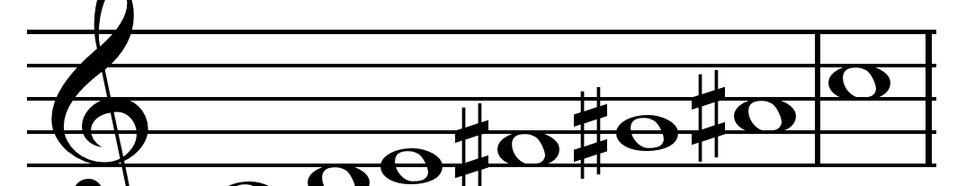
HR professionals are the first person most employees deal with – you set the tone and create the expectations of employees
This Photo by Unknown Author is licensed under CC BY-SA

Slide 14

Your role and how you perform it sets the model for the entire organization
This Photo by Unknown Author is licensed under CC BY-SA

Slide 15

Selection process

Slide 16

onboarding
Create an onboarding script
Set the tone and expectations…in a positive way
This Photo by Unknown Author is licensed under CC BY-NC-ND

Slide 17

Creating a positive environment
Look at the city’s work environment – is it conducive to positivity?
Motivational and relational posters/symbols/furnishings
Remember: How people feel about where they work is important
This Photo by Unknown Author is licensed under CC BY-NC

Slide 18

Is it fun?
HR professionals and the HR department can aid the city leadership to create opportunities for fun in the workplace.
Gallup and other sources have indicated that employees, in particular, Gen Y and Gen Z want a workplace that has opportunities for fun.
I have fundamentally changed my mind about role HR and department heads should play in creating opportunities for fun in the workplace.
Be the Fun Chairperson
Be Creative
Look at your area’s listing of the “Top 100 Places” to work –insert in local papers (Dallas Morning News; Houston Chronicle; and others) – what do you see? FUN!

Slide 19

Some examples
1 book programs with book discussions (paid for by the city) – books are chosen that support the needs of the city – such as change or leadership or whatever
Brown bag discussions (topics chosen by employees)
Opportunities to volunteer (food banks, etc.)
Celebrations – birthdays, work anniversaries, promotions – look for ways to celebrate
Recognition programs – achievement oriented (earning a degree, etc.)
Lunches – served by leadership teams (quarterly)
Intramural competition; bowling teams; walking teams (campus); guest lecturer
Use your imagination – have fun with it

Slide 20

Job descriptions development
Create job descriptions that are up-to-date and relevant
Include statement about “everyone’s duty is to help create a positive, harmonious work environment.”

Slide 21

Malcontents
HR can assist department heads in transitioning malcontents
Courage to confront (we tend avoid confrontation)
Process
This Photo by Unknown Author is licensed under CC BY-SA-NC

Slide 22

Satisfaction surveys
HR can assist department heads in conducting satisfaction surveys
Survey monkey
Jot form
Hubspot
Qualtrics
Questions pro
This Photo by Unknown Author is licensed under CC BY-NC

Slide 23

Assisting Department heads
After a HR problem has been identified by a department head…
Help the department head deal with it – especially if it is a problem employee
These folks create havoc and wreck a workplace (culture)
I call these folks: weapons of mass destruction

Slide 24

FINAL TIPS & TAKEAWAYS
How does it feel to work in your city? (some have described this as “vibe”)
Org culture indicators: artifacts, shared values and beliefs, world views
The right culture is the one where the goals and objectives of the city are being met while creating a positive work environment for its employees
Your city has at least 3 cultures – goal is to make the real one the right one
Are employees engaged? Take the pulse of the organization – wander around
Does your city have stated vision, mission and value statements? Does each department or unit have one?
Assist Dept heads in identifying personnel needs, now and into the future (inventory and assessment)
HR professionals are part of the team that helps with organization culture
  Lead by example
  Role models
Onboarding is critical to ensure understanding and appropriate attitudes and performance
  Especially important for the younger generational groups (Gen Y and Z)
Ensure job descriptions enable great work, but clearly establishes that all employees are to work towards making the workplace a harmonious one for everybody
Courage to confront – process – problem employees create havoc and are weapons of mass destruction
Make it about fun – people want to work in a great place with great people and have fun doing it
Surveys – inexpensive and easy to do – they help with transparency, identifying issues, developing policies and responses to identified issues, and builds trust!
Culture eats policy, procedure and practice for lunch

Slide 25

Questions

Slide 26

THANK YOU
Dr. G. M. Cox
(903) 875-4411
gmcox1100@yahoo.com
SHSU: gmc037@shsu.edu

