Slide 1
Powerful Customer Service in the Governmental Workplace

Slide 2
Powerful Customer Service in the Workplace
Defined:
Customer service for governmental employees refers to the provision of efficient, citizen-centric, and empathetic assistance that meets the needs and expectations of citizens and stakeholders in their interactions with the government.
Who are our customers?
Customers are all the people for whom we provide a product or service. Everyone who depends on the quality of our work is considered to be a customer.
Two Kinds of Customers
1. External Customers
Citizens, residence, visitors, businesses.
2. Internal customers
Employees, co-workers, supervisor, peers, commissioners, Mayor/City Council and other elected officials, board members, etc.

Slide 3
Public Sector Customer Service Challenges
Is providing customer service in account in a city environment different than providing customer service in a retail service, business or other kind of organization?

Slide 4
Challenges
1. Citizens have higher and sometimes unrealistic expectations of government.
2. Everyone is a customer or boss or expert. They tell us they pay our salary to show they're entitled to service because they've already paid for it.
3. Regulatory restraints laws, policies, codes, ordinances, etc. can remove flexibility in providing services.
4. Budgetary restraints and limited resources.
5. Dealing with rude, difficult, even abusive customers.
6. Getting along with people in other departments.
7. We're more visible – like a fishbowl or a glass house.

Slide 5
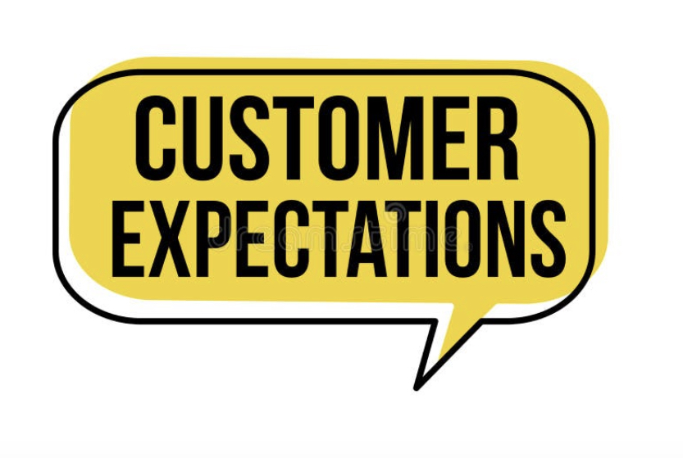
Customer Expectations:
What customers do not expect:
1. To be talked down to
2. To have complaints treated as nuisances
3. Excuses
(Replacement for excuse is apology)
4. To hear that's what our policy says
5. The runaround
What customers expect:
1. Promises be kept
2. Responsiveness
(A sense of urgency urgency )
3. Concern
4. Honesty

Slide 6
Golden Rules of Customer Service
Every interaction matters. Every. Single. One.
Stop. Breathe. And take a moment to remember that every interaction matters.
Customer service mistakes aren't outcomes, their opportunities.
Following a few simple steps – you can turn upset customers into satisfied individuals.
Hear: let the customer tell their entire story without interruption. Sometimes, we just want someone to listen.
Empathize: convey that you deeply understand how the customer feels.
Apologize: as long as it's sincere, you can't apologize enough. Even if you didn't do whatever made them upset, you can still genuinely be apologetic for the way the customer feels.
Resolve: resolve the issue quickly and make sure that your employees are empowered to do so. Don't be afraid to ask the customer: what can I do to make this right.
Diagnose: get to the bottom of the why the mistake occurred, without blaming anyone; focus on fixing the process so that it doesn't happen again.

Slide 7
Golden Rules of Customer Service
Give people the benefit of the doubt:
A customer who behaves badly once, within reason, is simply a customer behaving badly, give them the benefit of the doubt and employ your best customer service techniques to help them get back to normal.
Make things easy:
Always be thinking about how you can make life easier for your customers and they'll have a great reason to be loyal to you.
If you want to treat your customers well, treat your employees well:
Clients do not come first. Employees come first.
If you take care of your employees they will take care of your clients.
- Richard Branson

Slide 8
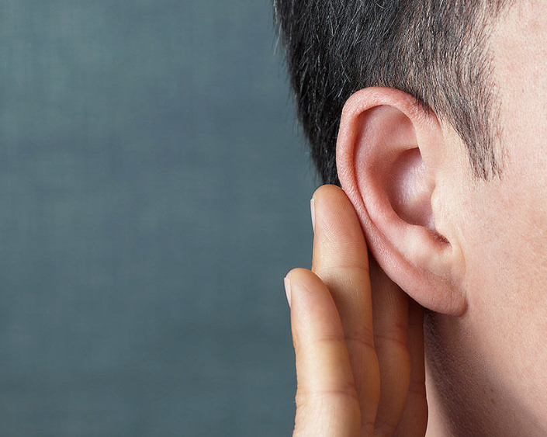
Customer Service Skills for Everyone!
Clear Communication Skills:
Someone who can effectively communicate thoughts, ideas, and feelings is better equipped for success both on the job and in personal relationships.
When it comes to important points that you need to relay clearly to customers, keep it simple and leave nothing to doubt.
Attentiveness:
Often when people talk to each other, they don't listen attentively. They are often distracted, half listening, half thinking about something else.
Not only is it important to pay attention to individual customer interactions (watching the language/terms that they use to describe their problems), but it's also important to be mindful and attentive to the feedback that you receive from others.

Slide 9
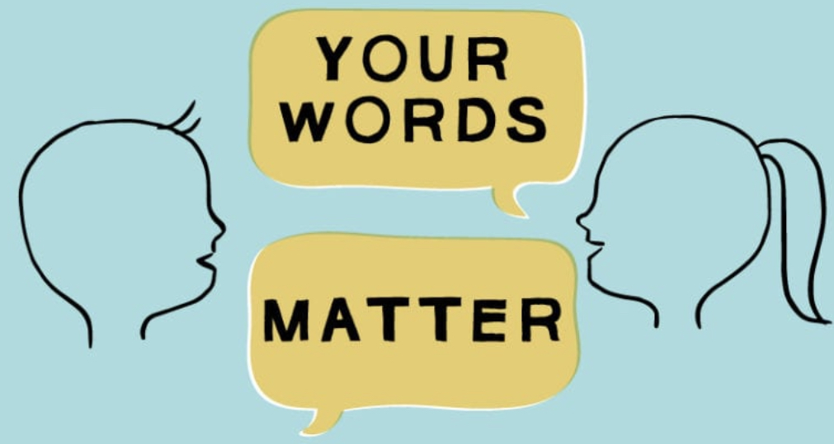
Customer Service Skills for Everyone!
Tenacity
A great work ethic and a willingness to do what needs to be done (no shortcuts) is a key skill when providing the kind of service that people talk about.
Customers remember the employee who refuses to just do the "status quo" when it comes to helping someone out.
Remembering that your customers are people too, and putting in the extra effort will come back to you ten-fold can drive motivation.
Ability to Use "Positive Language"
It sounds basic, but small changes that utilize "positive language" can greatly affect how the customer hears your response...
Without positive language: "I can't get you that product until next month; it is back-ordered and unavailable at this time."
With positive language: "That product will be available next month. I can place the order for you right now and make sure that it is sent to you as soon as it reaches our warehouse.

Slide 10
Customer Service Skills for Everyone!
Ability to Handle Surprises
Sometimes the customer support world is going to throw you a curveball.
Maybe the problem you encounter isn't specifically covered in the city’s policies, or maybe the customer isn't reacting how you thought they would.
Whatever the case, it's best to be able to think on your feet... but it's even better to create guidelines for yourself in these sorts of situations.
Who: Who is the best person to contact to assist with this situation?
What: What are you going to say to the best person to ensure that they understand the situation?
How: What is the best way to communicate the to the best person to contact and assist with the problem? (phone, email, text, face-to-face)

Slide 11
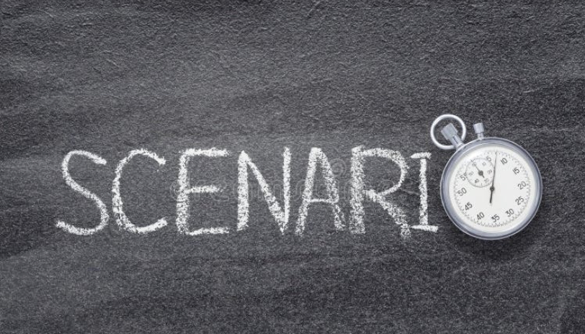
Customer Service Scenarios
Scenario 1:
A citizen received a bill from the government for a service that they believe is incorrect. They are frustrated and upset due to the unexpected charges and have come to you for clarification and resolution.
Scenario 2:
You are a government employee stationed near a street that is undergoing construction. A concerned citizen approaches you and asks about the construction timeline and the alternate routes that are available.
Scenario 3:
A citizen visits your department to inquire about the process for obtaining a business license. You are responsible for providing accurate information and excellent customer service during the interaction.

Slide 12
Questions?
How to reach me for training possibilities:
www.mstephenstc.com
marktrainer@sbcglobal.net
Phone number:817-368-7494

