Slide 1
FACE YOUR
FEARS
Cheri Garcia
Entrepreneur, Investor,
Second-Chance Advocate

Slide 2
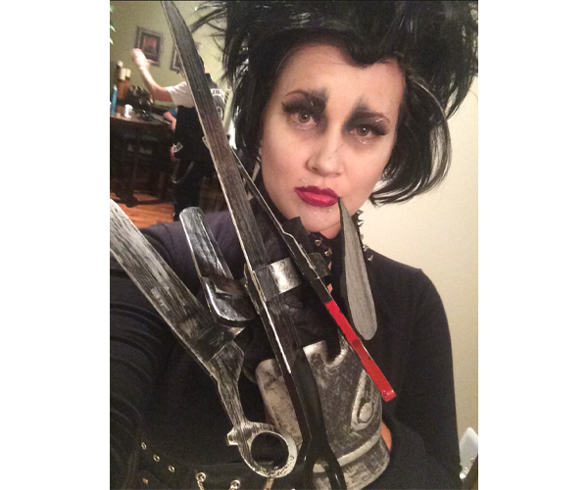
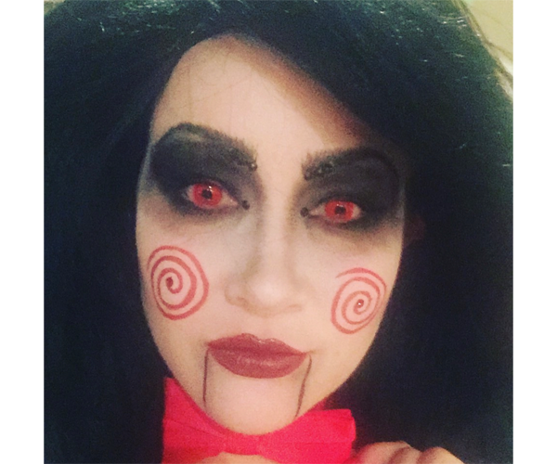

Slide 3
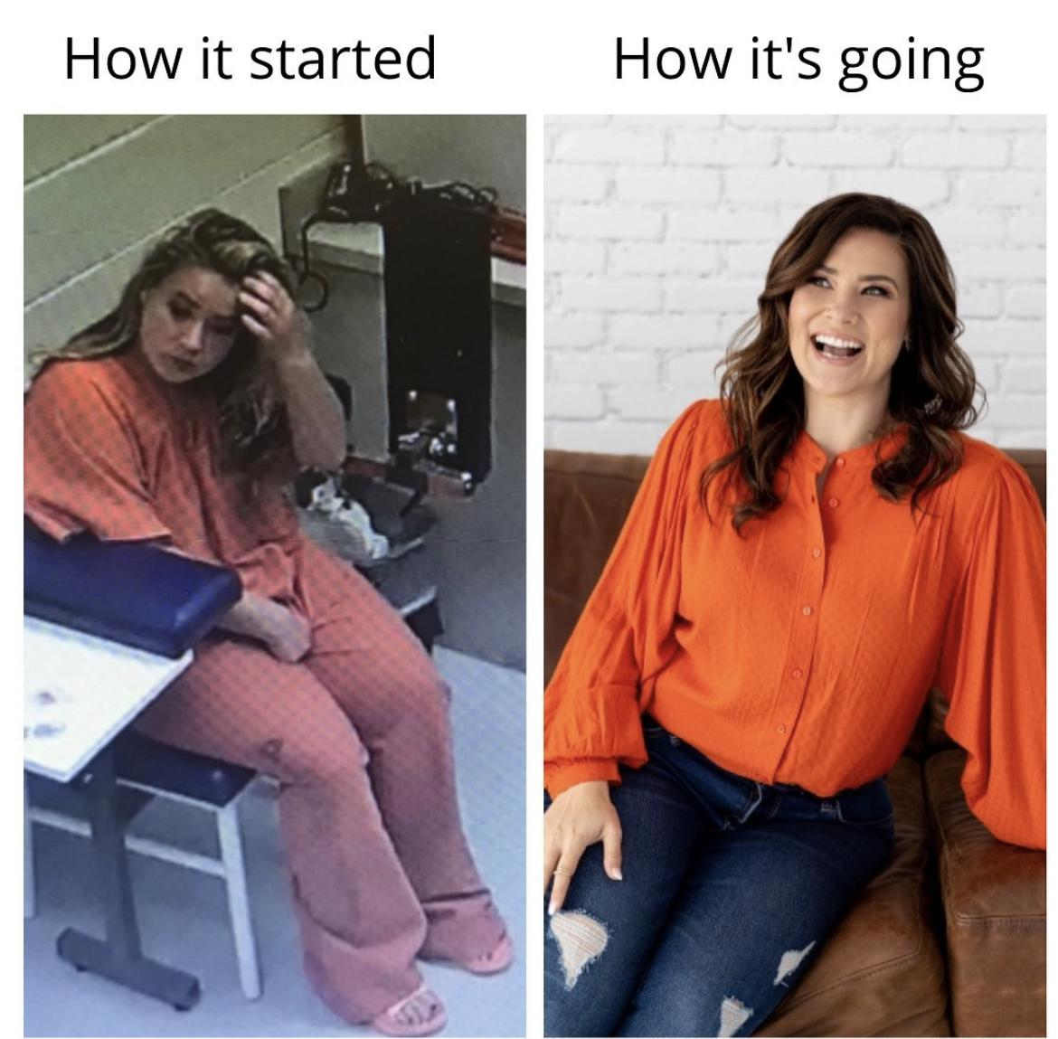
My Biggest Fear: Myself

Slide 4
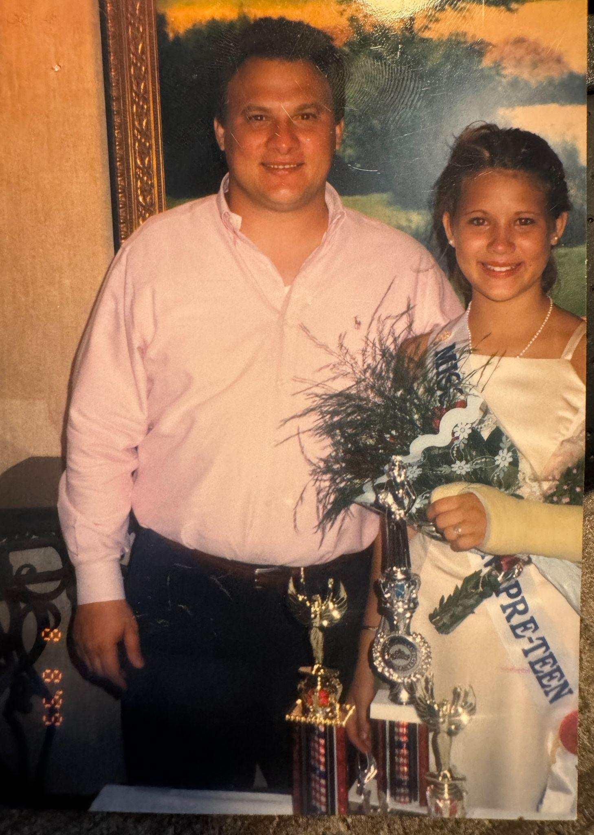
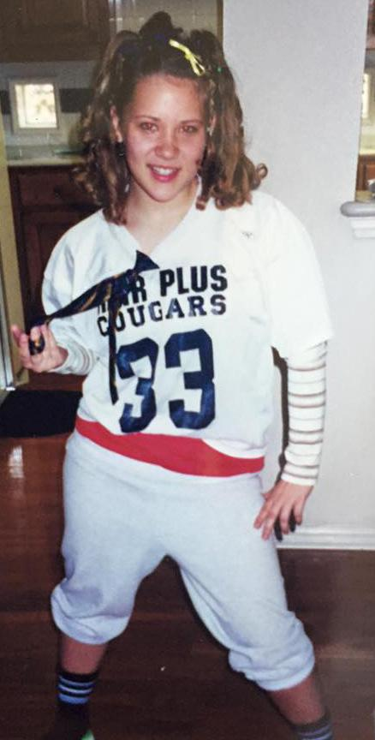
A bad decision in High School led to addiction.

Slide 5
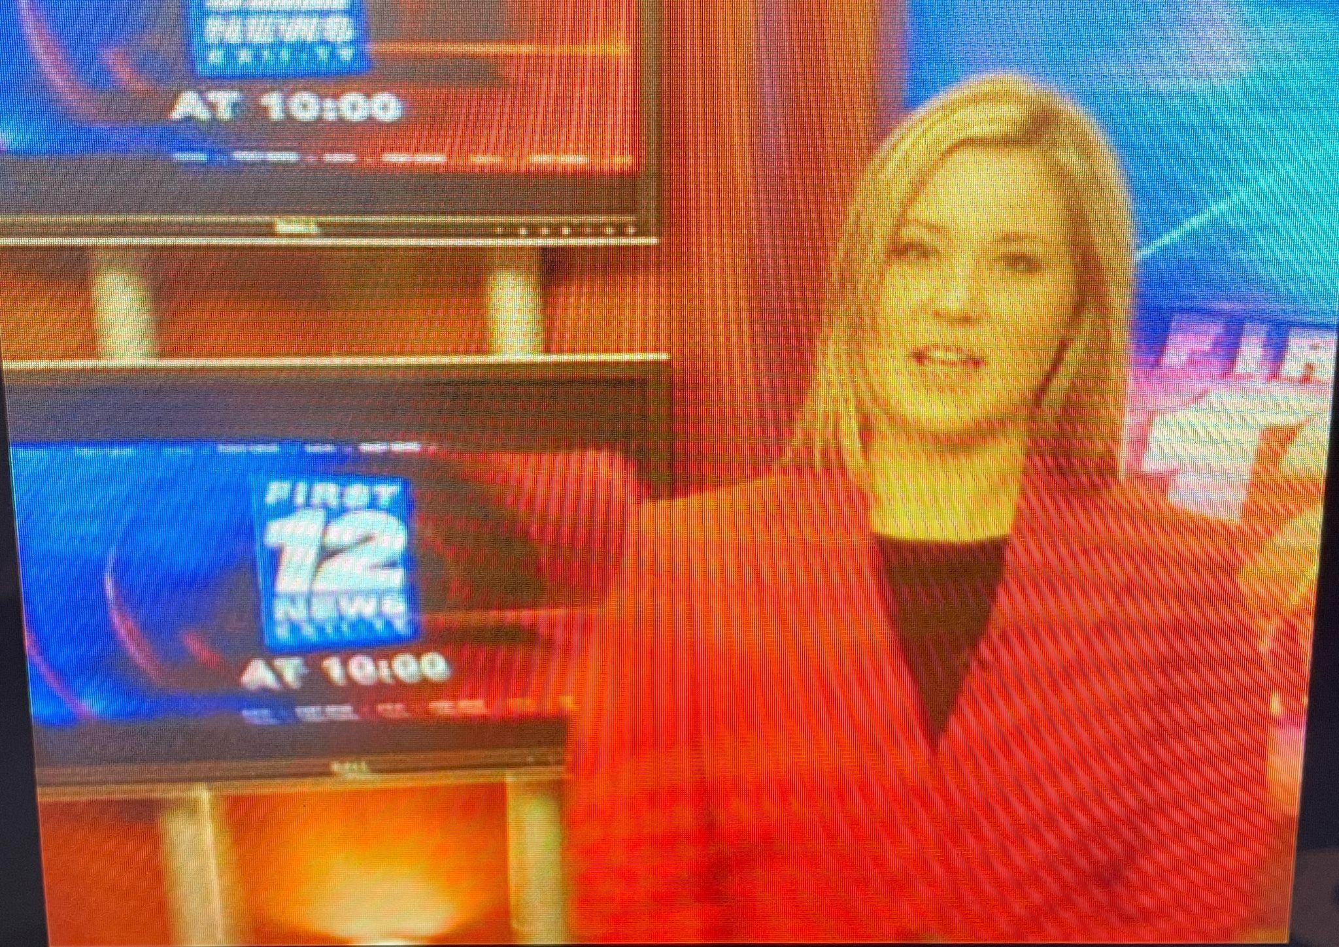
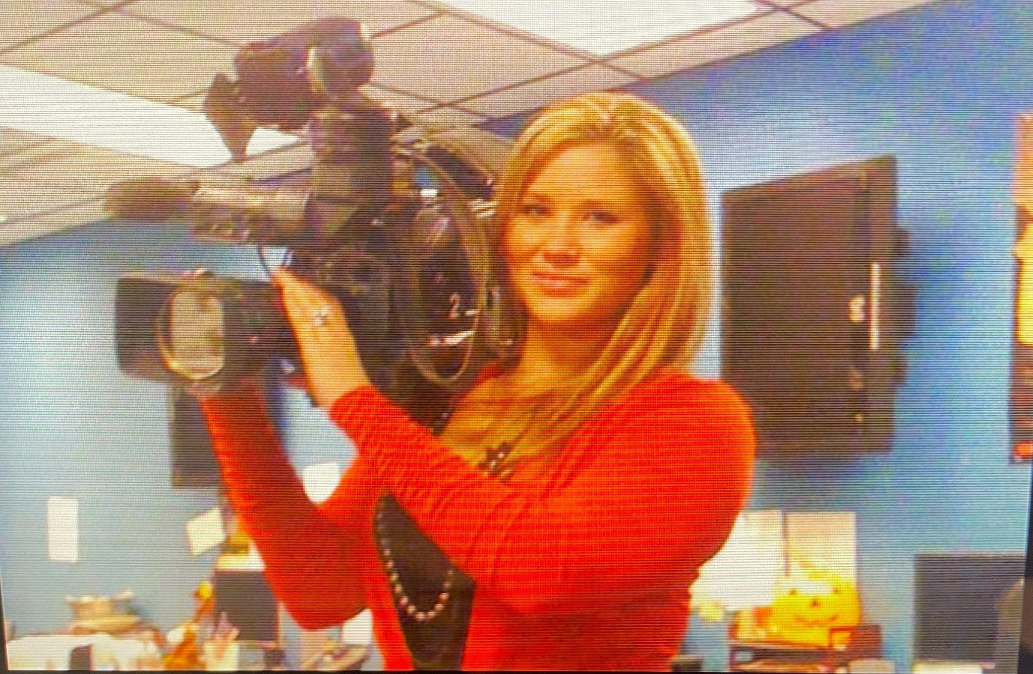
Look Mom! I’m on TV!

Slide 6
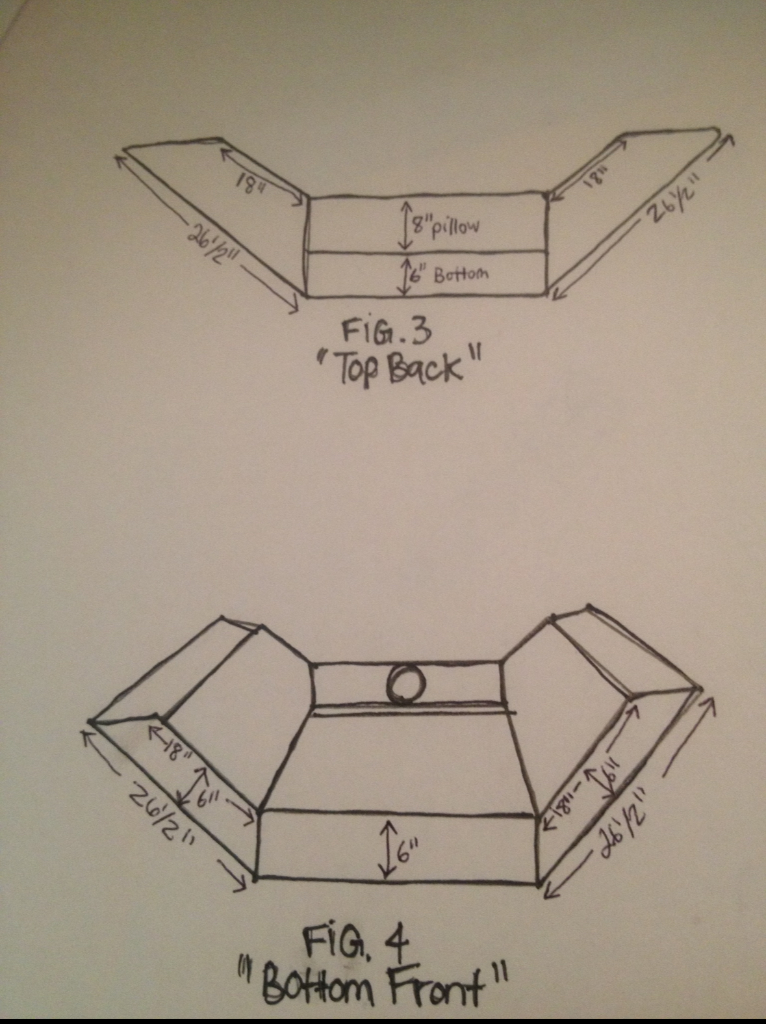
I Invented a Product and Received a Patent

Slide 7
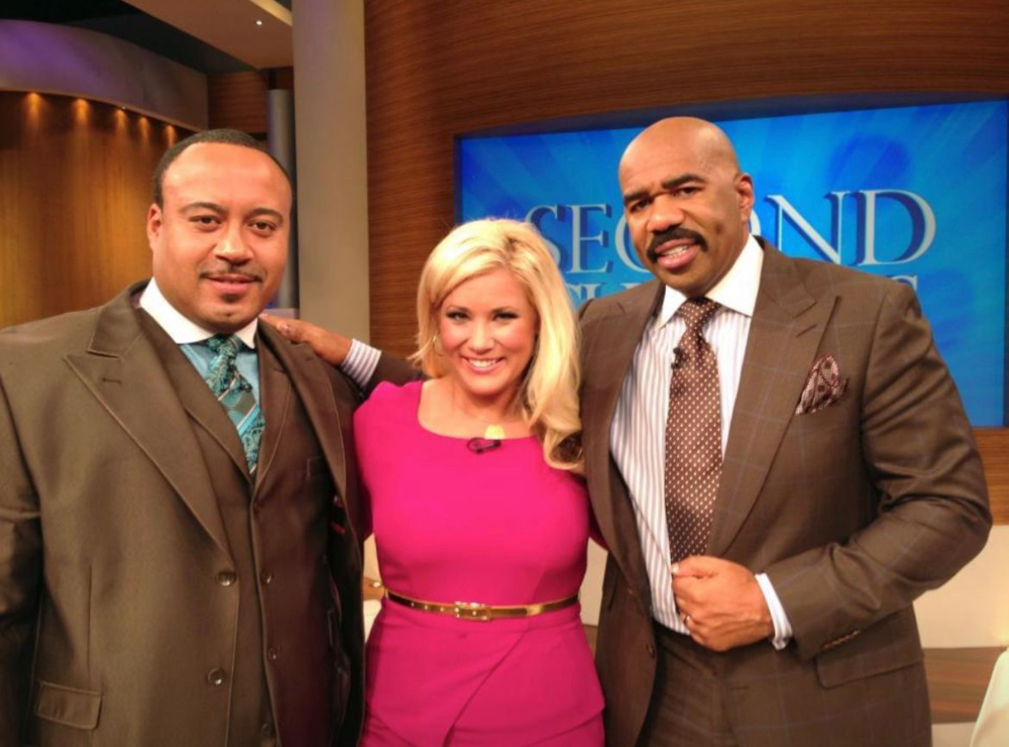
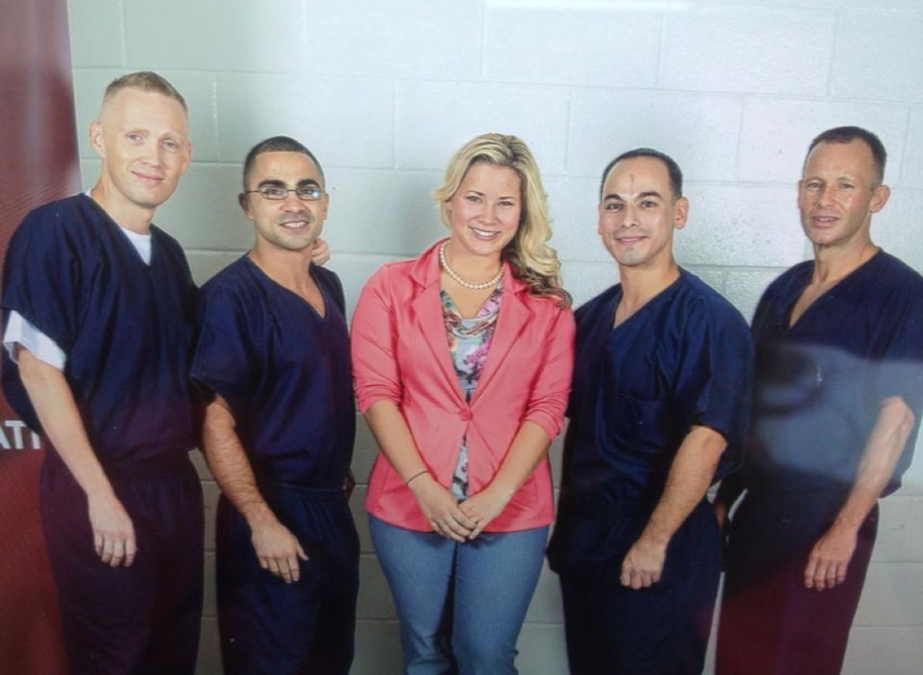
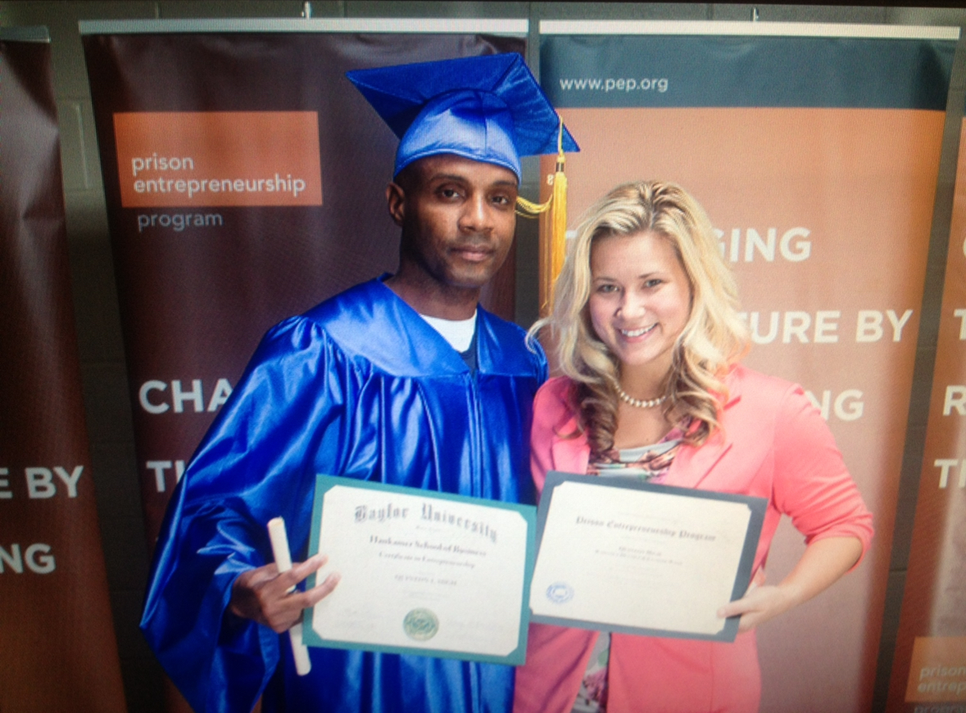
I Became a PEP Volunteer

Slide 8
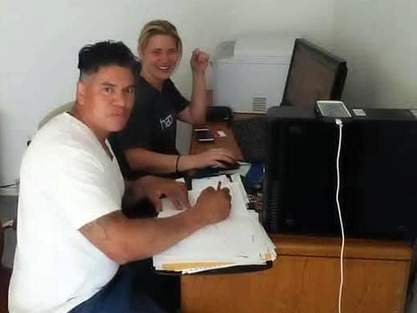
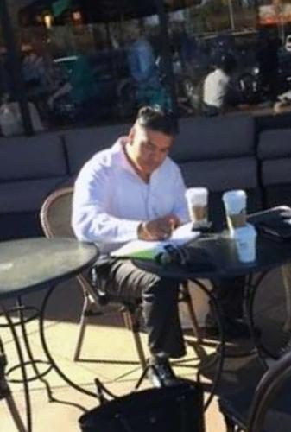
2016: PEP Inspired Me to Create Cornbread Hustle
March 2016
Cheri and Bennie, the first job-seeker placed by Cornbread Hustle
Bennie’s successful job interview, outside a Starbucks

Slide 9
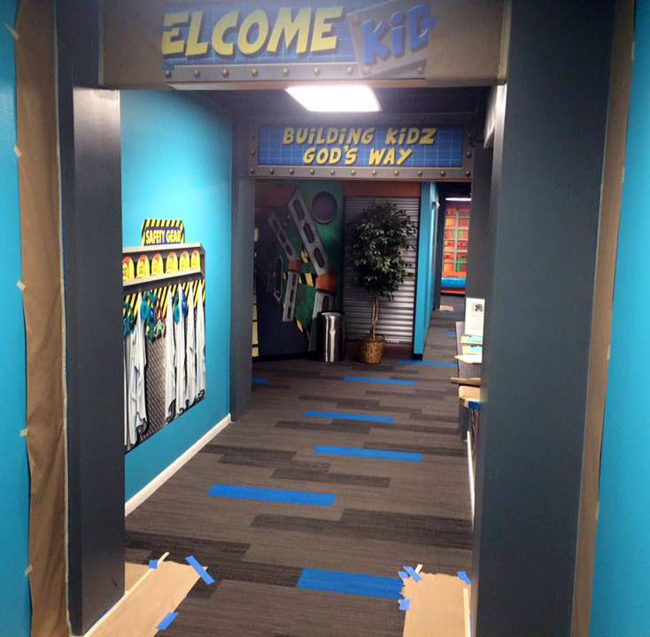
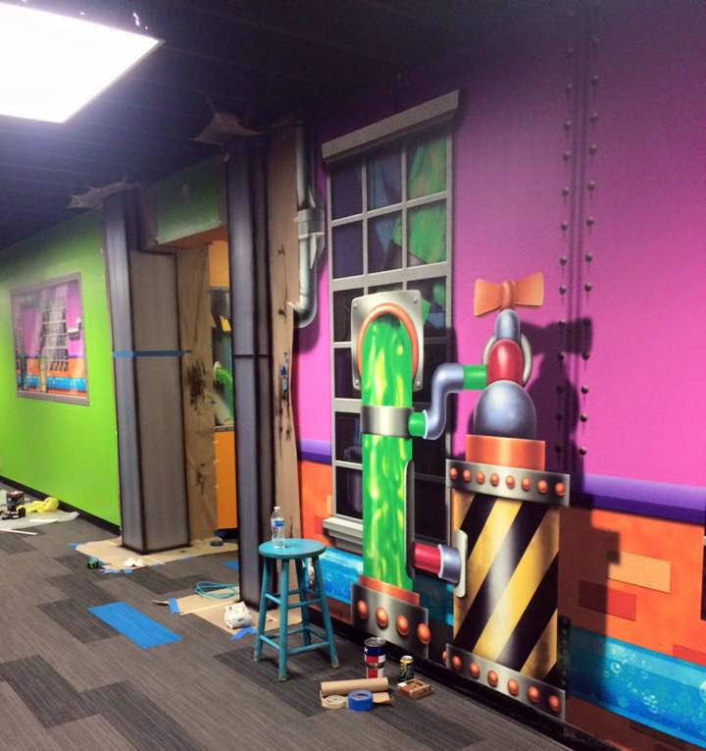
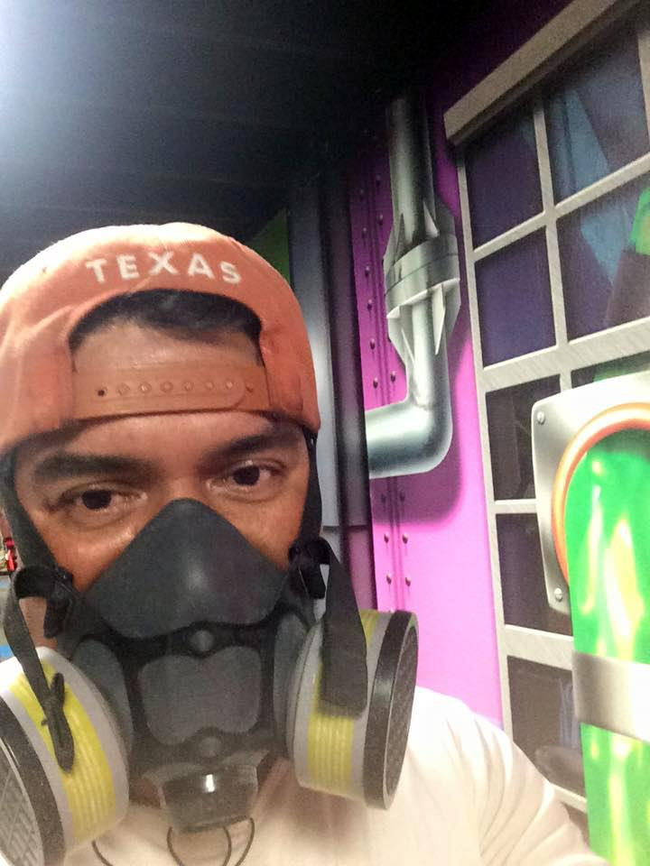
Bennie’s Passion Led to a Job as a Professional Artist.

Slide 10
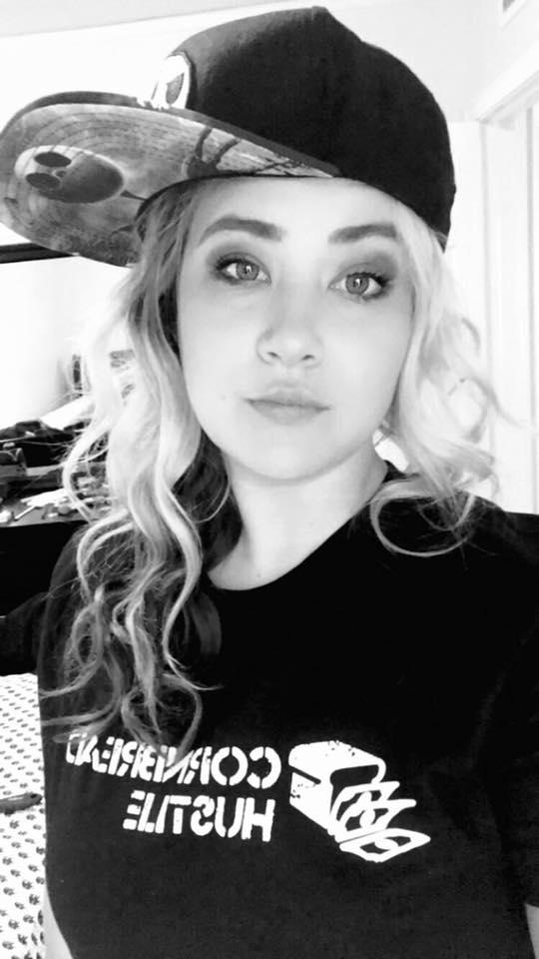
Good Entrepreneur
BAD
Leader
2017, Before Sobriety

Slide 11
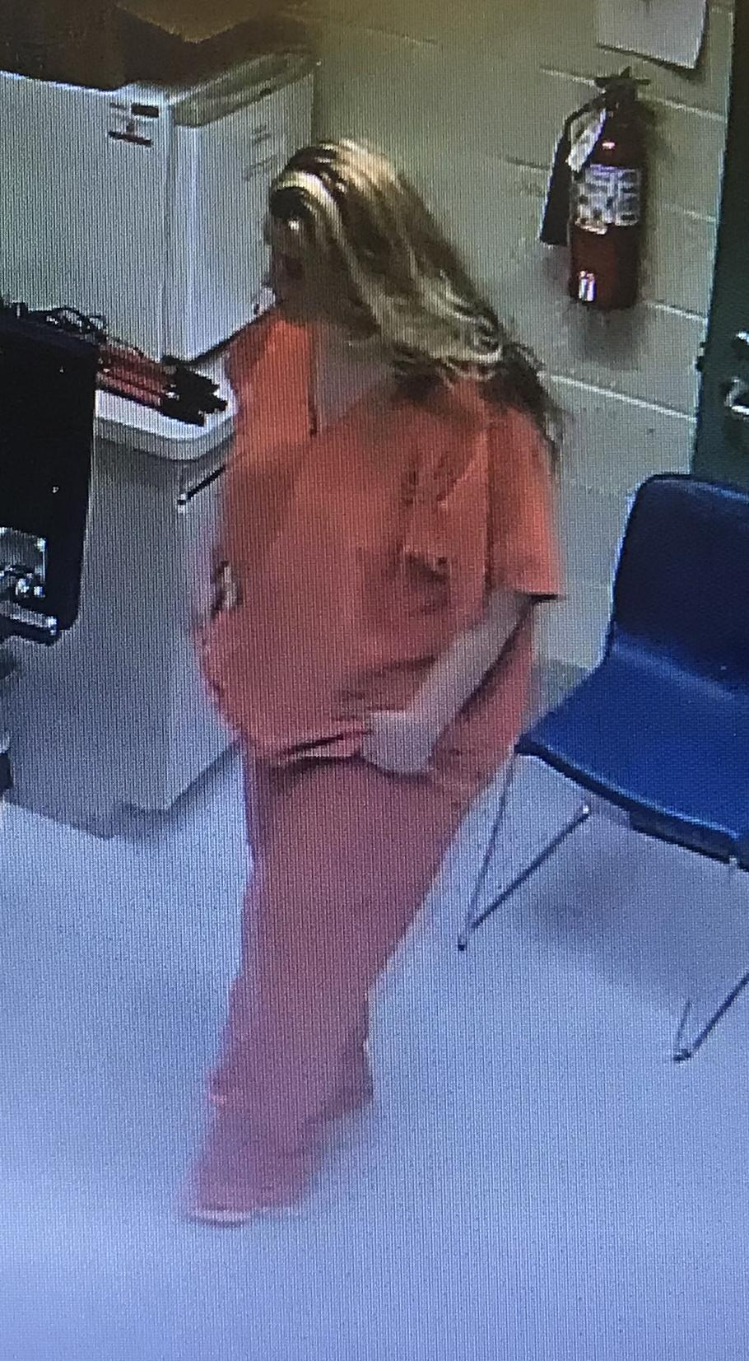
I Walked the Walk, and I Got Sober.
Sobriety helped me better understand my employees and become a better leader.

Slide 12
It’s Been a Bittersweet Journey

Slide 13
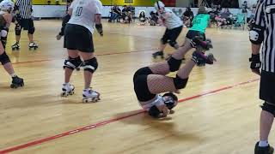

Slide 14
Taking a look in the mirror was hard.
Shadow Work
is Essential

Slide 15
Shadow Work
Example 1
Am I jealous of anyone?
Do I tend to immediately scrutinize that person, in order to avoid looking inward?
What fear is at the root of my jealousy?
What can I do every day to work toward giving myself grace?
Example 2
Is there a person or situation I am trying to manipulate or control, to influence an outcome I desire?
Can I admit that this behavior is deliberate, while giving myself grace that it isn’t malicious?
Sometimes, I hurt myself or others when I am led by fear. Who could I be hurting in this situation?
‹#›

Slide 16
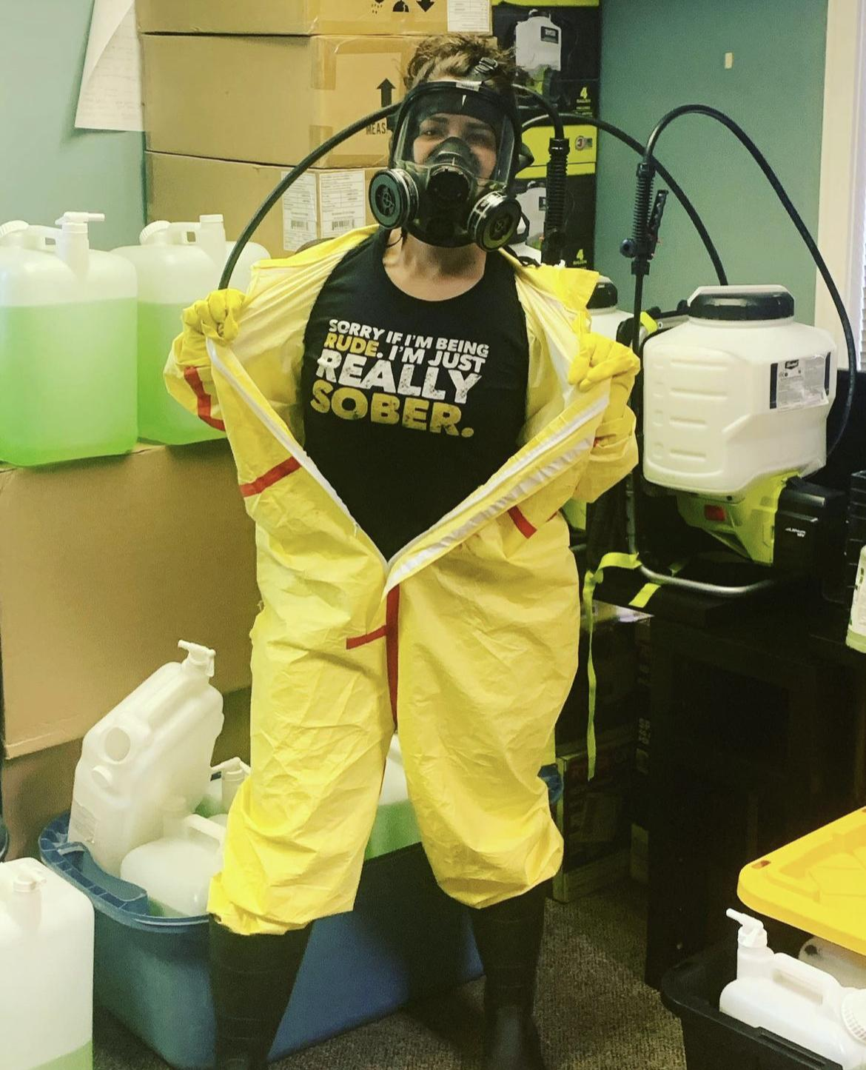
2020: One Year Sober & The Pandemic Pivot
Covid forced us to make drastic changes.
It also helped grow our business!

Slide 17
The Populations We Serve

Slide 18
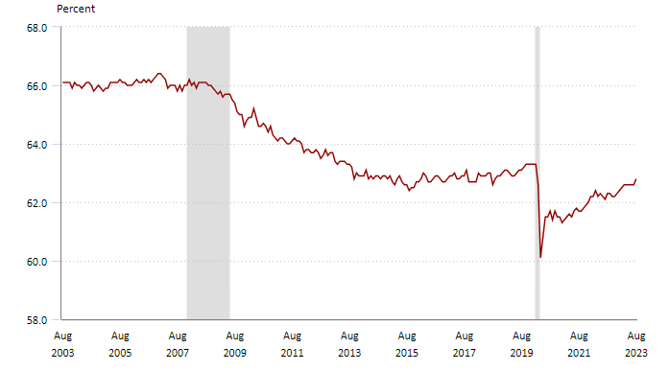
Fewer Americans Are Working.
Source: U.S. Department of Labor
% of Adults
Working or Seeking Jobs
Great
Recession
COVID

Slide 19
Fewer Americans Are Working.
Opioid
Epidemic
Pandemic
Disruption
Wages vs. Inflation
Baby Boomers Aging out of the Workforce

Slide 21
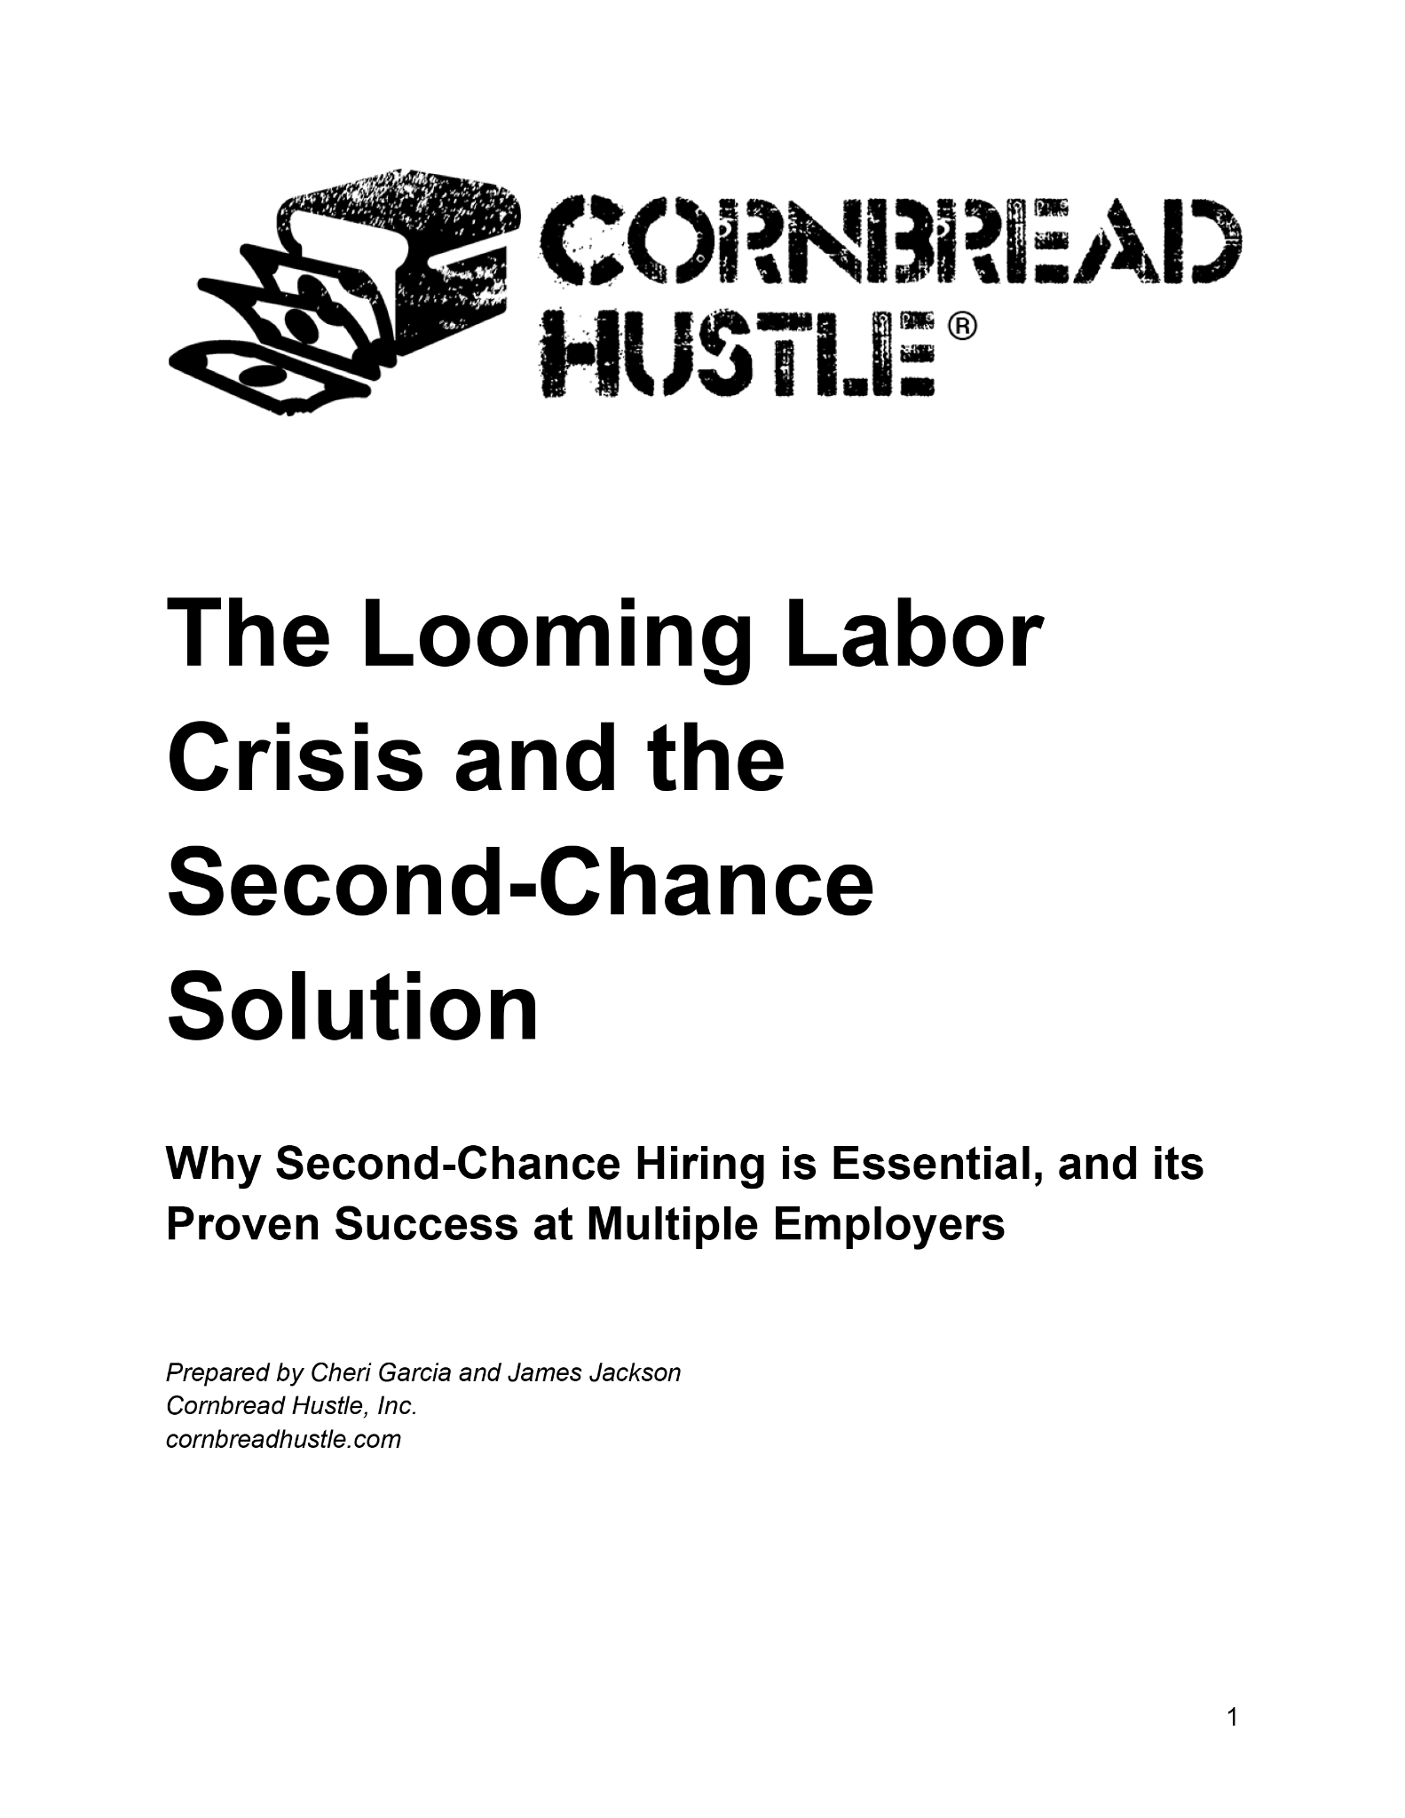
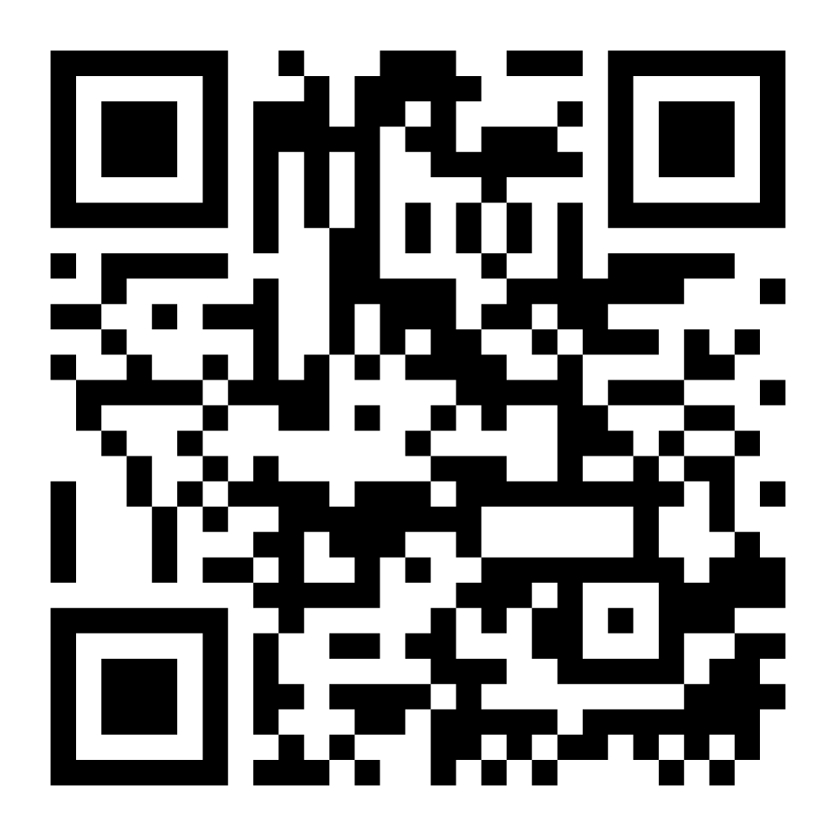
cornbreadhustle.com/report

Slide 22
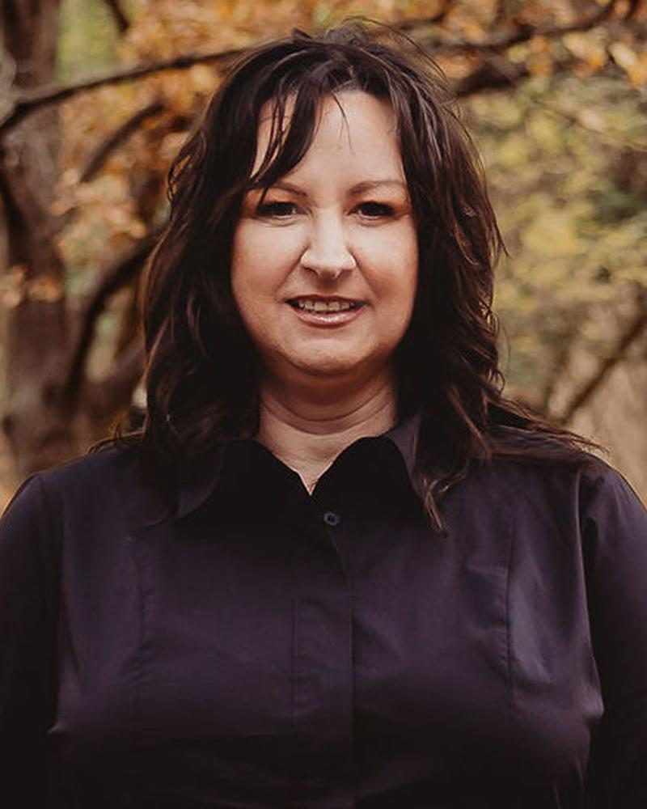
How Do We Do It?
All of our recruiters have lived experience:
5+ years incarceration or in recovery from substance use disorder.
This helps them better understand our applicants.
Dezi Bruce
Director of Recruiting

Slide 23
Dezi’s Background

Slide 24
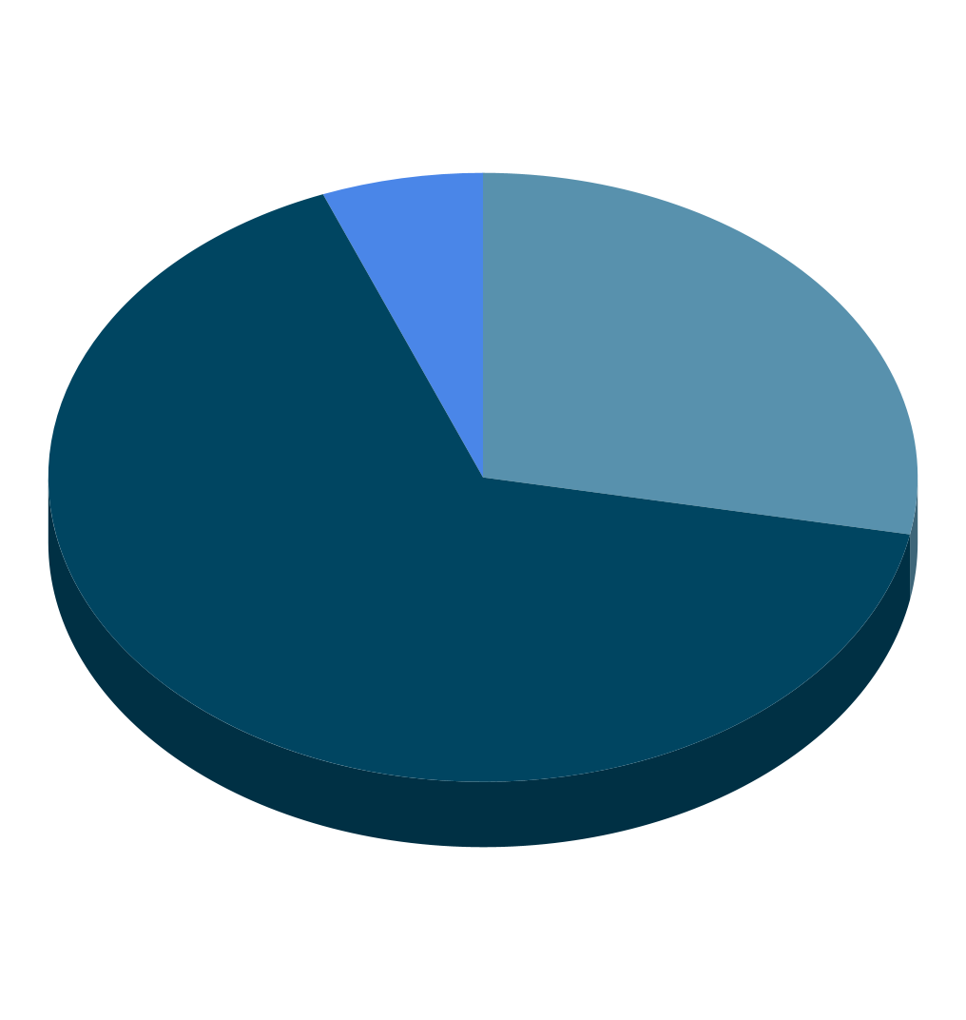
Second-Chance Placements by the Numbers
2,500+ Hires
Since 2016
6%
S.O.
28%
66%
Violent
Nonviolent
Workers with violent charges were 5x more likely to convert than those with nonviolent charges or no criminal record.

Slide 25
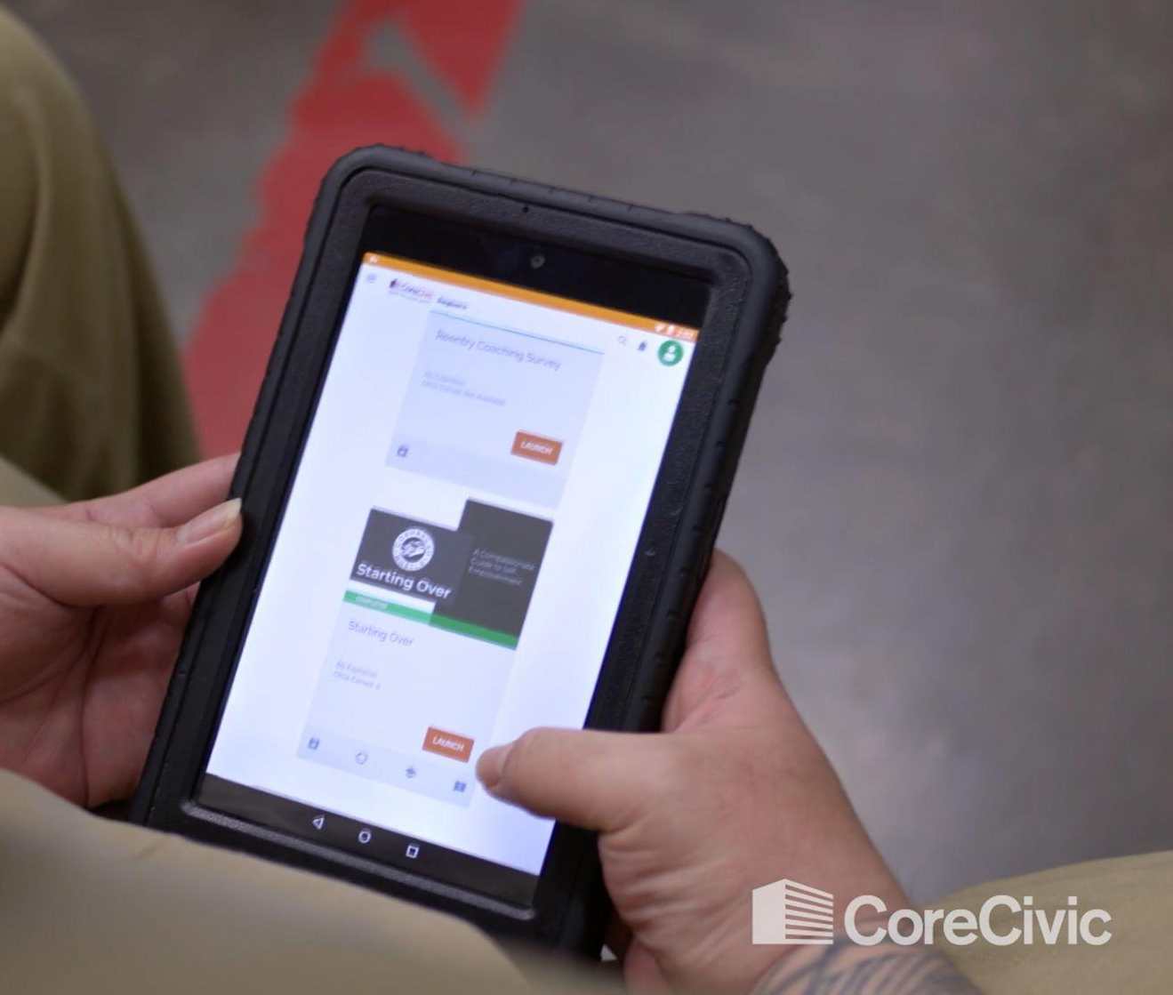
Managing Employees With Empathy and Compassion
Sympathy vs. Empathy:
Why Empathy is Essential
Resilience advocate / chaplain
Mental health days
“Happy hours” with choices
Employee Assistance Programs: access to mental health services
The 12-Week Starting Over Program,
free to all our employees for life

Slide 26
Transformation is Possible
You don’t have to be fully-prepared to make a difference.
We are all human, but empathy is essential to the journey.

Slide 27
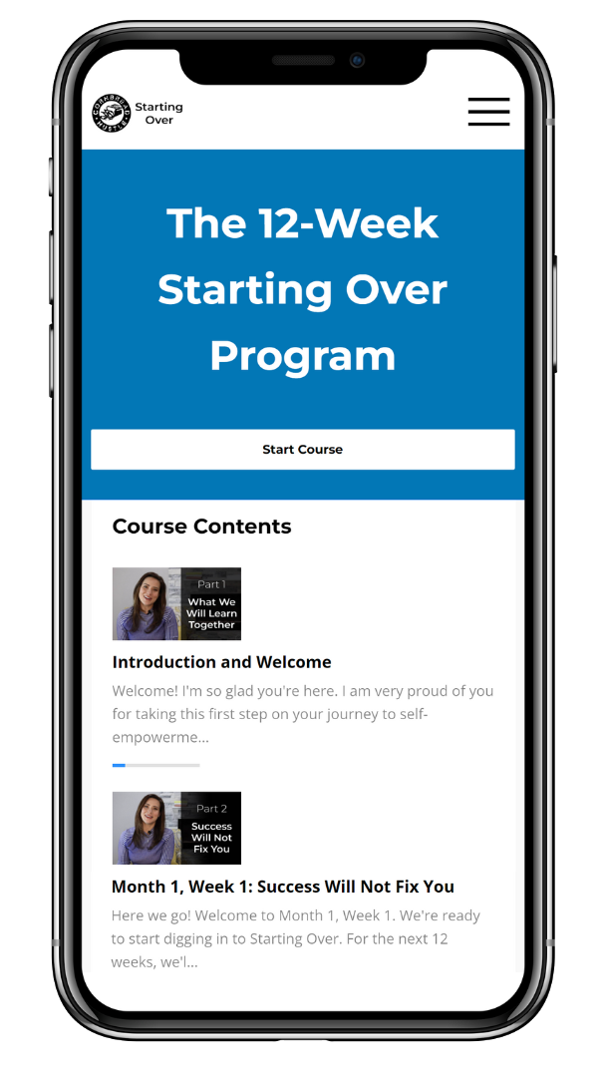
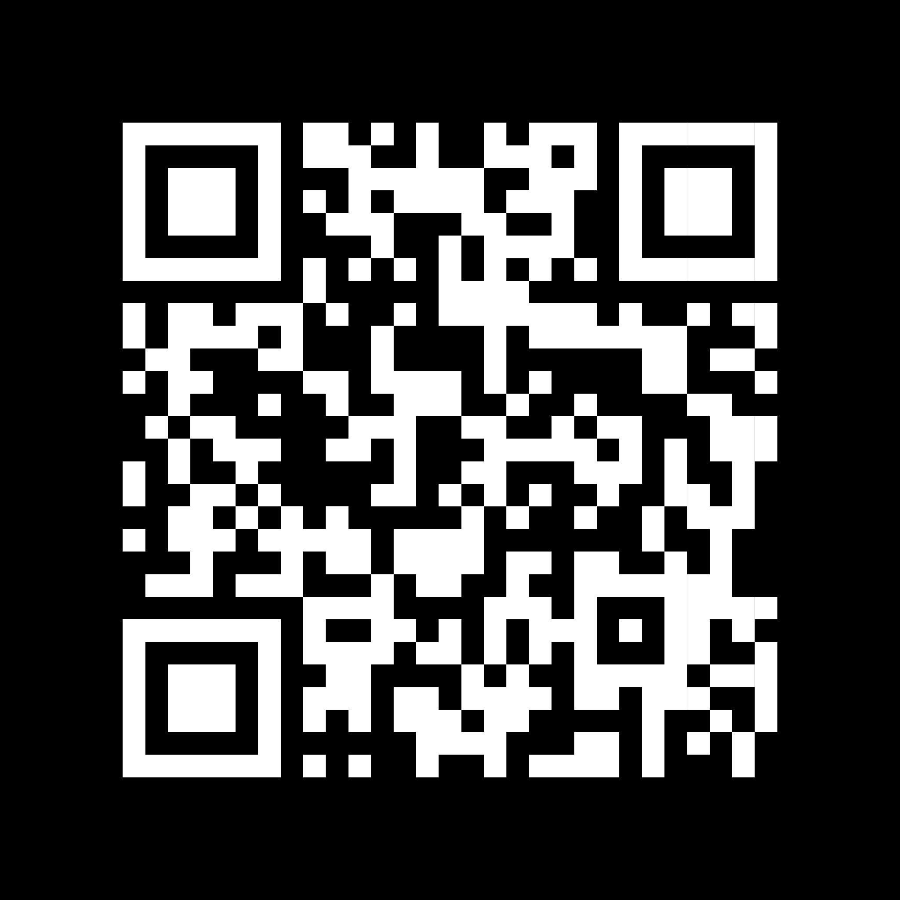
cornbreadhustle.com/startingover

