Slide 1
FMLA: Tips and Tricks
Presented by:
Julia Gannaway
May 7th, 2024

Slide 2
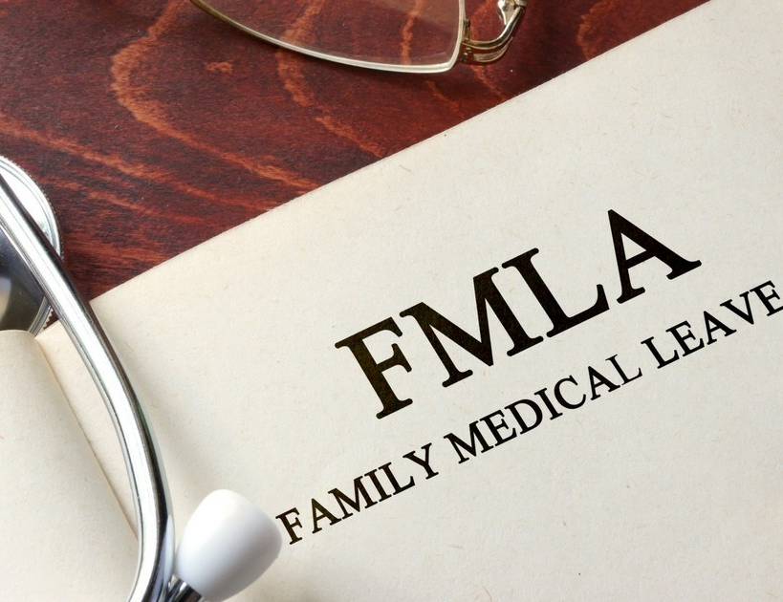
FMLA Basics: Coverage
Public agencies are covered employers without regard to number of employees
Individuals “acting in the interest of an employer” are individually liable for FMLA violations
But – for employee to be entitled, employer must have 50 or more EEs, within 75 miles; includes F/T, P/T, and employees on leave

Slide 3
FMLA Basics: Benefits of FMLA
12 weeks of job protected leave – can’t discipline or take other adverse action because EE requested/took leave (§825.220)
Same or equivalent job upon return (§§825.214, 825.215)
Continuation of group health insurance (§825.210)
Unpaid – best practice is to require unpaid FMLA to run concurrently with other applicable paid leave, including workers’ comp leave (§825.207)

Slide 4
FMLA Basics: Employee Eligibility
50 or more EEs, within 75 miles; includes F/T, P/T, and employees on leave
12 months of employment (within past 7 years)
1,250 hours of service (include OT) during 12 months prior to leave
Not already taken 12 or more weeks leave within previous 12-month period
EE must provide 30 days’ notice if foreseeable; otherwise, as soon as practicable (§825.302, §825.303)

Slide 5
FMLA Basics: Qualifying Reasons for Leave
EE’s own serious health condition (SHC) that prevents EE from working
To care for a spouse, child, or parent with a SHC
Incapacity due to pregnancy, prenatal medical care, or child birth
To care for EE’s child after birth, or placement for adoption or foster care (must conclude within 12 months of birth/placement)
Military family leave

Slide 6
Job Descriptions Must be Updated & Include Essential Job Functions
Just because supervisor says function is essential doesn’t make it so
If it’s essential, make sure “regular and timely attendance” is in job description
Consider: Frequency & importance of task; Can others perform task? Do other employees with same job title/duties perform same task?

Slide 7
What is Continuing Treatment?
Possibilities:
Incapacity & treatment - Inability to work, go to school, or perform other regular daily activities for more than 3 consecutive full calendar days, that also involves either:
2 doctor visits (1st within 7 & 2nd within 30 days of 1st day of incapacity)
1 doctor visit with regimen of continuing treatment (within 7 days of 1st day of incapacity)
Pregnancy & prenatal care
Chronic conditions
Permanent or long-term conditions
Conditions requiring multiple treatments

Slide 8
FMLA Basics: Key Definitions
Serious health condition (SHC) – illness, injury, impairment or physical or mental condition that involves inpatient care (§825.114) or continuing treatment (§825.115) by a health care provider (§825.125)
Spouse, Parent, Child (§825.122) – son or daughter includes stepchild, legal ward, and foster
In loco parentis (§825.122) – persons in loco parentis include those with day-to-day responsibilities to care and financially support a child, or, in the case of an employee, who had such responsibility for the employee when the employee was a child. A biological or legal relationship is not necessary.
Intermittent leave / reduced schedule leave (§825.202) – FMLA taken in separate blocks of time due to a single qualifying reason / schedule that reduces usual number of hours per workday (normally from F/T to P/T)

Slide 9
FMLA Leave Year – 12 Weeks in 12-Month Period
4 methods to establish 12-month period (§825.200), but ER must use for all EEs & changes require 60 days’ notice with no harm to EE:
Calendar year
Any fixed 12-months
12-month period measured forward – measured from first date EE takes FMLA; next 12-month period begins first time EE takes FMLA after completion of prior 12-month period
Rolling 12-month period measured backward - from date EE uses any FMLA leave
*If do not set forth time period, calendar year applies

Slide 10
Why Care if an Absence is FMLA-Qualifying?
Ability to address attendance issues
FMLA-qualifying absences are protected even if not designated as FMLA
To prohibit “protected” absences of indefinite duration
To comply with law

Slide 11
Does EE Have Choice to Not Designate Absence as FMLA?
ER may place EE on FMLA leave if absence due to SHC
Have & enforce consistent policy - if absence is FMLA-qualifying, then designate as FMLA (& provide required notices)
It is not EE’s choice – make sure supervisors know this

Slide 12
Employer Must Designate FMLA Leave
US DOL Opinion FMLA 2019-1-A: 3/14/2019
ER may not allow EE to “save” FMLA – neither EE nor ER has discretion not to trigger FMLA if applicable
Burden on ER to know and apply FMLA: If EE provides enough information, then up to ER to raise the issue with EE and designate FMLA whether EE asks for FMLA or not (**Supervisor communication crucial**)
When the law says that EE may not waive FMLA rights, it means ERs cannot allow EEs to waive FMLA rights.

Slide 13
ER’s Required FMLA Notices (§825.300)
Poster in plain view for all EEs/applicants to see
General notice in EE Handbook
Notice of Eligibility / Rights & Responsibilities Notice
**Designation Notice**

Slide 14
Notice of Eligibility / Rights & Responsibilities Notice (§825.300(b) and (c); DOL Form WH-381)
ALWAYS make sure EE has worked 1250 hours!
ER must notify EE of eligibility to take FMLA w/in 5 business days (absent extenuating circumstances) from date of:
EE’s request for FMLA OR when ER learns absence may be FMLA-qualifying
Must provide separate notice for each FMLA-qualifying event
Sets out ER’s expectations, EE’s obligations, & consequences if not met

Slide 15
Notice of Eligibility / Rights & Responsibilities Notice (§825.300(b) and (c); DOL Form WH-381)
Include blank Certification form & job description – EE has 15 days to return completed Certification
Retroactive designation – if EE is continuously absent/not harmed by designation (825.301(d))
If EE’s eligibility status changes, ER must notify EE w/in 5 business days – keep EE informed

Slide 16
Designation Notice (§825.300(d); DOL Form WH-382)
When ER has enough information to determine if absence FMLA-qualifying (typically upon receipt of Certification), ER (usually HR) must notify EE if leave is or is not FMLA
Must be given w/in 5 business days, absent extenuating circumstances
If information in Notice changes, ER must notify EE w/in 5 business days
Must include if FFD certification will be required

Slide 17
Certifications:
(§§825.305, 825.306, 825.307)
Types of certification forms
What must they contain?
What if unclear or incomplete? (825.305)
How long are they valid? (generally, yr.; 825.300(d)((1)
Recertifications (§825.308)
Fitness for duty certification (§825.312)
Failure to provide certification (§825.313)

Slide 18
Confidentiality of Medical Information – This is Critical!
Medical records include emails & texts, doctor’s notes, FMLA certifications, & ADA records
Supervisors must maintain confidentiality of EE health and other information
Doctor’s notes, FMLA certifications, etc., must be kept in locked file cabinet in HR, separate from EE’s personnel file
Don’t gossip with peers or subordinates
Breach is a violation of law
Potential personal liability – watch out!!

Slide 19
FMLA Confidentiality Requirements (29 C.F.R. §825.500(g))
Records/documents relating to certifications, recertifications or medical histories of EEs/family members, created for purposes of FMLA, must be maintained as confidential medical records in separate files/records from usual personnel files
If ADA also applicable, records must be maintained per ADA’s confidentiality requirements.
The only exceptions to FMLA confidentiality are:
Supervisors and managers may be informed regarding necessary restrictions on EE’s work/duties and necessary accommodations;
First aid and safety personnel may be informed (when appropriate) if the EE’s physical or medical condition might require emergency treatment; and
Government officials investigating compliance with FMLA (or other pertinent law) shall be provided relevant information upon request.

Slide 20
Confidentiality of Medical Information – “Need to Know”
FMLA regulations strictly limit who is in “need-to-know” zone.
Only authorized EEs should have access and only on strict “need-to-know” basis.
HR staff who determine FMLA eligibility
Supervisors/managers needing info on work restrictions/ accommodations
Supervisors don’t have “need-to-know” based solely on their status as a supervisor
Ask: What is legitimate business reason for disclosure to particular individual or group of individuals?
“Need–to-know” zone can vary on case-by-case basis

Slide 21
HIPAA Privacy Rule & Protected Health Information (PHI)
Covered entities (those that routinely handle PHI) must take certain steps to avoid improperly disclosing confidential information.
HIPAA Privacy Rule does not apply to a covered entity when it is acting as an ER
PHI does not include employment records maintained by covered entity in its capacity as ER.
Under HIPAA, HCP can disclose PHI directly to their patient; this is what normally occurs with FMLA. EE obtains completed FMLA Certification from HCP and turns into ER.
If, instead, HCP provides Certification to ER, HCP has responsibility to obtain authorization from EE to share PHI.
HIPAA should not impede disclosure of medical information necessary to establish FMLA.

Slide 22
Internal Processes/Best Practices

Slide 23
Problem: Supervisors Don’t Timely Designate & Track All FMLA-Covered Absences
EE misses weeks/months before anyone thinks about FMLA
Supervisors don’t think “FMLA” if EE using vacation, sick leave, worker’s comp or shift swaps (FD)
Supervisors need to know when to notify and/or get HR involved
Make sure w/comp absences designated as FMLA & run concurrently
HR: Can’t count absences toward FMLA unless & until Designation Notice issued
Retroactive designation? Possible if no harm to EE

Slide 24
Make Sure Supervisors Require Compliance with Call-In Procedures
Enforce normal call-in procedures for reporting absences, tardies & requesting leave, e.g., contacting specific supervisor by certain time
Notice may be given by EE’s spokesperson if EE physically unable to do so personally
If EE does not comply with call-in procedures & no unusual circumstances justify, FMLA-protected leave (& paid time off) may be delayed/denied. EE also subject to discipline
Be careful of enforcing policies that are stricter than allowed by FMLA

Slide 25
Create and Follow Reliable System for Recording Reasons for Absences
Do you have a reliable system?
If so, is it consistently followed?
Risks of lost text messages
Risks of uniformed/
untrained supervisors
Consider departmental “point” person for leave & absences

Slide 26
How Do Supervisors Know Which Absences Covered by FMLA Certification?
Length of absence set out in Certification, which supervisors don’t usually see
Frequency & length of intermittent leave – how is this tracked?
How much information does HR share with supervisors?
Who is responsible for recording FMLA absences in timekeeping system?
Have EE say “FML”, or if multiple certifications, “FML 1”, “FML 2”, etc.

Slide 27
Intermittent FMLA Leave (§825.202)
FMLA allows for “intermittent absences,” i.e., smaller, separate periods of time off
FMLA can be taken in small chunks of time if:
Medically necessary
Because of qualifying exigency
For planned medical treatment, or
As otherwise approved by ER
Certification must set out reasons for & schedule of intermittent leave; if unforeseeable, then an estimate of frequency & duration of absences.
Can’t require EE to bring doctor note for each intermittent FMLA absence.

Slide 28
Leave Entitlements – How to Calculate

Slide 29
Calculation on Workweek basis (§825.205(b))
Actual workweek is the is the basis of leave entitlement
Fractions! Fractions! Fractions!
Intermittent: If an employee takes off 8 hours from 40 workweek – 1/5 week
Reduced leave – 4-hour days – ½ week
Can convert fractions to hours only if conversion “equitably reflects” regular schedule
What if: variable schedule?
What if: unable to work scheduled overtime?

Slide 30
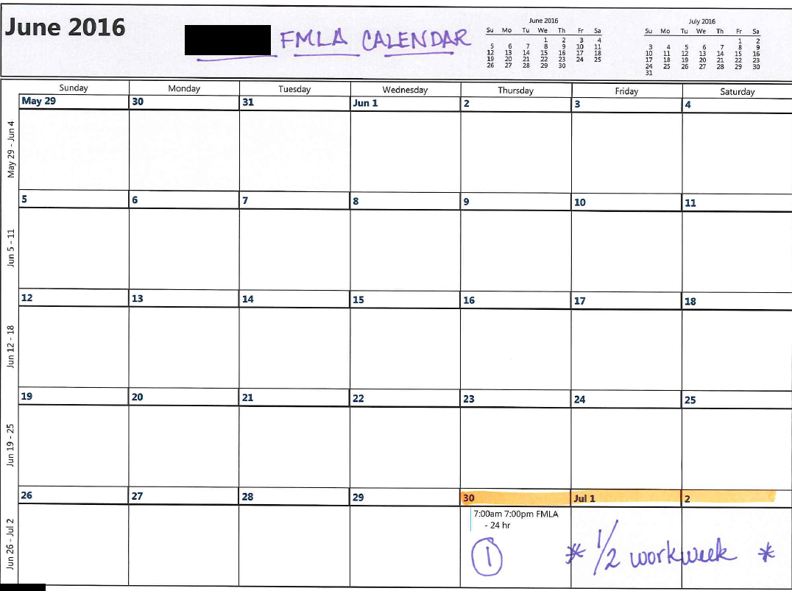
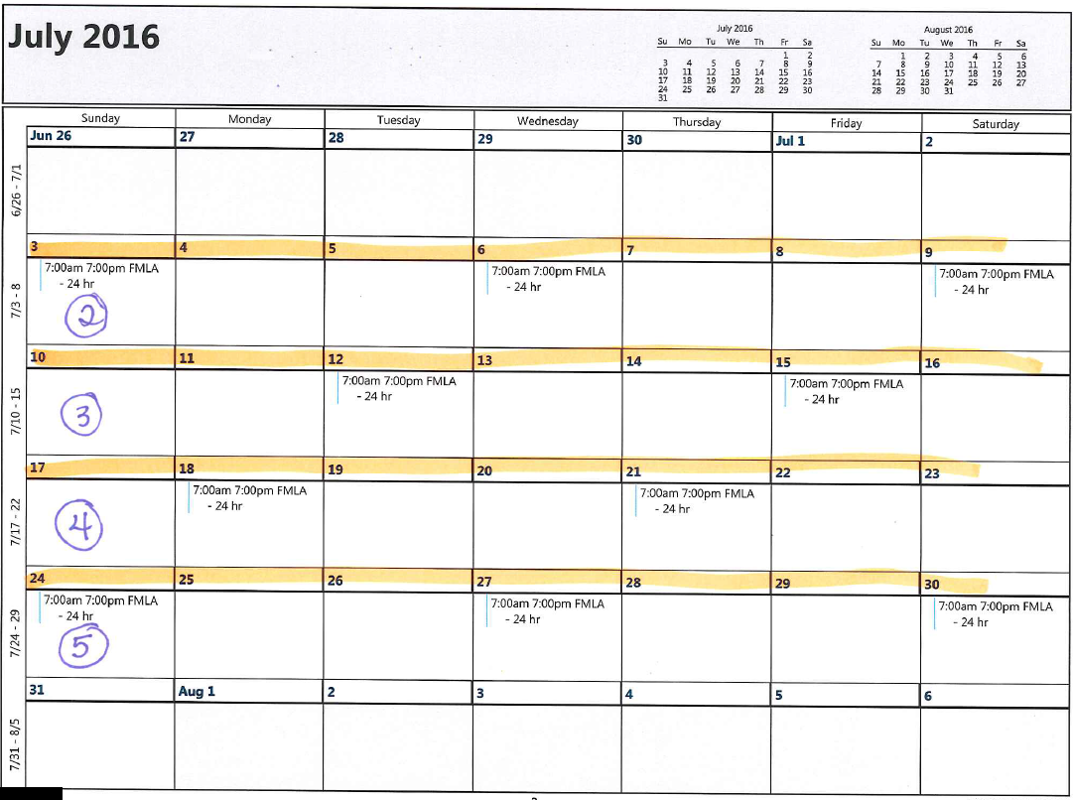

Slide 31
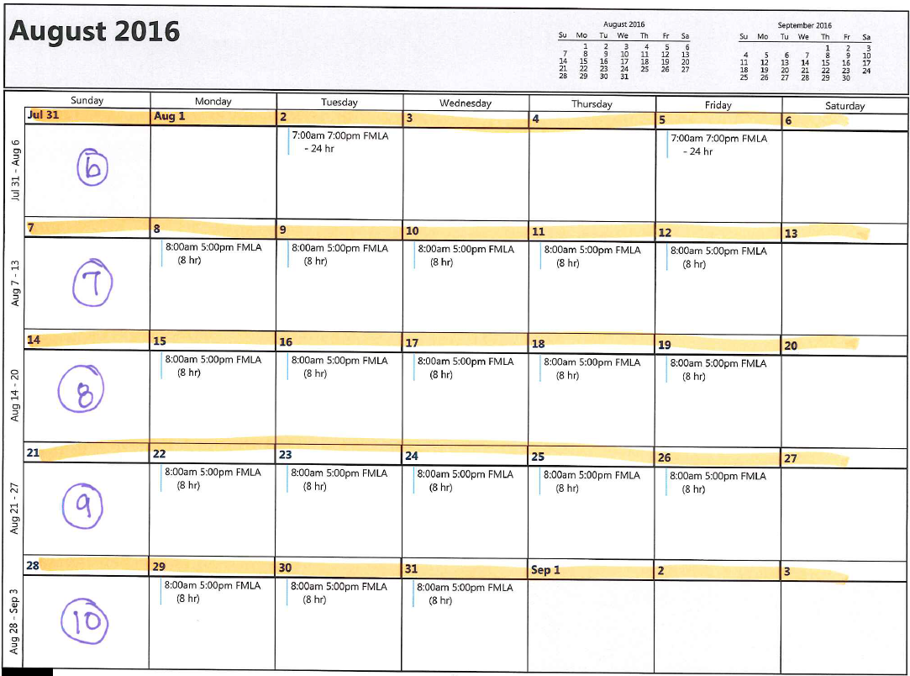
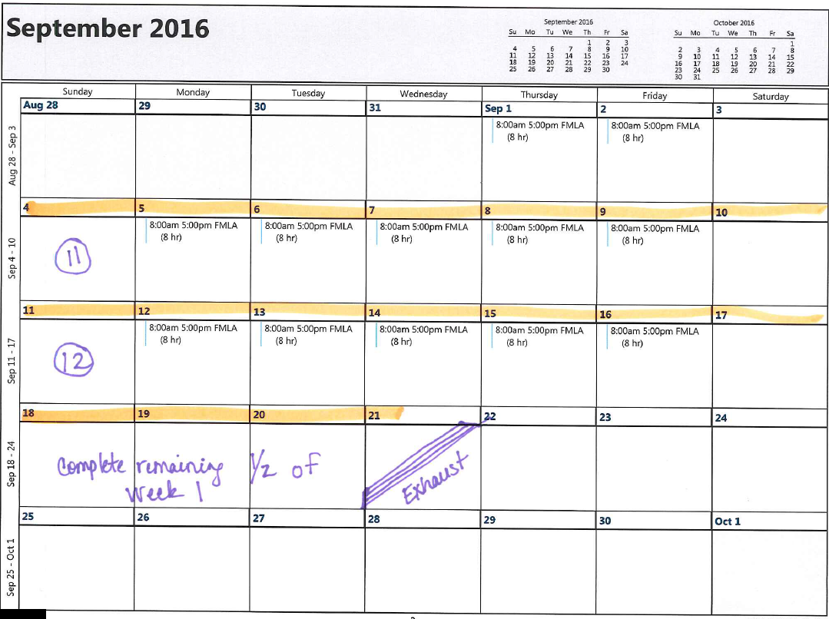

Slide 32
Increments of FMLA leave (§825.205)
ER must use shortest amount of time; not greater than one hour
Exempt employees – if leave exhausted, can deduct pay (825.206)

Slide 33
Return to Work

Slide 34
Fitness-for-Duty/Return to Work Certifications
Require before return to work if leave due to EE’s own SHC, but only if advance Notice given to EE & limited to SHC causing FMLA leave
Designation Notice – include job description w/ essential job functions
Must specifically address ability to perform essential job functions set out in Designation Notice (or in attached job description), but limited to SHC causing FMLA leave
EE responsible for costs & not paid for time or travel costs
HR (not supervisor) may contact HCP to clarify/authenticate, but can’t delay return to work while contacting HCP
Can’t require for each intermittent absence; can require once every 30 days if reasonable belief of significant risk of harm to EE/others
If EE fails to timely provide, not allowed to return to work
If EE fails to provide at all & fails to request more FMLA leave, EE not entitled to reinstatement & may be terminated; ER might ask for recertification

Slide 35
FMLA & ADA: Fitness-for-Duty/Return to Work Certifications
Problem: Supervisor allows
EE to return to
work without
proper release
Solution: Involve HR in return-to-work process
Always provide copy of job description & check the box on Designation Form!

Slide 36
VIP Stuff!
Do you have a Return to Work/Fitness for Duty form for FMLA?
Calendar communications with employees while on FMLA!
Attendance?

Slide 37
Courts More Likely to Find Regular, Predictable Attendance Essential Job Function If:
Job requires specialization or other circumstances make it difficult to replace EE
Job requires performance at place of employment
Employment tasks are time sensitive
Performance requires teamwork
Work is critical, & failure to be present adversely affects others
Number of available employees to cover absences is limited
ER has strictly enforced its attendance policy, i.e., consistently treats attendance as essential job function.

Slide 38
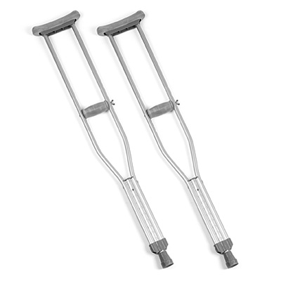
Bermuda Triangle: FMLA, ADA & Worker’s Comp
Ramji v. Hospital Housekeeping System, (11th Cir. Apr. 6, 2021)
Ramji seriously injured knee at work
HHS told her nothing about FMLA; provided WC benefits
HHS gave some time off and light duty and Ramji was medically cleared
HHS required essential functions test prior to reinstatement; included deep squats
Ramji suffered knee pain and failed test
HHS fired her
Ramji sued for FMLA interference
HHS lost on appeal
Takeaways
When EE informs ER of SHC, ER must provide FMLA notice of rights (5 days), including 1) leave may be counted against FMLA entitlement; 2) rights to substituted paid leave for unpaid leave and 3) right to maintain benefits during FMLA and job restoration
Workers’ compensation benefits not substitute for FMLA; statutory schemes overlap, but WC does not displace FMLA
EE cannot be mandated to work light duty instead of FMLA; EE is free to reject light duty offer under FMLA analysis

Slide 39
What Happens if No FMLA or if 12 Weeks of FMLA Runs Out?
Additional leave may be reasonable accommodation under ADA if:
Enables EE to return to work & perform essential job functions
Does not cause ER undue hardship
“ADA was enacted to enable people to work, not excuse them from working”

Slide 40
Questions?

Slide 41
Julia Gannaway JG@RossGannaway.Law 817.332.8512
This document is provided for general informational purposes only. It is not intended and is not to be construed to constitute legal advice. Please consult your employment attorney for specific situations.

