Slide 1
Creating Sustainable Retiree Medical Plans
May 9, 2024

Slide 2


Agenda
Medical Plan Coverage in Texas
Market Trends
Retiree Coverage
GASB 75 – controlling cost inside the valuation
Controlling cost outside the valuation

Slide 3



Your Moderators
David Gibson, CEBS
VP, Employee Benefits
DGibson@holmesmurphy.com
Shawn Quildon
VP – Client Service, EB/Shareholder
SQuildon@holmesmurphy.com
Julie Rickman
AVP – Client Service
JRickman@holmesmurphy.com
3
© 2024 HOLMES MURPHY & ASSOCIATES – PROPRIETARY AND CONFIDENTIAL

Slide 4

Medical Plan Coverage in Texas:
Why are we here? C
Why Are We Here?
4

Slide 5
Retiree Medical Coverage
Why focus on retiree health coverage strategies?
    OPEB Liability implications and Affordability concerns
    Re-direct some of your focus back to “Retirees”
      Smaller populations but……
        Higher health care expenditures
        Greater clinical risks
        Minimal connection back to the organization, reduced engagement, and fewer tools and resources used to promote wellbeing
Texas Municipalities with 25,000 residents are required to offer retiree coverage.
5

Slide 6
Medical Coverage in Texas
2023*
U.S.
Texas
Per Enrollee Costs – Private Insurance | $4,994 | $4,923
Health Care Cost Increase vs. 2022 | 5.7% | 6.4%
6
*0-64 non-elderly population
Source: Kaiser Family Foundation

Slide 7
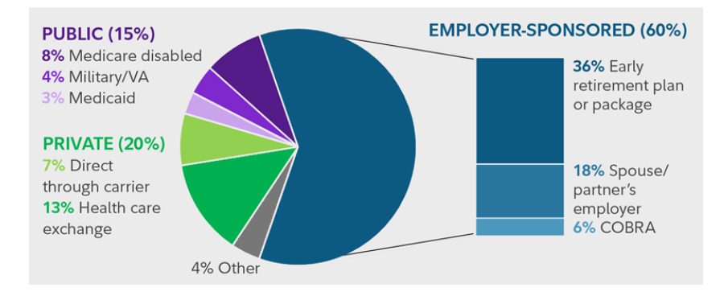
Early (Under 65) Retiree Medical Coverage
7
Source: Fidelity Workplace
Source: Fidelity Workplace
Notes:
Majority of employer sponsored coverage – PE/Unions/Oil & Gas

Slide 8
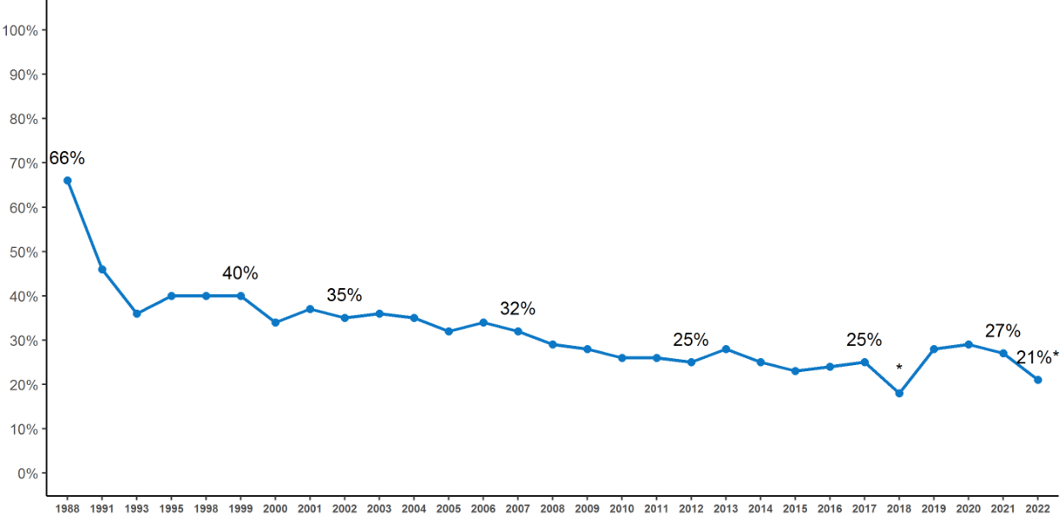
Firms Offering Retiree Health Benefits,
1988 - 2023
Percentage of Firms Offering Retiree Health Benefits, 1988 - 2023
8
Source: KFF, Health Benefits Survey, 2023

Slide 9
Offering Retiree Health Benefits – By Industry
9
Source: KFF, Health Benefits Survey, 2023
Notes:
Large Firms = 200 or more workers
Many lower wage – at least 35% earn the 25th percentile or less of national earnings ($30,000, 2022)
Many higher wage – at least 35% earn the 75th percentile or less of national earnings ($70,000, 2022)
Many older workers – at least 35% of workers are age 50 or older
Many younger workers – at least 35% of workers are age 26 or younger

Slide 10
Market Trends in Texas
10

Slide 11
Market Trends in Texas – why?
Wide range of costs by market due to Quality of Care.
Provider leverage - In some markets, one or two Hospitals are the only option in town. Nursing Unions are here and gaining leverage during the negotiation process. Private Equity ownership of provider practices.
Limited Number of Access points for members (e.g. Primary Care, Mental Health). Increased demand, but less supply.
Covid impact – fewer members sought preventative treatment during the pandemic.
Higher incidence of large claims than usual (e.g., Cancer claims).
11

Slide 12
Retiree Coverage
12

Slide 13
Retiree Coverage Facts
Some long-term employees can’t perform their jobs anymore due to physical requirements or injury.
Based on observations, Pre-65 Retirees cost 2X what an Active employee costs. Wide range of costs by market due to Quality of Care and choice.
There are many options in the Post-65, Medicare marketplace.
Retirees are on a fixed-income, which may include small COLAs that don’t keep up with healthcare inflation.
Statutory requirements – Employers often offer the same plan to retirees that was available when they were Active employees. This can be costly to them and the organization. (Local government Code 175).
13

Slide 14
Retiree Coverage Facts - Local Govt. Code 175
Cities with 25,000 residents:
Sec. 175.002. RIGHT TO PURCHASE CONTINUED COVERAGE. Acts 1993, 73rd Leg.
Amended by: Acts 2009,
Sec. 175.003. LEVEL OF COVERAGE.
(b) Same as when employment ended.
(c) May substitute Medicare supplement health benefits coverage as the coverage.
(d) The person may elect to continue coverage at a reduced level, if offered by the political subdivision.
14

Slide 15
Retiree Coverage Facts - Local Govt. Code 175
What most Texas Public entities do:
Cities with 25,000 residents:
Sec. 175.002. RIGHT TO PURCHASE CONTINUED COVERAGE. Acts 1993, 73rd Leg.
Amended by: Acts 2009,
Sec. 175.003. LEVEL OF COVERAGE.
(b) Same as when employment ended.
(c) May substitute Medicare supplement health benefits coverage as the coverage.
(d) The person may elect to continue coverage at a reduced level, if offered by the political subdivision.
15

Slide 16
Retiree Coverage Facts - Local Govt. Code 175
What else should you consider?
Cities with 25,000 residents:
Sec. 175.002. RIGHT TO PURCHASE CONTINUED COVERAGE. Acts 1993, 73rd Leg.
Amended by: Acts 2009,
Sec. 175.003. LEVEL OF COVERAGE.
(b) Same as when employment ended.
(c) May substitute Medicare supplement health benefits coverage as the coverage.
(d) The person may elect to continue coverage at a reduced level, if offered by the political subdivision.
16

Slide 17



Does this matter?
Welcome
We-Haul
MOVING
17

Slide 18
Illustrative Population Growth
18

Slide 19

Retiree Personal Story
60 years old.
Worked for City for 40 years.
Eligible for retirement plan benefits which will provide $32,500 in annual income.
Medical contributions alone could cost $14,000 with a contribution based on years of service.
19

Slide 20
GASB 75
Inside the Valuation
20

Slide 21
GASB 75: Why not just offer a retiree plan?
Issues:
Retirees have more health issues than actives
Pre-65 retirees can’t get coverage elsewhere (other than ACA exchange)
Chapter 175 – right to continue coverage
Texas uninsured population
So why not just offer a retiree plan?
  Pre-GASB standards, a public entity could just implement a retiree medical plan and recognize the cost as the retirees “incurred” claims
  GASB 74/75 now require that that cost be recognized while they are actives “accruing” the benefits
21

Slide 22
GASB 75: What is it?
  Liability: PV of future commitments
PV₆₀(ben₃₅) = cost₆₀
    _{Trended 25 year (trend rates)}
    Times the probability of living (mortality tables)
    Times the probability of still working at employer at age 60 (turnover table)
    Times the probability of retiring at 60 (retirement rates)
    Times the probability of electing retiree coverage (participation rate)
    Plus spouse coverage times the probability of covering a spouse (spouse assumption)
    Discounted back to today’s dollars (discount rate)
22

Slide 23
GASB 75: People
  For all of these, make sure the assumptions and tables are based on recent studies of your population; recent demographic trends can help reduce the liability (e.g. the “great resignation” and turnover, recent increase in interest rates)
  A lot of attention spent on mortality and turnover tables, retirement rates, etc. that don’t have as significant of an impact
  Often overlooked assumption - participation rate and spouse assumption/ the people you want to cover
  Who do you want to cover?
      Make sure your assumption is up to date (used to be 75% - 100%; now 50% - 75% or less)
      Only pre-65 retirees or both pre-65 and post-65?
      Only those with long service?
      Only those who have been on the active health plan for a long time?
      Future hires?
      Do you want to cover spouses? How much?
23

Slide 24
GASB 75: Cost
Cost₆₀
The net employer contributions are what generates the GASB liability
Lower the liability by lowering the total cost or increasing the retiree contributions
Increasing retiree contributions is zero-sum won’t be discussed other than:
    Unlike actives, it is a stream of yearly contributions over 40 years or so
    You can cap the City’s contributions sometime in the future and lower the liability without affecting today’s cost
 | EE | EE + Sp | EE + Ch | Family
Total Rates | $800 | $1,760 | $1,440 | $2,400
Retiree Contributions | $200 | $440 | $360 | $600
Employer Contributions | $600 | $1,320 | $1,080 | $1,800
24

Slide 25
GASB 75: A tale of 2 Cities
25

Slide 26
GASB 75: A tale of 2 Cities
  What is the difference?
    Organization 2 only covers pre-65 retirees; Organization 1 Pre & Post
    Organization 2 does not contribute for spouses; Organization 1 does
    Organization 2 charges more to the retirees
    Organization 2 has a comeback option so many pre-65 retirees get coverage elsewhere, if they want, and can comeback once before age 65.
    Organization 2 has managed their active/retire plan more tightly (plan design, networks, directing care, wellness)
    Organization 2’s Finance and HR departments have coordinated in what benefits they want to offer versus their GASB liability; Organization 1 has not
26

Slide 27
GASB 75
Controlling the
Cost Component
(outside of the valuation)
27

Slide 28
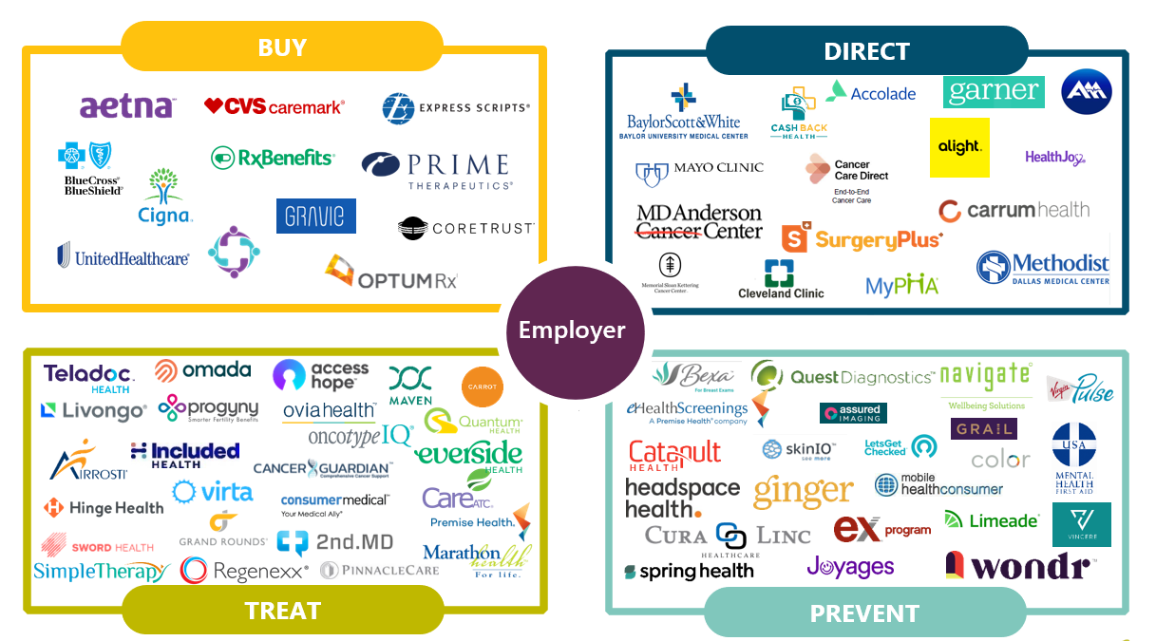
Retiree Strategy - Influence
28

Slide 29
1. Prevention – lowering costs
Make Primary Care the center of care for your members.
Improve and Eliminate barriers to Care for your members
Consider Direct Primary Care options
Introduce/Enhance Virtual options for members.
Evaluate On-site Clinic options to complement Group coverage.
29

Slide 30
2. Directing care – lowering costs
Costs vary considerably by Insurer, Network, Provider, Hospital
Quality of Care is the foundation of efficiency
Some providers are better at treating certain conditions than others
Formulary and Clinical strategies to drive members to lower cost drugs first before expensive Specialty medications.
Plan Design and incentives to steer members to the best providers/outcomes.
30

Slide 31


3. Technology/Engaging Retirees
Leverage technology to connect early retirees with best quality providers (tiered benefits).
Where possible, eliminate deductibles for members.
Best quality providers produce better outcomes, and usually at a lower costs.
Provides better transparency for members.
Provides cost-certainty for members on a fixed-income.
31

Slide 32




4. Evaluate your Post-65 strategy
32

Slide 33





Informed consumers are better consumers.
(Texas Brisket – the same Angus beef, but different costs)
$2.49 lb.
$3.79 lb.
$3.99 lb.
33

Slide 34
What can you do now to lessen your Expense and OPEB liability?
Retiree Consulting Strategy Matters: Reduce Your Liability
Review alternate plan designs with Quality of care as the foundation
Continued contract negotiation - network, pharmacy contracts, total cost guarantees
Evaluate eligibility rules, rate discounts, valuation assumptions
Focus on Retiree specific engagement & communications – year round
Explore exchange options, possibly in conjunction with a defined contribution approach
Evaluate Retiree Health Reimbursement Accounts (RHRA)
34

