Slide 3
Things You Won’t Read in a Law Book
ADA
Good Faith
Age
Unpredictable
Race
Fear of Guilt
LGBTQ
Like Religion
Religion
Exclusive
Retaliation
Victimization
The EEOC
A Peek Behind the Curtain: How the Agency Works
Not Becoming the Thing We hate: DEI Dilemmas
Everything is a Priority:
Strategic Enforcement Plan
All Talk No Do:
EEOC’s Emphasis on AI
GOOOAAAALLLL:
What We Learn from Goals?
All Gas No Brakes:
Charge Processing
Bonus: Stories of My Life at EEOC
What I learned about career success

Slide 4
Notes:
Stories matter. Societies since the beginning have told stories as a way of explaining who they are to themselves and others. We Americans are a story telling people. We have books and movies and song and poems and plays. One of my favorite stories is A River Runs Through It by Norman MacLean. I don’t usually recommend the book because it has practically zero plot and what plot it does have is about fly fishing. But I love it because I think it is a perfect piece of art. There is not a missing, misplaced or unnecessary word in the entire book. The narrator of the story is a writer, and late in the book he is having a conversation with his father, and his father says, “I know you like to tell true stories,” and he responds, “I like to tell stories that are true.” Those two sentences sound close, but you can fit all of human kind between their definitions. This is why storytellers matter. If I conducted a though experiment with you and asked you to envision a person entering a room. You know there are ten thousand separate facts that come along with, person entering a room, Facts about the room, the person, how they entered; sounds, sights, smells, thoughts. The storyteller will not list all ten thousand facts. They will instead pick and choose which facts tell the story they are trying to tell. A story that is true. This is why representation matters. Because storytellers are the people who create, support and perpetuate the social constructions we use to tell ourselves who we are and who we aren’t, what we value and what we don’t, what’s important and what isn’t. Representation matters because we need storytellers from a wide variety of experiences because they help make our national story more accurate and more reflective of who we really are. Bankers are story tellers. Yes, they are. The allocate capital in our society and in doing so, tell what what we value and what we don’t. What is worth investing in and what isn’t. Representation matters in banking. It also matters in science. What? Science is science. The scientist doesn’t matter, but they do. They decide what to study, how to study it and what the practical applications of their science will be. And in doing so, decide for us what is important and what is not, where we will go in our future and where we won’t. When I say representation matters, I don’t mean that employers should hire people of certain groups simply because they are of that group. That is antithetical to everything I have done in the past 30 years. But I do mean that employers should bring in candidates from as many different communities as possible and give them a real opportunity. That they should develop a hiring criteria that actually gives them good candidates. And that they should take those qualifications that have historically given them candidates with a narrow range of experiences and expland them. Why? Because we all know that there is more than one way to tell a good story. We are the most racially, religiously and culturally diverse country ever. But it’s not just that. There are other diverse countries. But it is where our obligation lie. We don’t have obligations to a king or queen or and idealogy. Our obligations are largely to each other. And the systems we have created and centered around the ideal of fairness. The irony, of course, is that we don’t always treat each other fairly. And it is right there in that space, that irony that I have spent my entire professional career, trying to answer that one simple question of why we don’t treat each other fairly, and that is my story. It is a story that is true, and it is a story that I hope will help you.

Slide 5
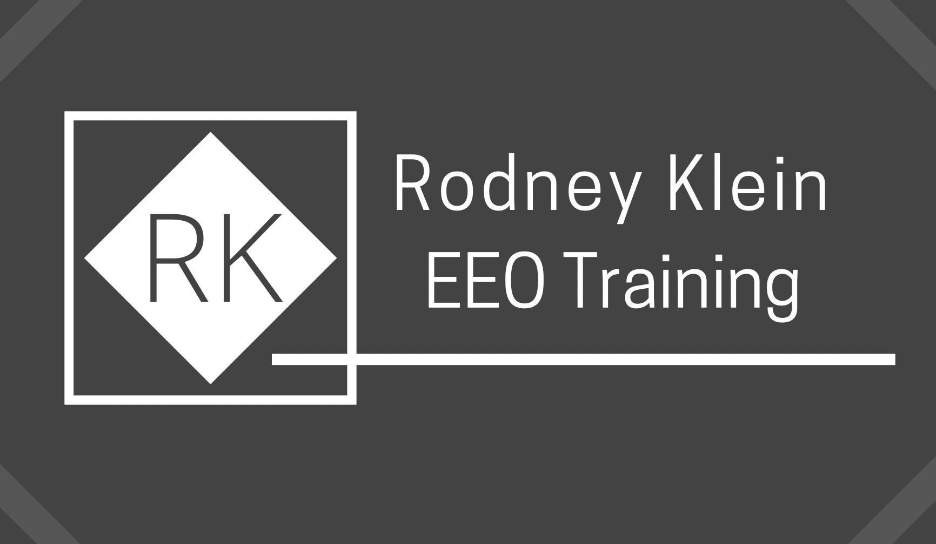
210-827-0991 (cell)
rk@rodneykleineeotraining.com
Connect with me on: Linkedin
www.rodneykleineeotraining.com

