Slide 1
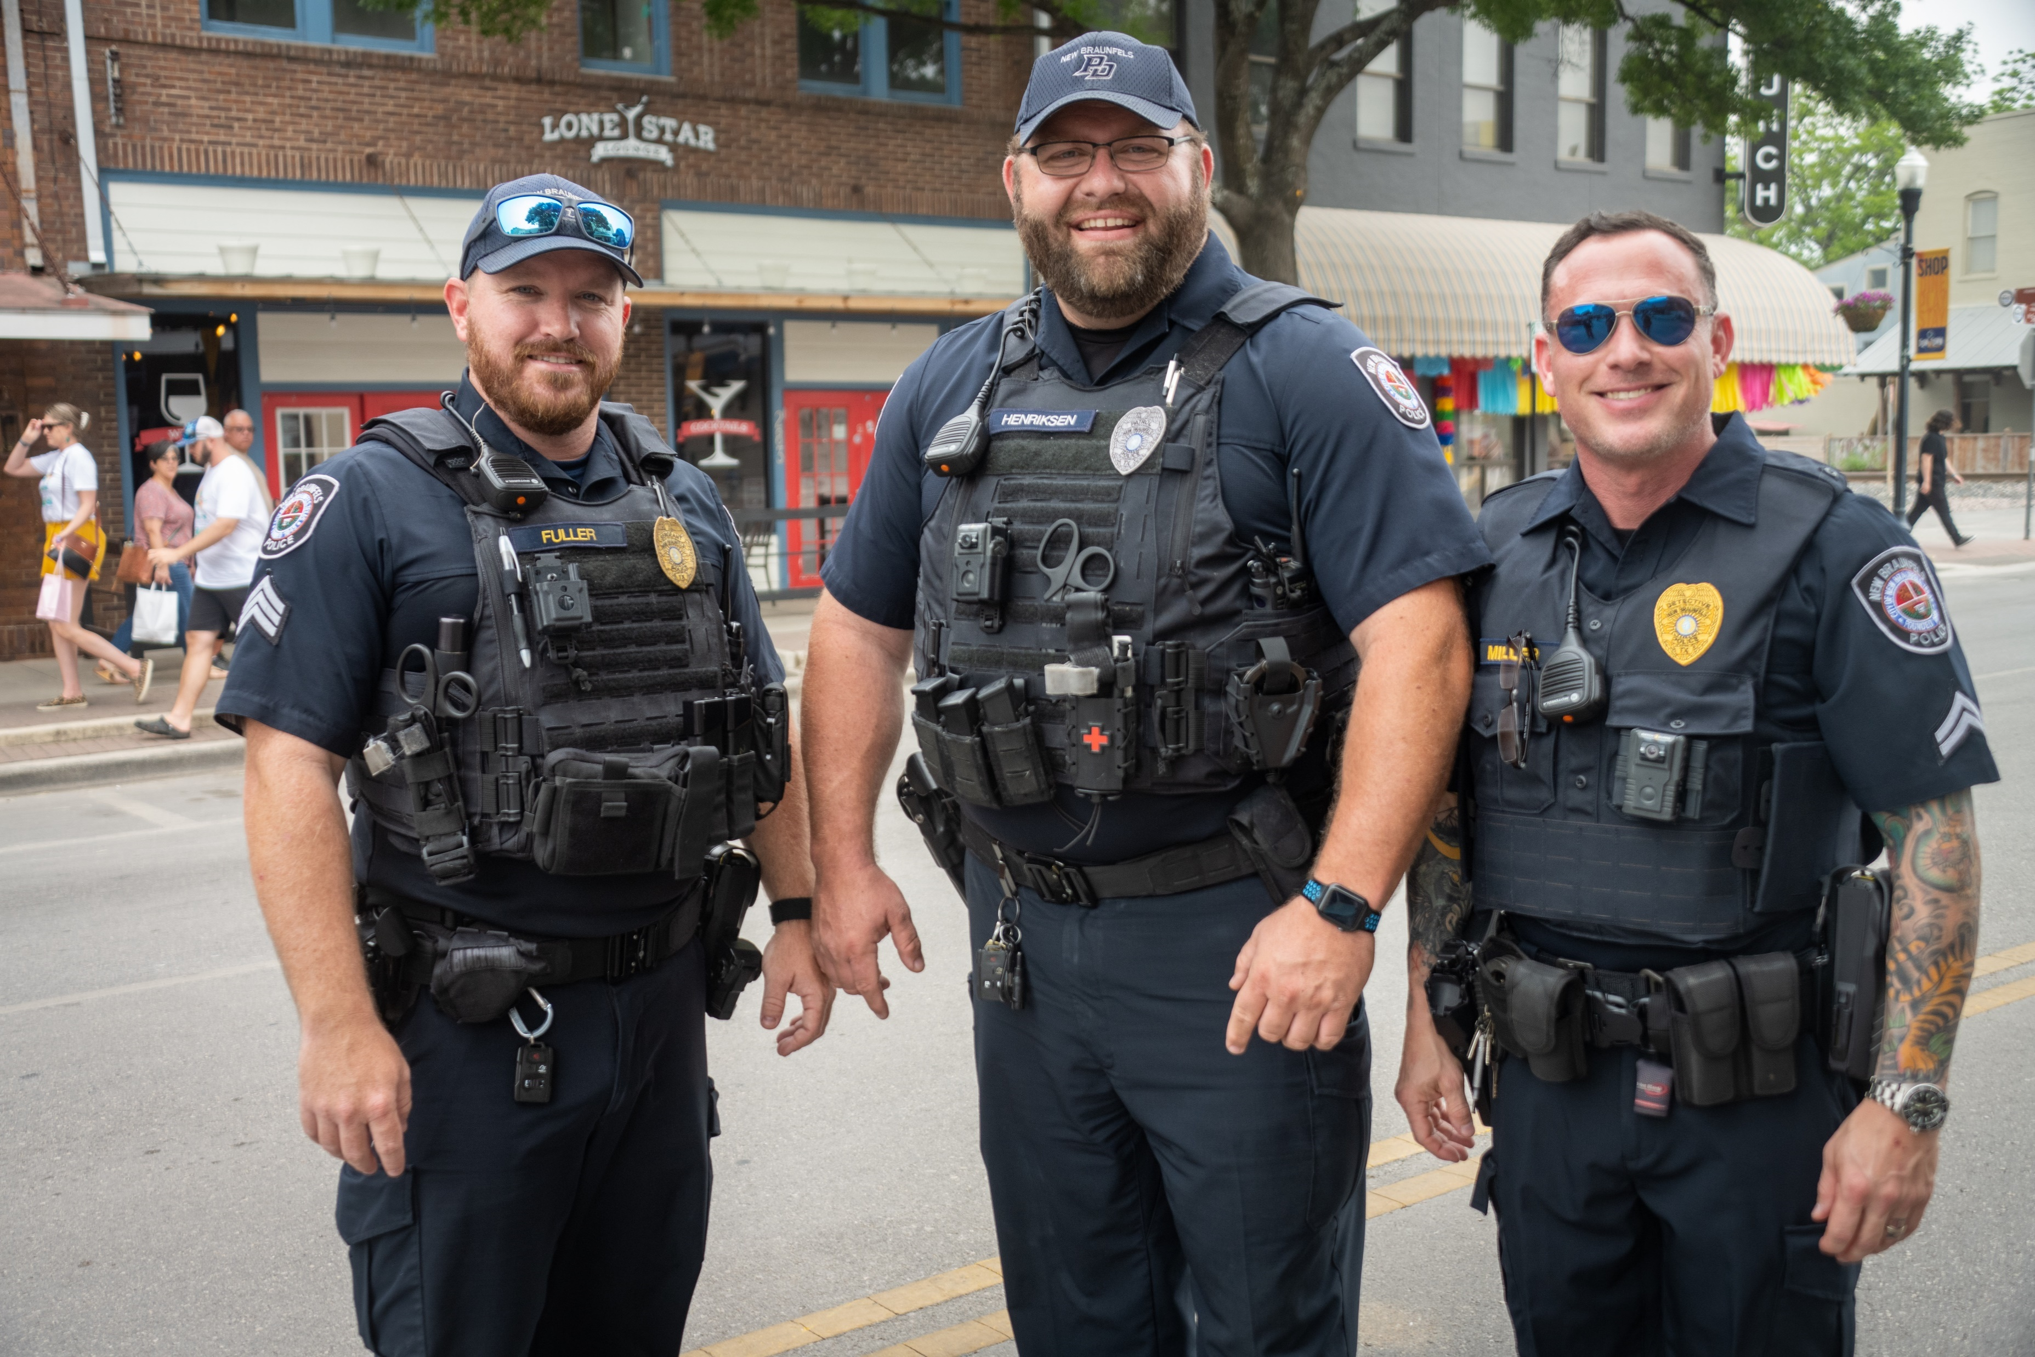
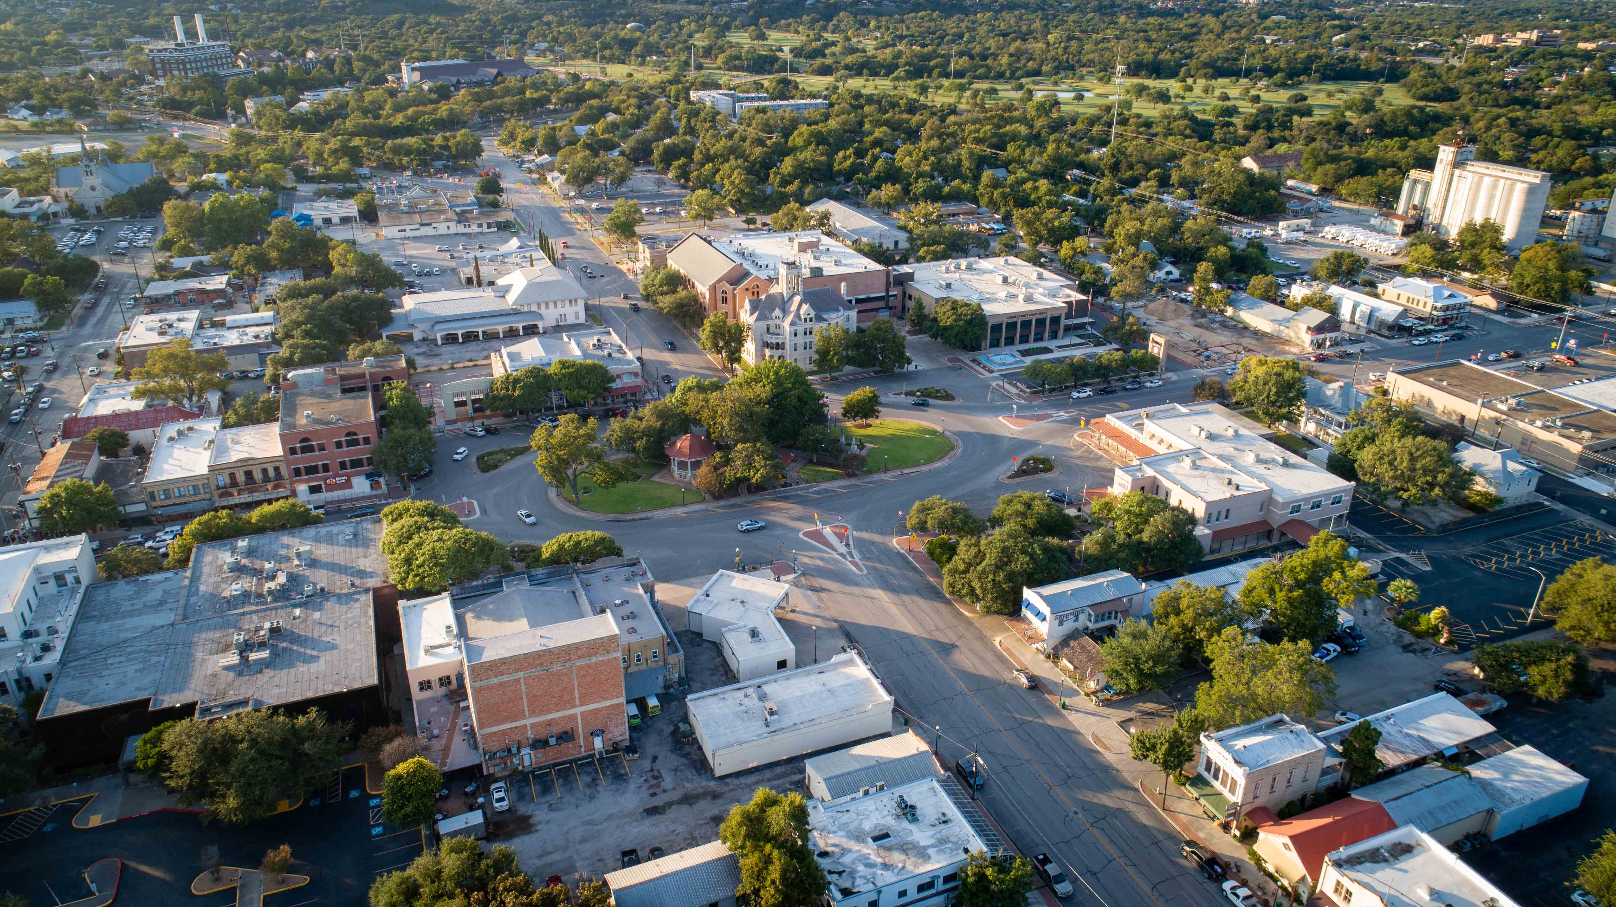
Communicating with Emotional Intelligence
Keith Lane, Chief of Police
Ruy Lozano, Fire Chief
Becca Miears, Director of Human Resources
Moderated by Cailin Cronin, Human Resources Manager

Slide 2
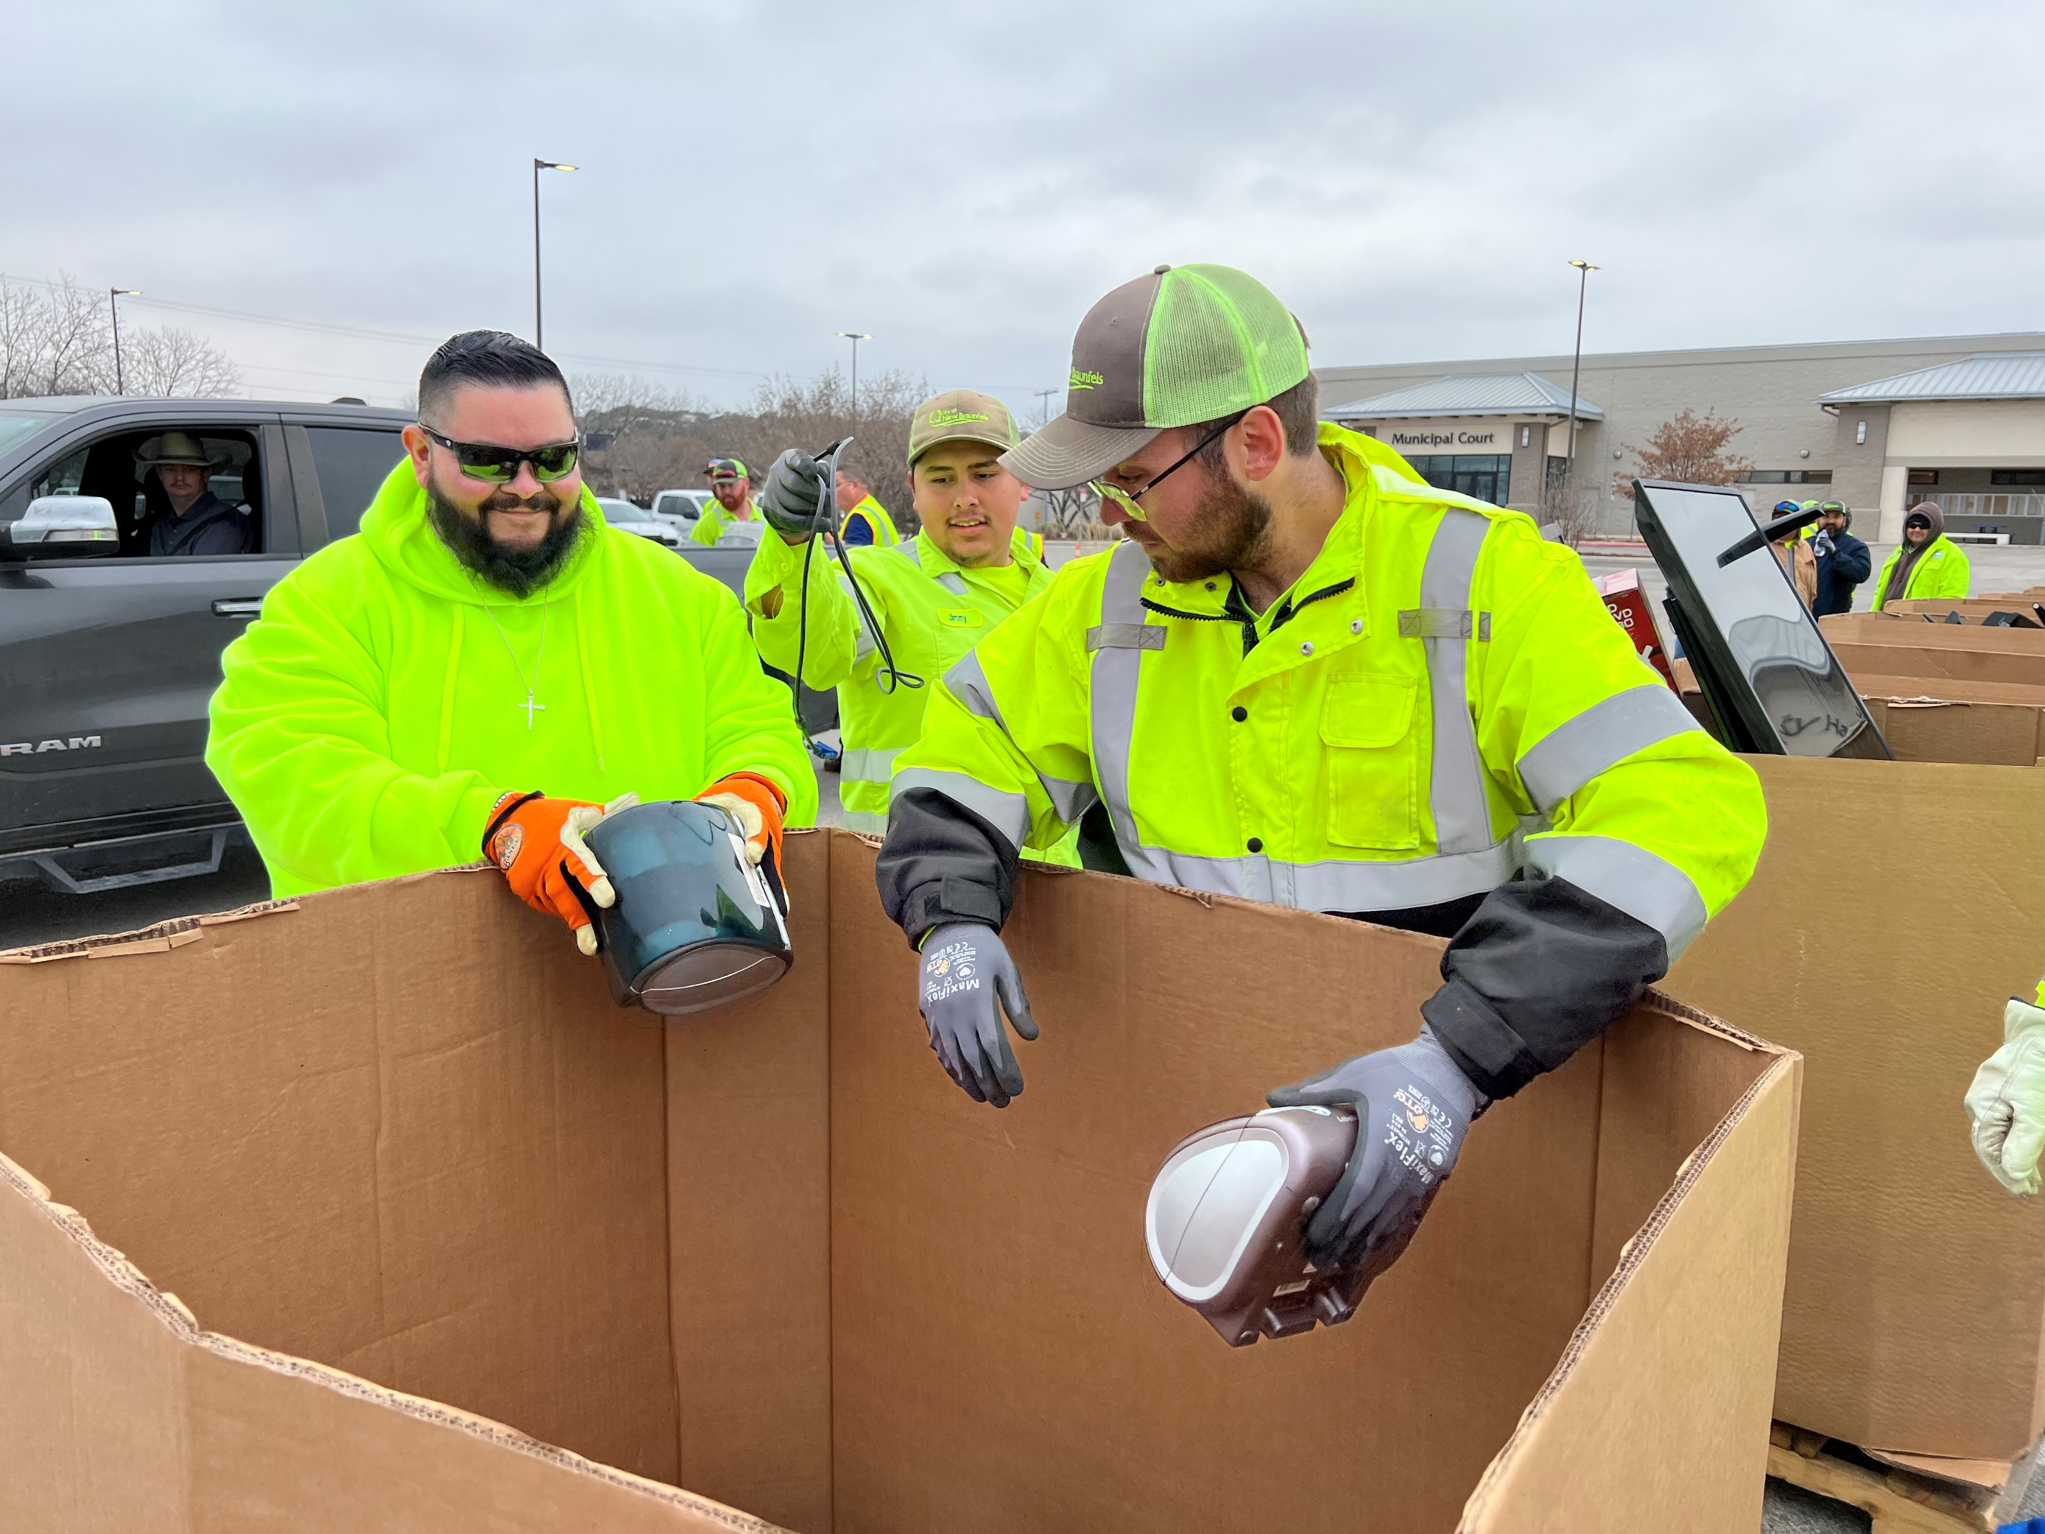
Purpose of Today’s Discussion
Explore emotional intelligence and how it is used in communication and building relationships
Importance of self-reflection/identifying our strengths and weaknesses
Focusing on a growth mindset

Slide 3
Five Components of Emotional Intelligence
Self-Awareness: Being aware of how others experience us
Self-Regulation: Staying in control of our emotions
Motivation: Our personal drive to improve and achieve
Empathy: Ability to recognize others' emotions and understand their perspectives
Social Skills: Ability to develop trust and rapport with others
Simply put, emotional intelligence is the ability to make emotions work for you, instead of against you.

Slide 4
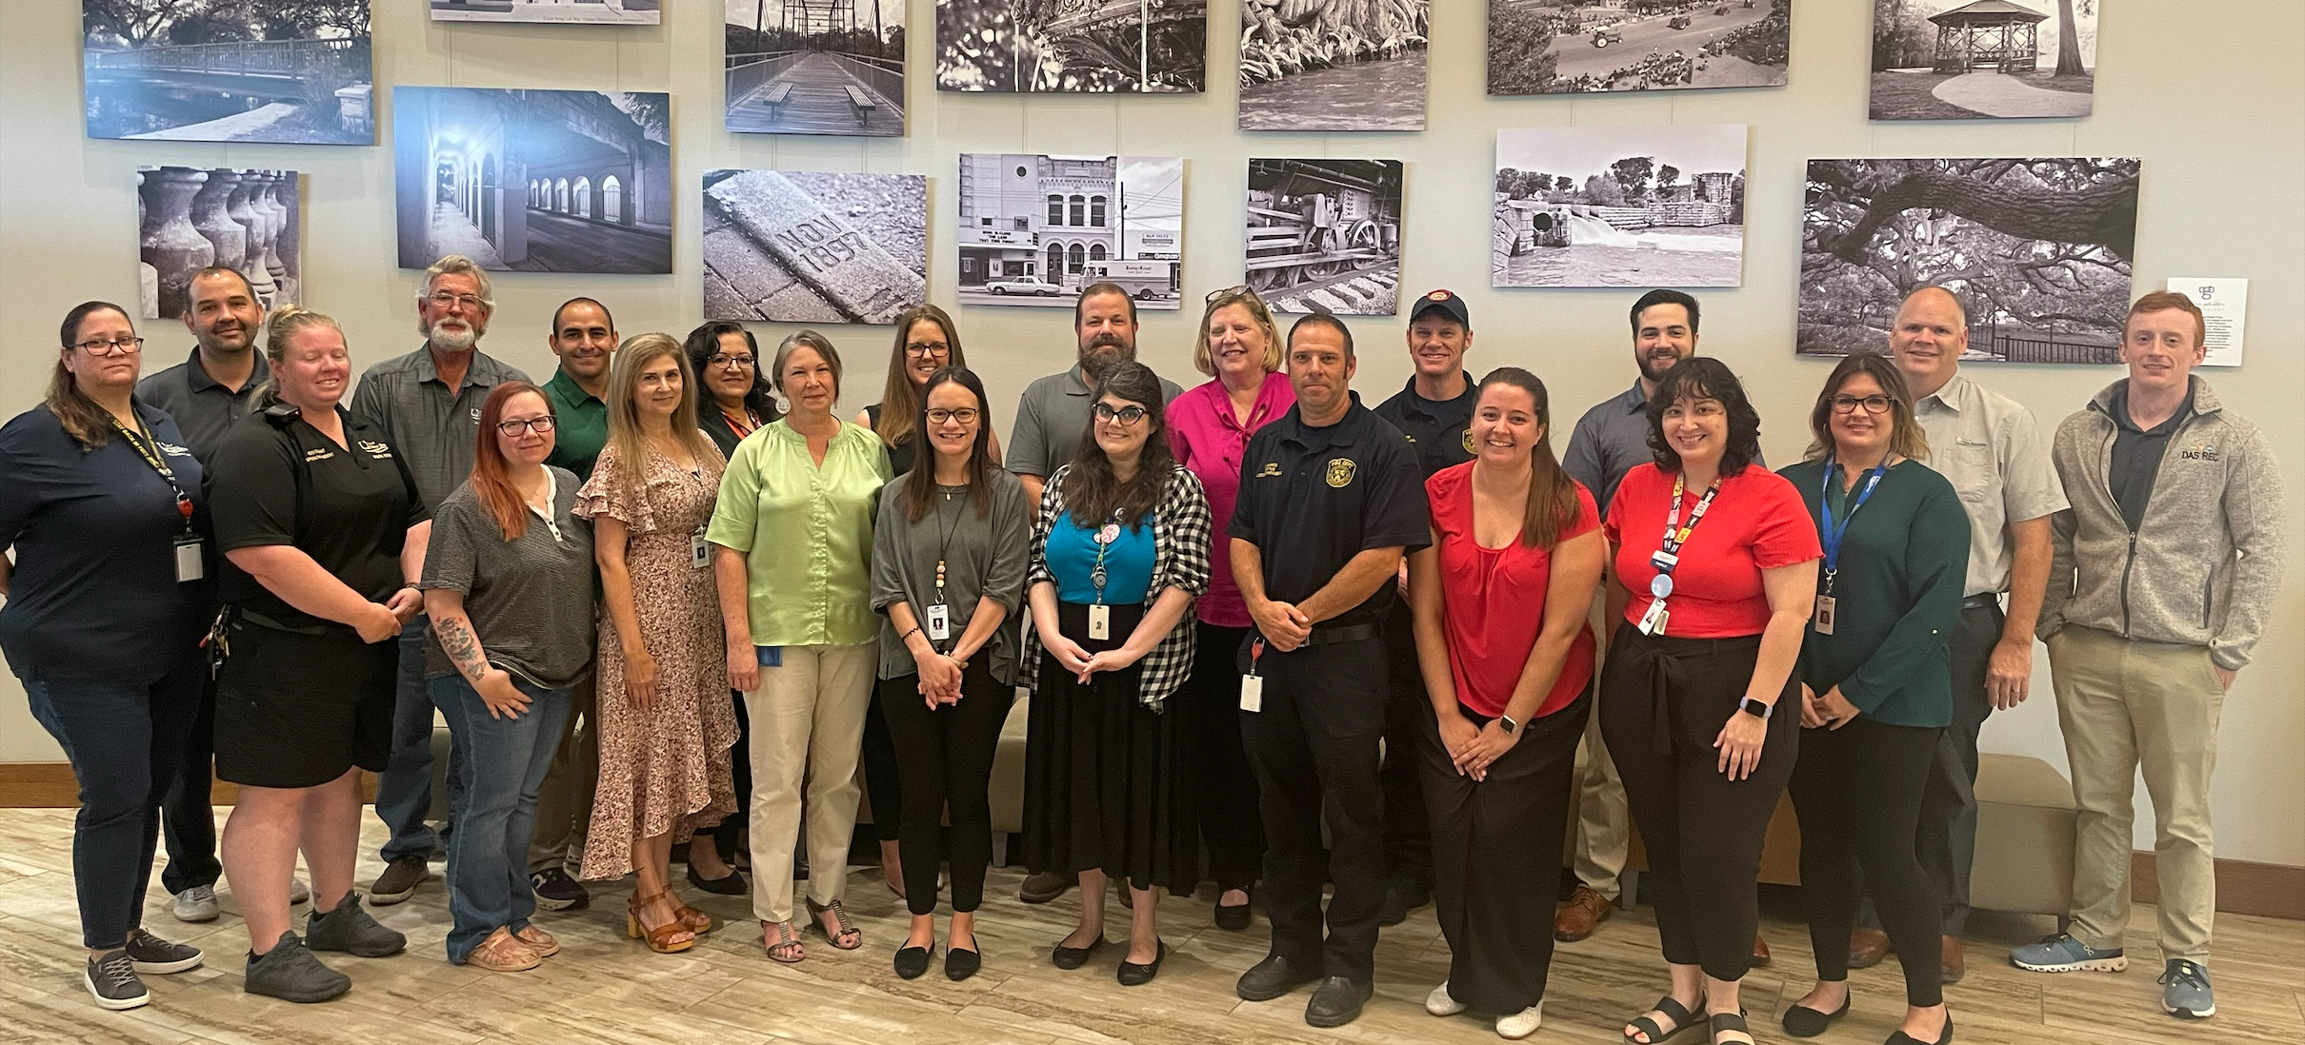
Growth Mindset vs. Fixed Mindset
Growth Mindset: Believing talents can be developed through hard work, effective strategy, and feedback from others
Fixed Mindset: Believe intelligence, talent, and other qualities are innate and unchangeable
Complacency: Often sets in when we fear or resist change
Notes:
Things to assist with fighting complacency/being growth minded:
-Set Challenging Goals
-Never Stop Learning
-Embrace Change
-Cultivate a Growth Mindset
-Network and Collaborate
-Celebrate Achievements
-Regularly Assess your Progress
-Encourage Constructive Feedback
-Set Aside Time for Reflection

Slide 5
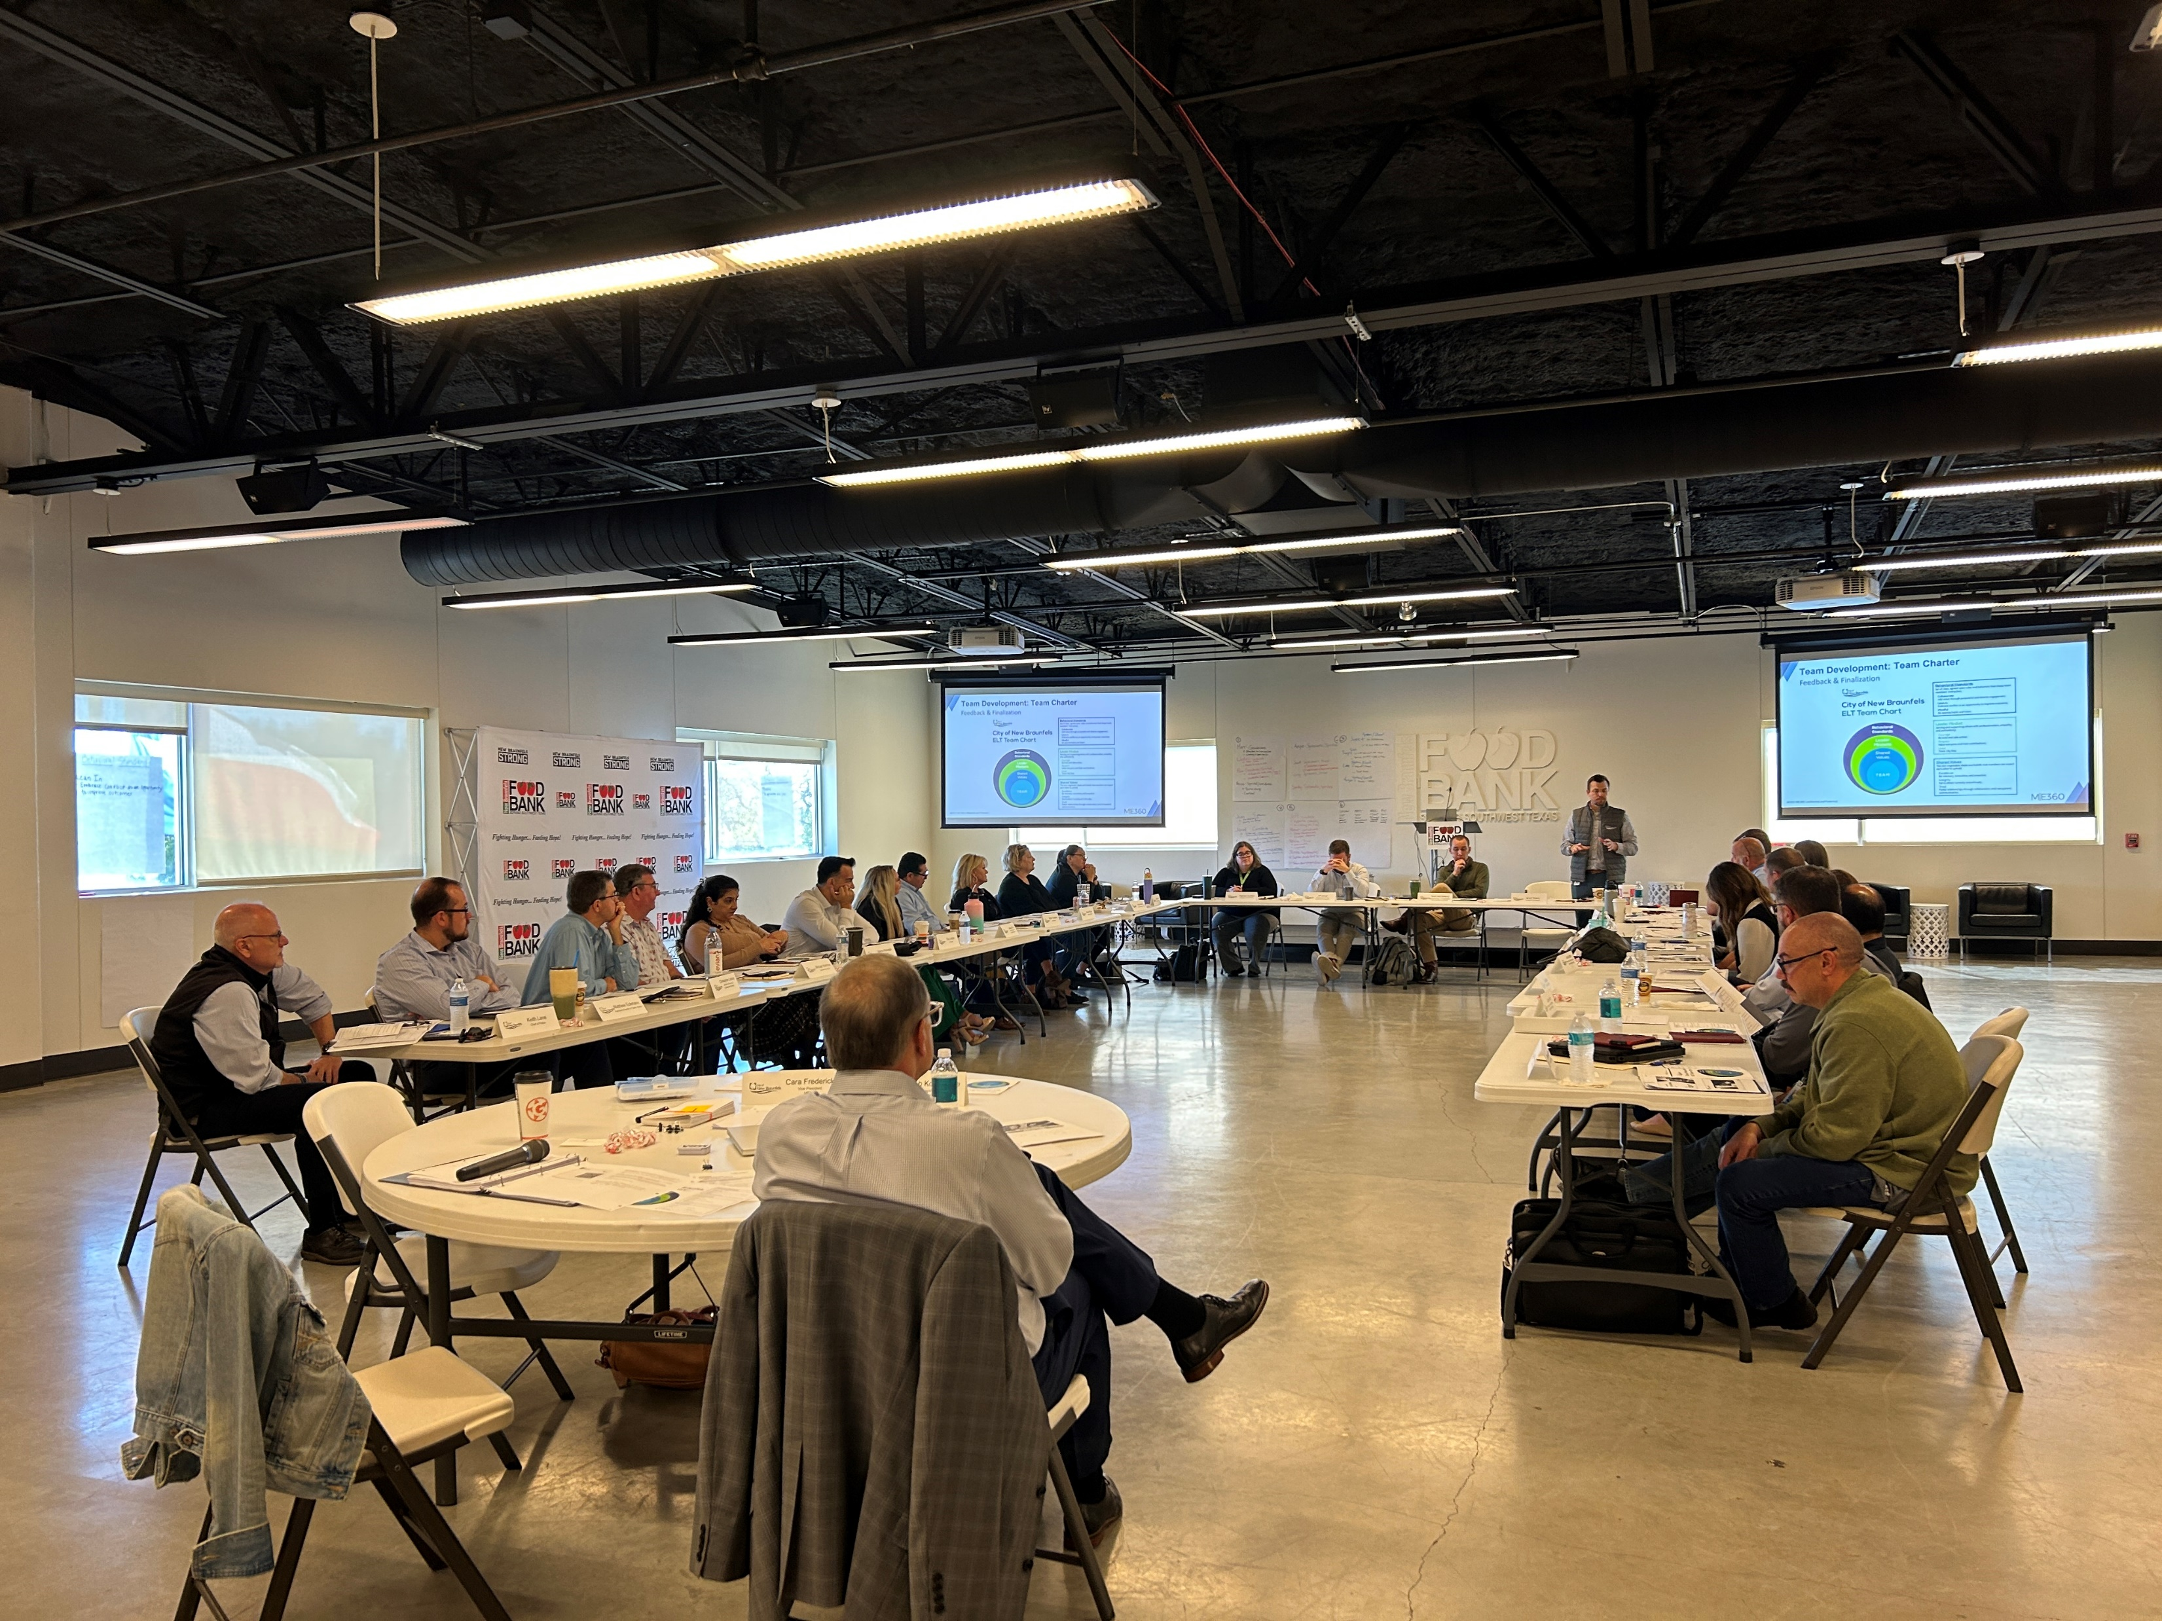
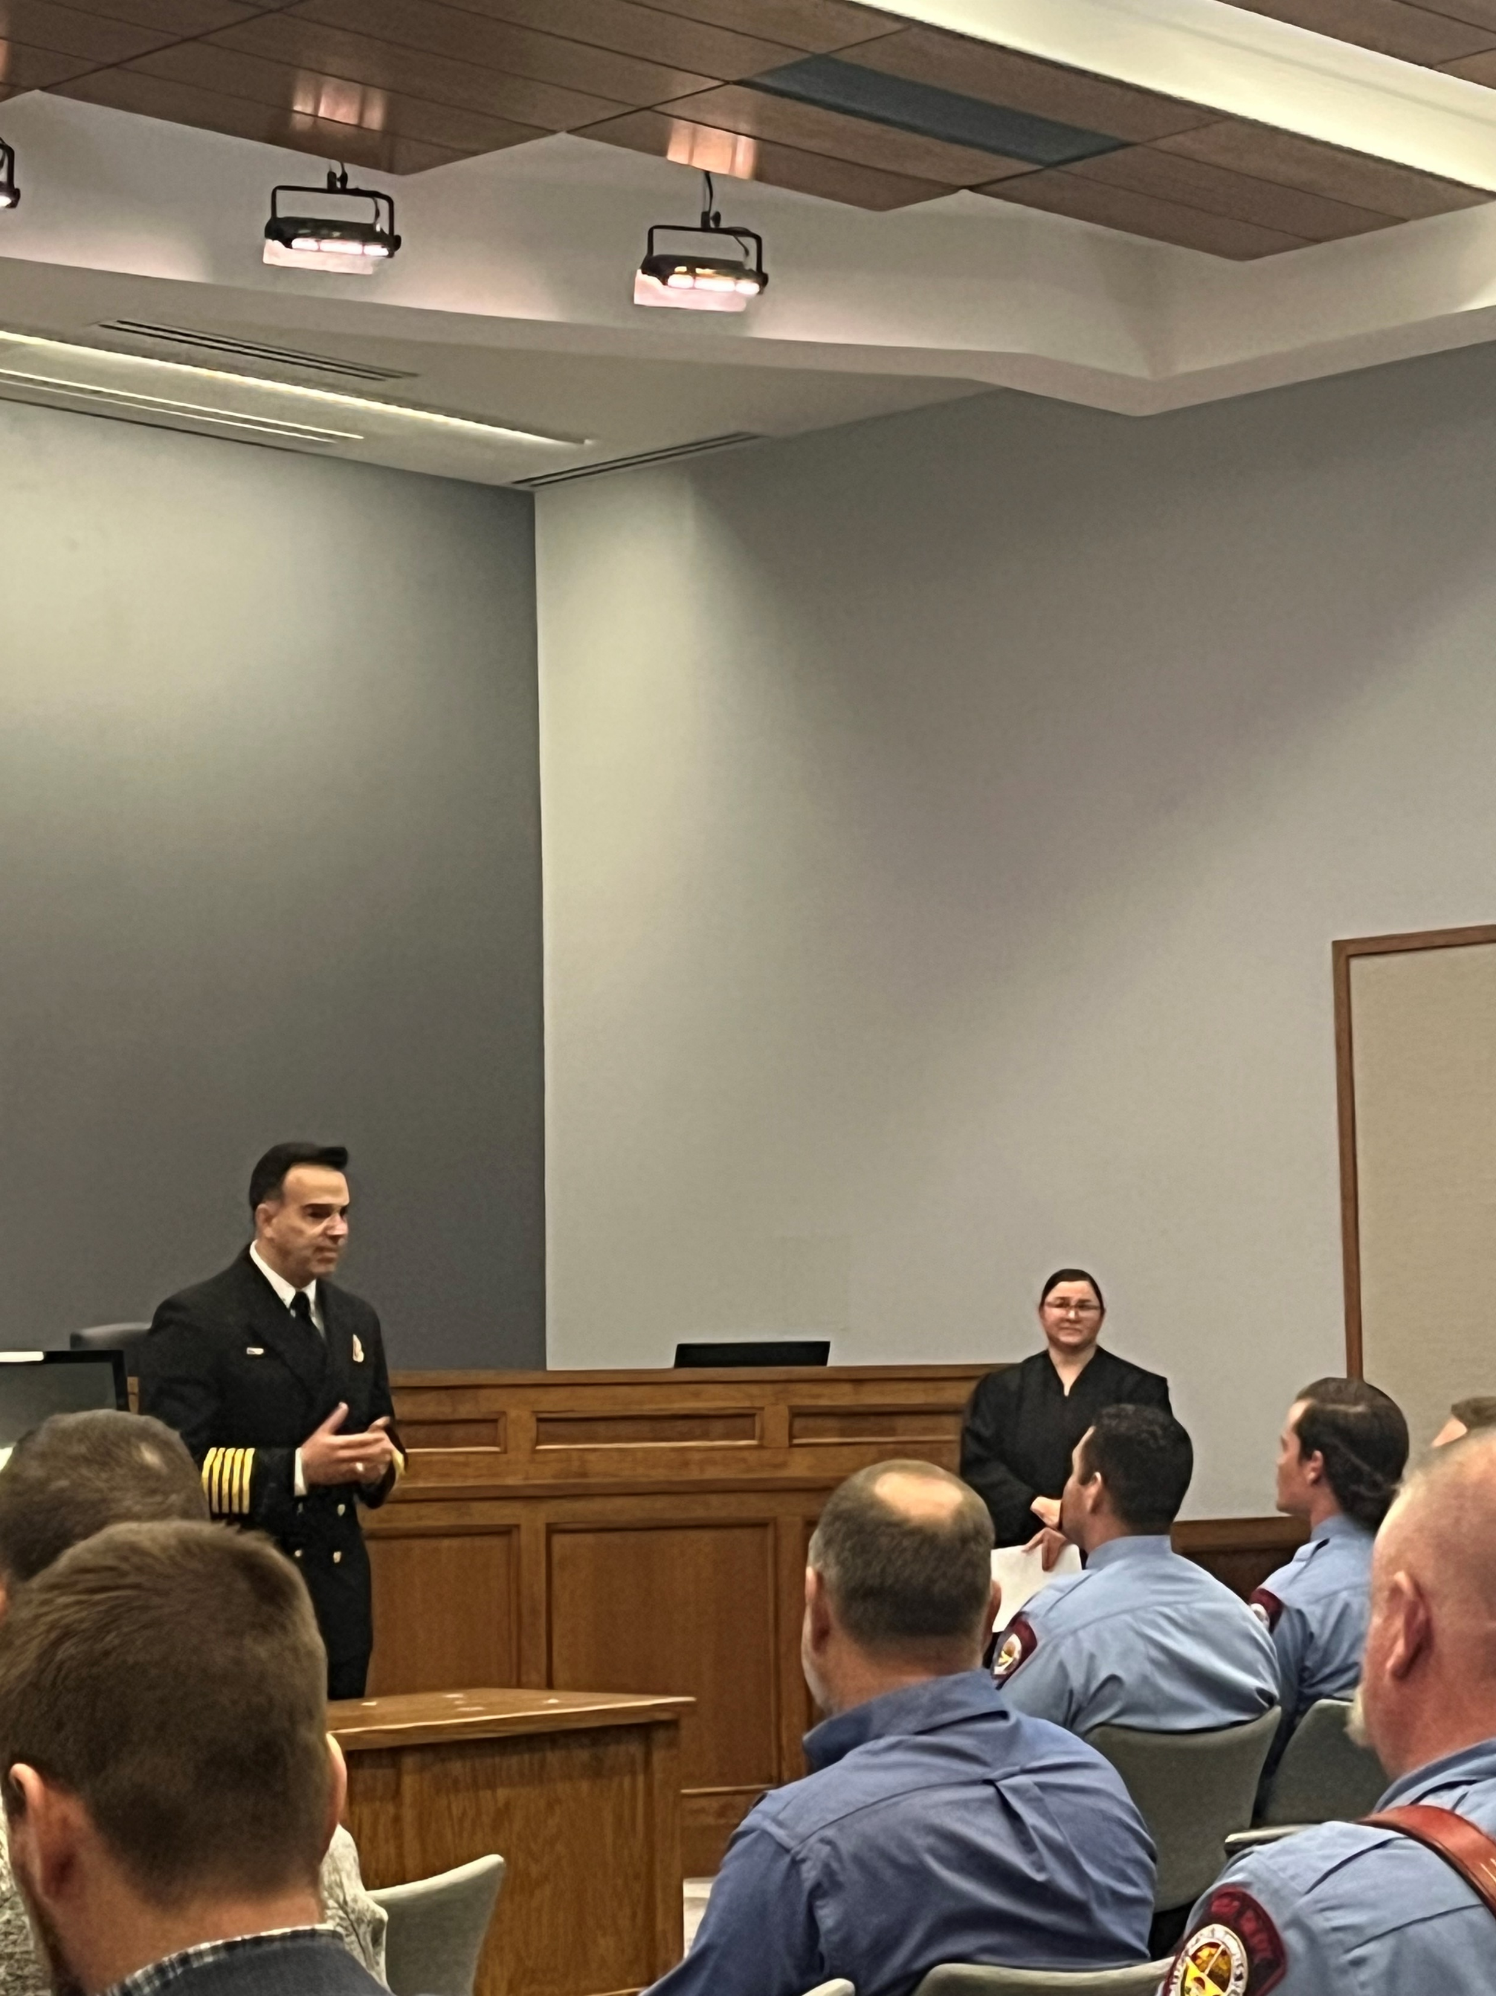
Let’s Discuss…

Slide 6
Questions?

