Slide 1
Becoming an Employer of Choice in the New World of Work
Bob Lavigna
Senior Fellow – Public Sector
UKG (Ultimate Kronos Group)

Slide 2
Key Takeaways
Organizations must adapt to the new world of work
To become an employer of choice – a great place to work – build employee engagement
Build engagement by providing a positive employee experience
Measure the experience with data
Talent is everyone’s job

Slide 3
UKG – Ultimate Kronos Group
UKG Lead Offerings – Option 2 (Single Slide Animation)
Leading
Comprehensive
HCM
Powerful and Flexible Payroll
Impactful
HR Service
Delivery
Enterprise
Workforce
Management
Specialty
Scheduling
Solutions
HCM technology facilitates what needs to be done to become a great place to work
Better Organizational Performance
More Connected Workforces
More Engaged
People

Slide 4
The New (Post-Pandemic) World of Work
Changed employee expectations – flexibility, voice, wellbeing
Employees re-evaluating priorities – “great reassessment” → intense competition to attract/retain talent
Major demographic changes
Remote vs. on-site (front-line) employees – different needs and expectations

Slide 5
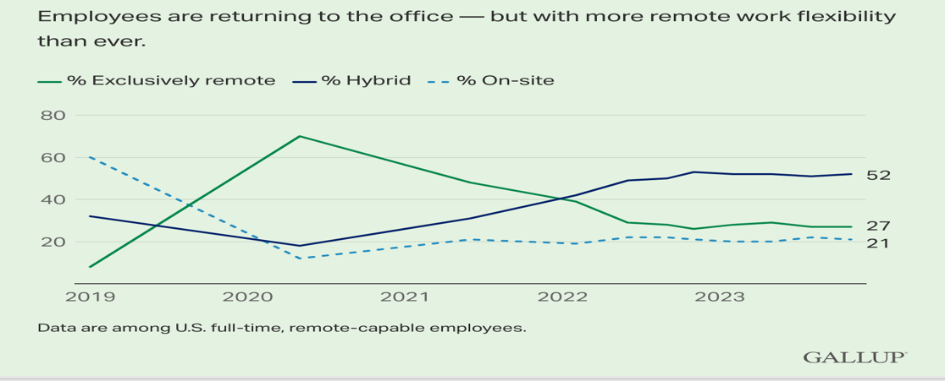
Job Locations for Remote-Capable Employees
“Defeated CEOs are now conceding that hybrid working is here to stay – a year after 62% said they expected a full-time return to office by 2026”
Fortune

Slide 6
3.5 million job quits/month
People continue to rethink what they want out of work – and life
1.6 jobs for every job seeker
492,000 vacancies in state/local government – only 182,000 hires
SLG ratio of vacancies to hires = 2.7
Private sector = 1.5
“Government Worker Shortages Worsen Crisis Response”

Slide 7
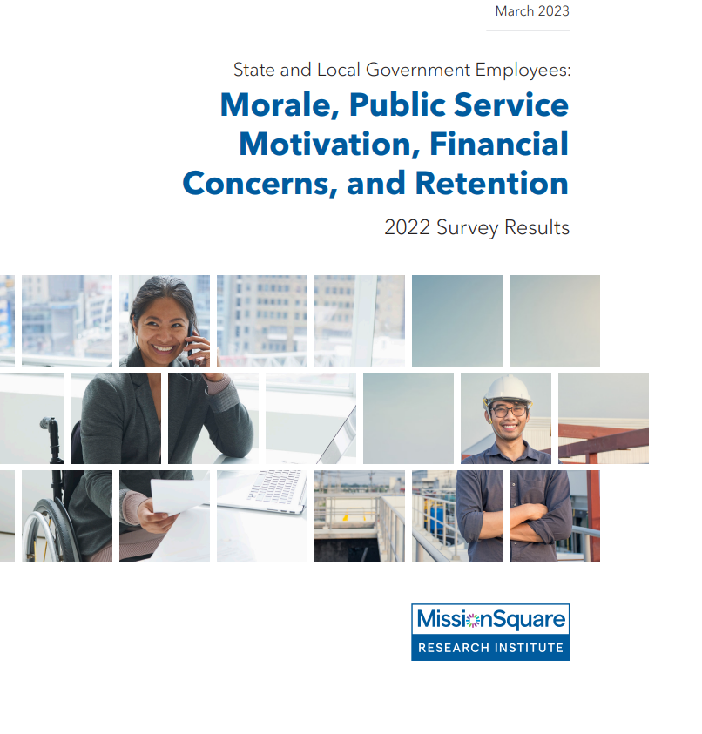
Retention Challenges

Slide 8
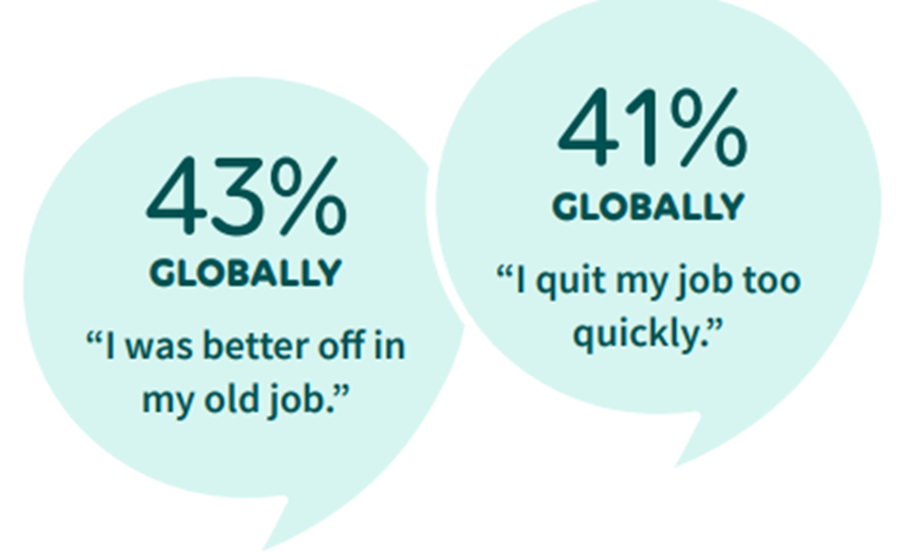
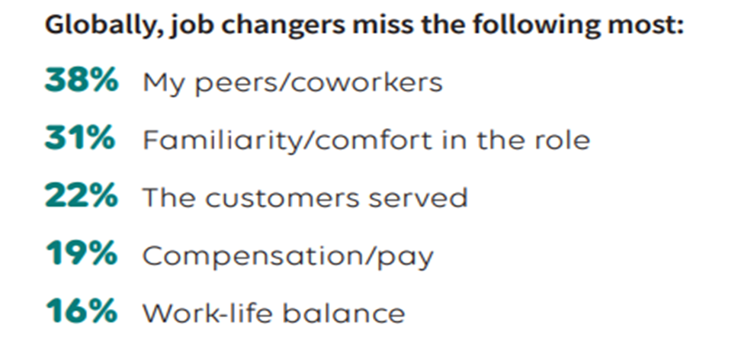

Slide 9
When Will Retirements Take Place?
Use primary font, Calibri; size text up or down (18 pt. minimum)
MissionSquare Research Institute

Slide 10
To Be an Employer of Choice …
… Build Employee Engagement

Slide 11
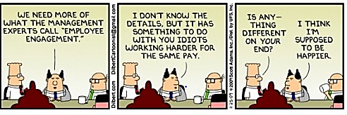

Slide 12
Engaged Employees
Have strong relationships in organization
Will stay – even for less money
Go extra mile for customers
Recommend organization as good place to work
Volunteer ideas
Show up for work
Work hard – and smart
Get things done

Slide 13
Why Does Engagement Matter?

Slide 14
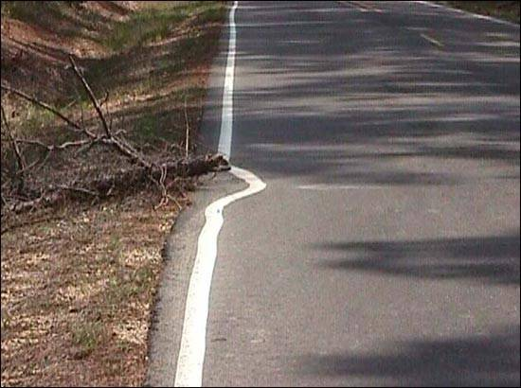

Slide 15
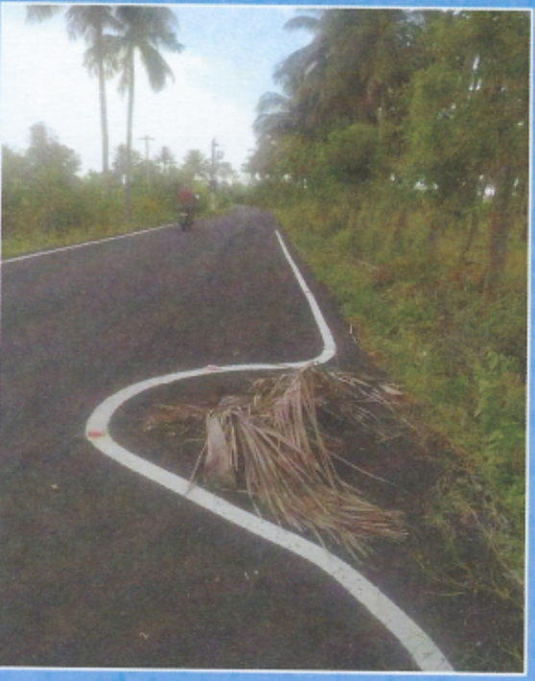

Slide 16
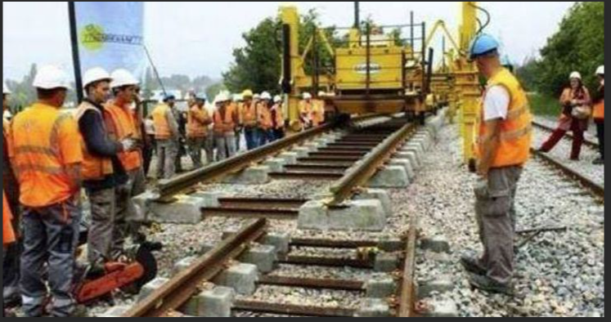

Slide 18
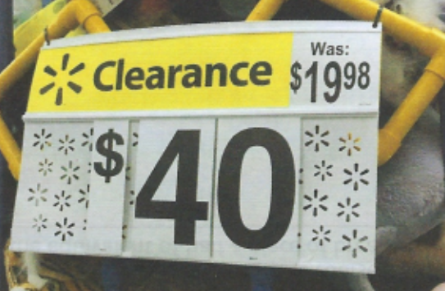

Slide 19
Great Places to Work Have Engaged Employees
KPIs | Employees say … | Great Place to Work-Certified Organizations | U.S. Average
Productivity | Are given resources needed to do job | 81% | 52%
Recruiting | Promote their organization to family and friends | 86% | 54%
Retention | Plan to work there for a long time | 84% | 55%
Service | Provide excellent customer service​ | 89% | 66%
Agility | Organization moves fast and innovates | 82% | 49%

Slide 20
Engaged Employees in Government:
10 times more likely to believe organization is achieving mission
Twice as likely to believe they influence cost savings
3 times more likely to say they influence customer service
3 times more likely to stay with the organization
4 times as likely to say their mental health is good or very good
Institute for Public Sector Employee Engagement

Slide 21
“We can build workplaces that are engines of well-being, showing workers that they matter, that their work matters, and that they have the necessary resources and support to flourish”

Slide 22
Wellbeing at Great Places to Work
People flourishing at work
16%
58%
Psychologically / emotionally healthy
53%
82%
Work/life balance encouraged
50%
84%
Management cares about people
52%
85%
People can be themselves
64%
88%
a
46%
84%
People look forward to work
Average Workplaces
Certified Workplaces

Slide 24
“I help send men to the moon”

Slide 25
Engagement Value Chain
Use primary font, Calibri; size text up or down (18 pt. minimum)
Higher customer satisfaction
Better performance
Improved engagement
More trust in organization

Slide 26
Most Employees Not Engaged
Global engagement nearly doubled in past 15 years...
but only from
12% to 23%
U.S.
Local Government: 40% Engaged
Globally, disengaged employees represent $8.8 trillion in untapped productivity
Gallup
Institute for Public Sector Employee Engagement
Gallup
Notes:
Jarik

Slide 27
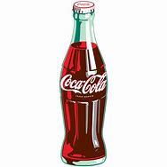
“Free pizza and Coke on a Friday afternoon is not an engagement strategy”
“It requires more than fun perks”

Slide 28
How Do We Build Engagement?
Create a Positive Employee Experience

Slide 30
The Employee Experience – Moments That Matter
Request leave of absence
Submit timecard
Interview
Attend training
Take sick day
Attest to hours
Apply
Get the job
Take vacation
Complete assigned work
Onboard
Set goals
Review performance
View accrued hours
Enroll in benefits
Learn skills for next job
Swap shifts
DAILY
WEEKLY
MONTHLY
YEARLY
ONCE
Request day off
Get paid
Access pay data
Get promoted
View schedule
Clock in/out
Leave (Retire)

Slide 31
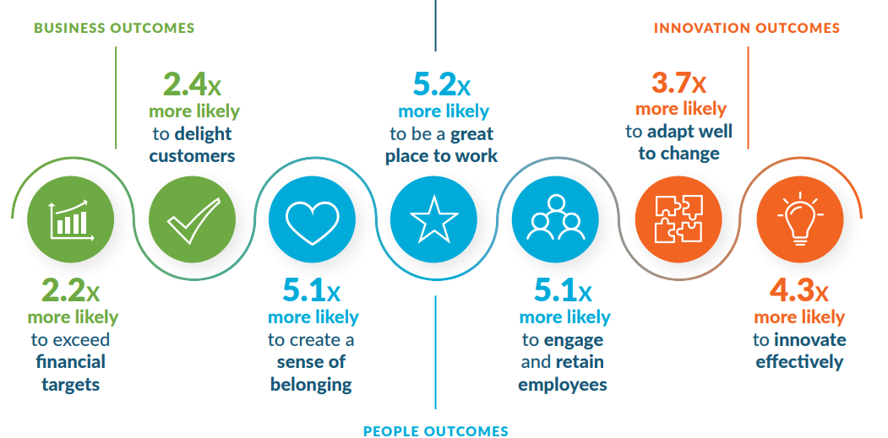
Positive Employee Experience: The Business Case
Josh Bersin

Slide 32
Positive Employee Experience Attracts Talent
“Engaged cultures will attract people from outside the organization who want to join. What happens internally goes external pretty quickly.”

Slide 33
Actual Employee Reviews – These?

Slide 34
Or These?
59% of job seekers would not apply to an organization with a bad reputation – even if they were unemployed!

Slide 35
Hire and Promote for Skills
“Hiring based on skills is five times more predictive of job performance than hiring based on education and more than twice as predictive as hiring based on work experience”

Slide 36
“STAR” – Skilled Through Alternate Routes
Screening Out STARs Limits Diversity

Slide 37
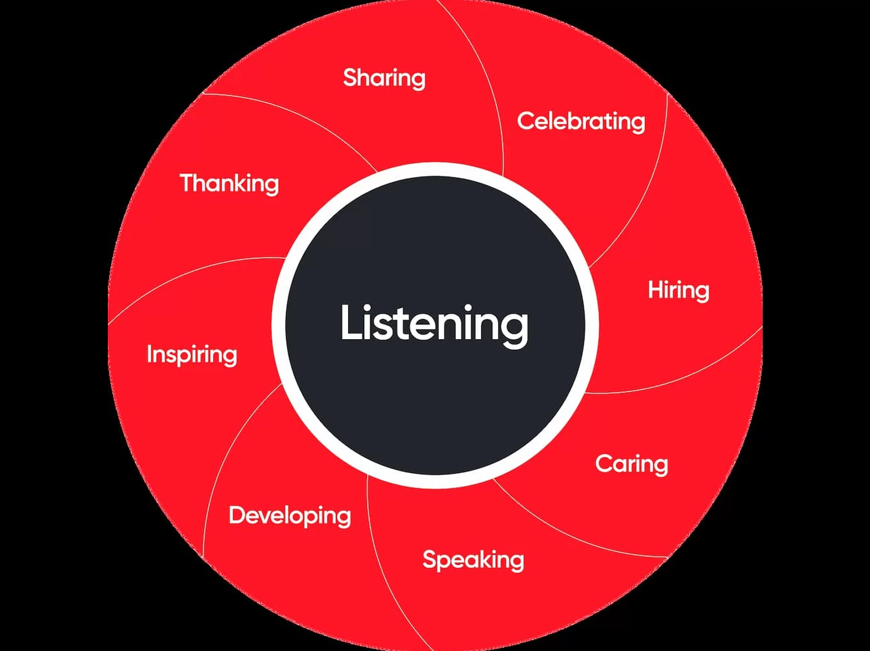
Leadership Behaviors That Create Great Workplaces

Slide 38
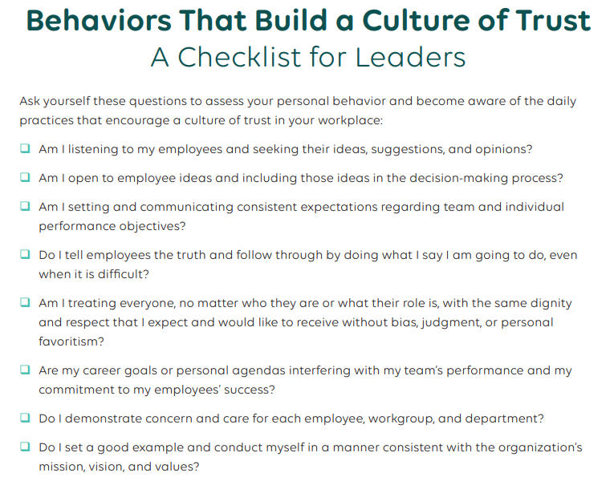

Slide 39
Recognition Drives Positive Experience
When employees believe they will be recognized, they are 2.7 times more likely to be highly engaged
Quantum Workplace

Slide 40
Recognition “Without Spending a Dime”
Recognize employee achievements at staff meeting
Surprise employee with Post-it note of thanks
Put thank-you note on department bulletin board
Compliment employee within earshot of others (and word will spread)

Slide 41
Recognition “Without Spending a Dime”
Mail handwritten note to employee’s home
Send department-wide email praising employee or team
Start meetings by recognizing employees and ask employees to recognize each other
Pull employee aside and ask for his/her opinion

Slide 42
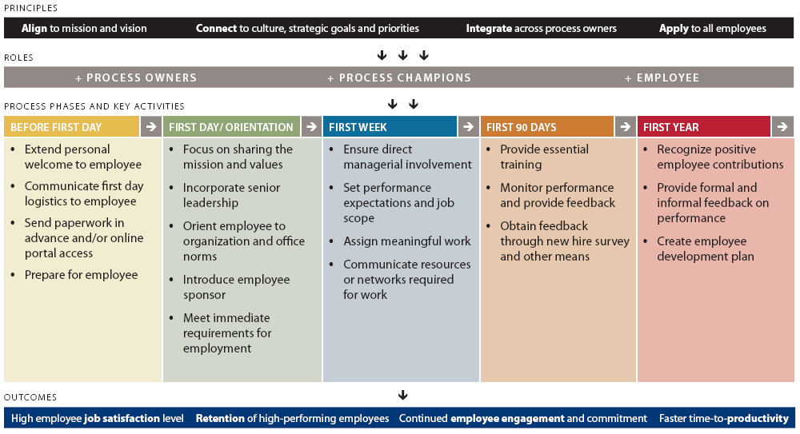
New Employee Onboarding

Slide 43
New Employee Onboarding Guide

Slide 44
How Do We Know If We Are a Great Place to Work?
Collect and Analyze Data!

Slide 45
What Kind of Data?
Applicant pool
Diversity
Retention/ turnover
Pay equity
Overtime
Focus groups
Exit and stay interviews
Engagement surveys

Slide 46
Engagement – Interest or Action?
MissionSquare Research Institute

Slide 47
Fastest-Growing Jobs in the U.S.

Slide 48
Fastest-Growing Jobs in the U.S.

Slide 49
Key Takeaways
Organizations must adapt to the new world of work
To become an employer of choice – a great place to work – build employee engagement
Build engagement by providing a positive employee experience
Measure the experience with data
Talent is everyone’s job

Slide 51
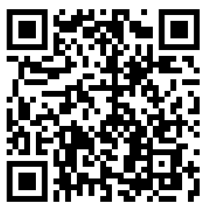
How Much Do You Know About Government?
Test your knowledge
Access additional resources

Slide 52
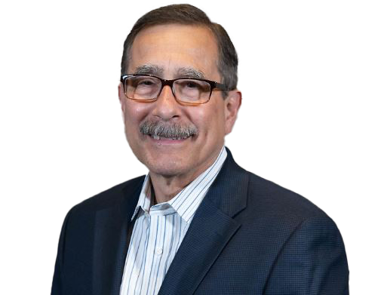
Questions and More Information
Bob Lavigna
bob.lavigna@ukg.com
608-395-8472
ukg.com
www.linkedin.com/in/bob-lavigna/

