Slide 1
6 Essential Questions to Ensure You Are Getting the Most from PBMs
May 8, 2024

Slide 2
Today’s Agenda
1
PBM Ownership
2
PBM Pharmacy Ownership
3
Control Over Plan Design
AGENDA
4
Spread Pricing
5
Rebates
6
Specialty Drug Management

Slide 3
Who owns your PBM?
The objective of the PBM’s owner can dictate business practices:
Service
Contract terms
Pricing
Formulary design
Rebate and drug manufacturer revenue
Savings
Security
Service
Notes:
VC objective – grow to point of being attractive target for acquisition or IPO
PE objective – maximize returns for their investors
Publicly traded company objective – to make money for shareholders

Slide 4
Does your PBM own pharmacies?
Lewandowski v. Johnson & Johnson
Agreeing to steer beneficiaries to PBM mail-owned pharmacies when PBM mail order prices are routinely higher than retail pharmacies charge for the same drugs is mismanagement
When a PBM owns a pharmacy, there are foreseeable ways in which it attempts “to enrich itself and its own pharmacy at the Plan’s expense.
A prudently administered plan would steer beneficiaries toward the option with a lower overall price, or at least would not allow a plan vendor (PBM) to self-interestedly steer beneficiaries toward the option with higher overall price.”
Plan Sponsors Pulled Between Fiduciary Duties & Vendor Arrangements
Savings
Security
Service
Notes:
Suit filed February 5, 2024

Slide 5
What plan design elements are PBM-driven?
Do plan design elements fit my organization?
Are there certain pharmacies to use?
Which management tools are used?
What clinical programs are available?
Savings
Security
Service

Slide 6
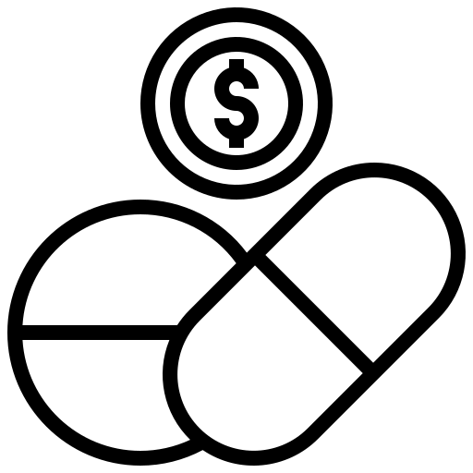
Does your PBM practice Spread Pricing?
Business
PBM
Pharmacy
$25 Retained by PBM as spread
$100
$75
Business pays contracted amount to PBM
PBM pays contracted amount to the pharmacy
The self-benefitting practice of spread pricing is more common for generic drugs but doesn’t result in lower costs.
Spread pricing is non-disclosed revenue that may be in place of charging actual administrative fees for services provided.
Savings
Security
Service

Slide 7
Does your PBM retain rebates?
PBMs often retain a portion of rebates:
The bigger the rebate, the more revenue the PBM makes
Rebates amounts often correlate to the price of the drug – higher priced drugs can produce higher rebates
The result could be the plan and member paying more overall
Drug | A | B
Ingredient Cost | $900 | $700
Rebate | $500 | $400
Net Cost | $400 | $300
Savings
Security
Service

Slide 8
How Are Specialty Drugs Managed?
Specialty drugs:
Profitable to dispense by PBM-owned specialty pharmacies
Generate rebates and/or other manufacturer revenue for PBMs
Savings
Security
Service

Slide 9
How Specialty Drugs Should Be Managed
Specialty Care Strategies
Patient Assistance Programs
Copay Cards
International Sourcing

Slide 10
Thank You!
What questions do you have?
www.truescripts.com

